Slide 1

Web 3.0
More than the Hype

Slide 2
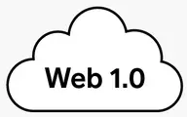

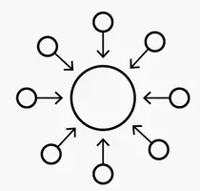
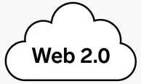
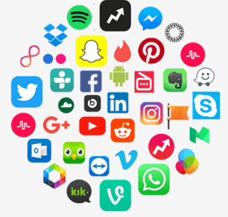
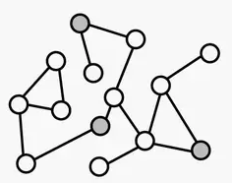
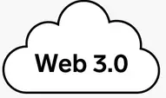
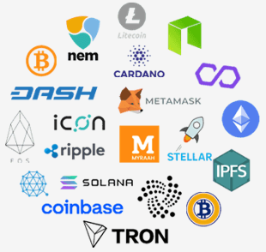
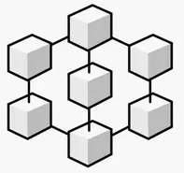
The Evaluation Of The Web
Web 1.0 : 1990- 2005
Basic Web pages
Search
Ecommerce
Web Forms
Centralization
HTML
Basic Web pages
Search
Ecommerce
Web Forms
During the phase that lasted from the 1990s to the 2000s, the internet mainly featured static pages with users granted zero options to voice their feedback or opinion.
Web 2.0 : 2005 - 2020
Centralization
XML/JSON/RSS
Global Internet
Social Media
IoT
Interactive Web
Apps
Started ~2005 and continues even now – the age of social web, users playing a key role in generated information. Generation of Social networking and IoT. Information is centralized
Web 3.0 : 2020 -
AI
Interoperability
Intelligent Web
RDF/RDFS/OWL
VAR & AR
Semantic Web
Decentralization
dApps & NFTs
Private
Blockchain
It is shaping up right in front of our eyes. Web 3.0 is also strongly focused on decentralized services and authority, which is a marked contrast to the centralization of Web 2.0

Slide 3

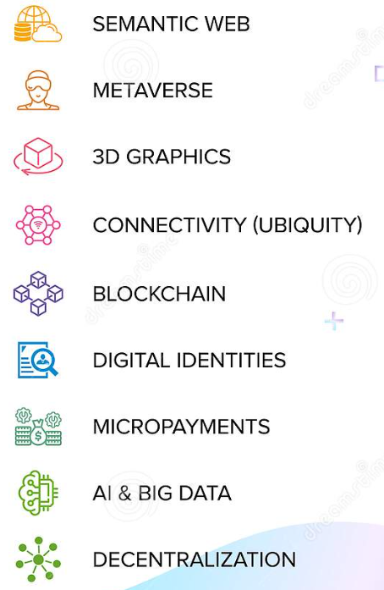
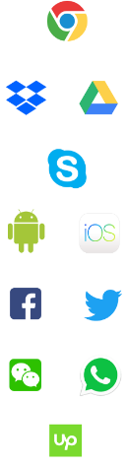
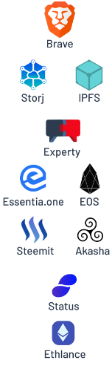












Web3 - The Future of the Internet
Why its different
Key Concepts
Transformation Journey
Criticism & Doubts
Omnipresence
No access limits
Difficult Regulation
Data control issue
No Absolute security
Require new measures
Openness
Open-source tools
Passive Data control
Tech giant control
Reliability
Secure operations
Device compatibility
Old device compatibility
Availability
Opened for everybody
Access money
Money based relations
Ownership
Users own their data
Expensive
Web3 is expensive
Secure
Reduced threats
Request perception
Reduced hacking threats

Slide 4
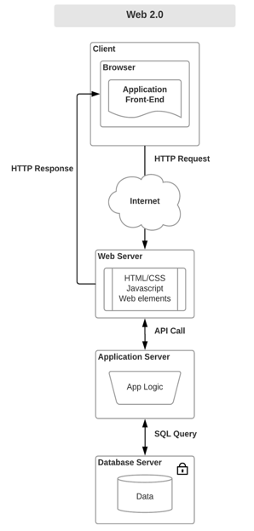
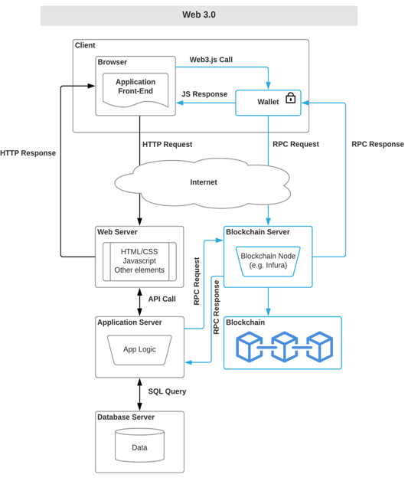
Web3.0 – Transformation
Front layer
Web3 frontend developers generally require the same skill set, including proficiency in HTML, CSS, JavaScript, React.js etc
Main difference is Web3.js, which is a collection of JavaScript libraries that lets you interact with Wallets and blockchain node with either a HTTP or IPC connection
Application layer
Application layer is divided in two parts:
Smart Contracts : - business logic executed on a blockchain. It will execute when predetermined conditions are agreed upon.
Off-chain App Logic: Usually provide processing pre and post processing of data used by smart contract.
Proper segregation is essential w.r.t speed and cost.
Storage layer
Blockchain supported storage–.persistence provided by platforms such EVM, Hashgraph etc.
Decentralized Off-chain DB Storage – Data stored off-chain but could be referred in blockchain. (e.g. gun & BigChainDB)
Decentralized file storage – Replacing any centralized storage (NTFS, s3) decentralized storage like with IPFS and Swarm
Blockchain storage costly, so it is important to use other storages

Slide 5
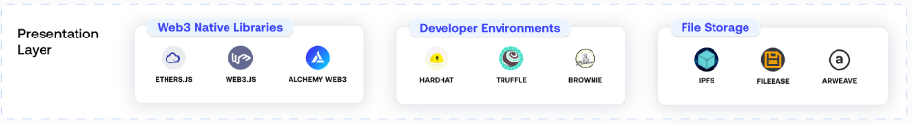
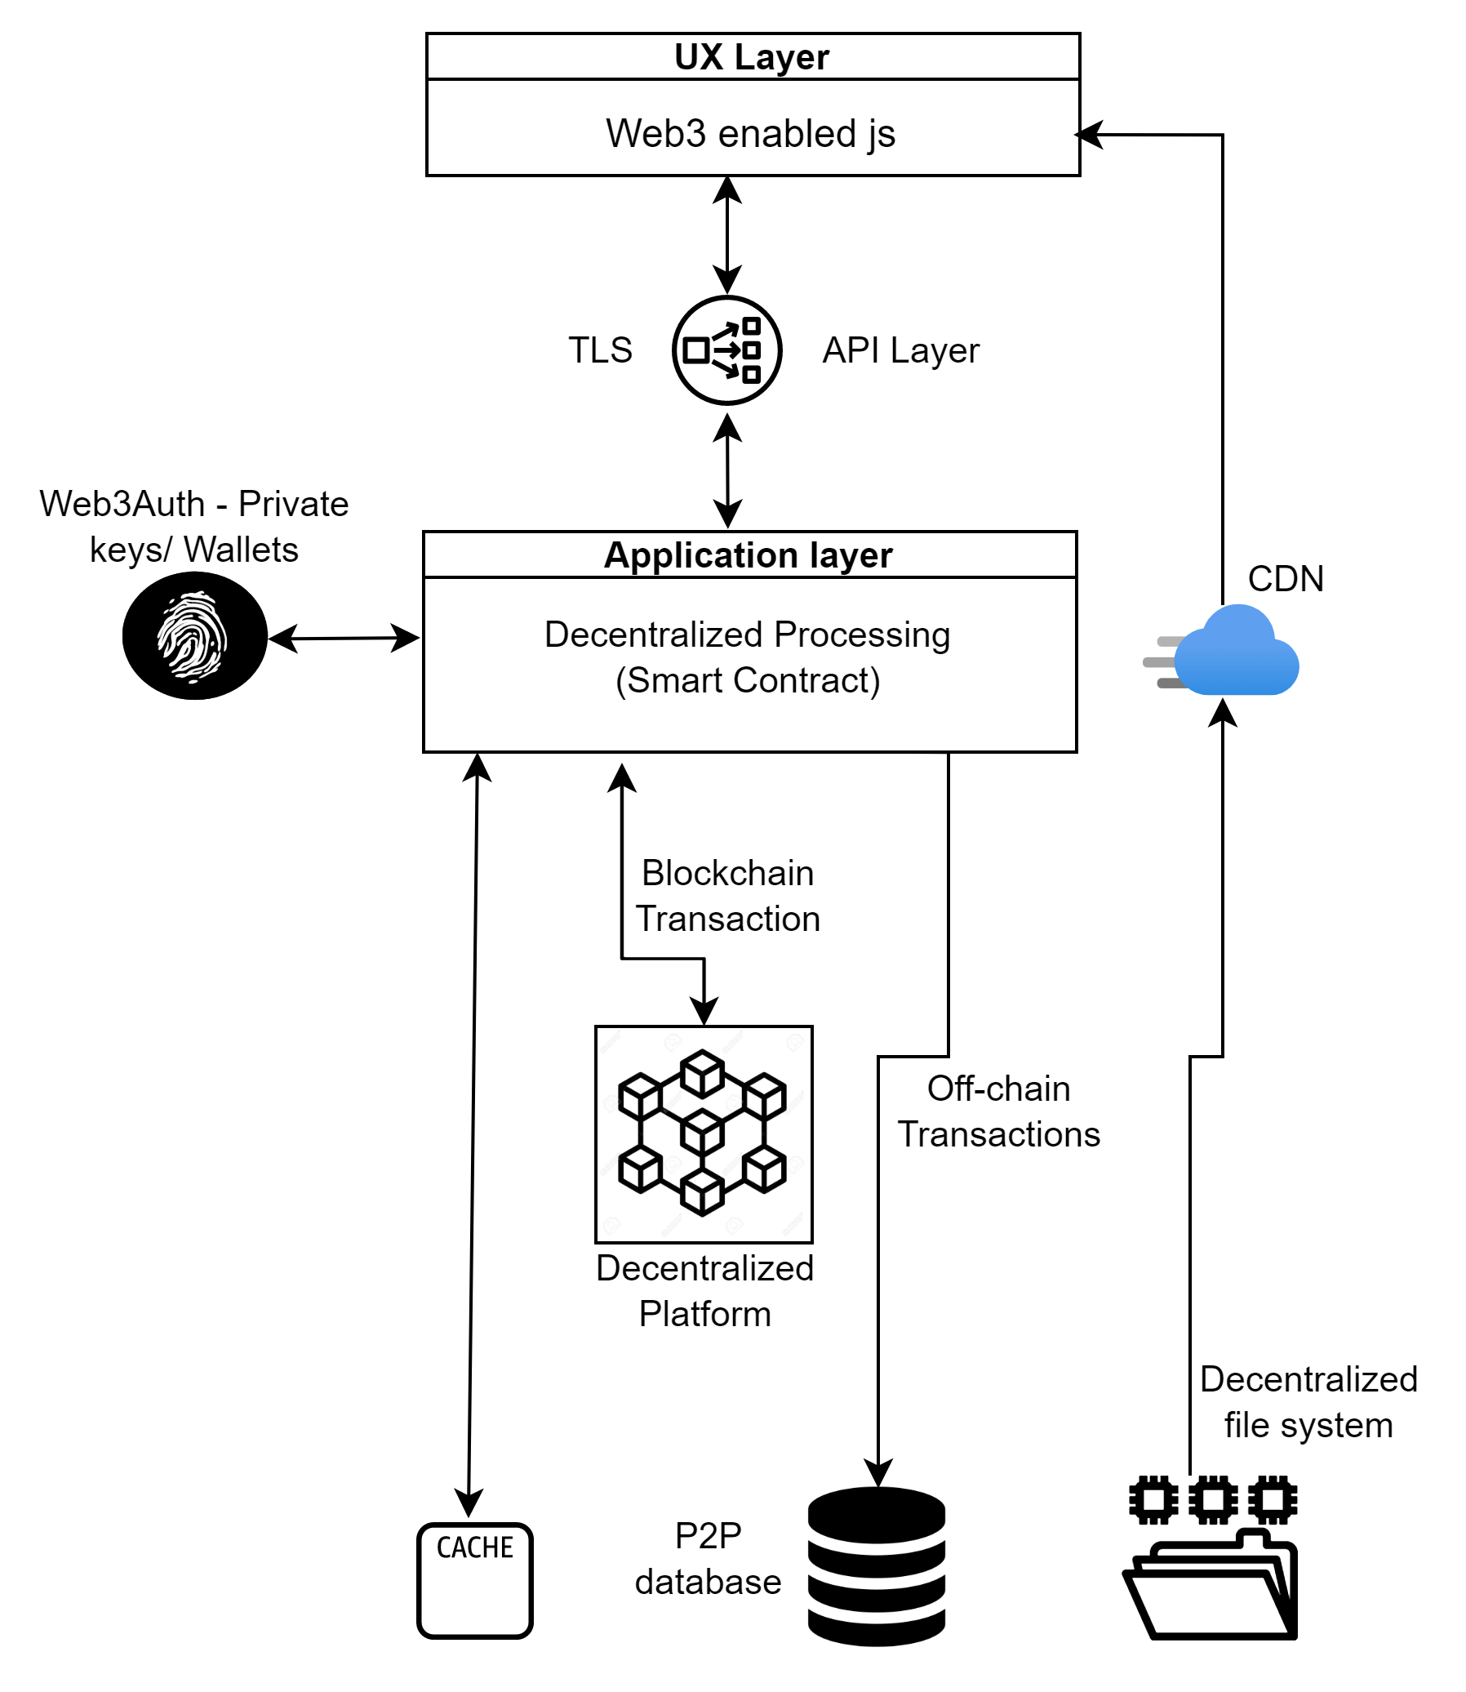
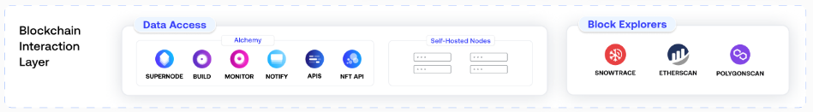
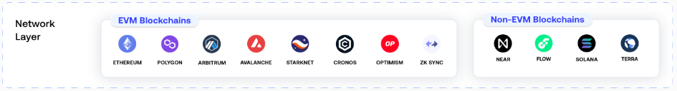
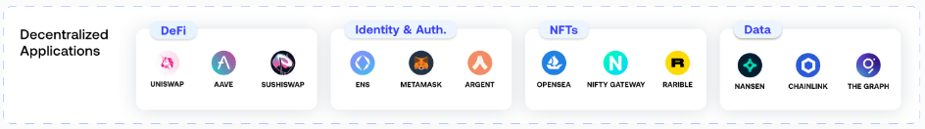
Web3.0 – The Tech Stack

Slide 6
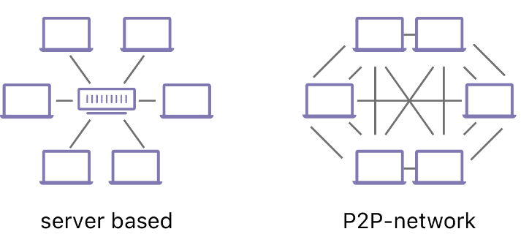
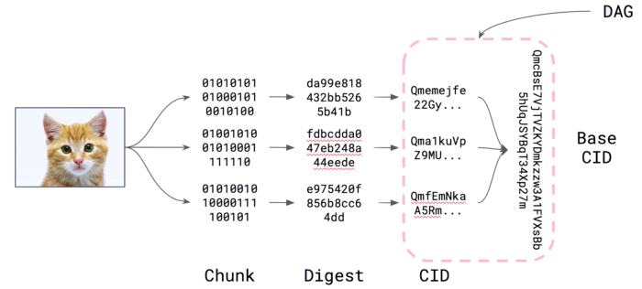
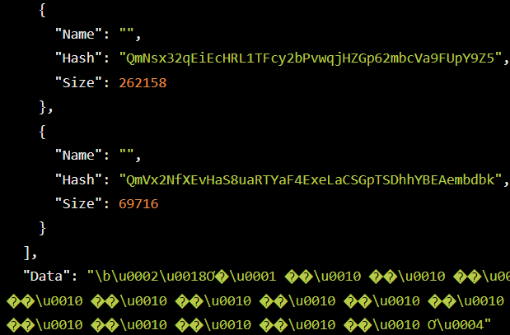

Decentralized File System
What is IPFS - InterPlanetary File System
IPFS, - “is a distributed system for storing and accessing files, websites, applications, and data.”
Its works on P2P protocol. DHT is used to map peers and file chunks.
Individual nodes connected to IPFS —offer their storage/bandwidth to store the content uploaded to the network.
This decentralization removes central points of failures and minimizes the chances of censorship and hacks.
How does IPFS work
When file is uploaded on the IPFS network, it is divided into smaller parts and encrypted with cryptographic hashing.
To identify the file, the network assigns it a unique identifier called a hash or content identifier (CID).
Unlike Web2 centralized storage, file can be served to any nodes and currently host this service.
What is IPLD - Inter-Planetary Linked Data
IPLD is the data model of the content-addressable web.
It allows us to treat all hash-linked data structures as subsets of a unified information space.
IPLD uses Merkle DAG, for managing all the chunks and linking it to the base CID.
IPLD (objects) consist of 2 components:
Data — blob of unstructured binary data of size <= 256 kB.
Links — array of Link structures. These are links to other IPFS objects.
Every IPLD Link has 3 parts:
Name — name of the Link
Hash — hash of the linked IPFS object
Size — the cumulative size of linked IPFS object, including following its links
What is IPNS - InterPlanetary Name System
System for creating mutable pointers to CIDs known as names or IPNS names.
IPNS names can be thought of as links that can be updated over time, while retaining the verifiability of content addressing.

Slide 7
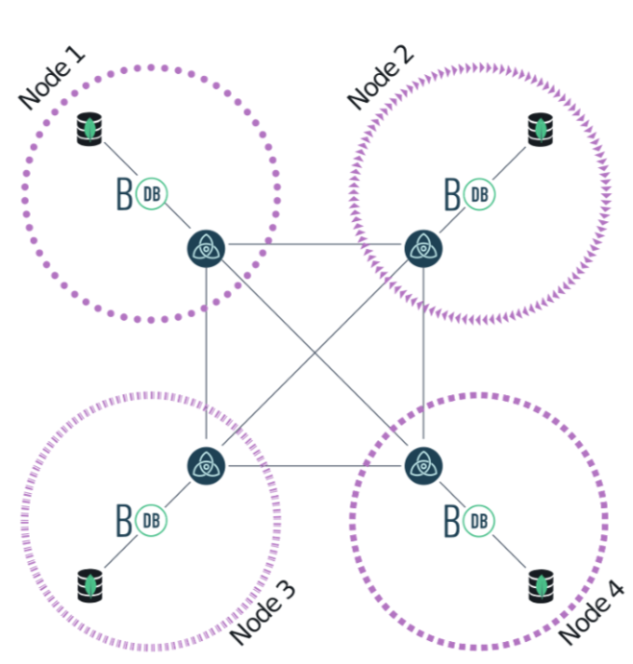
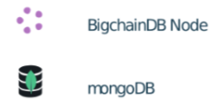
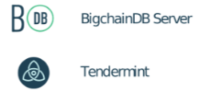
Decentralized Database (BigChainDB)
BigchainDB is an open-source blockchain database. It is a NoSQL database that has blockchain properties such as immutability, decentralization and owner-controlled asset.
Immutability is the property that once the data is stored in BigchainDB, it can’t be modified or erased.
Decentralization means there is no single point of failure in the control and storage process of the data.
The owner-controlled asset is the property that only the owner of the asset can transfer the asset.
The database provides the user with Byzantine Fault Tolerance (BFT) with no more than one-third arbitrary node failures.
Features of Decentralized DB
Data Immutability
Suppression of internode communication and DB admin activities guarantees that data can’t be modified.
Security & Privacy
Key based access allows network participants to identify new members. Members to have full control to selectively grant data access.
Massive Scalability
Allows block creation every second with transaction validation in parallel. Throughput of 100k+ TPS
Robust Architecture
Inherits the performance and scalability of the underlying database substrate.
Point of differences | Blockchain | Distributed databases | Decentralized DB
Centralized Authority | Y |  | Y
Immutability | Y |  | Y
Asset Anatomy | Y | Y | Y
High Throughput |  | Y | Y
Low Latency |  | Y | Y
High Capacity |  | Y | Y
Access Permission |  | Y | Y
Query & Search |  | Y | Y

Slide 8
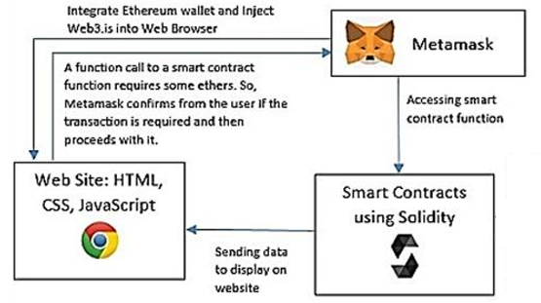
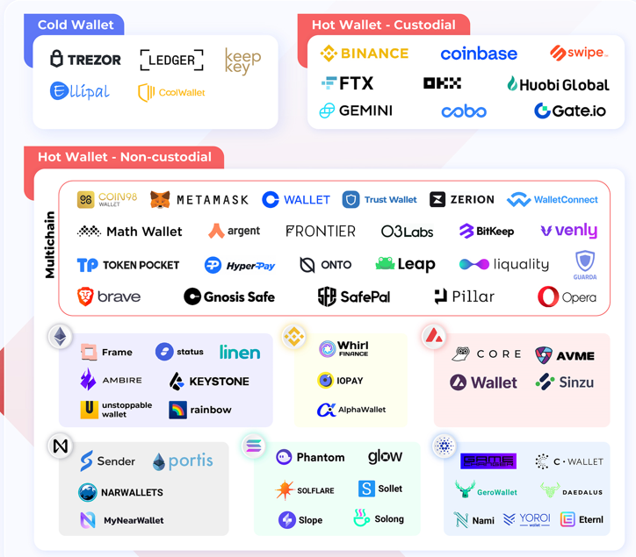
Wallet
What is Web3 wallet
A web3 wallet is simply a digital wallet that can be used to store digital assets.
These digital assets include Non-fungible tokens (NFTs).
Also used as “crypto wallet”, it is a tool for accessing the web3 economy, allowing users to interact with Dapps.
What are the Types of Web3 Wallet?
Hot Wallets : Hot Wallets are generally referred to as software wallets because they are hosted on devices that have access to the internet. They could be accessed from Desktop, Web and Mobile Wallets.
Custodial Wallet: A wallet in which the private keys are held by a third party. Users trust a third party to secure the funds and return them if you want to trade or send them somewhere else.
Non-custodial wallet: User have sole control of the private keys, which in turn control cryptocurrency and prove the funds are yours. This also means that users are solely responsible for not losing your keys and requires that you take your own precautions to protect your funds.
Cold Wallets: Wallets that are not connected to the internet are called cold wallet. they are hardware devices that store cryptocurrency offline. Most secure as they are less prone to malicious attacks and are hack-proof.
Pros of Web3 Wallet
Easy to Use : Easy to use as they are very easy to set up. Users can easily get wallet balance, send and receive assets instantly.
Privacy and Anonymity : Users’ privacy is a significant, wallet address also serves as an identity.
Security : Web3 wallets ensure utmost security, the responsibility of securing assets is on the users.
Freedom : Users are in total control of their wallets, and since they own the private keys, all assets in the wallet belonging to the user.
Cons of Web3 Wallet
User Responsibility : Users are their bank, meaning they have to take responsibility for anything that goes wrong.
Technicality : Some people find it to navigate through a web3 wallet for reasons like terminology or because they are unfamiliar with the new ecosystem.
Vulnerability : There is the risk of hacking or getting attacked by malicious links when private wallet keys are compromised.
Web3 wallet applications witnessed impressive growth in 2021: Metamask is up 1800% and blockchain.com is up 72%

Slide 9
APPENDIX

Slide 10
Next Step :
FS file will go up - done
DB slide will come in – done
Wallet -Done
Architectural changes in different flavours of apps – desktop, web and app
Use cases to support(different domains)
Trading Platform (to support all 3 versions)
Healthcare
Supply chain
Social media
Data market place/data mess
Royalties (music, art, - NFT) -??
Cypto.com. Ftx, binanance, Iconomy,teckpath,

