Slide 1
Chapter 30 Aggregate Operations for Collection Streams

Slide 2
Motivations
Double[] numbers = {2.4, 55.6, 90.12, 26.6};
Set<Double> set = new HashSet<>(Arrays.asList(numbers));
int count = 0;
for (double e: set)
if (e > 60) count++;
System.out.println("Count is " + count);
The code is fine. However, Java provides a better and simpler way for accomplishing the task. Using the aggregate operations, you can rewrite the code as follows:
System.out.println("Count is " +
set.stream().filter(e -> e > 60).count());

Slide 3
Objectives
To use aggregate operations on collection streams to simplify coding and improve performance (§30.1).
To create a stream pipeline, apply lazy intermediate methods (skip, limit, filter, distinct, sorted, map, and mapToInt), and terminal methods (count, sum, average, max, min, forEach, findFirst, firstAny, anyMatch, allMatch, noneMatch, and toArray) on a steam (§30.2).
To process primitive data values using the IntStream, LongStream, and DoubleStream (§30.3).
To create parallel streams for fast execution (§30.4).
To reduce the elements in a stream into a single result using the reduce method (§30.5).
To place the elements in a stream into a mutable collection using the collect method (§30.6).
To group the elements in a stream and apply aggreate methods for the elements in the groups (§30.7).
To use a variety of examples to demonstrate how to simplify coding using streams (§30.8 ).

Slide 4
Stream
A collection stream or simply stream is a sequence of elements. The filter and count are the operations that you can apply on a stream. These operations are known as aggregate operations, because they are applied to a collection of data.

Slide 5
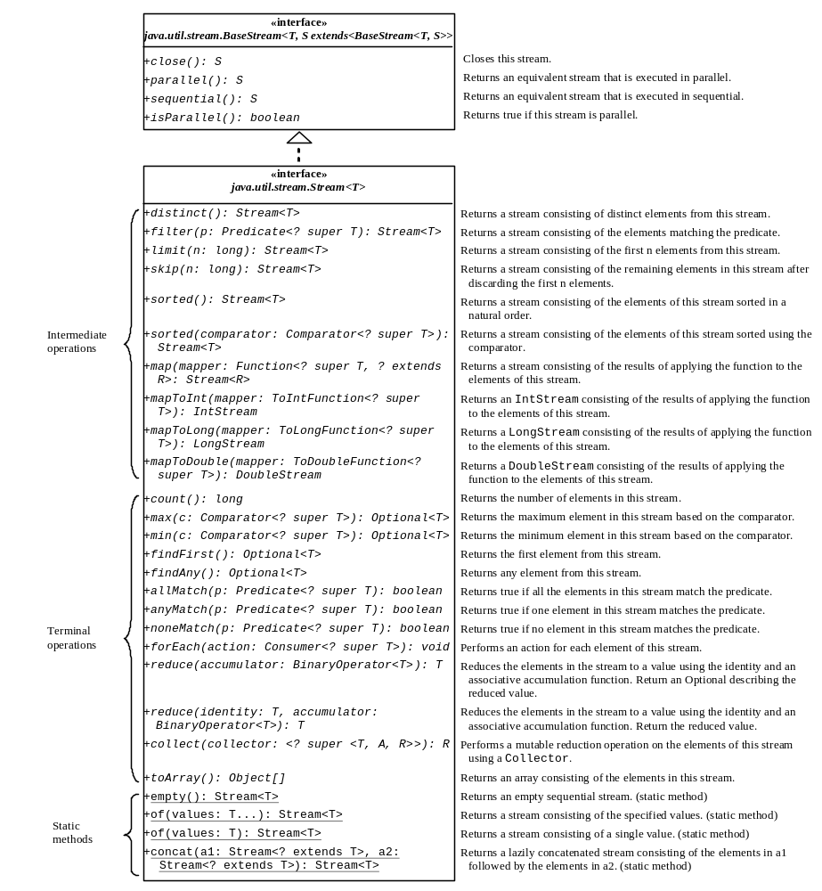
Stream Class
An intermediate method transfroms a stream into another stream.
An terminal method performs an action and terminates a stream.
A static method creates a stream.

Slide 6
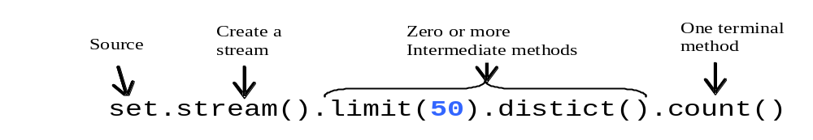
Stream Pipeline
A stream pipeline consists of a stream created from a data source, zero or more intermediate methods, and a final terminal method.
Streams are lazy, which means that the computation is performed only when the terminal operation is initiated. This allows the JVM to optimize computation.
StreamDemo

Slide 7
Functional Interface Arguments
Most of the arguments for stream methods are instances of functional interfaces. So the arguments can be created using lambda expressions or method references.

Slide 8
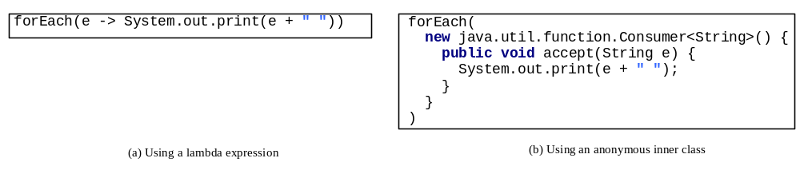
forEach Method
The lambda expression not only simplifies the code, but also the concept of the method. You can now simply say that for each element in the stream perform the action as specified in the expression.

Slide 9
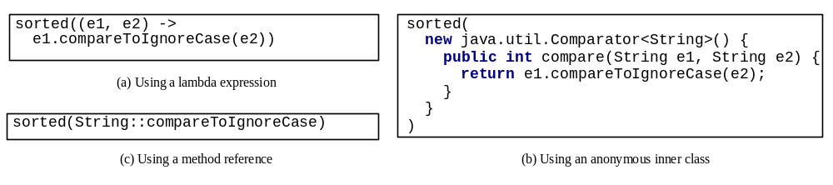
The sorted Method
sorted() is to sort the elements in their natural order and sorted(Comparator) sorts using the specified comparator.

Slide 10
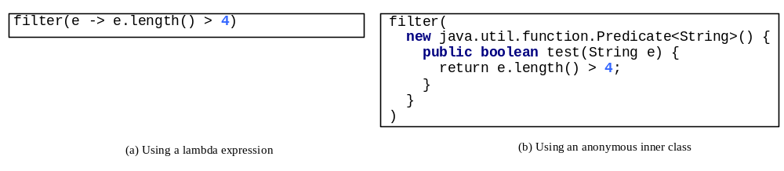
The filter Method
The filter method takes an argument of the Predicate<? super T> type, which is a functional interface with an abstract method test(T t) that returns a Boolean value. The method selects the elements from the stream that satisfies the predicate.

Slide 11
The max and min Methods
The max and min methods take an argument of the Comparator<? Super T> type. This argument specifies how the elements are compared in order to obtain the maximum and minimum element.

Slide 12
The anyMatch, allMatch, and noneMatch Methods
The anyMatch, allMatch, and noneMatch methods take an argument of the Predicate<? super T> type to test if the stream contains an element, all elements, or no element that satisfies the predicate.

Slide 13
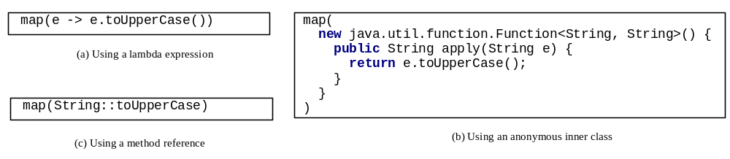
The map Method
The map method returns a new stream by mapping each element in the stream into a new element. The map method takes an argument of the Function<? super T, ? super R> type to return an instance of the Stream<R>. The Function is a functional interface with an abstract method apply(T t) that maps t into a value of the type R.

Slide 14
IntStream, LongStream, and DoubleStream
Stream represents a sequence of objects. In addition to Stream, Java provides IntStream, LongStream, and DoubleStream for representing a sequence of int, long, and double values. These streams are also subinterfaces of BaseStream. You can use these streams in the same way like a Stream. Additionally, you can use the sum(), average(), and summaryStatistics()methods for returning the sum, average, various statistics of the elements in the stream. You can use the mapToInt method to convert a Stream to an IntStream and use the map method to convert any stream including an IntStream to a Stream.

Slide 15
IntStream, LongStream, and DoubleStream Examples
IntStreamDemo

Slide 16
Parallel Streams
Streams can be executed in parallel mode to improve performance.
The stream() method in the Collection interface returns a sequential stream. To execute operations in parallel, use the parallelStream() method in the Collection interface to obtain a parallel stream. Any stream can be turned to into a parallel stream by invoking the parallel() method defined in tbe BaseStream interface. Likewise, you can turn a parallel stream into a sequential stream by invoking the sequential() method.

Slide 17
Parallel Streams
Streams can be executed in parallel mode to improve performance.
The stream() method in the Collection interface returns a sequential stream. To execute operations in parallel, use the parallelStream() method in the Collection interface to obtain a parallel stream. Any stream can be turned to into a parallel stream by invoking the parallel() method defined in tbe BaseStream interface. Likewise, you can turn a parallel stream into a sequential stream by invoking the sequential() method.

Slide 18
Parallel Streams Example
ParallelStreamDemo

Slide 19
Stream Reduction Using the reduce Method
int total = 0;
for (int e: s) {
total += e;
}
int sum = s.parallelStream()
.reduce(0, (e1, e2) -> e1 + e2);
The reduce method makes the code concise. Moreover, the code is parallelizable, because multiple processors can simultaneously invoke the applyAsInt method on two integers repeatedly.
StreamReductionDemo

Slide 20
Stream Reduction Using the collect Method
You can use the collect method to reduce the elements in a stream into a mutable container.
In the preceding example, the String’s concat method is used in the reduce method for Stream.of(names).reduce((x, y) -> x + y). This operation causes a new string to be created when concatenating two strings, which is very inefficient. A better approach is to use a StringBuilder and accumulate the result into a StringBuilder. This can be accomplished using the collect method.
CollectDemo

Slide 21
Grouping Elements Using the groupingby Collector
You can use the groupingBy collector along with the collect method to collect the elements by groups.
The elements in a stream can be divided into groups using the groupingby collector and then apply aggregate collectors on each group.
CollectGroupDemo

Slide 22
Case Studies: Analyzing Numbers
AnalyzeNumbersUsingStream

Slide 23
Case Studies: Counting the Occurrences of Each Letter
CountLettersUsingStream

Slide 24
Case Studies: Counting the Occurrences of Each Letter in a String
CountOccurrenceOfLettersInAString

Slide 25
Case Studies: Processing All Elements in a Two-Dimensional Array
TwoDimensionalArrayStream

Slide 26
Case Studies: Finding the Directory Size
DirectorySizeStream

Slide 27
Case Studies: Counting Keywords
CountKeywordStream

Slide 28
Case Studies: Occurrences of Words
CountOccurrenceOfWordsStream

