Slide 1
Chapter 31 Advanced JavaFX

Slide 2
Objectives
To specify styles for UI nodes using JavaFX CSS (§31.2).
To create quadratic curve, cubic curve, and path using the QuadCurve, CubicCurve, and Path classes (§31.3).
To translation, rotation, and scaling to perform coordinate transformations for nodes (§31.4).
To define a shape’s border using various types of strokes (§31.5).
To create menus using the Menu, MenuItem, CheckMenuItem, and RadioMemuItem classes (§31.6).
To create context menus using the ContextMenu class (§31.7).
To use SplitPane to create adjustable horizontal and vertical panes (§31.8).
To create tab panes using the TabPane control (§31.9).
To create and display tables using the TableView and TableColumn classes (§31.10).
To create JavaFX user interfaces using FMXL and the visual Scene Builder (§31.11).

Slide 3
JavaFX CSS
A JavaFX style property is defined with a prefix –fx- to distinquish it from a property in CSS. All the available JavaFX properties are defined in http://docs.oracle.com/javafx/2/api/javafx/scene/doc-files/cssref.html. Listing 31.1 gives an example of a style sheet .

Slide 4
Style Class and Style ID
A style sheet uses the style class or style id to define styles. Mutiple style classes can be applied to a single node and a style id to a unique node. The syntax .styleclass defines a style class. The syntax #styleid defines a style id.
mystyle.css
StyleSheetDemo

Slide 5
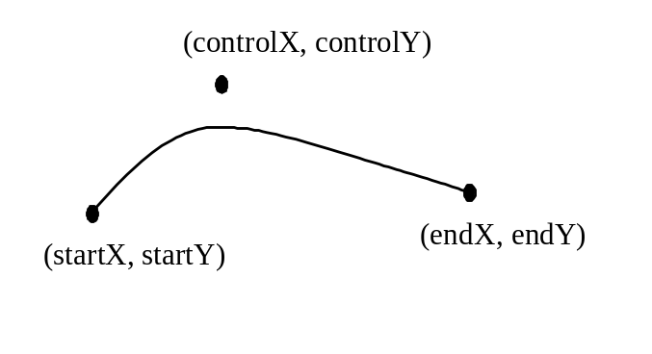
QuadCurve
A quadratic curve is mathematically defined as a quadratic polynomial. To create a QuadCurve, use its no-arg constructor or the following constructor:
QuadCurve(double startX, double startY,
double controlX, double controlY, double endX, double endY)

Slide 6
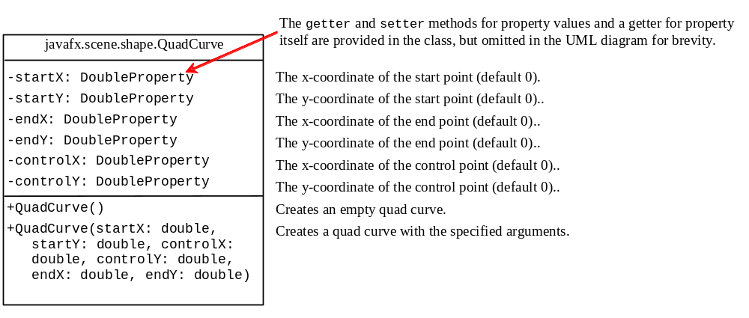
QuadCurve

Slide 7
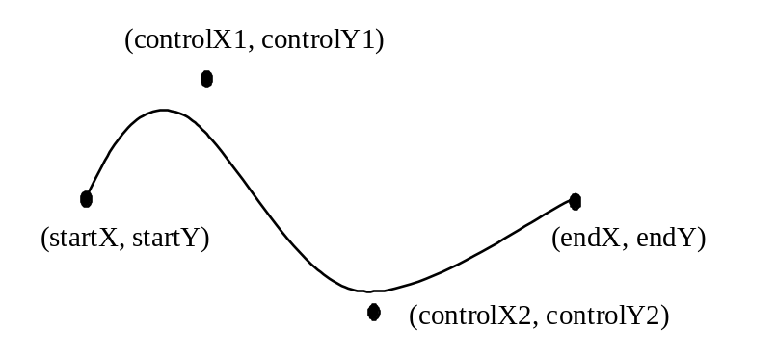
CubicCurve
A cubic curve is mathematically defined as a cubic polynomial. To create a CubicCurve, use its no-arg constructor or the following constructor:
CubicCurve(double startX, double startY, double controlX1,
double controlY1, double controlX2, double controlY2,
double endX, double endY)

Slide 8
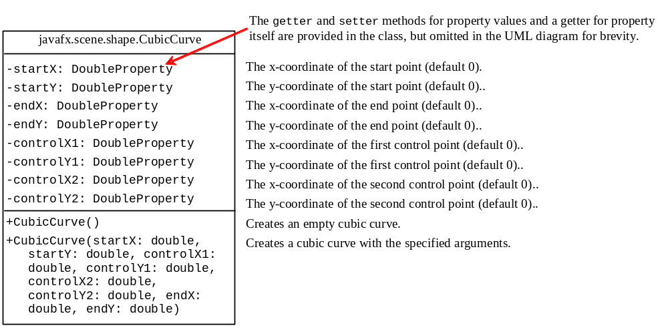
CubicCurve
CurveDemo

Slide 9
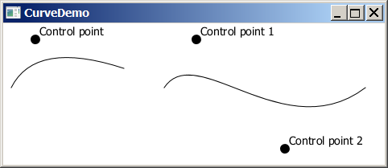
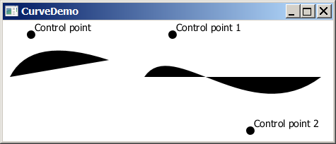
Curve Demo
CurveDemo

Slide 10
Path
The Path class models an arbitrary geometric path. A path is constructed by adding path elements into the path. The PathElement is the root class for the path elements MoveTo, HLineTo, VLineTo, LineTo, ArcTo, QuadCurveTo, CubicCurveTo, and ClosePath.
PathDemo

Slide 11
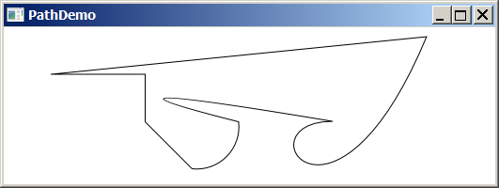
Path
ClosePath
HLineTo
VLineTo
LineTo
CubicCurveTo
ArcTo
QuadCurveTo
PathDemo

Slide 12
Coordinate Transformations
JavaFX supports coordinate transformations using translation, rotation, and scaling.

Slide 13
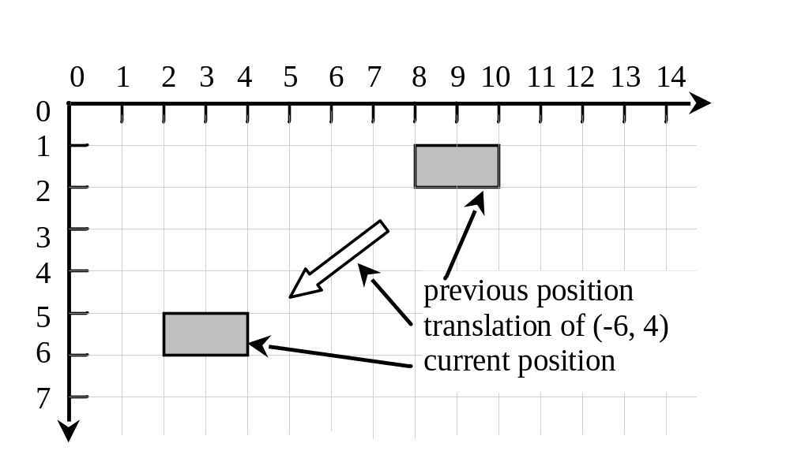
Translations
You can use the setTranslateX(double x), setTranslateY(double y), and setTranslateZ(double z)methods in the Node class to translate the coordinates for a node.
TranslationDemo

Slide 14
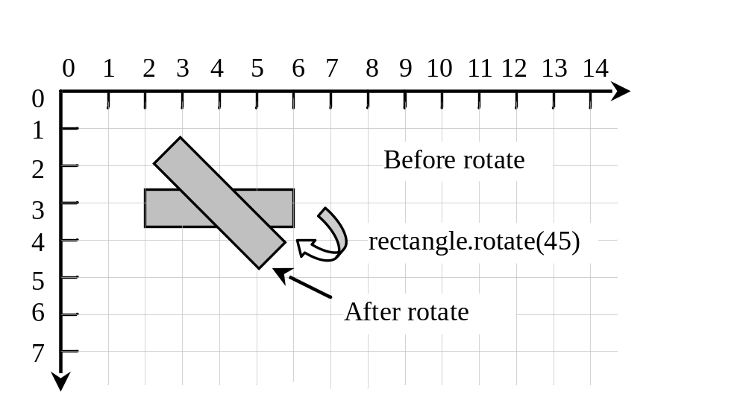
Rotations
You can use the rotate(double theta) method in the Node class to rotate a node by theta degrees from its pivot point clockwise, where theta is a double value in degrees. The pivot point is automatically computed based on the bounds of the node.
RotateDemo

Slide 15
Scaling
You can use the setScaleX(double sx), setScaleY(double sy) , and setScaleY(double sy) methods in the Node class to specify a scaling factor. The node will appear larger or smaller depending on the scaling factor. Scaling alters the coordinate space of the node such that each unit of distance along the axis is multiplied by the scale factor. As with rotation transformations, scaling transformations are applied to enlarge or shrink the node around the pivot point.
For a node of the rectangle shape, the pivot point is the center of the rectangle.

Slide 16
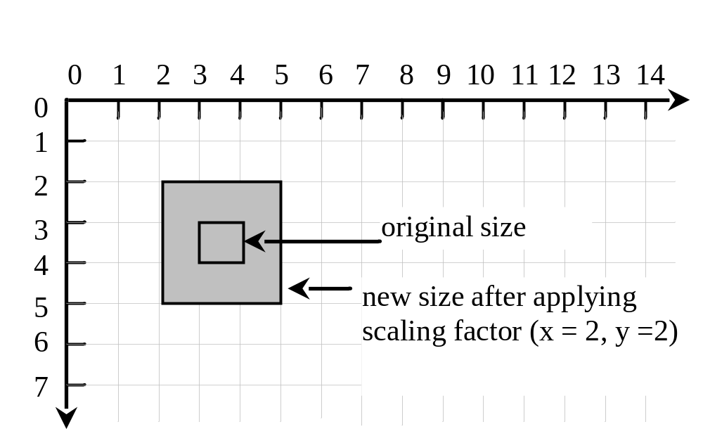
Scaling
ScaleDemo

Slide 17
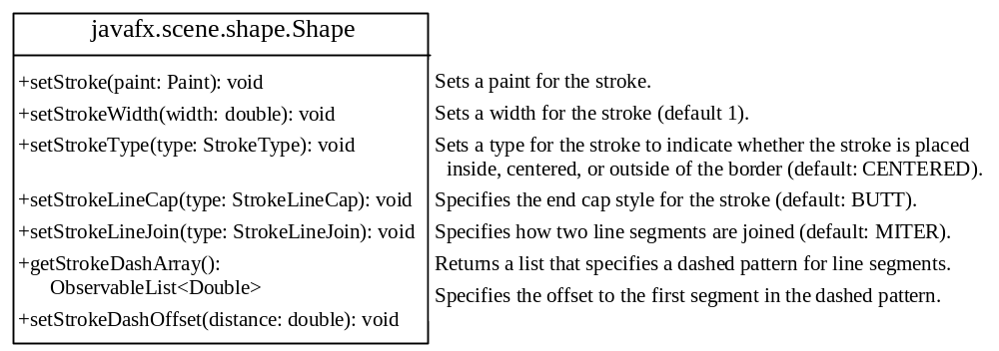
Strokes

Slide 18

strokeType
The setStrokeType(type) method sets a type for the stroke. The type defines whether the stroke is inside, outside, or in the center of the border using the constants StrokeType.INSIDE, StrokeType.CENTERED (default), or StrokeType.OUTSIDE,

Slide 19
strokeLineCap
The setStrokeType(type) method sets a type for the stroke. The type defines whether the stroke is inside, outside, or in the center of the border using the constants StrokeType.INSIDE, StrokeType.CENTERED (default), or StrokeType.OUTSIDE,

Slide 20

strokeLineJoin
The setStrokeLineJoin method defines the decoration applied where path segments meet. You can specify three types of line join using the constants StrokeLineJoin.MITER (default), StrokeLineJoin.BEVEL, and StrokeLineJoin.ROUND.

Slide 21
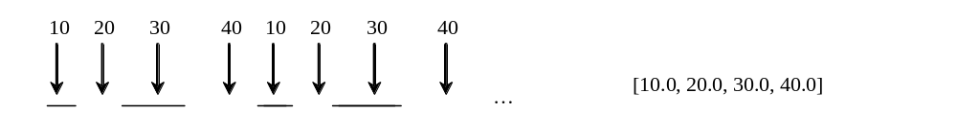
strokeDashArray
The Shape class has a property named strokeDashArray of the ObservableList<Double> type. This property is used to define a dashed pattern for the stroke. Alternate numbers in the list specify the lengths of the opaque and transparent segments of the dashes.

Slide 22
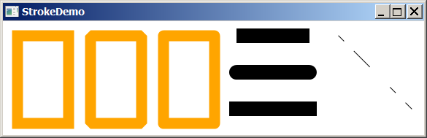
Stroke Demo
StrokeDemo

Slide 23
Menu
Menus make selection easier and are widely used in window applications. JavaFX provides five classes that implement menus: MenuBar, Menu, MenuItem, CheckMenuItem, and RadioButtonMenuItem.
MenuBar is a top-level menu component used to hold the menus. A menu consists of menu items that the user can select (or toggle on or off). A menu item can be an instance of MenuItem, CheckMenuItem, or RadioButtonMenuItem. Menu items can be associated with nodes and keyboard accelerators.

Slide 24
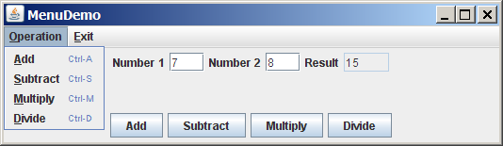
Creating Menus
MenuDemo

Slide 25
Context Menu
A context menu, also known as a popup menu, is like a regular menu, but does not have a menu bar and can float anywhere on the screen. Creating a context menu is similar to creating a regular menu. First, you create an instance of ContextMenu, then you can add MenuItem, CheckMenuItem, and RadioMenuItem to the context menu.

Slide 26
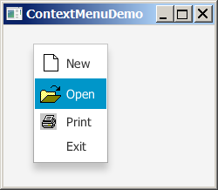
Creating Context Menus
ContextMenuDemo

Slide 27
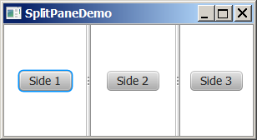
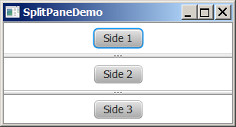
SplitPane
The SplitPane class can be used to display multiple panes and allow the user to adjust the size of the panes.

Slide 28
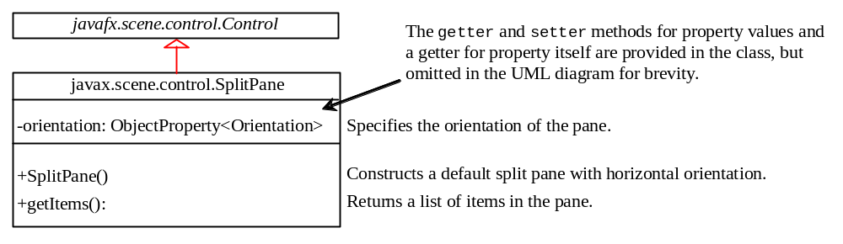
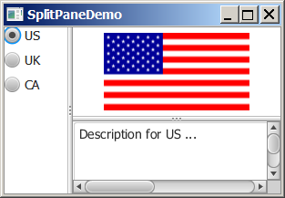
Using SplitPane
SplitPaneDemo

Slide 29
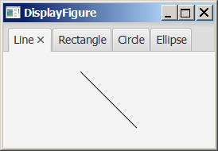
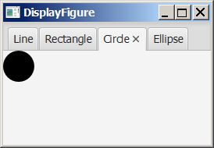
TabPane
The TabPane class can be used to display multiple panes with tabs.

Slide 30
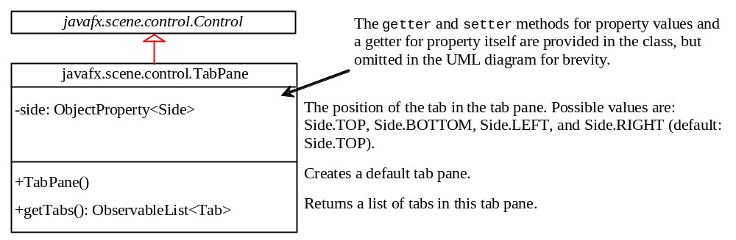
The TabPane Class

Slide 31
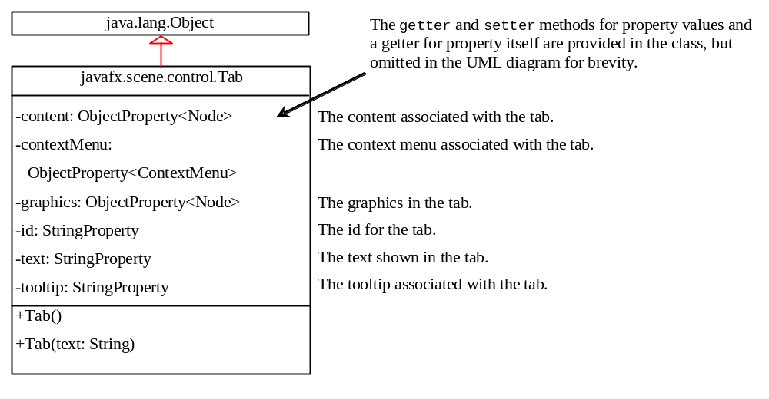
The Tab Class
TabPaneDemo

Slide 32
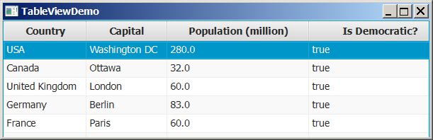
TableView
You can display tables using the TableView class.
TableViewDemo

Slide 33
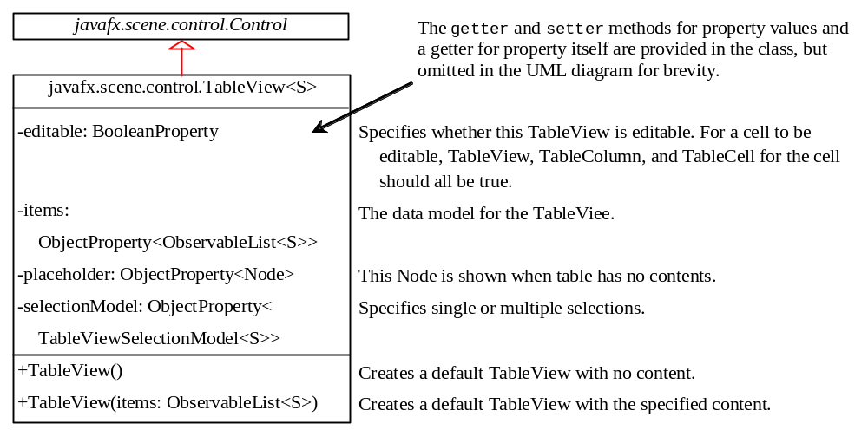
The TableView Class

Slide 34
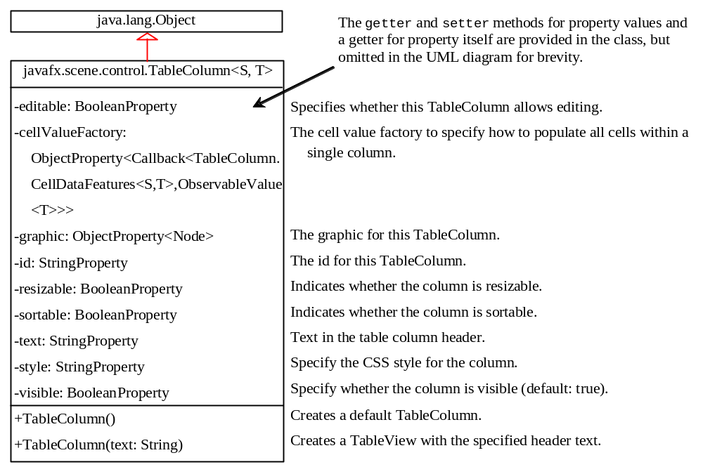
The TableColumn Class

Slide 35
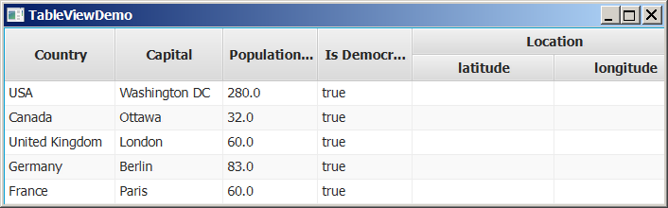
Add New Row
You can display tables using the TableView class.
AddNewRowDemo

