Slide 1
Chapter 33 Networking

Slide 2
Objectives
To explain terms: TCP, IP, domain name, domain name server, stream-based communications, and packet-based communications (§33.2).
To create servers using server sockets (§33.2.1) and clients using client sockets (§33.2.2).
To implement Java networking programs using stream sockets (§33.2.3).
To develop an example of a client/server application (§33.2.4).
To obtain Internet addresses using the InetAddress class (§33.3).
To develop servers for multiple clients (§33.4).
To send and receive objects on a network (§33.5).
To develop an interactive tic-tac-toe game played on the Internet (§33.6).

Slide 3
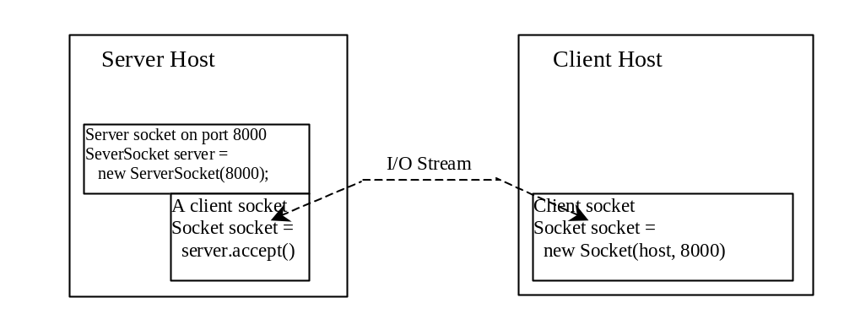
Client/Server Communications
The server must be running when a client starts. The server waits for a connection request from a client. To establish a server, you need to create a server socket and attach it to a port, which is where the server listens for connections.
After the server accepts the connection, communication between server and client is conducted the same as for I/O streams.
After a server socket is created, the server can use this statement to listen for connections.
The client issues this statement to request a connection to a server.

Slide 4
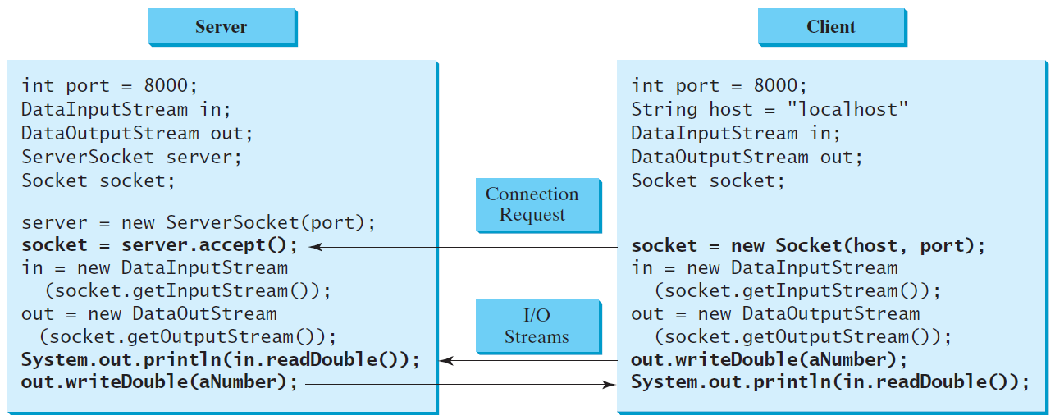
Data Transmission through Sockets
InputStream input = socket.getInputStream();
OutputStream output = socket.getOutputStream();

Slide 5
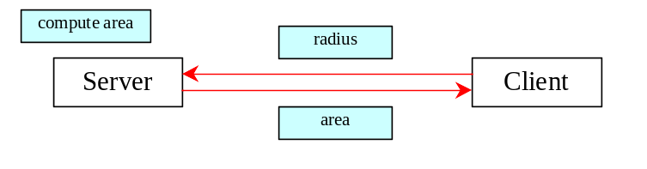
A Client/Server Example
Problem: Write a client to send data to a server. The server receives the data, uses it to produce a result, and then sends the result back to the client. The client displays the result on the console. In this example, the data sent from the client is the radius of a circle, and the result produced by
the server is the area of the circle.

Slide 6
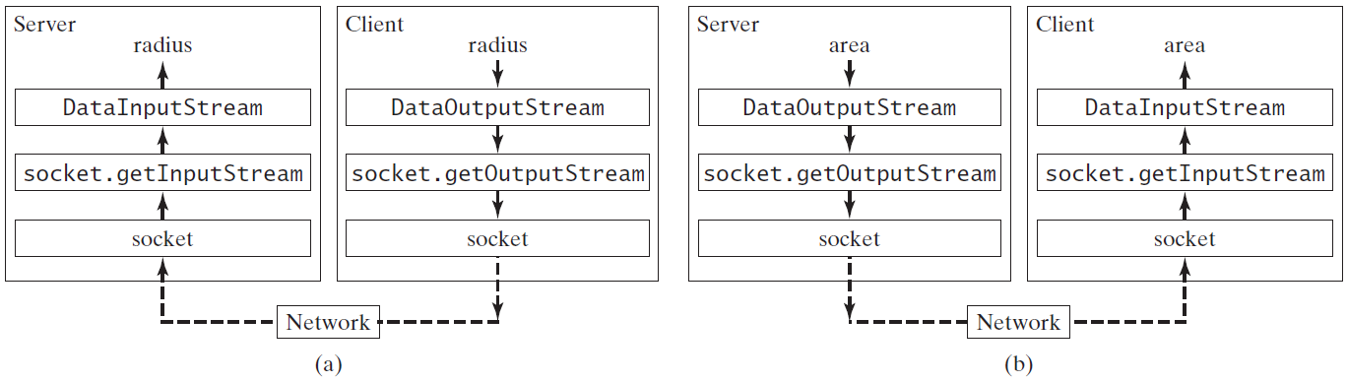
A Client/Server Example, cont.

Slide 7
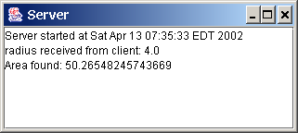
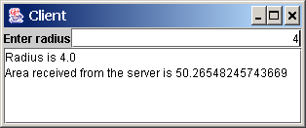
A Client/Server Example, cont.
Server
Client
Note: Start the server, then the client.

Slide 8
The InetAddress Class
Occasionally, you would like to know who is connecting to the server. You can use the InetAddress class to find the client's host name and IP address. The InetAddress class models an IP address. You can use the statement shown below to create an instance of InetAddress for the client on a socket.
  InetAddress inetAddress = socket.getInetAddress();
Next, you can display the client's host name and IP address, as follows:
  System.out.println("Client's host name is " +
  inetAddress.getHostName());
  System.out.println("Client's IP Address is " +
  inetAddress.getHostAddress());

Slide 9
Serving Multiple Clients
Multiple clients are quite often connected to a single server at the same time. Typically, a server runs constantly on a server computer, and clients from all over the Internet may want to connect to it. You can use threads to handle the server's multiple clients simultaneously. Simply create a thread for each connection. Here is how the server handles the establishment of a connection:
    while (true) {
    Socket socket = serverSocket.accept();
    Thread thread = new ThreadClass(socket);
    thread.start();
    }
The server socket can have many connections. Each iteration of the while loop creates a new connection. Whenever a connection is established, a new thread is created to handle communication between the server and the new client; and this allows multiple connections to run at the same time.

Slide 10
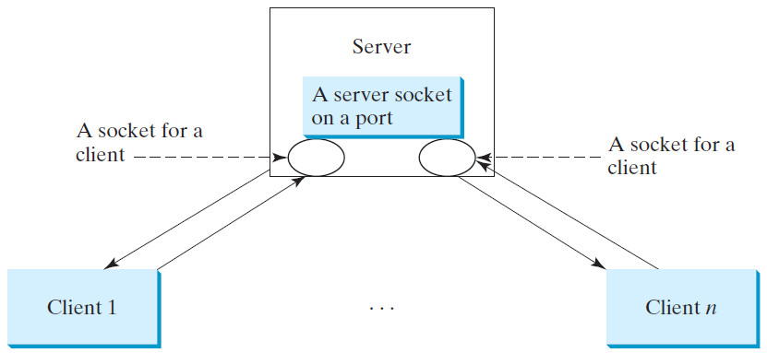
Example: Serving Multiple Clients
MultiThreadServer
Note: Start the server first, then start multiple clients.

Slide 11
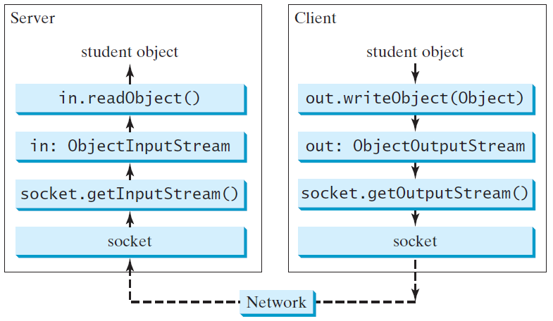
Example: Passing Objects in Network Programs
Write a program that collects student information from a client and send them to a server. Passing student information in an object.
StudentAddres Class
StudentServer
StudentClient
Note: Start the server first, then the client.

Slide 12
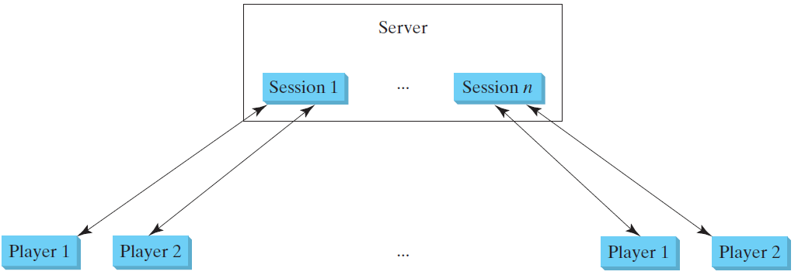
Case Studies: Distributed TicTacToe Games
Optional
TicTacToeServer
TicTacToeClient

Slide 13
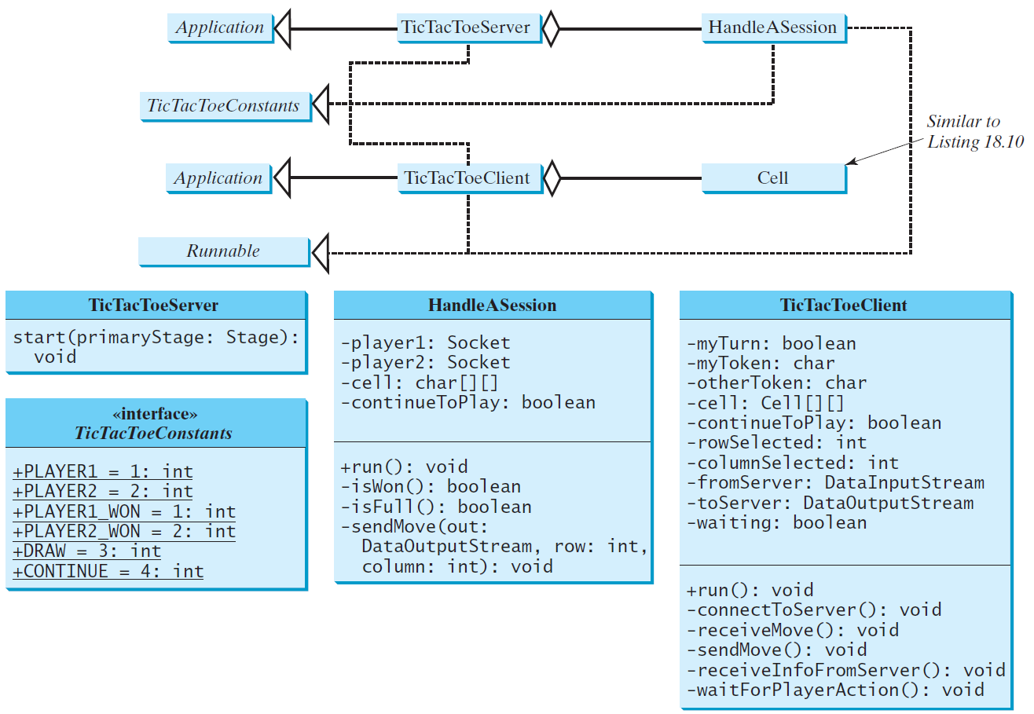
Distributed TicTacToe, cont.

Slide 14
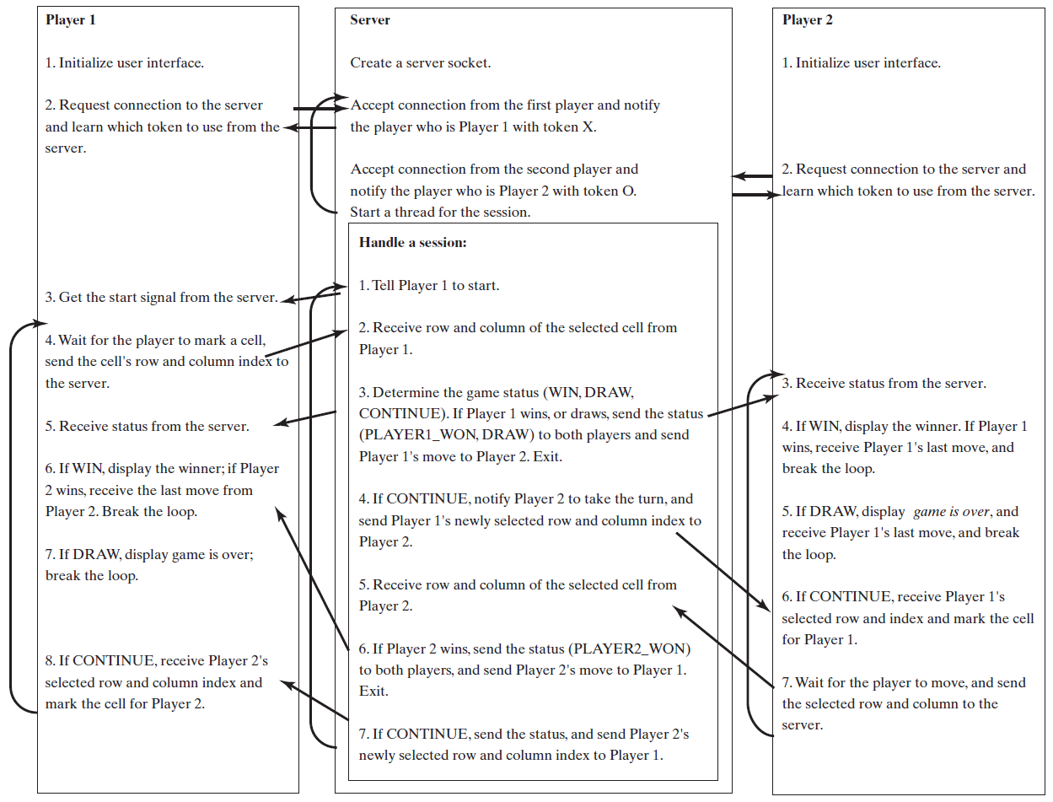
Distributed TicTacToe Game

Slide 15
Stream Socket vs. Datagram Socket
Companion Website
Stream socket
Datagram socket
A dedicated point-to-point channel between a client and server.
Use TCP (Transmission Control Protocol) for data transmission.
Lossless and reliable.
Sent and received in the same order.
No dedicated point-to-point channel between a client and server.
Use UDP (User Datagram Protocol) for data transmission.
May lose data and not 100% reliable.
Data may not received in the same order as sent.

Slide 16
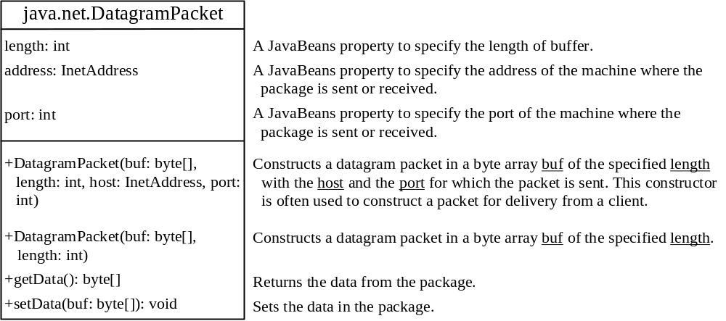
DatagramPacket
Companion Website
The DatagramPacket class represents a datagram packet. Datagram packets are used to implement a connectionless packet delivery service. Each message is routed from one machine to another based solely on information contained within the packet.

Slide 17
DatagramSocket
Companion Website
DatagramSocket
Create a server DatagramSocket
Create a client DatagramSocket
The DatagramSocket class represents a socket for sending and receiving datagram packets. A datagram socket is the sending or receiving point for a packet delivery service. Each packet sent or received on a datagram socket is individually addressed and routed. Multiple packets sent from one machine to another may be routed differently, and may arrive in any order.
To create a server DatagramSocket, use the constructor DatagramSocket(int port), which binds the socket with the specified port on the local host machine.
To create a client DatagramSocket, use the constructor DatagramSocket(), which binds the socket with any available port on the local host machine.

Slide 18
Sending and Receiving a DatagramSocket
Companion Website
Sending
Receiving
To send data, you need to create a packet, fill in the contents, specify the Internet address and port number for the receiver, and invoke the send(packet) method on a DatagramSocket.
To receive data, create an empty packet and invoke the receive(packet) method on a DatagramSocket.

Slide 19
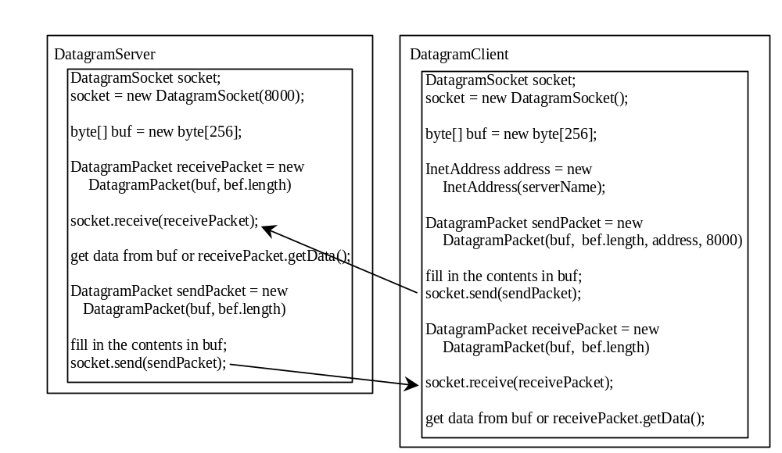
Datagram Programming
Companion Website
Datagram programming is different from stream socket programming in the sense that there is no concept of a ServerSocket for datagrams. Both client and server use DatagramSocket to send and receive packets.
Designate one a server

Slide 20
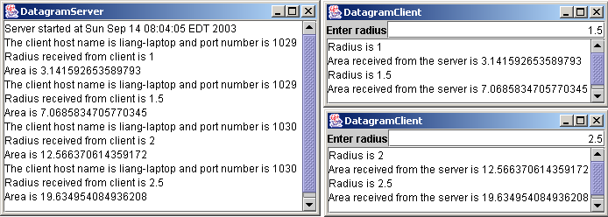
Example: A Client/Server Example
Companion Website
Section 33.2 presents a client program and a server program using socket streams. The client sends radius to a server. The server receives the data, uses them to find the area, and then sends the area to the client. Rewrite the program using datagram sockets.
DatagramClient
Note: Start the server, then the client.
DatagramServer

