Slide 1
Chapter 36 Internationalization

Slide 2
Objectives
To describe Java's internationalization features (§36.1).
To construct a locale with language, country, and variant (§36.2).
To display date and time based on locale (§36.3).
To display numbers, currencies, and percentages based on locale (§36.4).
To develop applications for international audiences using resource bundles (§36.5).
To specify encoding schemes for text I/O (§36.6).

Slide 3
Java’s International Support
1. Use Unicode
2. Provide the Locale class to encapsulate information about a specific locale. A Locale object determines how locale-sensitive information, such as date, time, and number, is displayed, and how locale-sensitive operations, such as sorting strings, are performed.
3. Use the ResourceBundle class to separate locale-specific information such as status messages and the GUI component labels from the program. The information is stored outside the source code and can be accessed and loaded dynamically at runtime from a ResourceBundle, rather than hard-coded into the program.

Slide 4
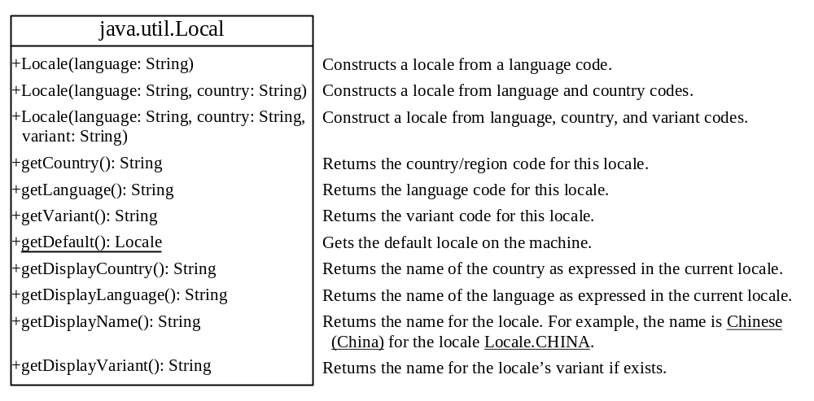
The Locale Class
A Locale object represents a specific geographical, political, or cultural region. An operation that requires a Locale to perform its task is called locale-sensitive. You can use Locale to tailor information to the user.

Slide 5
Creating a Locale
To create a Locale object, you can use the
following constructor in Locale class:
Locale(String language, String country)
Locale(String language, String country, String variant)
Example:
new Locale(“en”, “US”);
new Locale(“fr”, “CA”);
Locale.CANADA
Locale.CANADA_FRENCH

Slide 6
The Locale-Sensitive Operations
An operation that requires a Locale to perform its task is called locale-sensitive. Displaying a number as a date or time, for example, is a locale-sensitive operation; the number should be formatted according to the customs and conventions of the user's locale.
Several classes in the Java class libraries contain locale-sensitive methods. Date, Calendar, DateFormat, and NumberFormat, for example, are locale-sensitive. All the locale-sensitive classes contain a static method, getAvailableLocales(), which returns an array of the locales they support. For example,
  Locale[] availableLocales = Calendar.getAvailableLocales();
  returns all the locales for which calendars are installed.

Slide 7
Processing Date and Time
java.util.Date
Introduced in Chapter 9.
java.util.Calendar and java.util.GregorianCalendar
Introduced in Chapter 13.
Different locales have different conventions for displaying date and time. Should the year, month, or day be displayed first? Should slashes, periods, or colons be used to separate fields of the date? What are the names of the months in the language? The java.text.DateFormat class can be used to format date and time in a locale-sensitive way for display to the user.

Slide 8
The TimeZone Class
TimeZone represents a time zone offset and also figures out daylight savings. To get a TimeZone object for a specified time zone ID, use TimeZone.getTimeZone(id). To set a time zone in a Calendar object, use the setTimeZone method with a time zone ID. For example, cal.setTimeZone(TimeZone.getTimeZone("CST")) sets the time zone to Central Standard Time. To find all the available time zones supported in Java, use the static method getAvailableIDs() in the TimeZone class. In general, the international time zone ID is a string in the form of continent/city like Europe/Berlin, Asia/Taipei, and America/Washington. You can also use the static method getDefault() in the TimeZone class to obtain the default time zone on the host machine.

Slide 9
Creating a TimeZone
You can also get a TimeZone object by using the class method getTimeZone(), along with a time zone ID. For example, the time zone ID for central standard time is CST. Therefore, you can get a CST TimeZone object with the following:
TimeZone tz = TimeZone.getTimeZone("CST");

Slide 10
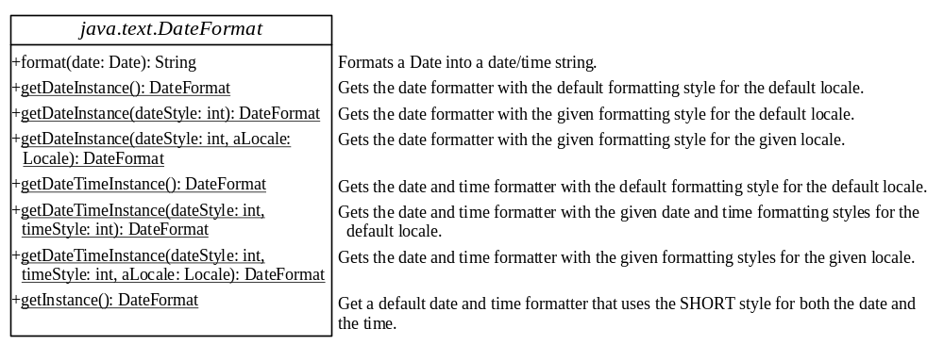
The DateFormat Class
The DateFormat class is an abstract class that provides many class methods for obtaining default date and time formatters based on the default or a given locale and a number of formatting styles, including FULL, LONG, MEDIUM, and SHORT.

Slide 11
DateFormat Formats
    SHORT is completely numeric, such as
    12.13.52 or 3:30pm
    MEDIUM is longer, such as Jan 12, 1952
    LONG is even longer, such as January 12, 1952 or 3:30:32pm
    FULL is completely specified, such as
    Tuesday, April 12, 1952 AD
    or 3:30:42pm PST

Slide 12
Creating a DateFormat
You can use the getDateTimeInstance() method
to obtain a DateFormat object:
public static final DateFormat getDateTimeInstance
(int dateStyle, int timeStyle, Locale aLocale)
This gets the date and time formatter with the given
formatting styles for the given locale.

Slide 13
The SimpleDateFormat Class
The date and time formatting subclass, such as SimpleDateFormat, enables you to choose any user-defined patterns for date and time formatting. To specify the time format, use a time pattern string:
formatter = new SimpleDateFormat("yyyy.MM.dd G
'at' hh:mm:ss Z");
1997.11.12 AD at 04:10:18 PST

Slide 14
Example:
Displaying an International Clock
Objective: Write a program that displays a clock to show the current time based on the specified locale and time zone. The locale and time zone are selected from the combo boxes that contain the available locales and time zones in the system.

Slide 15
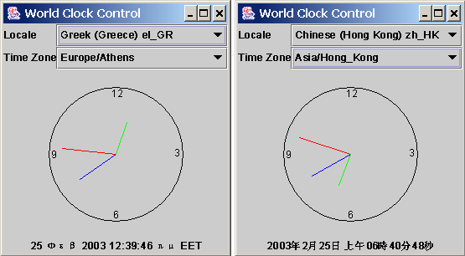
Example, cont.

Slide 16
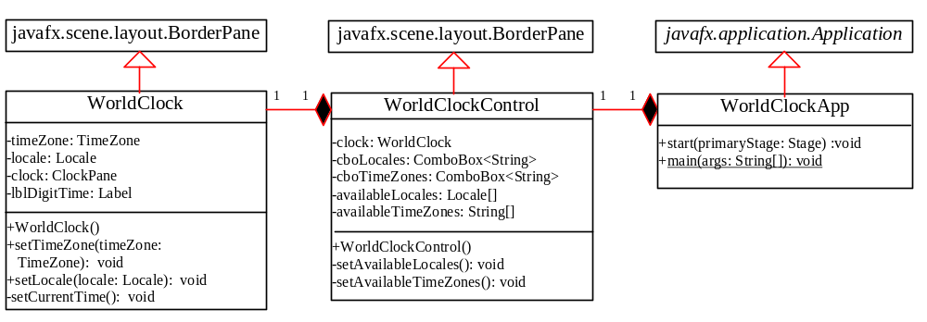
Example, cont.
WorldClock
WorldClockControl
WorldClockApp

Slide 17
Example:
Displaying a Calendar
Objective: Display the calendar based on the specified locale. The user can specify a locale from a combo box that consists of a list of all the available locales supported by the system.

Slide 18
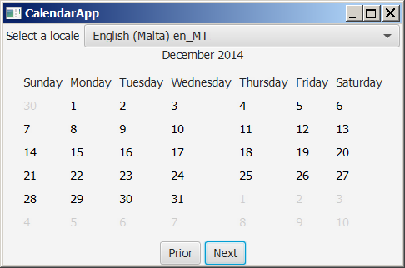
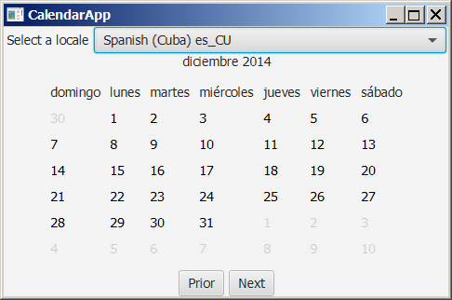
Example, cont.
CalendarApp

Slide 19
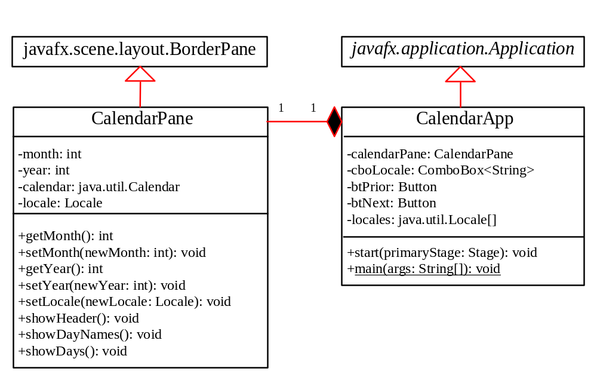
Example, cont.
CalendarPane
CalendarApp

Slide 20
Formatting Numbers
Formatting numbers as currency or percentages is highly locale dependent.
For example, number 5000.50 is displayed as $5,000.50 in the US currency, but the same number is displayed as 5 000,50 F in the French currency.

Slide 21
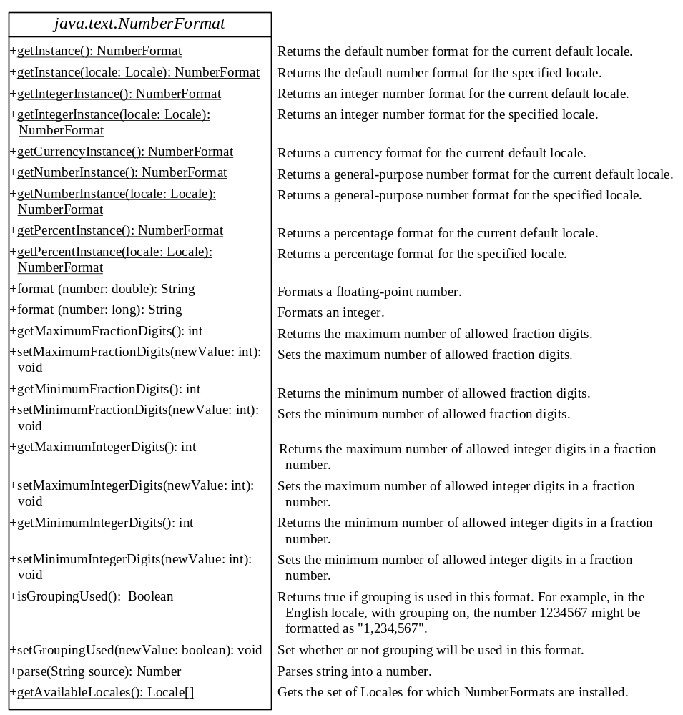

Slide 22
The NumberFormat Class
use one of the factory class methods to get a formatter.
Use getInstance() or getNumberInstance() to get the normal number format.
Use getCurrencyInstance() to get the currency number format.
Use getPercentInstance() to get a format for displaying percentages. With this format, a fraction like 0.53 is displayed as 53%.

Slide 23
The NumberFormat Class (cont.)
For example, to display a number in percentages, you can use the following code to create a formatter for the given locale.
  NumberFormat percForm
  NumberFormat.getPercentInstance(locale);
You can then use percForm to format a number into a string like this:
String s = percForm.format(0.075);

Slide 24
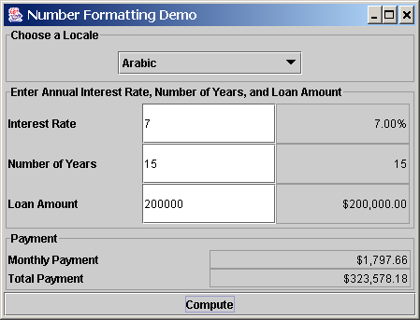
Example:
Formatting Numbers
Objective: This example creates a loan calculator similar to the one in Listing 15.6. This new loan calculator allows the user to choose locales, and displays numbers in locale-sensitive format.
NumberFormatDemo

Slide 25
Resource Bundles (Optional)
A resource bundle is a Java class file or a text file that provides locale-specific information. This information can be accessed by Java programs dynamically.
When your program needs a locale-specific resource, a message string for example, your program can load the string from the resource bundle that is appropriate for the desired locale. In this way, you can write program code that is largely independent of the user's locale isolating most, if not all, of the locale-specific information in resource bundles.

Slide 26
Example: Using Resource Bundles
Objective: This example modifies the NumberFormattingDemo program in the preceding example to display messages, title, and button labels in English, Chinese, and French languages.

Slide 27
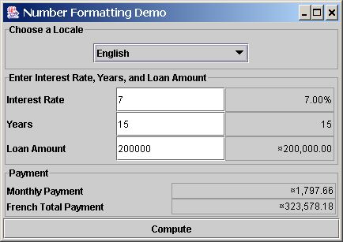
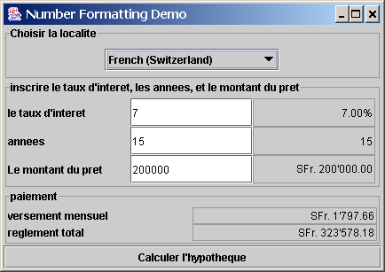
Example, cont.
ResourceBundleDemo

