Slide 1
Chapter 39 JavaServer Face

Slide 2
Objectives
To explain what JSF is (§39.1).
To create a JSF page using NetBeans (§39.2).
To create a JSF managed bean (§39.2).
To use JSF expressions in a facelet (§39.2).
To use JSF GUI components (§39.3).
To obtain and process input from a form (§39.4).
To track sessions in application, session, view, and request scope (§39.5).
To validate input using the JSF validators (§39.6).
To bind database with facelets (§39.7).
To program using contexts and dependency injection (§39.10).

Slide 3
What is JSF?
JSF completely separates Web UI from Java code so the application developed using JSF is easy to debug and maintain.

Slide 4
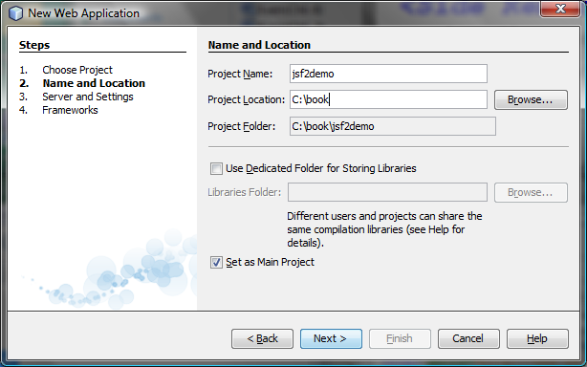
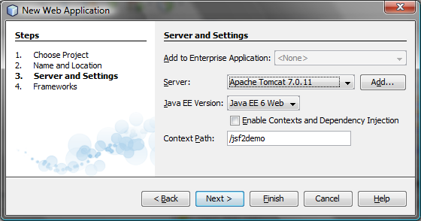
Creating a JSF Project
Create a Web project with JavaServer Faces.

Slide 5
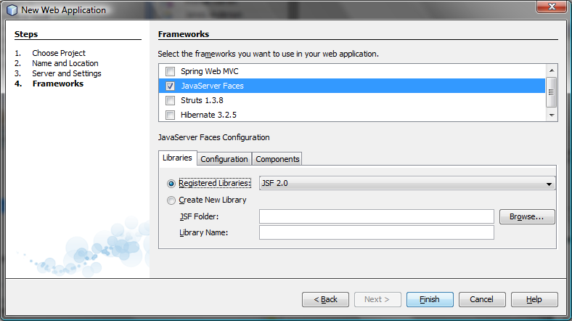
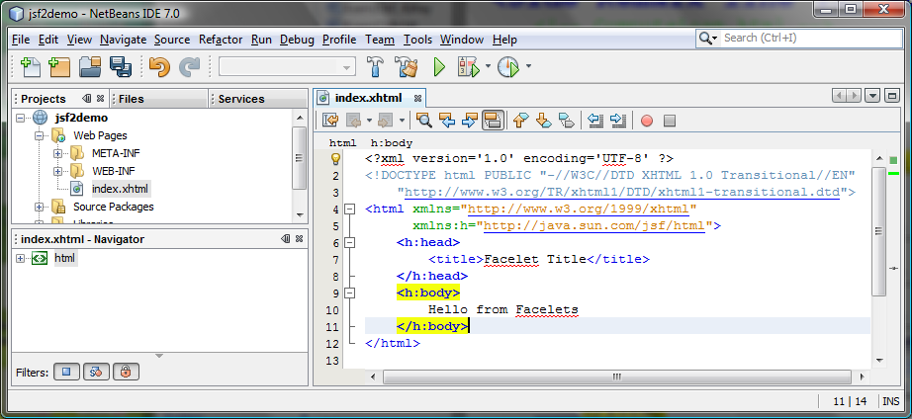
Creating a JSF Project

Slide 6
A Basic JSF Page
<?xml version='1.0' encoding='UTF-8' ?>
<!-- index.xhtml -->
<!DOCTYPE html PUBLIC "-//W3C//DTD XHTML 1.0 Transitional//EN"
"http://www.w3.org/TR/xhtml1/DTD/xhtml1-transitional.dtd">
<html xmlns="http://www.w3.org/1999/xhtml"
xmlns:h="http://java.sun.com/jsf/html">
<h:head>
<title>Facelet Title</title>
</h:head>
<h:body>
Hello from Facelets
</h:body>
</html>

Slide 7
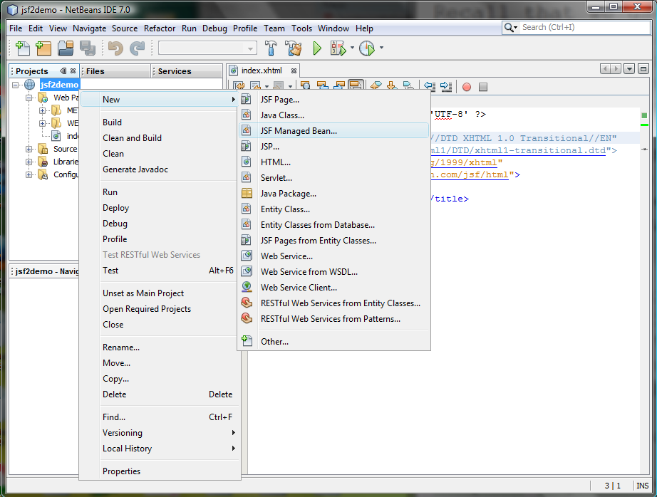
Managed JavaBeans for JSF

Slide 8
Managed JavaBeans for JSF
package jsf2demo;
import javax.faces.bean.ManagedBean;
import javax.faces.bean.RequestScoped;
@ManagedBean
@RequestScoped
public class TimeBean {
public String getTime() {
return new java.util.Date().toString();
}
}
#{expression}
#{timeBean.time}
#{timeBean.getTime()}

Slide 9
Listing 39.3 CurrentTime.xhtml
<?xml version='1.0' encoding='UTF-8' ?>
<!DOCTYPE html PUBLIC "-//W3C//DTD XHTML 1.0 Transitional//EN"
"http://www.w3.org/TR/xhtml1/DTD/xhtml1-transitional.dtd">
<html xmlns="http://www.w3.org/1999/xhtml"
xmlns:h="http://java.sun.com/jsf/html">
<h:head>
<title>Display Current Time</title>
<meta http-equiv="refresh" content ="60" />
</h:head>
<h:body>
The current time is #{timeBean.time}
</h:body>
</html>
Run

Slide 10
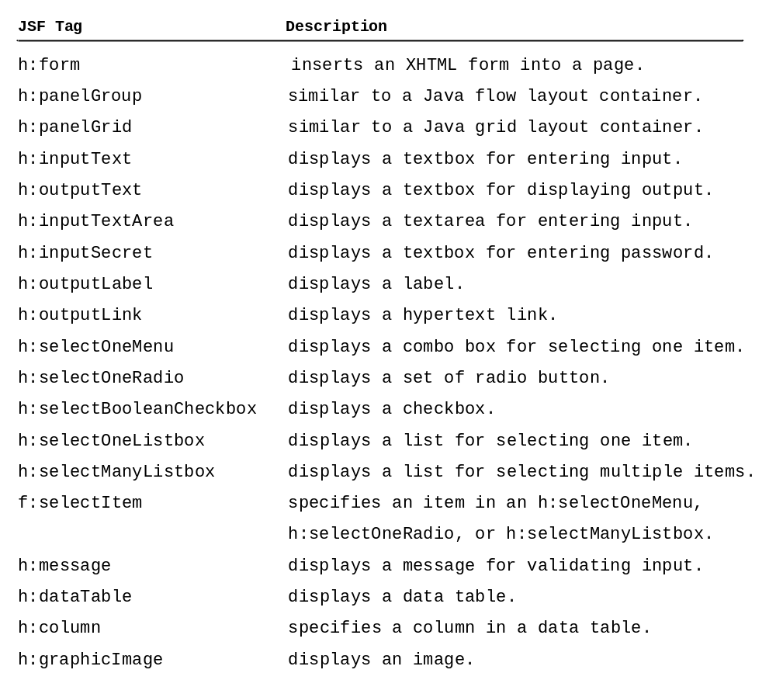
JSF GUI Components

Slide 11
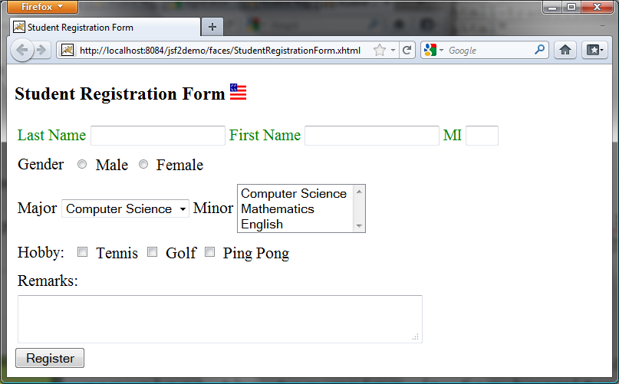
JSF UI Containers
Run

Slide 12
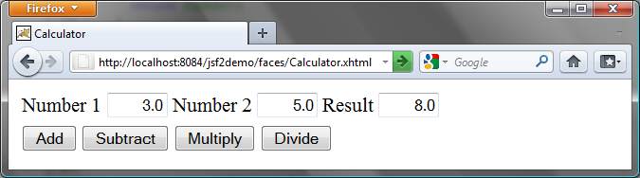
39.5 Case Study: Calculator
Run

Slide 13
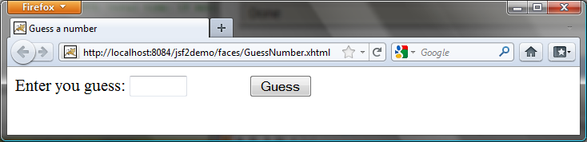
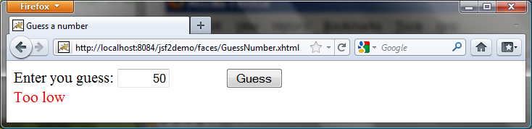
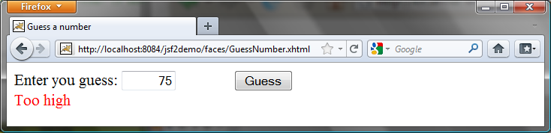
39.6 Session Tracking
Run

Slide 14
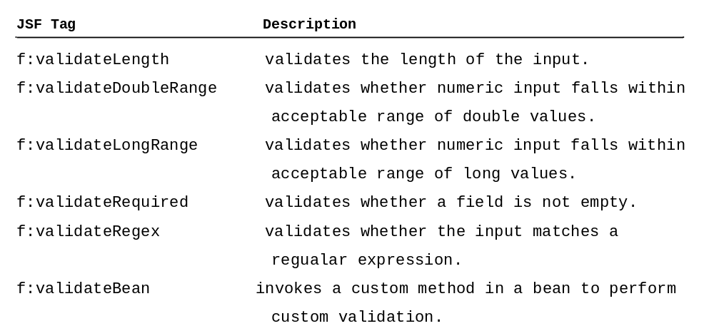
39.7 Validating Input
Run

Slide 15
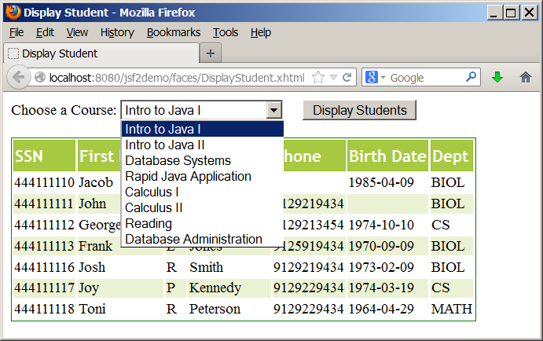
39.8 Bind Database with Facelets
Run

Slide 16
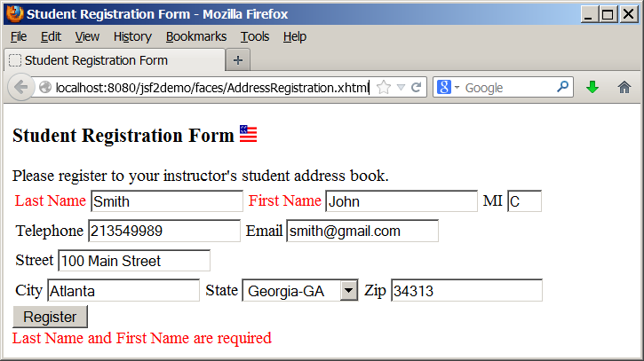
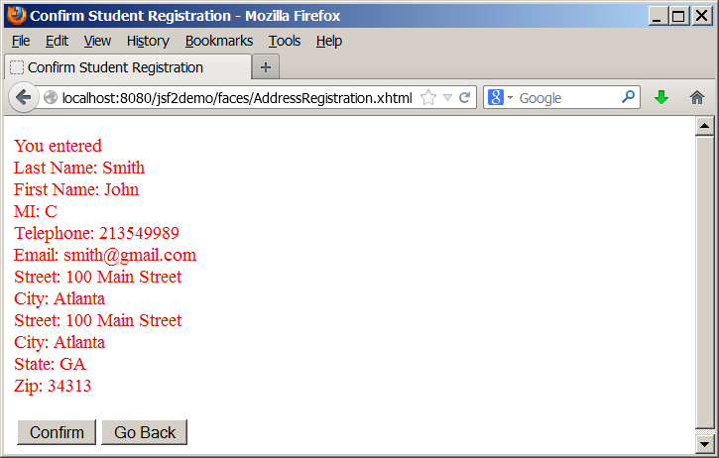
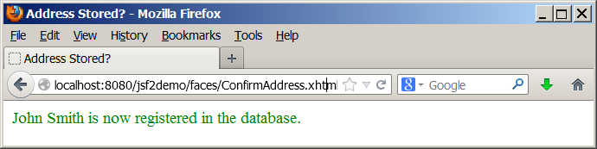
39.9 Opening New JSF Pages
Run

Slide 17
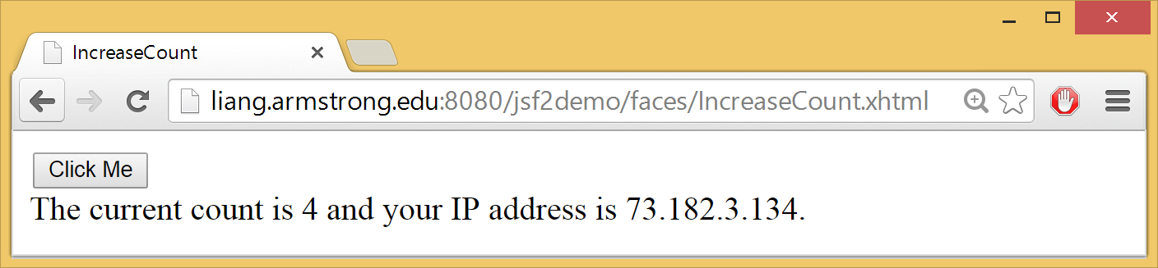
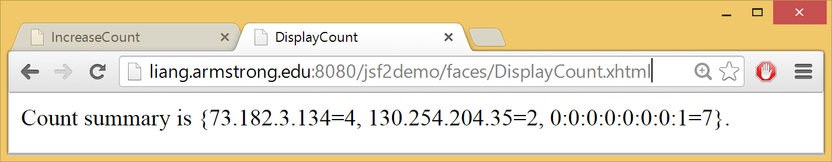
39.10 Contexts and Dependency Injection
IncreaseCount
DisplayCount

