Slide 1
Scrapy : Web Crawler
A tool for scraping the web

Slide 2
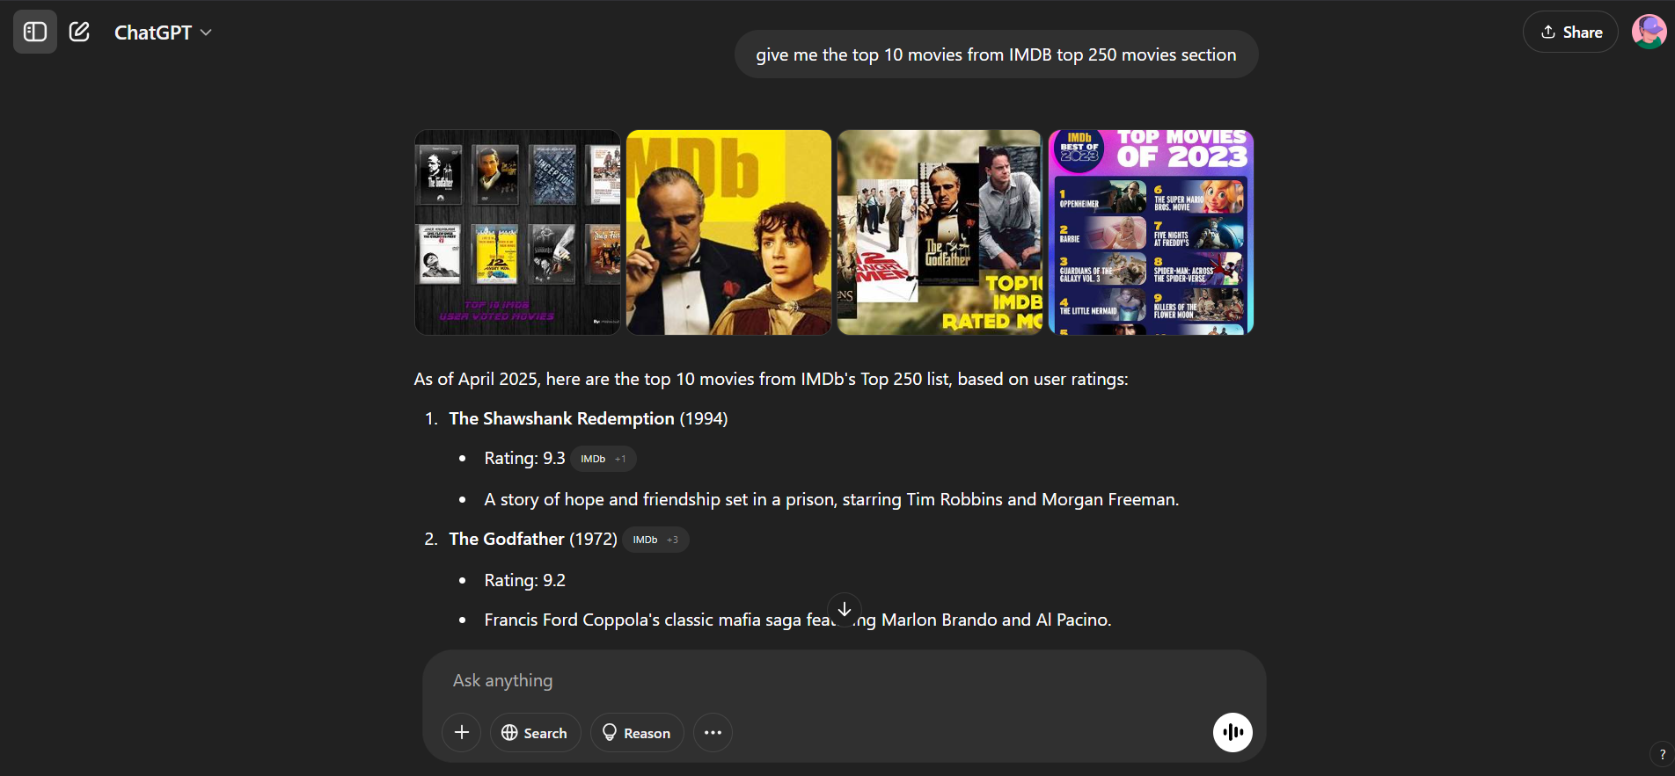
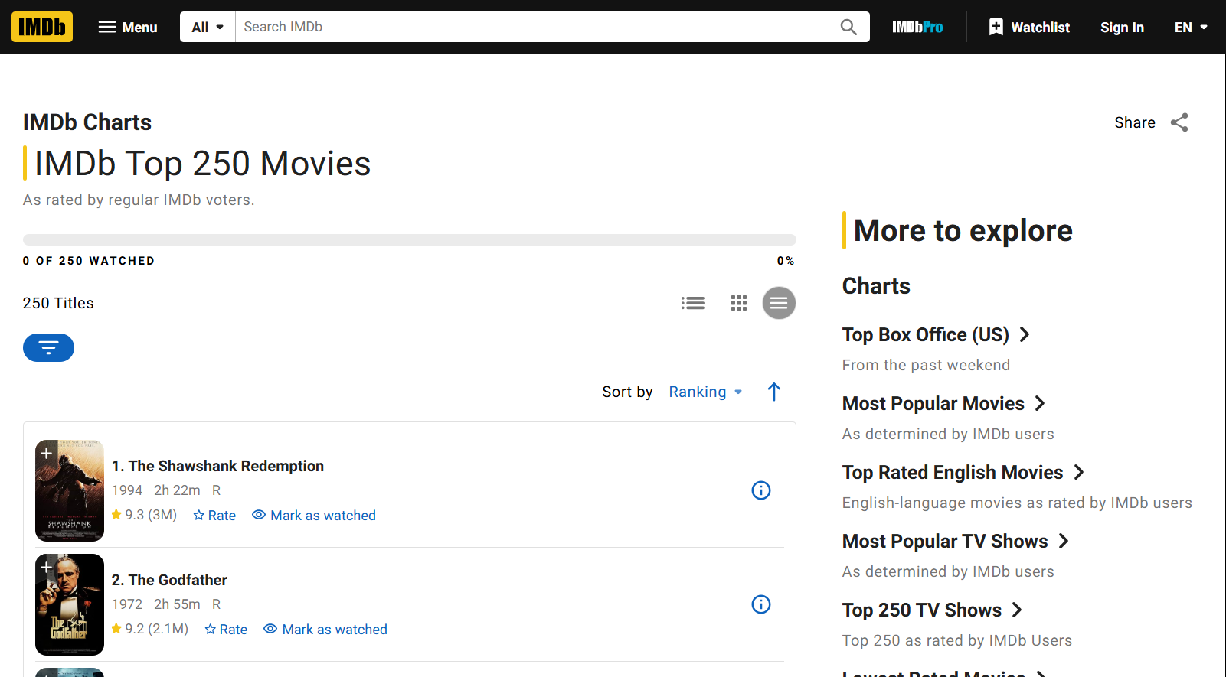
Have you ever wondered how ChatGPT searches for data on other sites?

Slide 3
Web Scraping

Slide 4
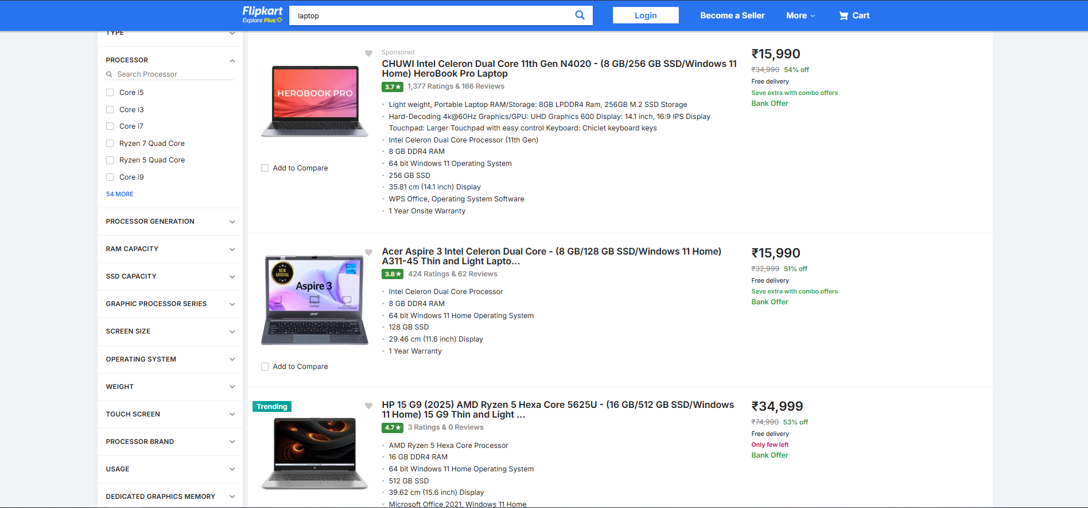
What is Web Scraping?
💡 Web scraping is the automated process of extracting specific data from websites, saving you time compared to manual copy-pasting.
📌 Web Scraping = Visiting a website + Extracting useful data
Is Web Scraping Legal?
✅ Allowed when:
  Data is publicly available
  The website’s ‘robot.txt’ allows it
❌ Not allowed when:
  Scraping personal/private data
  Ignoring a website’s terms of use

Slide 5



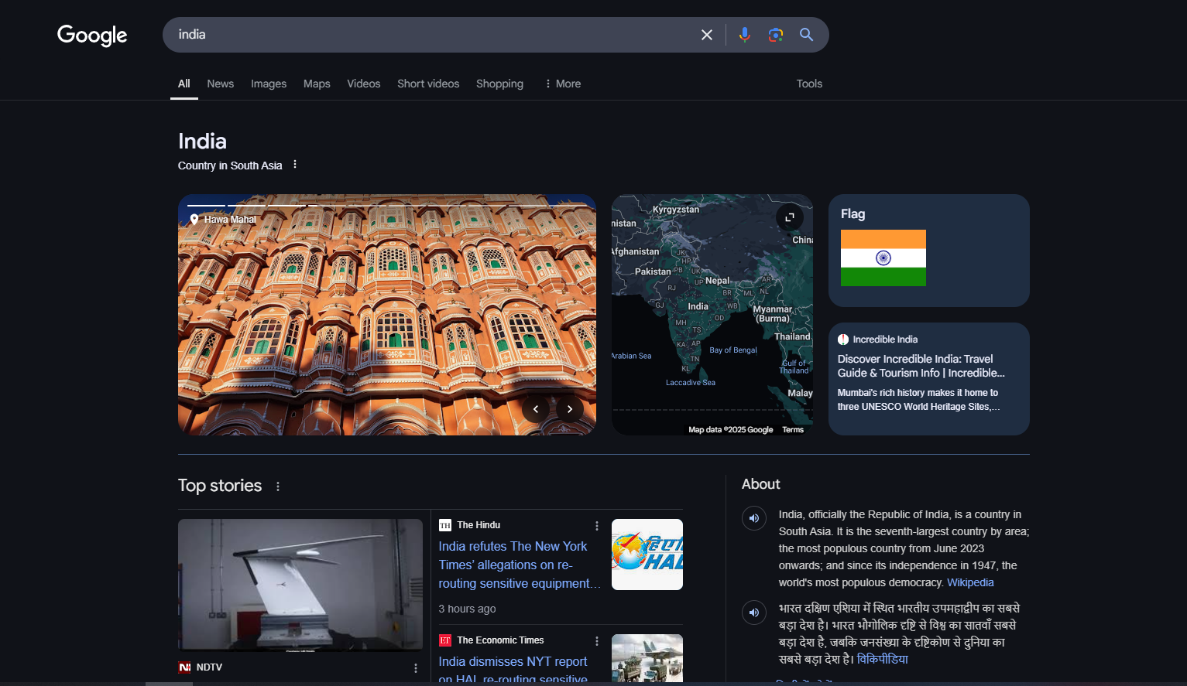
Why Web Scraping
📝 "Imagine you need the prices of 500 laptops from Amazon. Will you copy-paste them manually?"
3 Common Methods:
1️⃣ Manual Collection 📝 (Slow & tiring)
Example: Copying product prices from Amazon manually
2️⃣ APIs 🔗 (Limited access, but structured)
Example: Twitter API for tweet analysis
3️⃣ Web Scraping 🌐 (Fast & scalable)
Example: Collecting news headlines automatically
The Internet = A Goldmine of Data

Slide 6
Applications of Web Scraping
🛒 1. Price Monitoring: Track prices from websites like Amazon or Flipkart
🔍 Use Case: Compare prices, monitor competitors, get price-drop alerts
📰 2. News Aggregation: Collect latest headlines and summaries from news portals
🗞️ Use Case: Build a personalized news dashboard or newsletter
💼 3. Job Listings & Resume Extraction: Scrape job details from LinkedIn, Indeed, etc.
🔧 Use Case: Job search engines, alerts, or resume screening tools
🎓 4. Academic Research / ML Datasets: Gather large-scale data for analysis or model training
📊 Use Case: Create custom datasets for NLP, sentiment analysis, etc.
📈 5. Financial Market Data: Fetch stock prices, crypto rates, or economic indicators
💹 Use Case: Build investment dashboards, alerts, or prediction models
🏠 6. Real Estate Listings: Scrape housing data from property websites
📍 Use Case: Compare listings, track rent trends, or build a listing aggregator

Slide 7
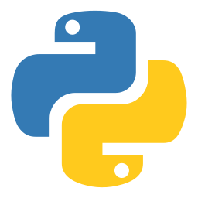






Choose Your Scraping Style
🐍 Python
• Scrapy — Fast & scalable
• BeautifulSoup — Easy HTML/XML parsing
• Selenium — Handles dynamic sites
• Requests + lxml — Lightweight, for basics
💻 JavaScript / Node.js
• Puppeteer — Headless Chrome automation
• Playwright — Cross-browser scraping
• Cheerio — jQuery-style HTML parsing
📊 R
• rvest — Tidy scraping for data analysis
• RSelenium — Dynamic site support
☕ Java
• Jsoup — Simple and powerful HTML parser
🧩 Web-Based / No-Code
• Octoparse — Drag-and-drop scraper
• ParseHub — Visual scraper tool
• Apify — Cloud-based scraping platform

Slide 8
Scrapy

Slide 9
Scrapy
What is Scrapy?
Scrapy is a fast and powerful Python framework for web scraping. It helps extract data from websites efficiently and automatically.
Why use Scrapy?
✅ Faster than manual scraping
✅ Handles large websites easily
✅ Smart crawler (follows links automatically)
Where is Scrapy used?
📊 Price comparison websites
📰 News aggregation
📈 AI & ML data collection

Slide 10
Creating Virtual Enviroment
📌 Step 1: Create a Virtual Environment (Recommended)
python -m venv scrapy_env
📌 Step 2: Activate the Virtual Environment
🟢 Windows:
scrapy_env\Scripts\activate
🟢 Mac/Linux:
source scrapy_env/bin/activate

Slide 11
Installing Scrapy
📌 Checking Installation (Python)
python --version
📌 Checking Installation (PIP)
pip --version
📌 Installing Scrapy
pip install scrapy
📌 Checking Installation (Scrapy)
scrapy version

Slide 12
Starting Scrapy Project
📌 Step 1: Create a New Scrapy Project
scrapy startproject quotes_scraper
📌 Step 2: Move Inside the Project Directory
cd my_scraper
📌 Step 3: Check the Project Structure
🟢 Windows:
dir my_scraper
🟢 Mac/Linux:
tree my_scraper

Slide 13
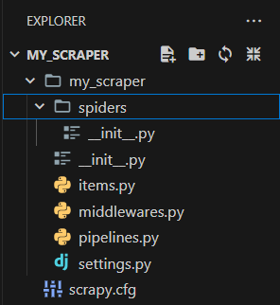
Folder Structure
📂 my_scraper/
│── 📄 scrapy.cfg (Project settings file)
│
├── 📂 my_scraper/ (Main module)
│ │── 📄 __init__.py (Marks this as a package)
│ │── 📄 items.py (Defines data structure)
│ │── 📄 middlewares.py (Custom middlewares for requests)
│ │── 📄 pipelines.py (Processes scraped data)
│ │── 📄 settings.py (Project-wide configurations)
│
├── 📂 spiders/ (Contains the actual web crawlers)
│ │── 📄 __init__.py (Marks this as a package)
│ │── 📄 example_spider.py (Your first spider!)

Slide 14
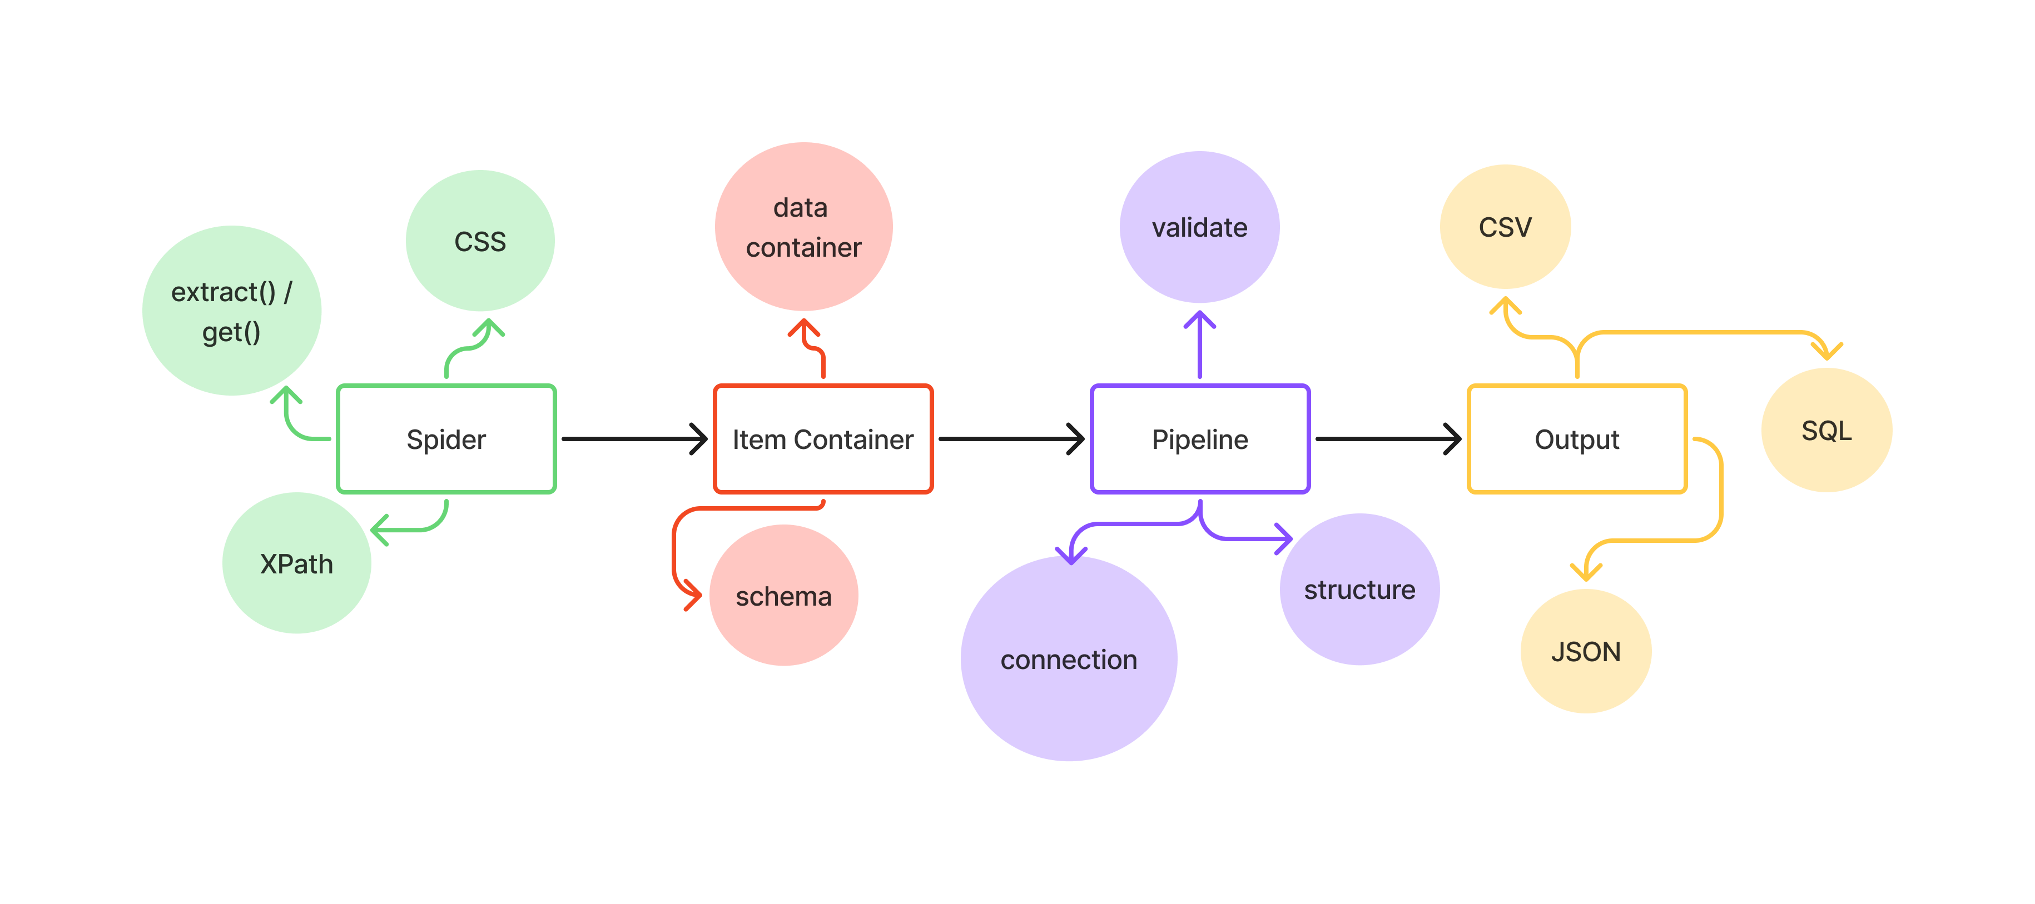
Scrapy Workflow

Slide 15
Spiders

Slide 16
Creating our First Spider (Web Crawler)
scrapy genspider <spider_name> <website_url>
📌 Create a Python file 🐍 > Inside 📂 /spiders/ folder > Name it 📝 spider_name.py
import scrapy # Importing Scrapy framework
class QuotesSpider(scrapy.Spider):
name = 'quotes' # Unique name for the spider
start_urls = ['https://quotes.toscrape.com/'] # The website URL to scrape
def parse(self, response):
# Extracting the title of the webpage
title = response.css('title::text').extract()
# Yielding the extracted data in dictionary format
yield {'title': title}
📌 Running the Spider
scrapy crawl <spider_name>

Slide 17
Selectors
📌 Why do we need selectors?
Scrapy extracts data from web pages, but we need a way to target specific elements (like titles, prices, or links).
Selectors help us find and extract the right data from HTML.
📌 Types of Selectors in Scrapy:
1️⃣ CSS Selectors – Simple, readable, and similar to how CSS styles elements.
2️⃣ XPath Selectors – More powerful and works like a pathfinder through HTML.
Feature | CSS Selectors 🎨 | XPath Selectors 🛤️
Syntax | tag.class / #id | tag[@attribute="value"]
Readability | ✅ Simple & Clean | ❌ Complex & Lengthy
Performance | ✅ Faster ⚡ | ❌ Slower 🐢
Functionality | ❌ Limited | ✅ More Powerful (can navigate backward)

Slide 18
Example
📌 CSS Selector
response.css('div.s-title-instructions-style span::text').extract()
📌 CSS Selector
response.css('a.tag::text').extract()
📌 Xpath Selector
response.xpath("//div[@class=‘title’]/text()").get()
📌 Xpath Selector
response.xpath("//div[@class='s-title-instructions-style']//span/text()").get()

Slide 19
Item & Pipeline

Slide 20
Item Container
📦 A structured way to define and store the scraped data. The main goal in scraping is to extract structured data from unstructured sources, typically, web pages. Spiders may return the extracted data as items, Python objects that define key-value pairs.
🧩 Used For:
Defining the fields you want to extract
Acting as a temporary holder for data (like a blueprint for your data fields)
Passing clean, structured data to pipelines
import scrapy
class QuotetutorialItem(scrapy.Item):
# define the fields for your item here like:
title = scrapy.Field()
author = scrapy.Field()
tags = scrapy.Field()

Slide 21
Pipeline
🔄 What is a Pipeline?
A Pipeline is a series of processing steps that are applied to every item scraped by the spider.
It handles cleaning, validation, transformation, and storage of data.
⚙️ Common Tasks in Pipelines:
✅ Data Cleaning
✅ Removing duplicates
✅ Field formatting (e.g., dates, prices)
✅ Saving to databases like MySQL, MongoDB
✅ Exporting to CSV, JSON, etc.
class MyPipeline:
def process_item(self, item, spider):
# process and return item
return item

Slide 22
Output
After scraping, we need to save the extracted data in a structured format for analysis or use in other applications. Scrapy allows exporting in multiple formats using the -o option
Format | File Extension | Example Command
JSON | .json | scrapy crawl my_spider -o output.json
CSV | .csv | scrapy crawl my_spider -o output.csv
XML | .xml | scrapy crawl my_spider -o output.xml
DB | SQL, MongoDB, etc. | Using pipeline

Slide 23
Pagination
🔁 What is Pagination?
Pagination refers to breaking content into multiple pages (like page 1, 2, 3...).
🔍 Why Handle It?
To scrape all data — not just what’s visible on the first page.
⚙️ Common Methods:
URL Manipulation: e.g., ?page=1, ?page=2
Next Button Clicks: Use response.follow() or simulate button actions
Infinite Scrolling: Requires tools like Selenium for JavaScript loading
📌 Scrapy Tip:
Use yield response.follow(next_page_url, callback=self.parse) to move across pages.

Slide 24



Drive Link
aneem3sh
m3cj

Slide 25
"Though a dwarf upon the summit of a mount he be, yet a dwarf remaineth he;
And though a god in the deep dark well dost dwell, still divine is he."
~ William Sher

Slide 26
The End

