Slide 1
Distroless Containers: Less OS, Less Risk
OWASP Tampa Chapter
Practical container hardening with distroless, Wolfi, and Chainguard
Notes:
Speaker Notes:
- Keep pacing fast.
- Avoid over-explaining container basics.
- Emphasize operational tradeoffs and security outcomes.
- Refer audience to GitHub repository for full examples.

Slide 2
Who Am I?
Mello Bkirouac
Information Security Architect at Cisco
35 years in security architecture
OWASP Tampa member
Biker, Floridian, container security nerd
Additional implementation details, Dockerfiles, scripts, and speaker notes will be available in the GitHub repository.

Slide 3
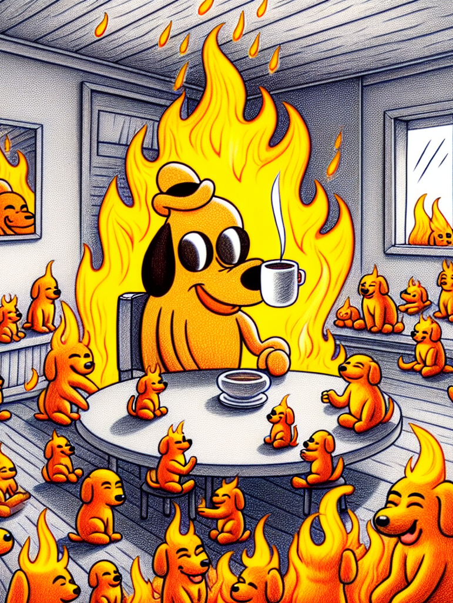
What Attackers Want Inside Containers
/bin/sh or bash
curl/wget
Package managers
Interpreters and debugging utilities
Notes:
Speaker Notes:
- Keep pacing fast.
- Avoid over-explaining container basics.
- Emphasize operational tradeoffs and security outcomes.
- Refer audience to GitHub repository for full examples.

Slide 4
Demo: Command Injection
01-demo-debian (debian:12, shell present)
Build and run:
docker build -f Dockerfile -t 01-demo-debian ..
docker run -d --name 01-demo-debian -p 5001:5000 01-demo-debian
Normal request:
curl "http://localhost:5001/ping?host=8.8.8.8"
{ "returncode": 0, "stdout": "... 2 packets transmitted ..." }
Exploit:
curl "http://localhost:5001/ping?host=8.8.8.8%3B+id"
{ "stdout": "PING 8.8.8.8 ...\nuid=10001(appuser) gid=10001(appuser)" }
Shell access:
docker exec -it 01-demo-debian /bin/bash

Slide 5
Why Are We Shipping Entire Operating Systems?
Modern containers often include shells, package managers, editors, and debugging tools.
Many workloads only need an application binary and runtime.
More software means more attack surface and more CVEs.
The consequences
Extra packages increase operational exposure.
Attackers benefit from built-in tooling.
Vulnerability scanners produce more noise with larger images.
Additional implementation details, Dockerfiles, scripts, and speaker notes will be available in the GitHub repository.
Notes:
Speaker Notes:
- Keep pacing fast.
- Avoid over-explaining container basics.
- Emphasize operational tradeoffs and security outcomes.
- Refer audience to GitHub repository for full examples.

Slide 6
Traditional Base Image Comparison
Ubuntu/Debian/UBI: large, convenient, broad attack surface
Debian-slim/UBI-Minimal: smaller but still includes tooling
Alpine: lightweight but still a full distro
Distroless: runtime-focused
Scratch: nearly empty
Additional implementation details, Dockerfiles, scripts, and speaker notes will be available in the GitHub repository.
Notes:
Speaker Notes:
- Keep pacing fast.
- Avoid over-explaining container basics.
- Emphasize operational tradeoffs and security outcomes.
- Refer audience to GitHub repository for full examples.

Slide 7
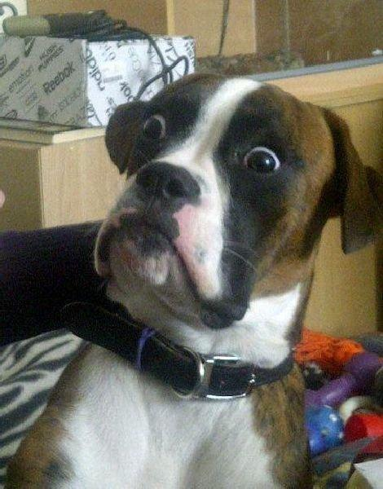
Demo: Enumerating Packages
Standard images contain tooling unrelated to runtime execution.
Even minimal images still contain tooling unrelated to runtime execution.
Operational convenience often increases exposure.
docker run --rm 01-demo-debian dpkg -l | wc -l
Demo Image | dpkg -l / apk list / rpm -qa | wc -l
Full Images
01-demo-debian (debian:12) | 248
02-demo-alpine (alpine:3.20) | 45
03-demo-ubi (ubi9/ubi:latest) | 190
Minimal Images
04-demo-debian-slim (debian:12-slim) — slim strips docs/locales, same package count | 248
05-demo-ubi-minimal (ubi9/ubi-minimal:latest) | 119
Additional implementation details, Dockerfiles, scripts, and speaker notes will be available in the GitHub repository.
Notes:
Speaker Notes:
- Keep pacing fast.
- Avoid over-explaining container basics.
- Emphasize operational tradeoffs and security outcomes.
- Refer audience to GitHub repository for full examples.

Slide 8
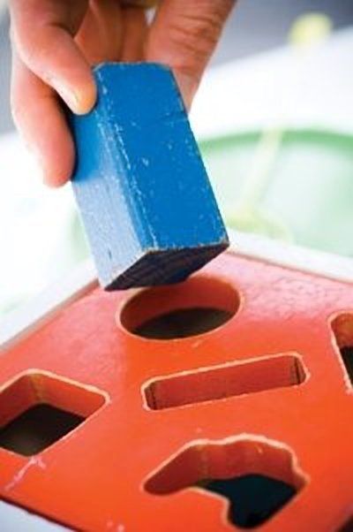
Why Existing Linux Distributions Struggle in Containers
Traditional Linux distros were designed for servers and VMs.
Containers are immutable and single-purpose.
Package managers and shells are often unnecessary at runtime.
Additional implementation details, Dockerfiles, scripts, and speaker notes will be available in the GitHub repository.
Notes:
Speaker Notes:
- Keep pacing fast.
- Avoid over-explaining container basics.
- Emphasize operational tradeoffs and security outcomes.
- Refer audience to GitHub repository for full examples.

Slide 9

Distroless Containers Explained
Runtime-only philosophy
No shell
No package manager
Reduce attacker convenience
Additional implementation details, Dockerfiles, scripts, and speaker notes will be available in the GitHub repository.
Notes:
Speaker Notes:
- Keep pacing fast.
- Avoid over-explaining container basics.
- Emphasize operational tradeoffs and security outcomes.
- Refer audience to GitHub repository for full examples.

Slide 10
Scratch Images and Static Binaries
Extremely small attack surface.
“FROM scratch" creates nearly empty images.
Need create /etc/passwd and then copy over for user mapping
Static binaries are easy.
Dynamic binaries require a lot more work.
Missing libc/glibc
Missing runtime loaders
Shared library dependencies are absent
Additional implementation details, Dockerfiles, scripts, and speaker notes will be available in the GitHub repository.
Notes:
Speaker Notes:
- Keep pacing fast.
- Avoid over-explaining container basics.
- Emphasize operational tradeoffs and security outcomes.
- Refer audience to GitHub repository for full examples.

Slide 11
Demo: Static with Go App
06-demo-scratch-go -- CGO_ENABLED=0, single static binary, FROM scratch
Build and run:
docker build -f Dockerfile -t 06-demo-scratch-go .
docker run -d --name 06-demo-scratch-go -p 5006:5000 06-demo-scratch-go
Normal request:
curl "http://localhost:5006/ping?host=8.8.8.8"
{ "error": "fork/exec /bin/sh: no such file or directory" }
Exploit attempt:
curl "http://localhost:5006/ping?host=8.8.8.8%3B+id"
{ "error": "fork/exec /bin/sh: no such file or directory" }
Shell exec:
docker exec 06-demo-scratch-go /bin/sh
OCI error: /bin/sh: no such file or directory
Image size: 6.88 MB
Additional implementation details, Dockerfiles, scripts, and speaker notes will be available in the GitHub repository.
Notes:
Speaker Notes:
- Keep pacing fast.
- Avoid over-explaining container basics.
- Emphasize operational tradeoffs and security outcomes.
- Refer audience to GitHub repository for full examples.

Slide 12
Demo: Scratch with Python App
07-demo-scratch-python -- Python Flask app, Alpine builder, FROM scratch
Build and run:
docker build -f Dockerfile -t 07-demo-scratch-python ..
docker run -d --name 07-demo-scratch-python -p 5007:5000 07-demo-scratch-python
Normal request:
curl "http://localhost:5007/ping?host=8.8.8.8"
HTTP 500 -- subprocess(shell=True) needs /bin/sh, which does not exist
Exploit attempt:
curl "http://localhost:5007/ping?host=8.8.8.8%3B+id"
HTTP 500 -- /bin/sh missing, exploit never executes
Shell exec:
docker exec 07-demo-scratch-python /bin/sh
OCI error: /bin/sh: no such file or directory
Image size: 112 MB
Additional implementation details, Dockerfiles, scripts, and speaker notes will be available in the GitHub repository.
Notes:
Speaker Notes:
- Keep pacing fast.
- Avoid over-explaining container basics.
- Emphasize operational tradeoffs and security outcomes.
- Refer audience to GitHub repository for full examples.

Slide 13
Distroless as the Practical Middle Ground
Scratch is secure but operationally painful.
Traditional distros are convenient but bloated.
Distroless balances minimalism and usability.
Additional implementation details, Dockerfiles, scripts, and speaker notes will be available in the GitHub repository.
Notes:
Speaker Notes:
- Keep pacing fast.
- Avoid over-explaining container basics.
- Emphasize operational tradeoffs and security outcomes.
- Refer audience to GitHub repository for full examples.

Slide 14
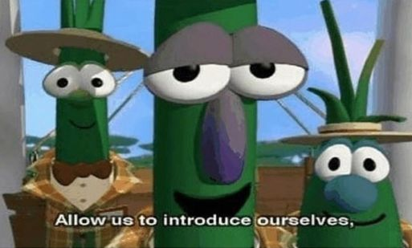
Introducing Chainguard Images
Wolfi foundation
Distroless but friendly runtimes
Signed artifacts
Continuously rebuilt images
Additional implementation details, Dockerfiles, scripts, and speaker notes will be available in the GitHub repository.
Notes:
Speaker Notes:
- Keep pacing fast.
- Avoid over-explaining container basics.
- Emphasize operational tradeoffs and security outcomes.
- Refer audience to GitHub repository for full examples.

Slide 15
Continuous Rebuilds and Supply Chain Visibility
Chainguard images are rebuilt daily from source.
SBOMs and signed provenance improve visibility.
Reduce vulnerability drift over time.
Additional implementation details, Dockerfiles, scripts, and speaker notes will be available in the GitHub repository.
Notes:
Speaker Notes:
- Keep pacing fast.
- Avoid over-explaining container basics.
- Emphasize operational tradeoffs and security outcomes.
- Refer audience to GitHub repository for full examples.

Slide 16
What Is Wolfi and Why?
Container-focused userspace created by Chainguard.
Not a traditional Linux distribution.
Designed for secure cloud-native supply chains.
Reduce CVE noise
Enable rapid rebuilds
Granular packaging
Improve provenance and SBOM generation
Additional implementation details, Dockerfiles, scripts, and speaker notes will be available in the GitHub repository.
Notes:
Speaker Notes:
- Keep pacing fast.
- Avoid over-explaining container basics.
- Emphasize operational tradeoffs and security outcomes.
- Refer audience to GitHub repository for full examples.

Slide 17
Chainguard Runtime Examples
08-demo-chainguard-python (cgr.dev/chainguard/python:latest)
No shell -- subprocess(shell=True) fails with HTTP 500
09-demo-chainguard-java (cgr.dev/chainguard/jre:latest)
No shell -- Runtime.exec("/bin/sh") returns error in JSON
10-demo-chainguard-node (cgr.dev/chainguard/node:latest)
/bin/sh IS present (busybox -- npm requires it) -- exploit WORKS
Chainguard does not mean no-shell. Runtime requirements drive content.
11-demo-chainguard-go (cgr.dev/chainguard/static:latest)
No shell -- exec.Command("/bin/sh") fails
All images run as uid=65532 (nonroot)
Additional implementation details, Dockerfiles, scripts, and speaker notes will be available in the GitHub repository.
Notes:
Speaker Notes:
- Keep pacing fast.
- Avoid over-explaining container basics.
- Emphasize operational tradeoffs and security outcomes.
- Refer audience to GitHub repository for full examples.

Slide 18
FIPS Compliance and Containers
FIPS 140-2 / 140-3 cryptographic module validation
Important for regulated environments
Containers complicate crypto validation
Custom OpenSSL builds
Runtime validation complexity
Operational overhead and patching pain
Additional implementation details, Dockerfiles, scripts, and speaker notes will be available in the GitHub repository.
Notes:
Speaker Notes:
- Keep pacing fast.
- Avoid over-explaining container basics.
- Emphasize operational tradeoffs and security outcomes.
- Refer audience to GitHub repository for full examples.

Slide 19
Chainguard FIPS Images
12-demo-chainguard-fips-python (python-fips-appd-3.13)
No shell -- subprocess(shell=True) fails with HTTP 500
13-demo-chainguard-fips-java (jre-fips-appd-openjdk-17, BouncyCastle FIPS)
No shell -- Runtime.exec("/bin/sh") returns error in JSON
14-demo-chainguard-fips-node (node-fips-appd-24-slim)
No shell -- exec() returns ENOENT (contrast: non-FIPS node has busybox)
15-demo-chainguard-fips-go (glibc-openssl-fips, systemcrypto + requirefips)
No shell -- exec.Command("/bin/sh") returns ENOENT
All images run as uid=65532 (nonroot)
Additional implementation details, Dockerfiles, scripts, and speaker notes will be available in the GitHub repository.
Notes:
Speaker Notes:
- Keep pacing fast.
- Avoid over-explaining container basics.
- Emphasize operational tradeoffs and security outcomes.
- Refer audience to GitHub repository for full examples.

Slide 20
FIPS Caveats and Compliance Reality
FIPS-capable images do not automatically make deployments compliant.
Runtime controls and governance still matter.
Additional implementation details, Dockerfiles, scripts, and speaker notes will be available in the GitHub repository.
Notes:
Speaker Notes:
- Keep pacing fast.
- Avoid over-explaining container basics.
- Emphasize operational tradeoffs and security outcomes.
- Refer audience to GitHub repository for full examples.

Slide 21
Demo: Chainguard Package Counts
Demo | Base Image | Packages
01-demo-debian | debian:12 | 248
02-demo-alpine | alpine:3.20 | 45
03-demo-ubi | ubi9/ubi:latest | 190
04-demo-debian-slim | debian:12-slim | 248
05-demo-ubi-minimal | ubi9/ubi-minimal:latest | 119
06-demo-scratch-go | scratch | 0
07-demo-scratch-python | scratch (Alpine builder) | 0
08-demo-chainguard-python | cgr.dev/chainguard/python | 25
09-demo-chainguard-java | cgr.dev/chainguard/jre | 37
10-demo-chainguard-node | cgr.dev/chainguard/node | 27
11-demo-chainguard-go | cgr.dev/chainguard/static | 3
12-demo-chainguard-fips-python | chainguard python-fips-3.13 | 30
13-demo-chainguard-fips-java | chainguard jre-fips-openjdk-17 | 57
14-demo-chainguard-fips-node | chainguard node-fips-24-slim | 28
15-demo-chainguard-fips-go | chainguard glibc-openssl-fips | 16
docker export $(docker create <image>) | tar -xO usr/lib/apk/db/installed | grep "^P:" | wc -l
Additional implementation details, Dockerfiles, scripts, and speaker notes will be available in the GitHub repository.

Slide 22
Vulnerability Scanner Comparison Demo
Ran both scanners against all 15 demo images. Results on following slides.
Trivy:
trivy image 01-demo-debian
trivy image --severity HIGH,CRITICAL 01-demo-debian
trivy image --format table 01-demo-debian
Docker Scout:
docker scout cves local://01-demo-debian
docker scout cves --only-severity critical,high local://01-demo-debian
docker scout recommendations local://01-demo-debian
Additional implementation details, Dockerfiles, scripts, and speaker notes will be available in the GitHub repository.
Notes:
Speaker Notes:
- Keep pacing fast.
- Avoid over-explaining container basics.
- Emphasize operational tradeoffs and security outcomes.
- Refer audience to GitHub repository for full examples.

Slide 23
Trivy Vulnerability Scan Results
Demo | CRIT | HIGH | MED | LOW | TOTAL
01-demo-debian | 21 | 204 | 992 | 774 | 1991
02-demo-alpine | 0 | 0 | 0 | 1 | 1
03-demo-ubi | 0 | 2 | 134 | 228 | 364
04-demo-debian-slim | 21 | 204 | 992 | 774 | 1991
05-demo-ubi-minimal | 0 | 0 | 118 | 71 | 189
06-demo-scratch-go | 1 | 14 | 23 | 2 | 40
07-demo-scratch-python | 0 | 1 | 3 | 2 | 6
08-demo-chainguard-python | 0 | 0 | 0 | 1 | 1
09-demo-chainguard-java | 0 | 0 | 0 | 0 | 0
10-demo-chainguard-node | 0 | 0 | 0 | 0 | 0
11-demo-chainguard-go | 0 | 0 | 0 | 0 | 0
12-demo-chainguard-fips-python | 0 | 0 | 0 | 1 | 1
13-demo-chainguard-fips-java | 0 | 0 | 0 | 0 | 0
14-demo-chainguard-fips-node | 0 | 0 | 0 | 0 | 0
15-demo-chainguard-fips-go | 0 | 0 | 0 | 0 | 0
Scans were done on 2026-06-04
Additional implementation details, Dockerfiles, scripts, and speaker notes will be available in the GitHub repository.

Slide 24
Docker Scout Vulnerability Scan Results
Demo | CRIT | HIGH | MED | LOW | TOTAL
01-demo-debian | 19 | 16 | 140 | 4 | 179
02-demo-alpine | 2 | 7 | 2 | 0 | 11
03-demo-ubi | 26 | 37 | 12 | 1 | 76
04-demo-debian-slim | 19 | 16 | 140 | 4 | 179
05-demo-ubi-minimal | 17 | 22 | 5 | 0 | 44
06-demo-scratch-go | 18 | 21 | 2 | 1 | 42
07-demo-scratch-python | 1 | 3 | 2 | 0 | 6
08-demo-chainguard-python | 0 | 0 | 1 | 0 | 1
09-demo-chainguard-java | 0 | 0 | 0 | 0 | 0
10-demo-chainguard-node | 0 | 0 | 0 | 0 | 0
11-demo-chainguard-go | 0 | 0 | 0 | 0 | 0
12-demo-chainguard-fips-python | 0 | 0 | 1 | 0 | 1
13-demo-chainguard-fips-java | 0 | 2 | 0 | 0 | 2
14-demo-chainguard-fips-node | 0 | 0 | 0 | 0 | 0
15-demo-chainguard-fips-go | 1 | 1 | 0 | 1 | 3
Scans were done on 2026-06-04
Additional implementation details, Dockerfiles, scripts, and speaker notes will be available in the GitHub repository.

Slide 25
Chainguard Images: Docker Scout CVE Detail
Demo | CVE | Package | Severity | Published | Fixed In
08 + 12 (Python) | CVE-2026-27205 | flask 3.1.1 | LOW | 2026-02-21 | 3.1.3
13 (FIPS Java) | CVE-2025-12194 | bc-fips 2.1.1 | MEDIUM | 2025-10-24 | 2.1.2
13 (FIPS Java) | CVE-2026-8149 | bc-fips 2.1.1 | MEDIUM | 2026-05-08 | not fixed
15 (FIPS Go) | CVE-2026-42504 | go stdlib 1.26.3 | HIGH | 2026-06-02 | go 1.26.4
15 (FIPS Go) | CVE-2026-42507 | go stdlib 1.26.3 | MEDIUM | 2026-06-02 | go 1.26.4
15 (FIPS Go) | CVE-2026-27145 | go stdlib 1.26.3 | UNSPEC | 2026-06-02 | go 1.26.4
Scans were done on 2026-06-04
Additional implementation details, Dockerfiles, scripts, and speaker notes will be available in the GitHub repository.

Slide 26
Distroless Is Not a Silver Bullet
Security:
Does not prevent compromise
Does not eliminate vulnerabilities
Should be part of defense in depth
Operational Tradeoffs:
Harder debugging
Different troubleshooting workflows
Compatibility edge cases
Additional implementation details, Dockerfiles, scripts, and speaker notes will be available in the GitHub repository.
Notes:
Speaker Notes:
- Keep pacing fast.
- Avoid over-explaining container basics.
- Emphasize operational tradeoffs and security outcomes.
- Refer audience to GitHub repository for full examples.

Slide 27
Debugging Distroless Containers
kubectl debug
Ephemeral containers
Separate debug images
Additional implementation details, Dockerfiles, scripts, and speaker notes will be available in the GitHub repository.
Notes:
Speaker Notes:
- Keep pacing fast.
- Avoid over-explaining container basics.
- Emphasize operational tradeoffs and security outcomes.
- Refer audience to GitHub repository for full examples.

Slide 28
When You Actually Need a Shell
Valid operational cases exist.
Use dedicated debug images rather than bloating production runtimes.
Additional implementation details, Dockerfiles, scripts, and speaker notes will be available in the GitHub repository.
Notes:
Speaker Notes:
- Keep pacing fast.
- Avoid over-explaining container basics.
- Emphasize operational tradeoffs and security outcomes.
- Refer audience to GitHub repository for full examples.

Slide 29
Container Hardening Beyond Distroless
Run as non-root
Read-only filesystems
Drop capabilities
Use seccomp/AppArmor
Additional implementation details, Dockerfiles, scripts, and speaker notes will be available in the GitHub repository.
Notes:
Speaker Notes:
- Keep pacing fast.
- Avoid over-explaining container basics.
- Emphasize operational tradeoffs and security outcomes.
- Refer audience to GitHub repository for full examples.

Slide 30
Recommended Architecture Patterns
Multi-stage builds
Minimal runtime images
Signed images
CI/CD scanning and SBOM generation
Additional implementation details, Dockerfiles, scripts, and speaker notes will be available in the GitHub repository.
Notes:
Speaker Notes:
- Keep pacing fast.
- Avoid over-explaining container basics.
- Emphasize operational tradeoffs and security outcomes.
- Refer audience to GitHub repository for full examples.

Slide 31
Demo Repository Walkthrough
Dockerfiles
Scanning scripts
Runtime examples
Speaker notes and implementation details
Additional implementation details, Dockerfiles, scripts, and speaker notes will be available in the GitHub repository.
Notes:
Speaker Notes:
- Keep pacing fast.
- Avoid over-explaining container basics.
- Emphasize operational tradeoffs and security outcomes.
- Refer audience to GitHub repository for full examples.

Slide 32
Key Takeaways
Distroless reduces runtime attack surface.
Wolfi modernizes container packaging.
Chainguard improves supply chain visibility and operational security.
Security is risk reduction, not magic.
Additional implementation details, Dockerfiles, scripts, and speaker notes will be available in the GitHub repository.
Notes:
Speaker Notes:
- Keep pacing fast.
- Avoid over-explaining container basics.
- Emphasize operational tradeoffs and security outcomes.
- Refer audience to GitHub repository for full examples.

Slide 33
Questions
GitHub repository and examples available after the talk.
Additional implementation details, Dockerfiles, scripts, and speaker notes will be available in the GitHub repository.
Notes:
Speaker Notes:
- Keep pacing fast.
- Avoid over-explaining container basics.
- Emphasize operational tradeoffs and security outcomes.
- Refer audience to GitHub repository for full examples.

