Slide 1

CS 301 PROJECT PRESENTATION Partition into Cliques
Group No: 30
Enver Atahan Çelik
Mehmet Enes Battal
Taylan Karadeniz
Muhammed Batuhan Odabaşı
Problem Question: What is the minimum number k such that the nodes of G be partitioned into t<=k disjoint sets - V1,...,Vt - in such a way that for each Vi (1<=i<=t), the subgraph Gi(Vi,Ei) induced by Vi is a clique, i.e. a graph in which every pair of nodes is connected by an edge?

Slide 2
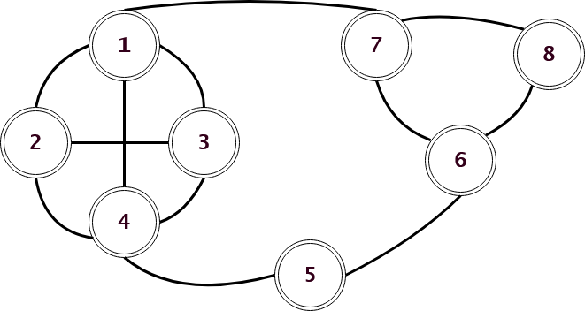
PROBLEM DESCRIPTION
- A clique is a special subset of vertices in an undirected graph such that any two vertices in the clique are adjacent.
- Minimum Clique Partition is to find the minimum number for an undirected graph G = (V, E) such that V can be partitioned into minimum number of cliques. Such minimum number for an undirected graph G is also called the clique cover number of G.
- Examples for Minimum Clique Cover:

Slide 3
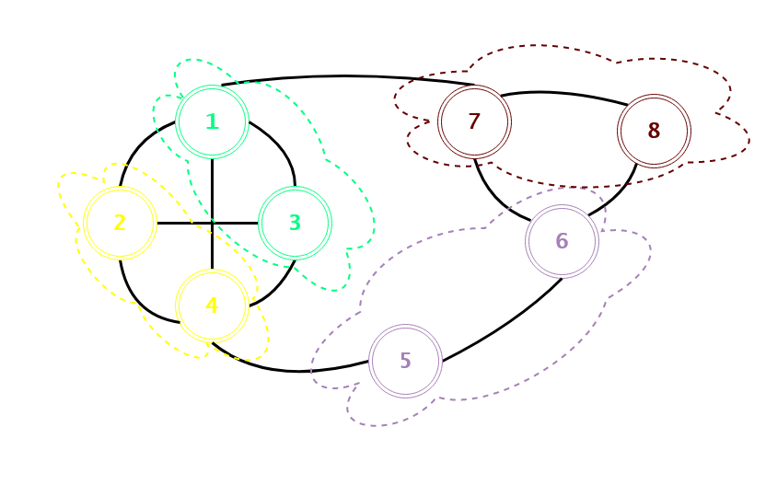
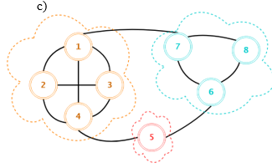
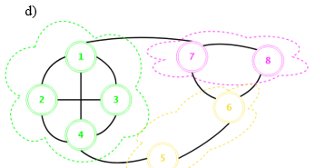
Consider the above partition; vertices of G partition into 4 subsets in G. For every subset, any vertex in the set has edges to any other vertex in the set, hence the partition above is a clique cover of G.
The partitions in c) and d) are clique covers that both partitions V into 3 cliques.
Since the graph G can be partitioned into 3 cliques at minimum, both of these partitions are minimum clique
partitions with a clique cover number of 3.

Slide 4
- Another way to solve the mimium clique partition problems is considering the vertex coloring in the complement graph G’ by using a minimum number of colors.
- Consider a clique C in G. In the complement graph G’, all vertices in C are isolated from each other since all edges between them are erased. Therefore one can colour these vertices to the same color, since none of them are adjacent.
- Similarly consider two disjoint cliques in G, C1 and C2, i.e. (C1 U C2) is not a clique. In the complement graph G’, as stated above, vertices of C1 are colored to same color, such as C2 because both of them are clique in G. In G’ there is surely and edge between C1 and C2 since their union is not a clique in G. Therefore vertices of C1 should be colored differently then C2. In other words. we have partitioned two cliques of G by coloring them in G’.
- Coloring G’ accordingly, counting the number of colors is exactly equivalent to minimum clique partition of G.

Slide 5
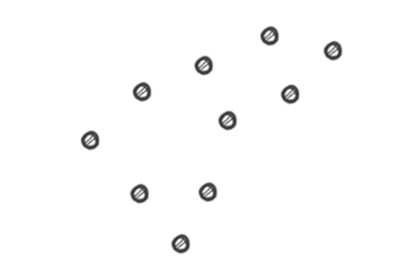
An Application
- For a party/organization/player, a unit is any extension of the party that is established by consuming the limited resource of the party, for example: a branch of a food chain.
- Potential sites for locating units are called demand points. Example demand points;

Slide 6
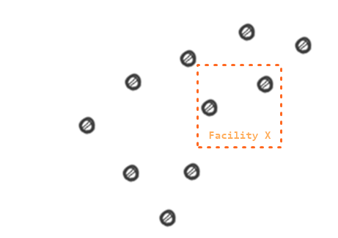
- A facility covers a demant point if it is positioned in a neighbourhood of the demant point.
- A Mandatory coverage problem is a problem to find the minimum number of facilities that cover all demand points.

Slide 7
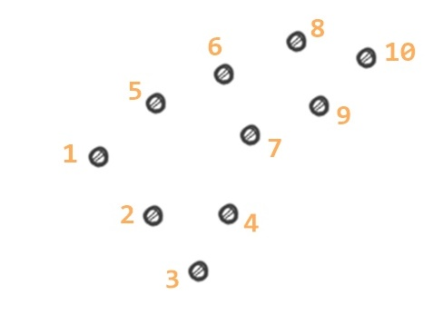
- Such a problem instance can be translated into a graph. Hence it is sufficient to solve the minimum clique partition in order to cover demand point with minimum number of facilities.
- First enumerate the demand points;

Slide 8
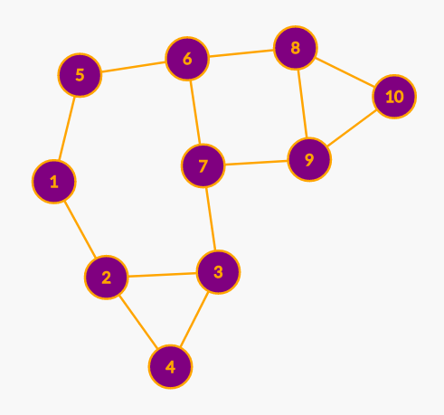
- Then construct the edges according to the neighbourhood definition, in our problem it corresponds to the distance between two demand points.
- Now we can solve the minimum clique partition problem to find minimum coverage of the demand points.

Slide 9
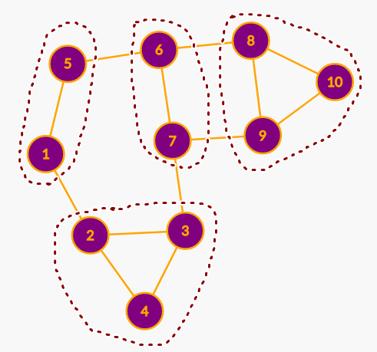
- Result of the minimum clique partition is below.
- A party can locate their facilities according to this partition in order to achieve mandatory coverage and therefore spending minimum resources.

Slide 10
Minimum Clique Partition is NP - Complete
Theorem: Minimum Clique Partition is NP Complete.
This can be proved by showing that the following are true:
Minimum Clique Partition is in NP.
NP Complete problem can be reduced to Minimum Clique Partition in polynomial time.

Slide 11
Minimum clique partition is in NP
A problem should have polynomial-time verifiability if it belongs to the NP class. According to a given certificate, we should be able to verify in polynomial time if it is a solution to the problem or not.
Proof:
1- Certificate: Suppose certificate is a set S consisting of nodes in the clique and S is a subgraph of G.
2- Verification: It should be checked that if there is a clique of size k in the graph. Therefore, It takes O(1) time verifying if the number of nodes in S equals k. It takes O(k^2) time to verify if each vertex has an out-degree of (k-1)(Since in a complete graph, each vertex is connected to every other vertex through an edge. Therefore the total number of edges in a complete graph = k*(k-1)/2 ). Hence, it takes O(k^2) = O(n^2) time to check if the graph formed by the k nodes in S is complete or not, (because of k <= n, where n is number of vertices in G).
Because this Clique Decision Problem has polynomial time verifiability it belongs to the NP Class.

Slide 12
Minimum clique partition can be reduced to an NP - Complete
If every NP problem is reducible to L in polynomial time then problem L belongs to NP-Hard. Now, let the Clique Decision Problem be referred to as C. For proving C is NP-Hard, we take an already known NP-Hard problem, say that is S, then reduce it to a specific instance. C is also an NP-Hard problem if this reduction can be done in polynomial time. The Boolean Satisfiability Problem (S) is an NP-Complete problem as proved by Cook's theorem. Hence, all problems in NP can be reduced to S in polynomial time. Therefore, if S is reducible to C in polynomial time, then every NP problem can be reduced to C in polynomial time, so proving C to be NP-Hard. ⁵

Slide 13
Algorithm Description
Minimum clique cover is NP-complete and because of it no algorithm has been found that can solve this problem optimally in polynomial time. However other approaches such as heuristic algorithms can be used to approximate an answer in polynomial time. The guarantee of the heuristic algorithm’s solution being optimal is not given. Keeping this in mind, A heuristic algorithm for minimum clique cover will be analyzed in this project.

Slide 14
Pseudo code for this algorithm is as follows:
Create an empty list called clique_list which will hold the cliques that have been found.
Create a copy of the input called graph.
While there are nodes in the graph:
Create an empty list called clique for a single clique.
Create a list consisting of remaining nodes in the graph.
Randomly shuffle this list.
For every node in this list:
Check if node is adjacent to every node in the clique list.
If it is, add to the clique list.
Remove the nodes that have been added into the clique list from the graph.
Append the found clique to clique_list.
Return the clique_list.
The minimum number of cliques can be found by getting the length of the returned clique_list. Since it actually returns the list of the cliques, the cliques that have been found by the algorithm can be seen as well.

Slide 15
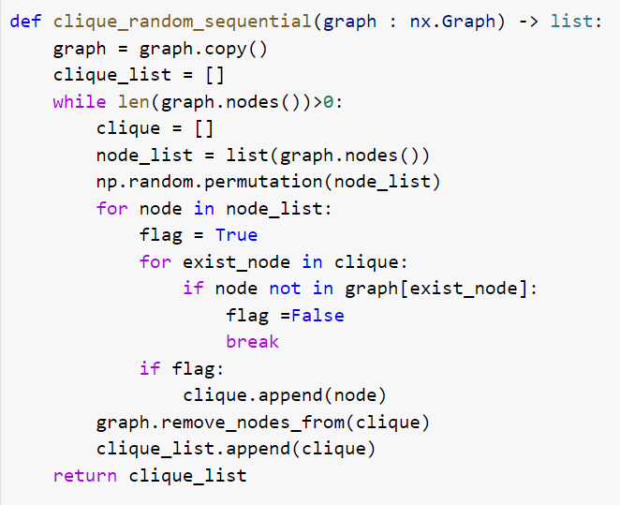
The following is the implementation of the mentioned algorithm using python.

Slide 16
Algorithm Analysis
- This heuristic algorithm finds the minimum clique cover of a given graph. This algorithm runs in O(V^2) and in this section, finding the running time will be explained.
- A graph has V vertices and E edges. Algorithm uses the vertices of a given graph to find the minimum clique cover.
- The while loop can iterate at most V times because for every iteration at least 1 vertex is removed from the graph decreasing the count of vertices. Similarly the outer for loop can iterate at most V times since a graph has V vertices. The inner for loop also can iterate at most V times since there are V vertices and a clique can consist of all of these vertices. Note that in this case there is only one clique which is all of the graph.

Slide 17
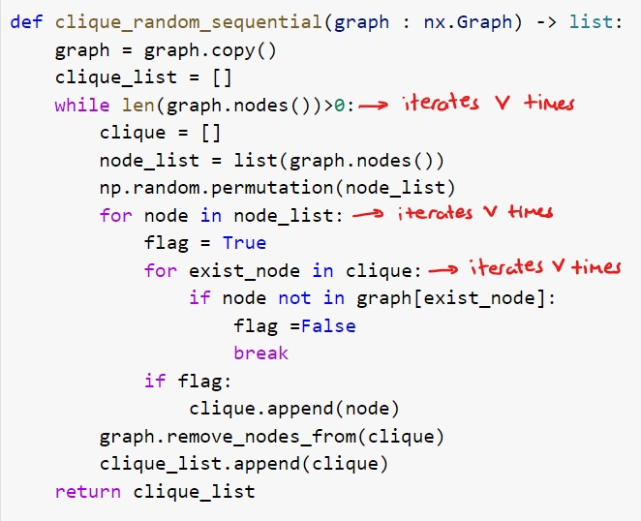
Suppose the following iteration times are valid:
So the running time is O(V^3) by multiplying these. But these iterations are not possible in reality. By assuming that these are possible, an upper bound for this algorithm is found but what if finding a tighter bound is possible?

Slide 18
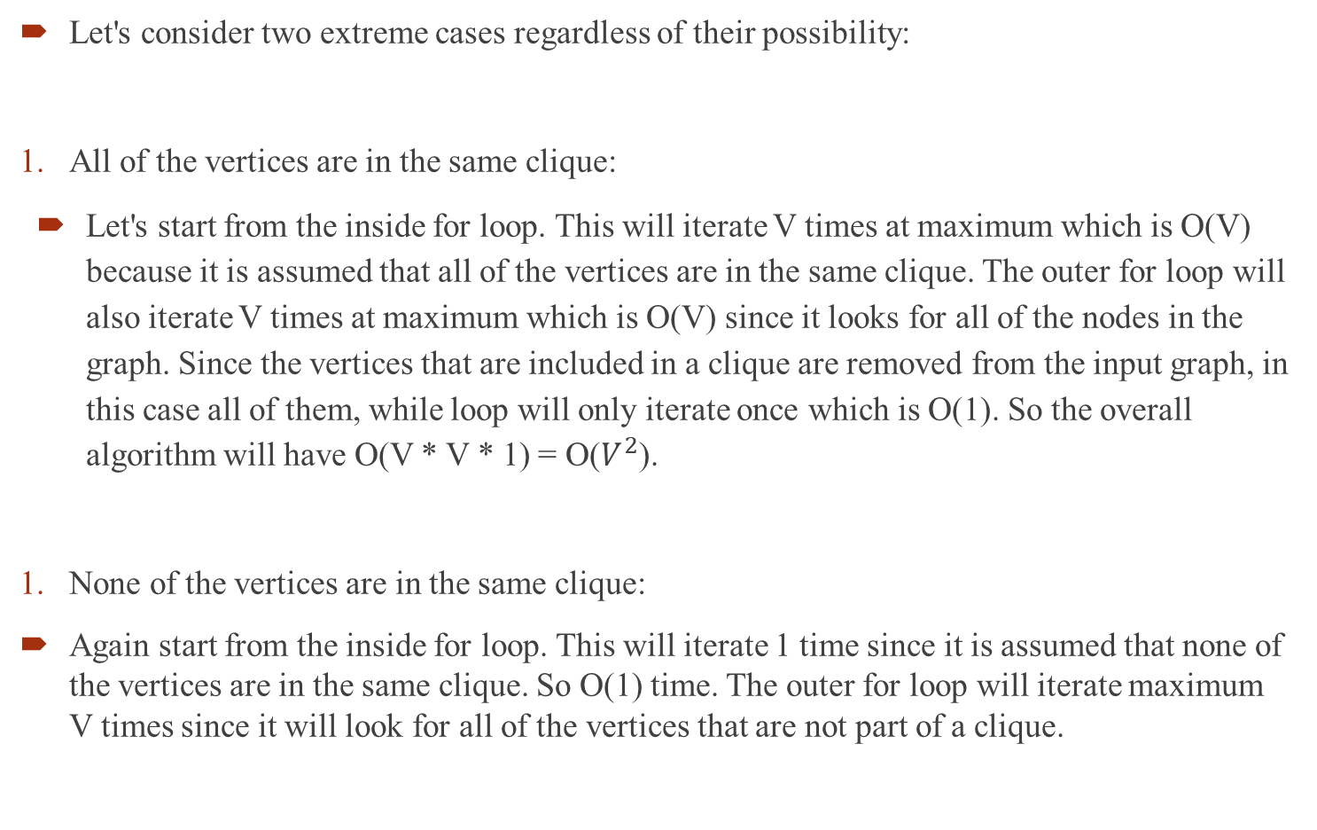

Slide 19
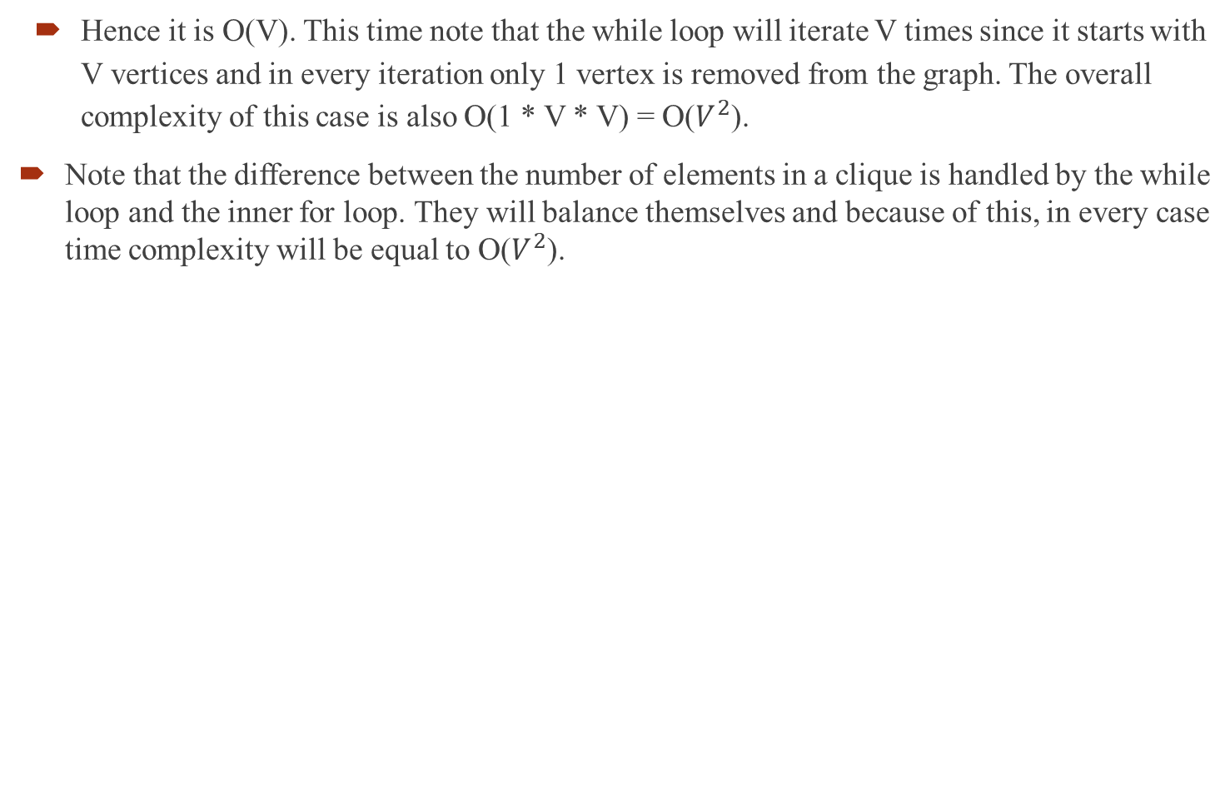
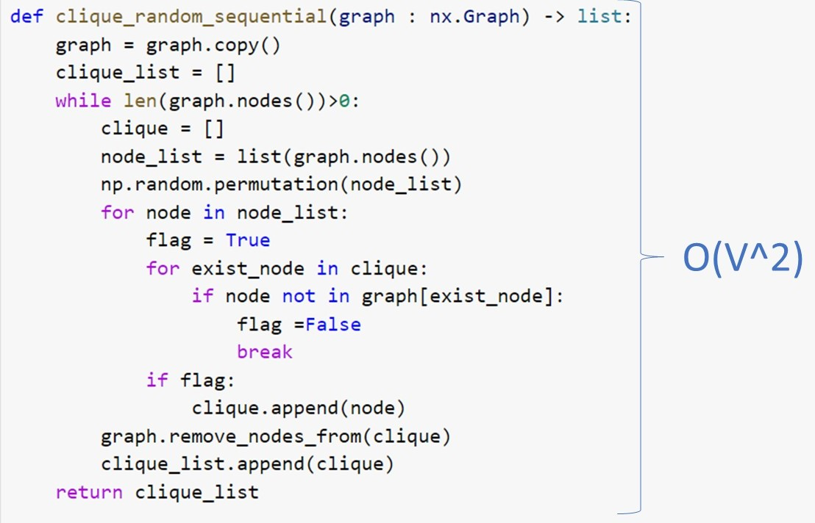

Slide 20
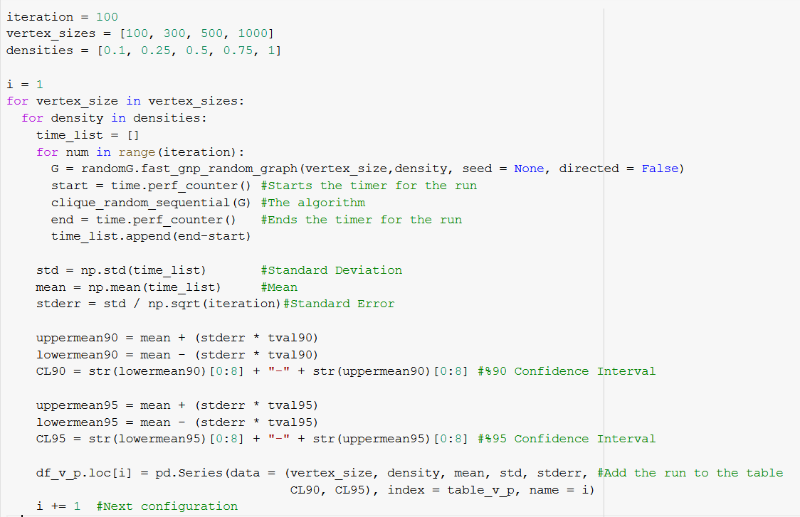
Experimental Analysis
Running time experimental analysis
The algorithm performance analysis is done by comparing the running times for different input sizes (V, E). Below code used in the analysis in order to compute respective running time, mean, standard deviation, standard error and interval for confidence levels.

Slide 21
The approximation values, 1.645 for %90 confidence level t-value, and 1.96 for %95 confidence level t-value are used in the analysis.
Python networkX library is used for generating random graphs by;
1) Fixed edge size, increasing the vertex size
2) Fixed vertex size, increasing the edge size
3) Increasing the density with the vertex size
On each category and on each configuration of the input size, the algorithm runs for 100 random graphs. Since the algorithm running time is mainly dependent on the vertex size, (1) and (3) are more meaningful than (2). The time values are in seconds.

Slide 22
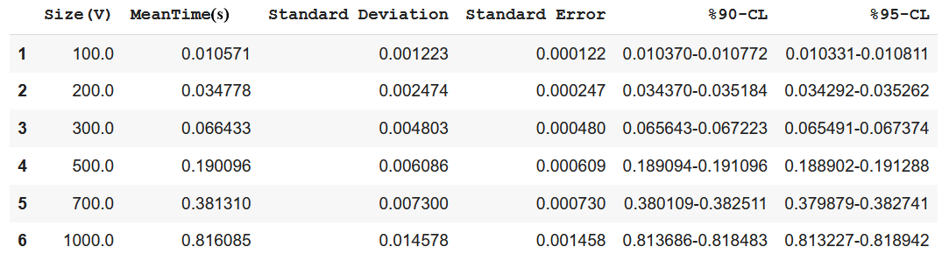
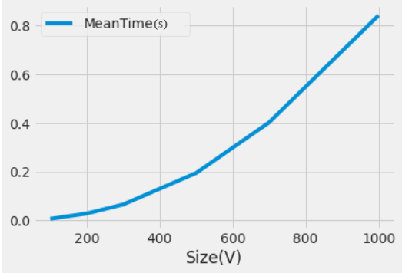
1. Fixed edge size, increasing the vertex size

Slide 23
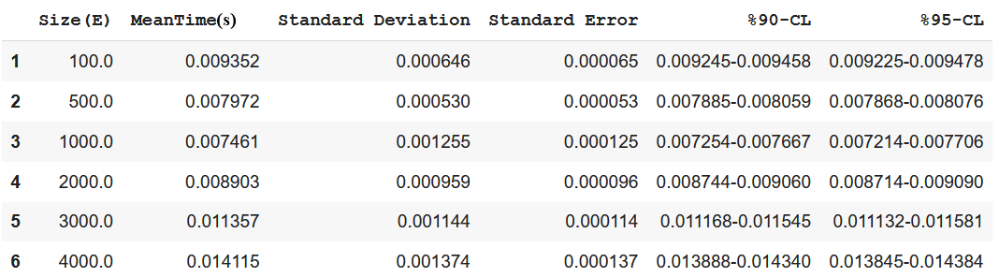
2. Fixed vertex size, increasing the edge number

Slide 24
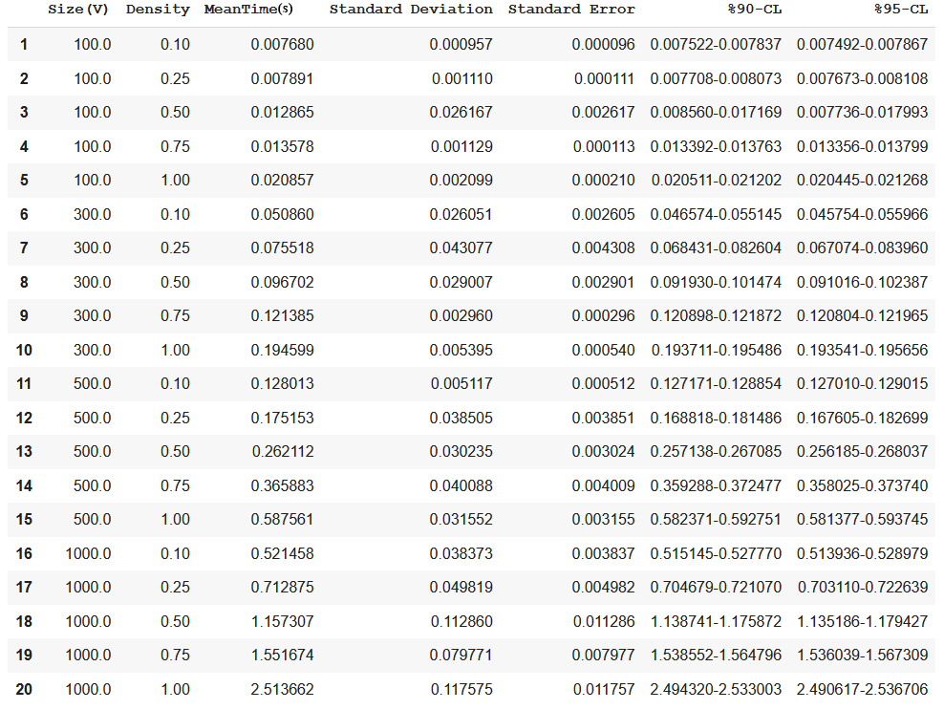
3. Increasing the density with vertex size

Slide 25
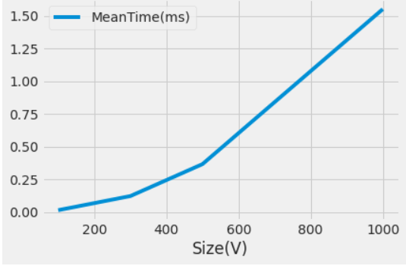
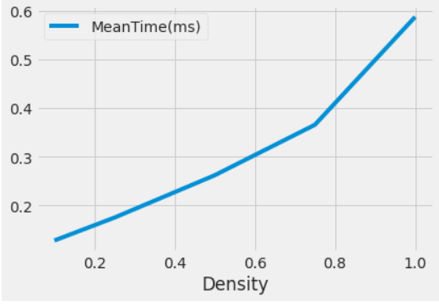
In (3), running time increases polynomially as the size of V and the density of the graph increases. As examples, the following first graph shows the running time with respect to the size of V while density is 0.75. The latter graph shows the running time with respect to the density of the graph while the size of V is 500.

Slide 26
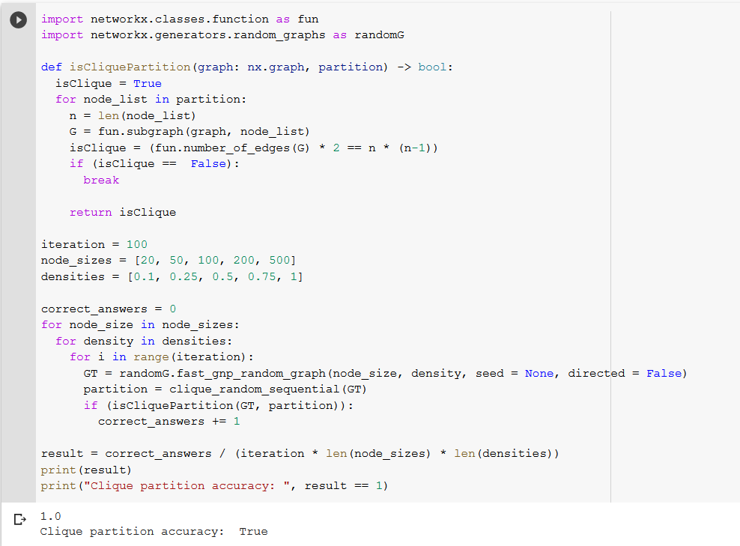
B. Correctness
Analized heuristic algorithm for solving Minimum Clique Partition problem doesn’t guarantee that the answer is minimum, since it is a greedy alternative to the brute force approach that checks all subsets to find minimum clique partition. On the other hand, the algorithm always returns a valid partition of a given graph. Following code checks if a given partition is a clique in 100 random graphs, for each vertex size and density configuration. NetworkX library is again utilized to calculate the accuracy of the algorithm for finding successful clique partitions.

Slide 27
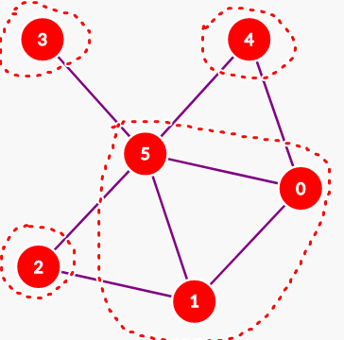
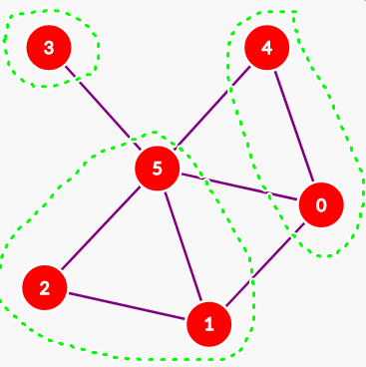
Testing
To test this heuristic algorithm, blackbox testing is used to analyze correctness of the algorithm. In order to test the algorithm, random graphs of various sizes are generated and solved with the heuristic algorithm.
To show that it doesn’t always find the correct solution, we decided to include more of the failed cases than the successful ones.
FAILED: First graph is our algorithm’s minimum clique partition and it uses 4 cliques, while the second graph is the correct minimum clique partition which has 3 cliques.

Slide 28
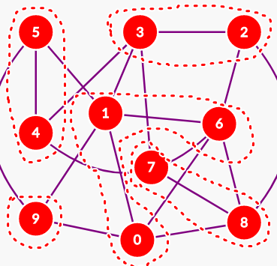
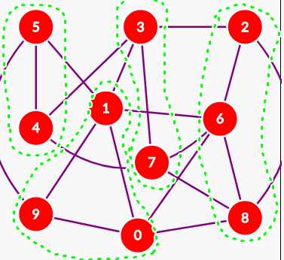
FAILED: First graph is our algorithm’s minimum clique partition, that uses 5 cliques, while the second graph is the correct minimum clique partition, that uses 4 cliques.

Slide 29
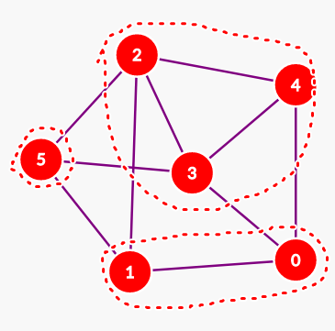
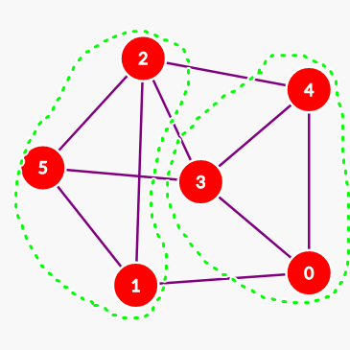
FAILED: First graph is our algorithm’s minimum clique partition, that uses 3 cliques, while the second graph is the correct minimum clique partition, that uses 2 cliques.

Slide 30
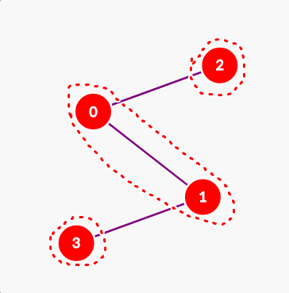
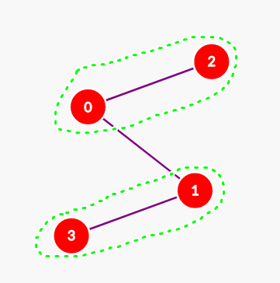
FAILED: First graph is our algorithm’s minimum clique partition, that uses 3 cliques, while the second graph is the correct minimum clique partition, that uses 2 cliques.

Slide 31
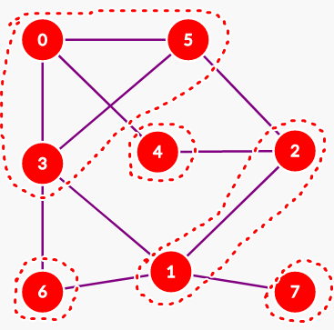
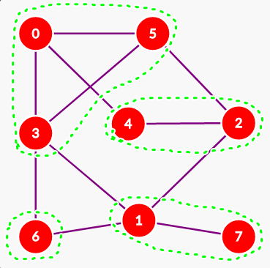
FAILED: First graph is our algorithm’s minimum clique partition, that uses 5 cliques, while the second graph is the correct minimum clique partition, that uses 4 cliques.

Slide 32
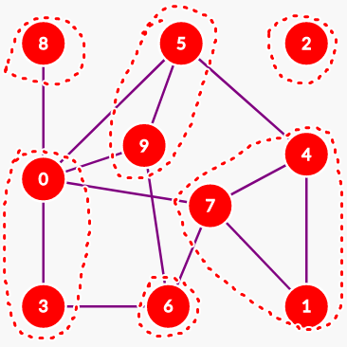
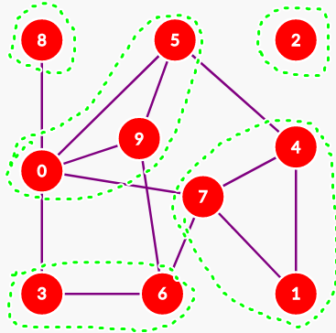
FAILED: First graph is our algorithm’s minimum clique partition, that uses 6 cliques, while the second graph is the correct minimum clique partition, that uses 5 cliques.

Slide 33
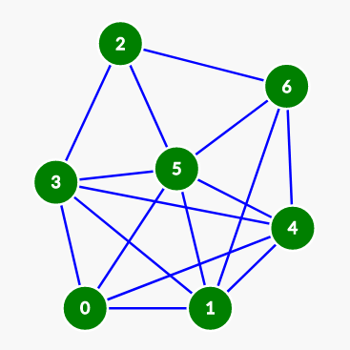
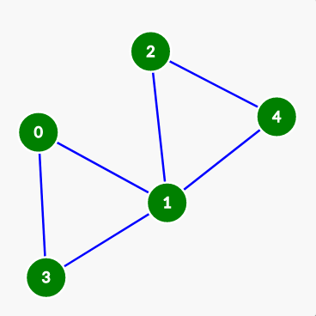
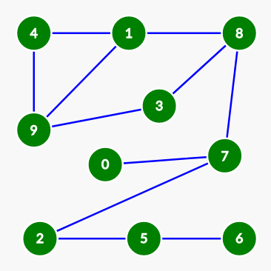
SUCCEEDED: Our algorithm’s minimum clique partition, uses 2 cliques, which is the correct minimum clique partition.
SUCCEEDED: Our algorithm’s minimum clique partition, uses 2 cliques, which is the correct minimum clique partition.
SUCCEEDED: Our algorithm’s minimum clique partition, uses 5 cliques, which is the correct minimum clique partition.

Slide 34
