Slide 1

Cancer & demographics
Group 6: Raul Doria, Ever campos & Aida Ndiongue

Slide 2

Agenda
Cancer by age groups
Cancer by race
Cancer by gender
Cancer by Hispanic origin

Slide 3

Introduction
Are certain demographics more prone to getting cancer?
We have decided to explore cancer (a.k.a neoplasm) in year 2020 to see if there is a correlation between Age, Race and Ethnicity, and the likeliness of getting a malignant form of neoplasm resulting in mortality.

Slide 4

Cancer by age groups

Slide 5
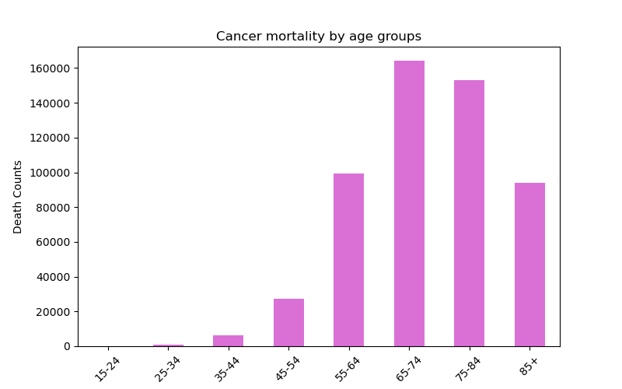
Cancer by age groups
Cancer mortality seems to increases with age.
The lowest age group of our study (15-24 yrs) presents the lowest mortality with 199 death count in 2020
The 65-74 age group presents the highest mortality with 164,081 cancer deaths with the same year.

Slide 6
Cancer by Race

Slide 7
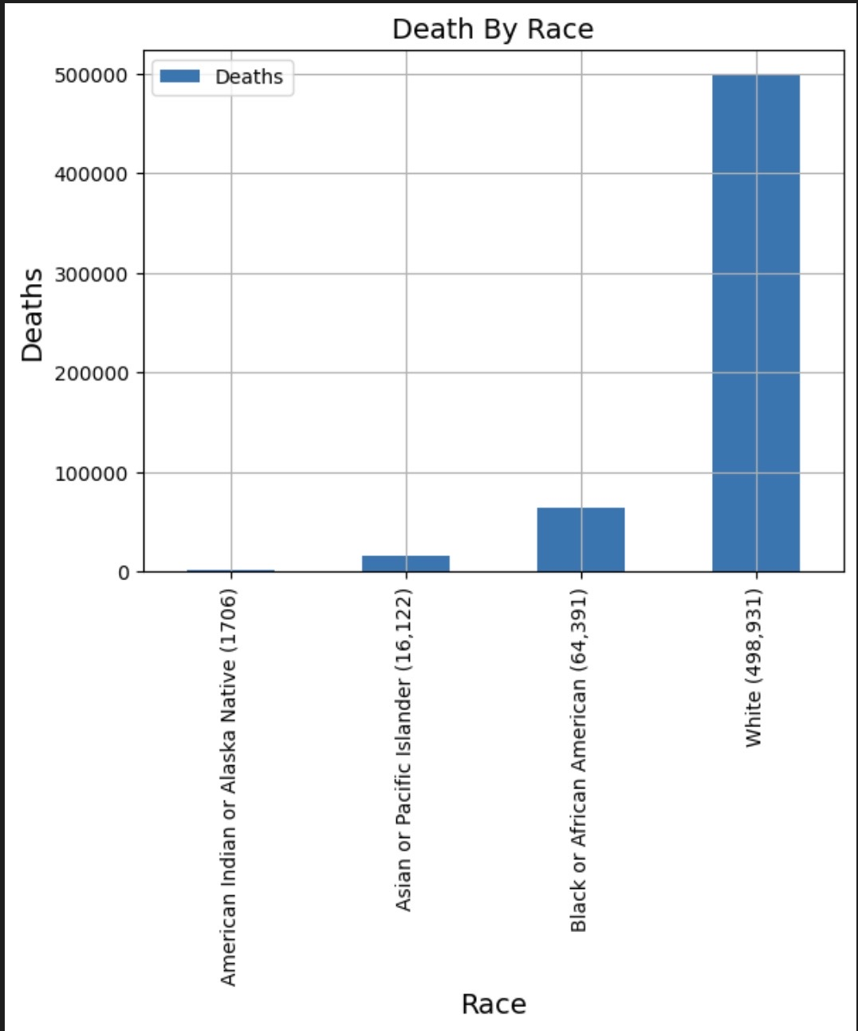
Cancer by race
Dataframe we used contained 4 races from year 2019 to 2020. For comparative reasons, we decided to look into 2020 alone
The Races were :
American Indian or Alaska Native 1,706
Asian or Pacific Islander 16,122
Black or African American 64,391
White 498931
The data set we used had the different types of cancers and how many deaths resulted in each type. So we were able to determine that if you are of the White demographic you are more prone to getting cancer that results in death, followed by African Americans.

Slide 8
Cancer by gender

Slide 9
Cancer by gender
To follow

Slide 10
Cancer by gender
To follow

Slide 11
Cancer by Hispanic or Non-Hispanic origin

Slide 12
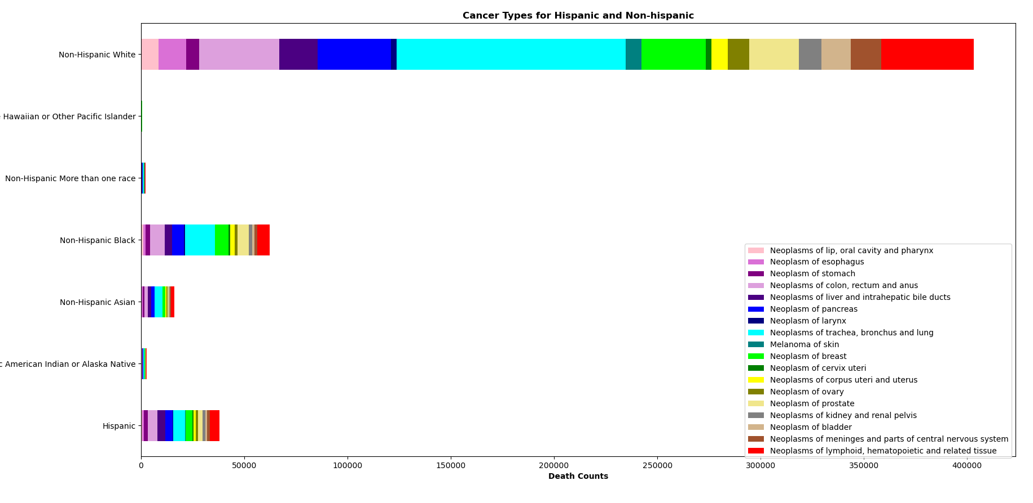
Cancer by Hispanic or non-Hispanic origin

Slide 13
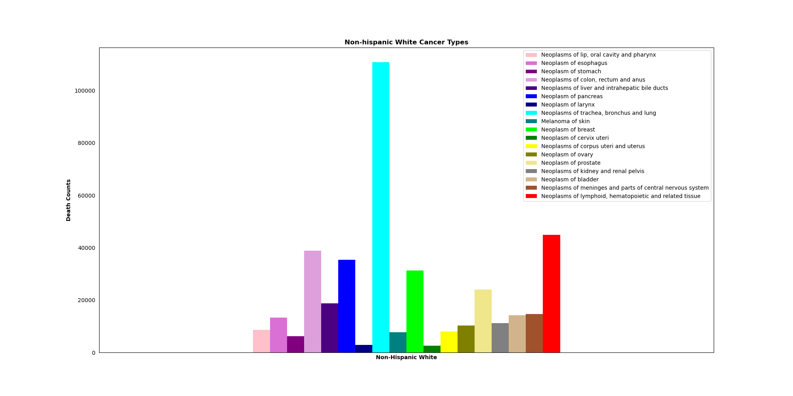
Cancer by Hispanic or non-Hispanic origin: Non-Hispanic white
Out of the Hispanic and non-Hispanic groups studied, the following group show highest mortality:
1- non-Hispanic white,
2- non-Hispanic black,
3- Hispanic
The non-Hispanic white has neoplasm of trachea, bronchus and lung, as the cancer type with highest death count with 110,833 deaths, vs neoplasm of the cervix with 2612 deaths

Slide 14
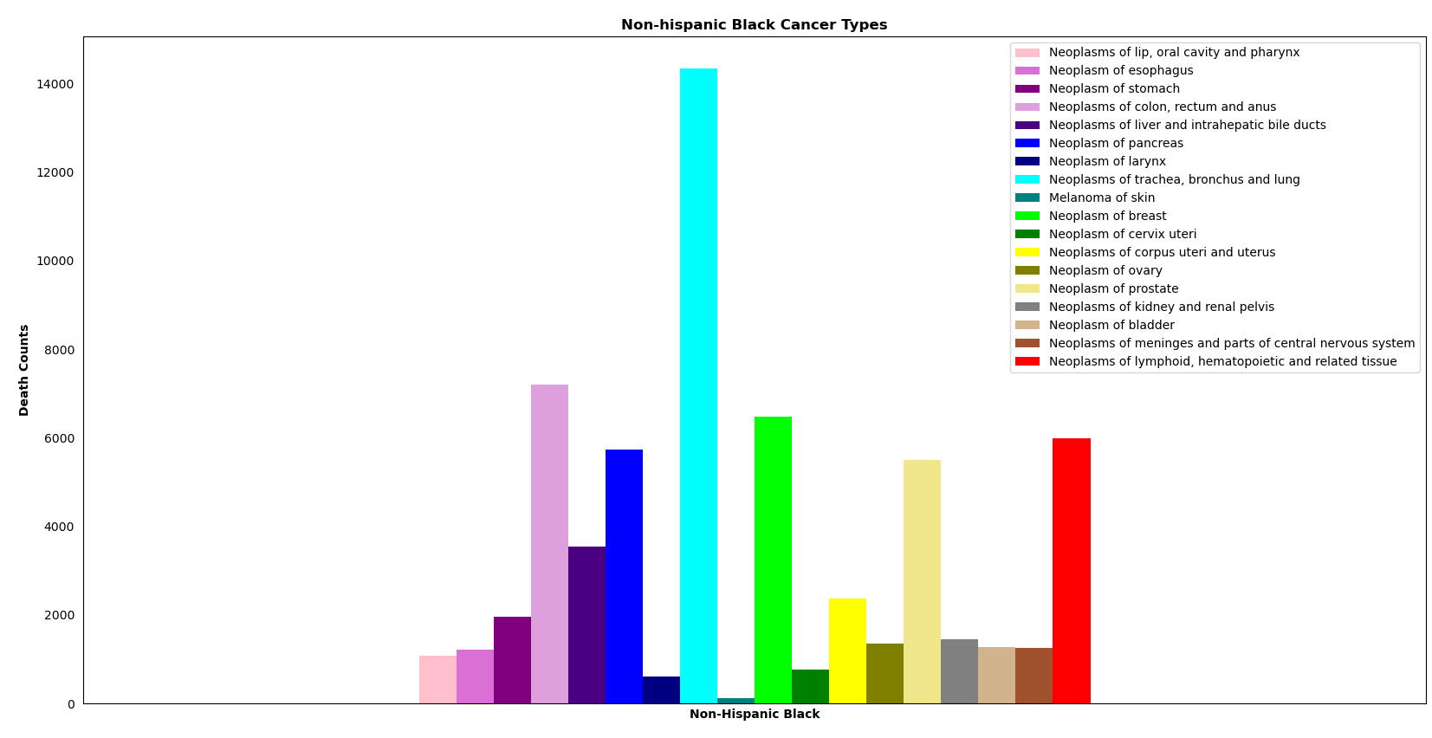
Cancer by Hispanic or non-Hispanic origin: Non-Hispanic black
The non-Hispanic black, second largest group, has also neoplasm of trachea, bronchus and lung, as the cancer type with highest death count with 14,347 deaths and melanoma of skin as its lowest cancer type with 121 deaths.

Slide 15
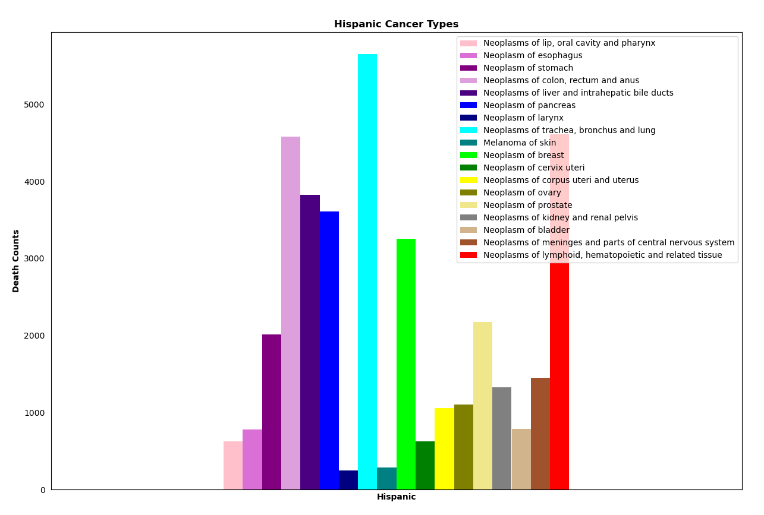
Cancer by Hispanic or non-Hispanic origin: Hispanic
The Hispanic, third largest group, has also neoplasm of trachea, bronchus and lung, as the cancer type with highest death count with 5654 deaths and neoplasm of larynx as its lowest cancer type with 243 deaths.

Slide 16
Summary
What age group is more prone to dying from Cancer?
The graph seems to imply that the older people are the more they are prone to die from cancer. More specifically people aged between 65 and 74 yrs olds are more notable in cancer mortality.
Which Demographic is most prone to Cancer resulting in Death?
Our 2020 data shows that in the united states, cancer mortality goes up in the following race order: Caucasian, Black, Asian or Pacific Islander and American Indian or Alaska Native
Which Type of Cancer presents the highest Mortality?
Out of the 3 ethnic groups with highest cancer mortality, neoplasm of trachea, bronchus and lung is the most prominent, and in most cases neoplasm of larynx, neoplasm of cervix and melanoma of skin are the lowest.

Slide 17


Thank you
Group 6: Raul Doria, Ever campos & Aida Ndiongue

