Slide 1

Translational Pitch
Friday, 8th September 2017

Slide 2
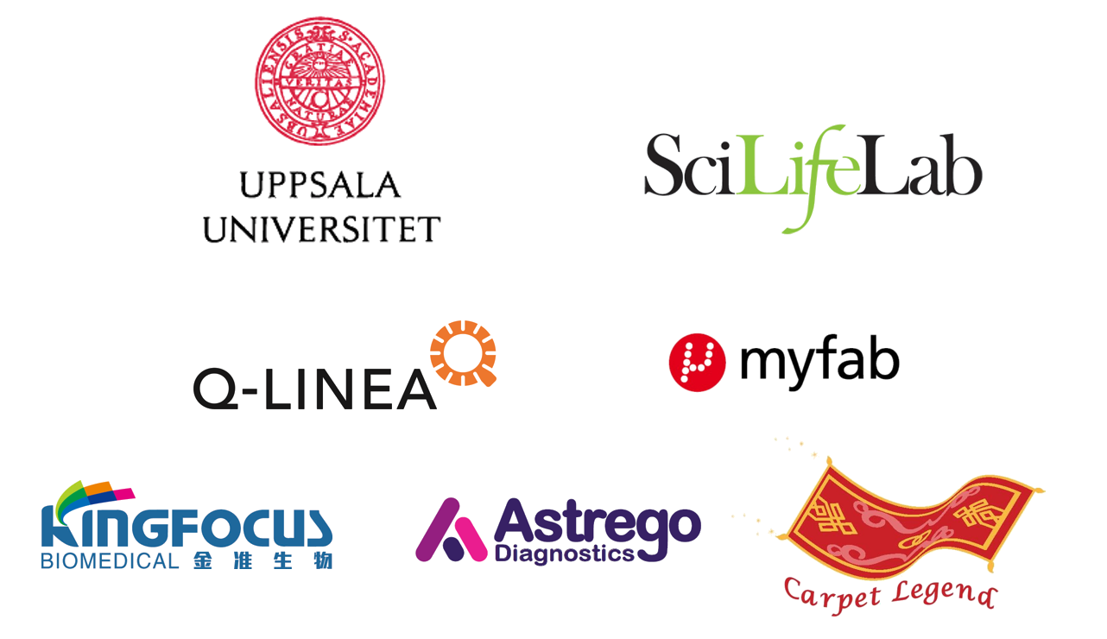
Sponsors

Slide 3

Medical Application
33 618 people died 2013 (cf. Eurostat, 37.4%)
Problem with NT-proBNP: Centralized tests only
Source: visitsweden.se

Slide 4
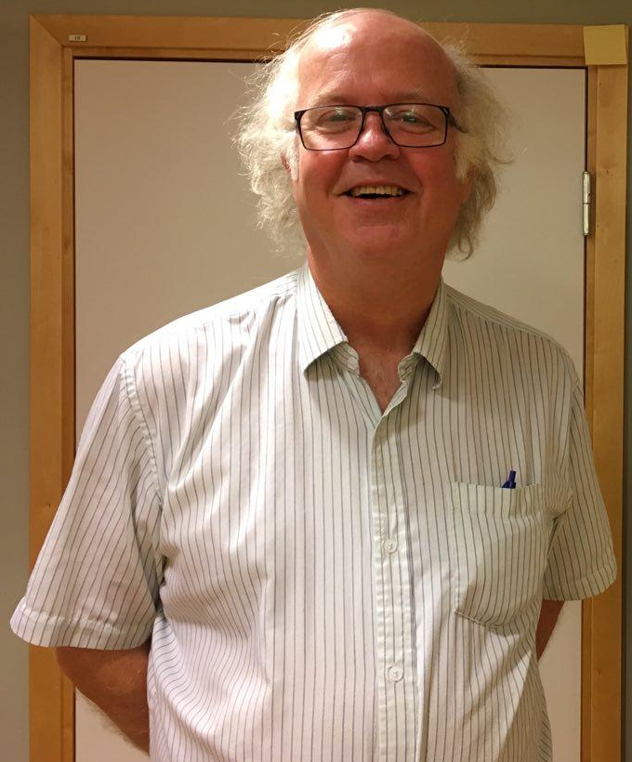
Medical Application
Patient needs to go to clinic
Receives test after a day earliest → Patient is already home again
Shortest time to get a value from a sample 10 min
Prof. Anders Larsson, Department of Medical
Sciences, Clinical Chemistry, Uppsala University (Hospital)

Slide 5
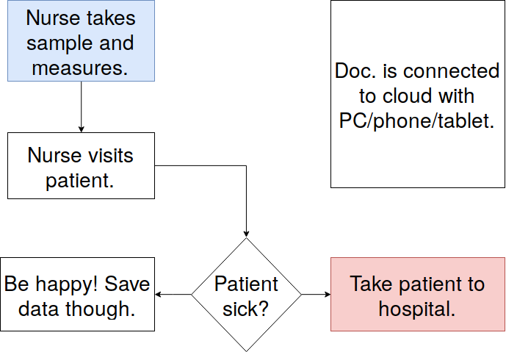
Medical Application
UppSense proposes another solution
NT-proBNP devices for every nurse (40 €)

Slide 6
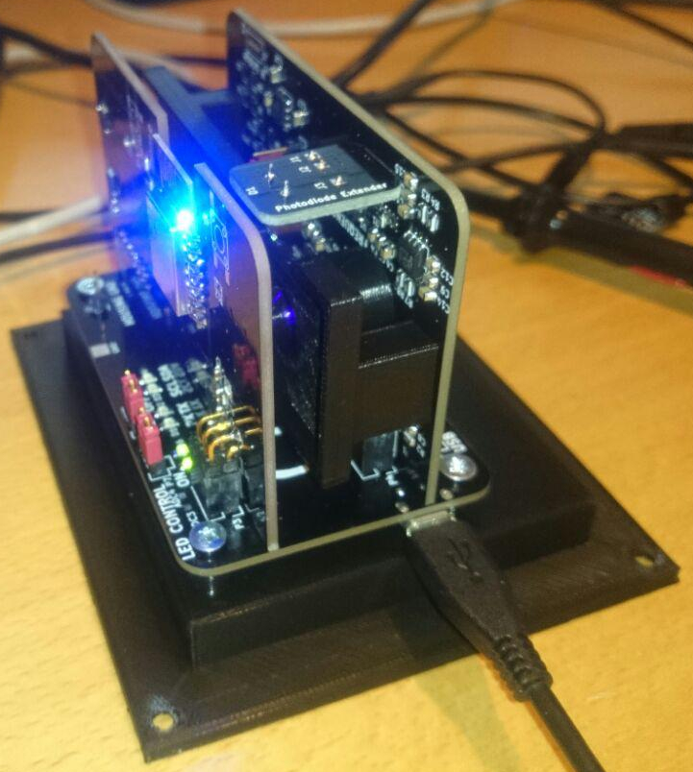
Medical Application
Value can be obtained much quicker
Costs can be lowered
Long-term observation of patients
No confusion between NT-proBNP and BNP

Slide 7
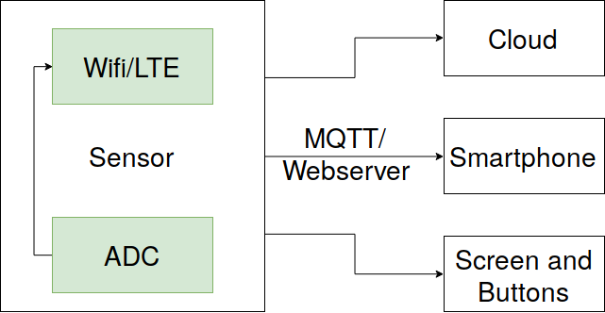
Medical Application
Tailorable software
User-friendliness for different age groups

Slide 8
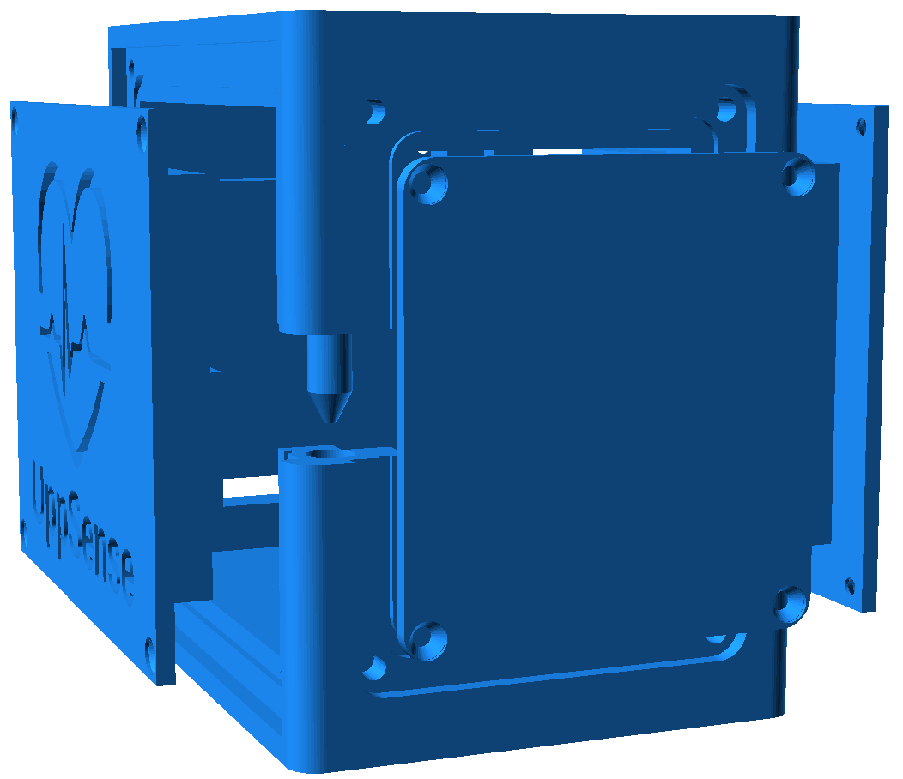
Industrialization and Commercialization
Housing can be produced in a injection molding process
Less metal
Thinner
More stability for circuitry inside

Slide 9
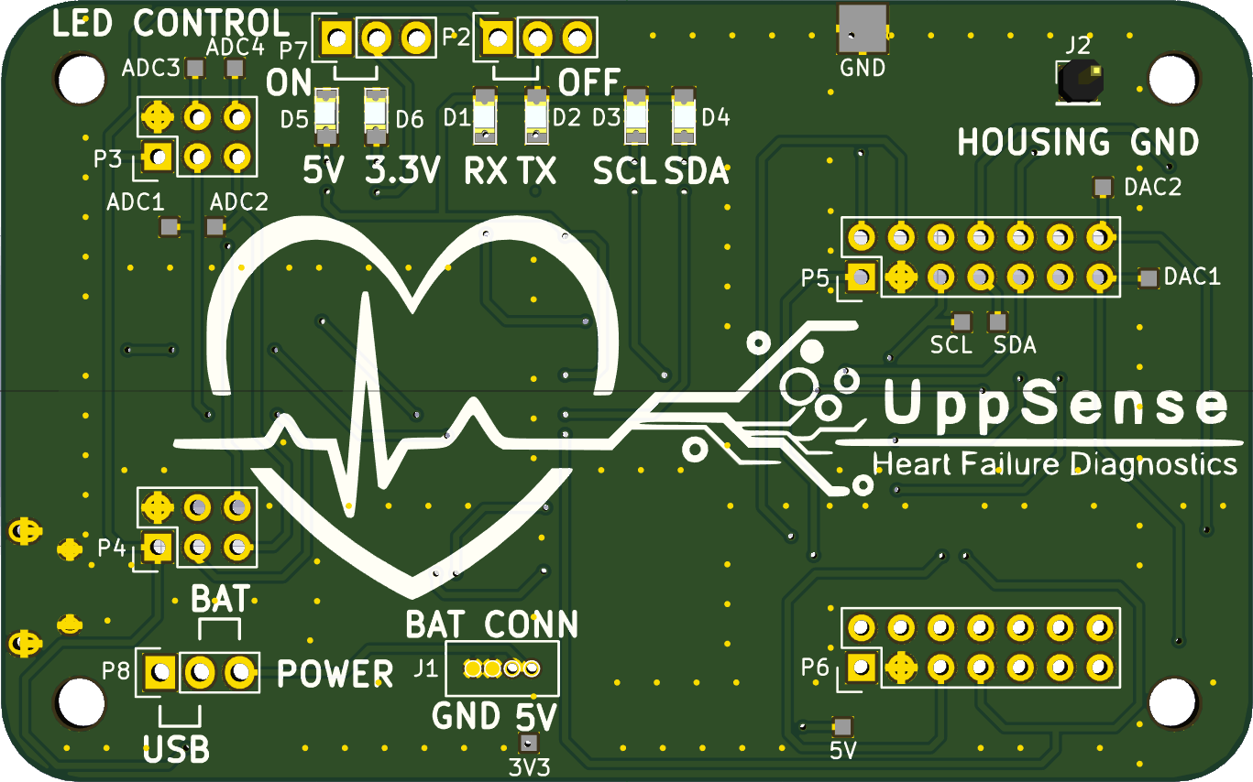
Industrialization and Commercialization
Electronic components are cheap and easy to produce on a large scale
COTS
Different kind of fluoresence assays are compatible

Slide 10
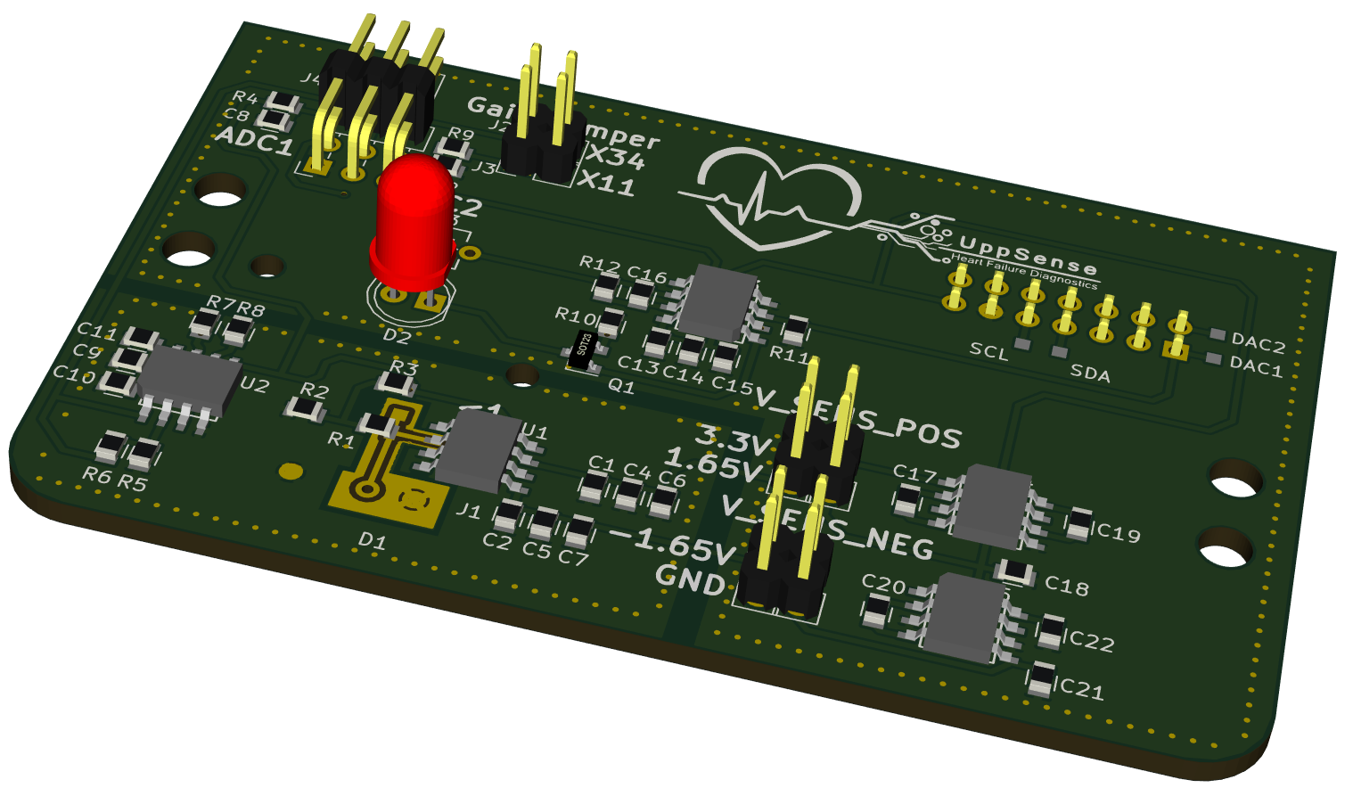
Industrialization and Commercialization
Sensitivity in the femtoampere region has to be confirmed
Sensitivity is less than 3 pA
CE labeling
Smaller bug fixing still required
Component optimization

Slide 11
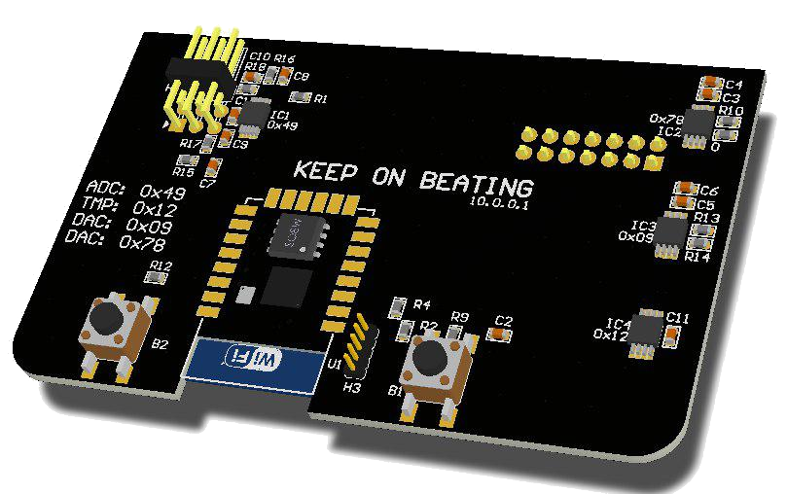
Industrialization and Commercialization
Component | Estimated Costs
Device | 40 €
Assay | 15 €
Cartridge | < 1€
Σ | < 16€ for one measurement
→ A single test will be cheaper (current costs in Uppsala: 231.4 SEK)

Slide 12
Industrialization and Commercialization
Antibodies dry and pre-set in the reaction chamber
Micro injection molding to produce the microfuidic system

Slide 13
Summary
Portable and small
User friendly and easily tailorable software
Cheap

Slide 14
What questions do you have?

Slide 15




Contact Infomation
www.uppsense.eu
contact@uppsense.eu
www.github.com/m3x1m0m/UppSense
www.facebook.com/UppsalaSensUs/

