Slide 1
UppSense
Introduction.
Uppsala University 07-02-2017

Slide 2
Agenda
Team Introduction
Time Plan
Questions
Notes:
If you don’t want the animations, just go to the ”Animations” tab above, click ”Animation pane”, and delete all the animations in the sidebar.

Slide 3
Introduction
1
Uppsala University
2
International
3
Interdisciplinary
Notes:
If you don’t want the animations, just go to the ”Animations” tab above, click ”Animation pane”, and delete all the animations in the sidebar.

Slide 4
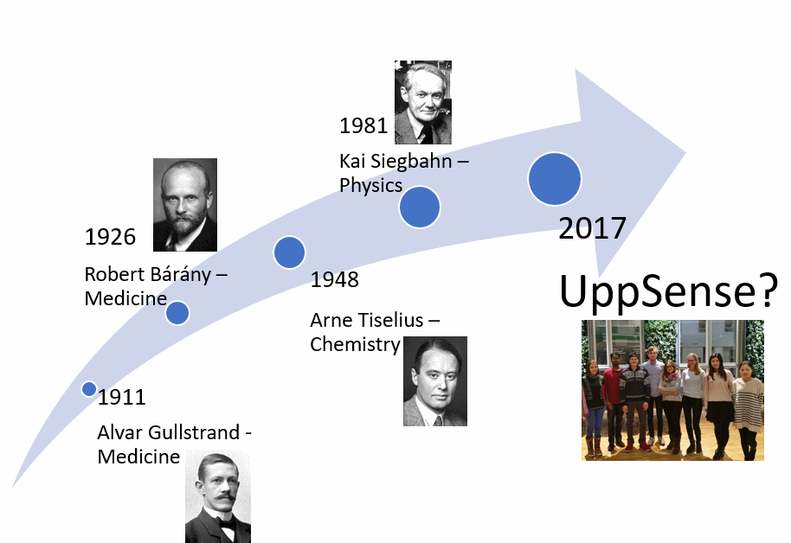
Nobel laureates from Uppsala University
in the city of science the inspiring environment will motivate us to design an innovative bio sensor
COMPY LOGO
Notes:
If you don’t want the animations, just go to the ”Animations” tab above, click ”Animation pane”, and delete all the animations in the sidebar.

Slide 5
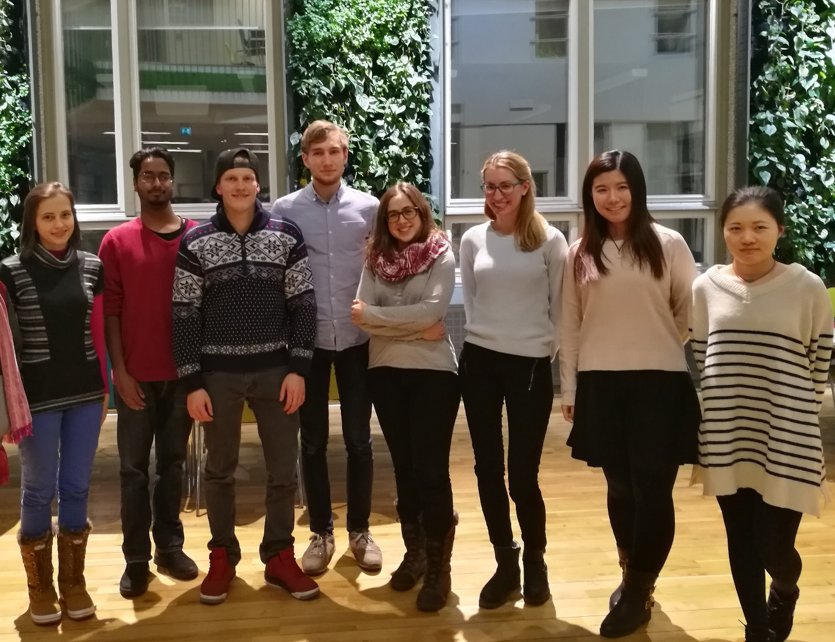
The Team (1)
From the left: Ruth, Rasmus, Max, Elmar, Anna, Faye, Hanzhao, Linlin
COMPANY LOGO
Notes:
If you don’t want the animations, just go to the ”Animations” tab above, click ”Animation pane”, and delete all the animations in the sidebar.

Slide 6
The Team (2)
Name | Home Country | Background
Ruth | Romania | Biomedical Engineering
Rasmus | Sweden | Computer Science
Max | Germany | Electrical Engineering
Elmar | The Netherlands | Electrical Engineering
Anna | Spain | Chemistry
Faye | Germany | Biomedicine
Hanzhao | China | Biomedicine
Linlin | China | Biomedicine
Notes:
If you don’t want the animations, just go to the ”Animations” tab above, click ”Animation pane”, and delete all the animations in the sidebar.

Slide 7
Preliminary schedule
Transducer
HW design
Device software
Competition
April
May
June
July
August
September
Assay
HW ready
User Interface
Feedback moment
Notes:
If you don’t want the animations, just go to the ”Animations” tab above, click ”Animation pane”, and delete all the animations in the sidebar.

Slide 8
Questions to you
Notes:
If you don’t want the animations, just go to the ”Animations” tab above, click ”Animation pane”, and delete all the animations in the sidebar.

Slide 9
Questions from you
Notes:
If you don’t want the animations, just go to the ”Animations” tab above, click ”Animation pane”, and delete all the animations in the sidebar.

