Slide 1
Music-Reactive Procedural Content Generation in Video Games
Marcus Yiu Yeung Yip
Professor Ian Miguel

Slide 2


MOTIVATION
People enjoy playing Video Games
People enjoy listening to Music
. . . Rhythm games!
Fixed music
Handcrafted content
A new way to enjoy both?
Music-Reactive Procedural Content Generation!
(Generate game content from music in real-time)

Slide 3
GOAL
Music-Reactive Procedural Content Generation
Design,
Implement,
Evaluate
. . . a “Music-Reactive” game.
Audio Analysis
Waveform
Amplitude
Frequencies
Procedural Content Generation
Environment
Enemies
HUD
Weapons
Sound Effects

Slide 4
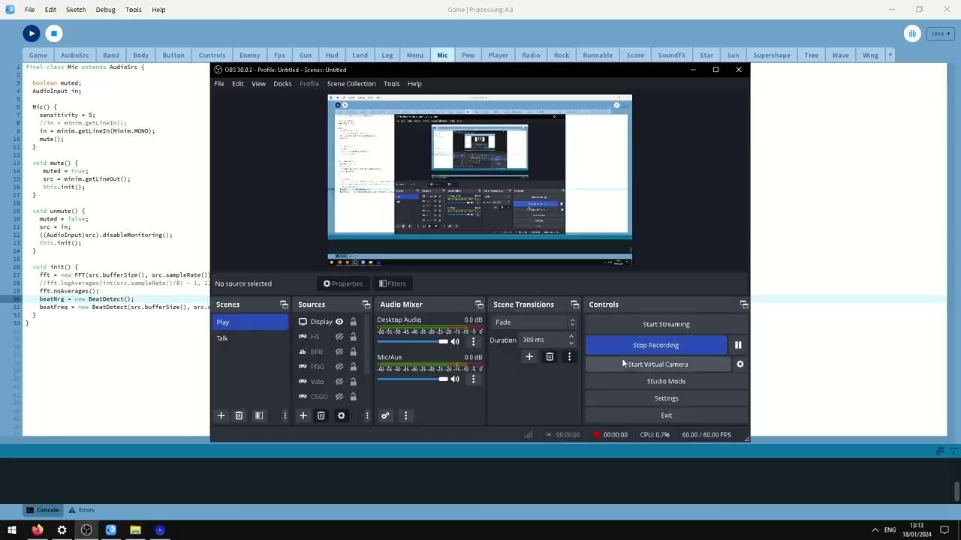
FLО̄
A Rhythmic Rail Shooter

