Slide 1
DD2437 - ANNDA
Lab assignment 3
Hopfield networks
Notes:
Quick introduction
(group 17, Hopfield networks, unsupervised learning)

Slide 2

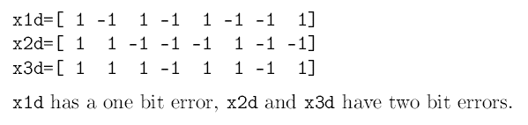
Convergence and attractors
all learned points stable states
x2d failed to converge
network has 14 (3 + 11) attractors
Notes:
To start of we created an 8-neuron Hopfield network and trained it on three patterns of the same dimensions.
We used the one-shot Hebbian learning rule as in all other experiments to follow.
The three patterns were stable states (attractors) in our network which showed that the rule did indeed work.
Using the batch updating rule we tested the network on three patterns with errors x1d (1-bit error), x2d (2-bit) and x3d (2-bit).
The network converged to stored patterns for x1d and x3d but failed to do so for x2d and converged into a state which was not learned.
By testing all possibilities we found that there are 14 attractors altogether, 3 learned and 11 spurious states.

Slide 3
Sequential update
learning 3 patterns works
a distorted p1 (p10) converges to a stored pattern, a mix of p2 and p3 (p11) does not
Notes:
In the next assignment we created a 1024-neuron network to learn picture patterns of 32 x 32 pixels.
We successfully learned 3 pictures and they were stable states just like in the previous experiment.
We tested the network on a distorted p1 pattern and a mix of patterns p2 and p3.
The distorted p1 pattern converged to the stored p1 pattern, but the mix of p2 and p3 failed to do so using batch updating.
It sometimes converged to p3 using sequential updating.
We also tested the network on randomly generated patterns using the sequential updating rule.
The network always converged but the final stable states were sometimes spurious states, and not the stored patterns.
We can see animations of the updating process here.

Slide 4
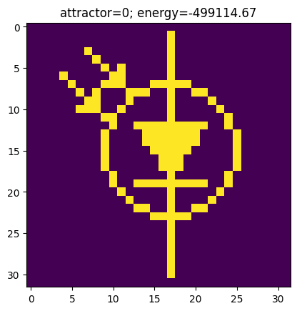
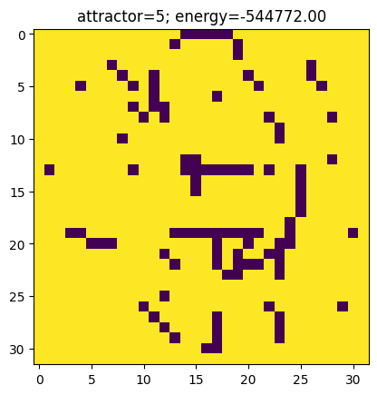
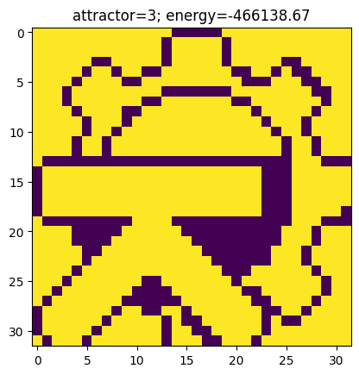
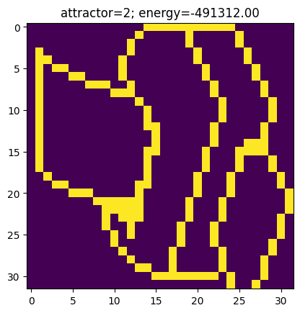
Energy
Attractors
Energies
E(p10) = -141988.0
E(p11) = -59221.33
Notes:
8 attractors in total (4 and negative counterparts), the 4 one was found by sampling random patterns and apply update rule
Energy level around -500 000 each (newly found one is global minima)
Energy for distorted patterns p10 and p11, higher than the one for attractors

Slide 5
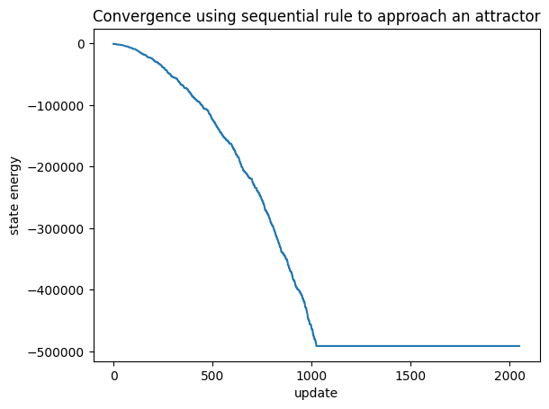
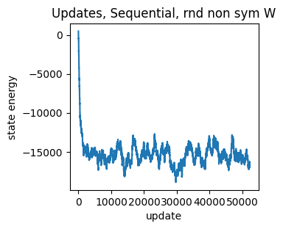
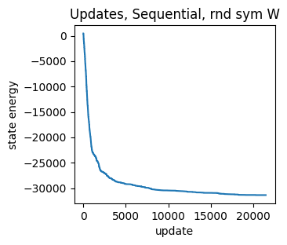
Energy
Sequential update rule comparison
P1, P2, P3 learnt
Random Weights
Asymmetric
Symmetric
Notes:
On the left: Normal convergence to a local minima (in respect to energy)
Random weights:
Non sym: no stabilization, stops at a maximum of iterations
Sym: Stabilization
Rnd W: In batch mode minimization doesn’t occurs, we focused on sequential update

Slide 6
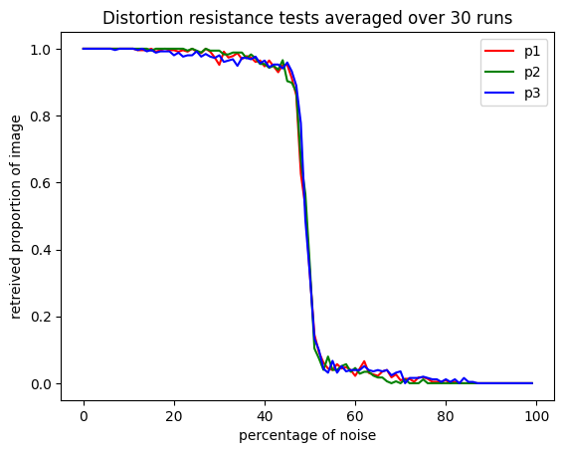
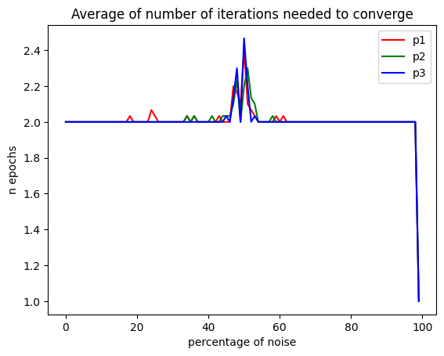
Distortion resistance
Notes:
Averaged runs to get smooth curves. Very similar behaviours for p1, p2, p3
Model works well until ~50% noise then performance drops
Around that threshold it takes a bit longer to converge but overall 1 epoch is good
After that thresholds it still converges quickly but not on the right attractor

Slide 7
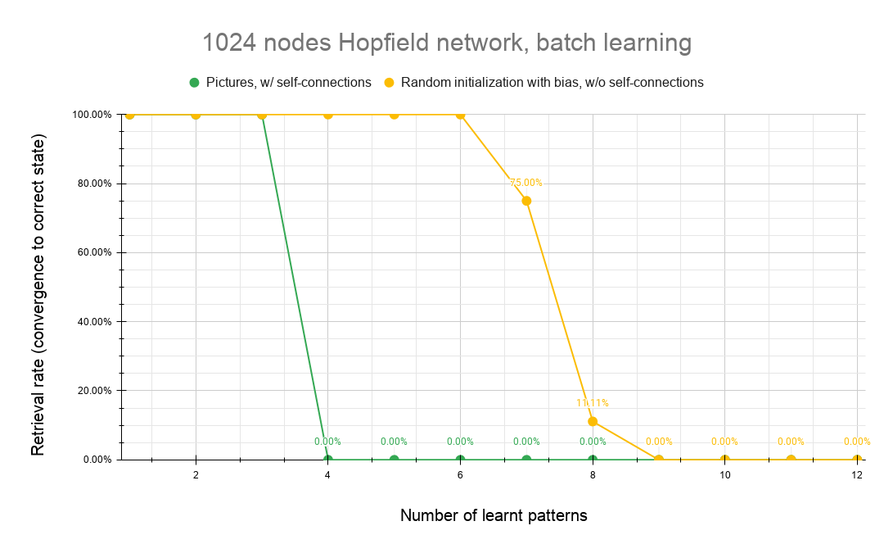
Capacity
Abrupt drop in retrieval performance when picture 4 added
Similar effect when learning randomly initialized pictures with bias (more ones)
Notes:
In this task, we observed how adding more memories affected the stability of the network, using retrieval rate of non-distorted and moderately distorted patterns as a measure of the networks capacity.
Firstly we tried adding more pictures to the initial three pictures (p1, p2 and p3) and observed that adding just one additional picture (PICTURE 4) would prevent the network from converging to learnt patterns. The retrieval performance would ABRUPTLY DROP. (GREEN LINE)
When learning randomly initialized pictures WITH BIASED DITRIBUTION [N(0.5, 1) vs N(0,1)], we observed a similar effect (YELLOW LINE)

Slide 8
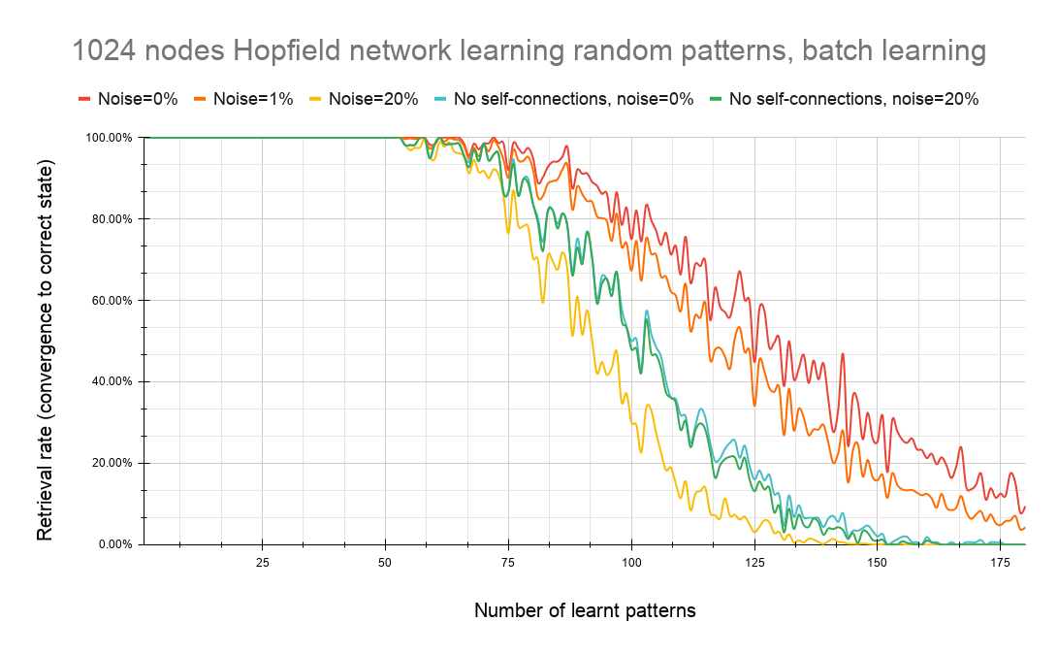
Capacity
w/ self-connections:
53 patterns with up to 20% noise
more patterns gradually decreased the performance
non-distorted patterns have constantly higher performance (red > orange > yellow)
Notes:
WITH SELF-CONNECTIONS:
When using UNBIASED random vectors, we noticed enormous difference in performance metrics when adding more patterns to learn. The network could store up to 53 PATTERNS with perfect retrieval for patterns with up to 20% NOISE.
Learning more patterns gradually decreases the performance, until after 200 learnt patterns when the retrieval rate is very low and approaches 0%
The retrieval rate performance on non-distorted patterns is constantly higher that the performance on patterns with noise added. This difference in behaviour means lower robustness towards noise and higher noticeable degradation of basins of attraction.

Slide 9
Capacity
w/o self-connections:
noiseless and noisy have similar result (green ≈ cyan)
seems to lower performance (red > green)
noise robustness (green & cyan > yellow)
Notes:
NOTE --> ITS THE SAME GRAPH
NO SELF-CONNECTIONS:
We removed the self-connections and observed that the DIFFERENCE GOES AWAY between the curves from pure and noisy patterns (CYAN AND GREEN LINE OVERLAP).
Even though removing the self-connections SEEMS TO LOWER the memory performance (CYAN AND GREEN LINE ARE BELOW RED AND ORANGE LINE), it is generally preferred not to have self-connections because they promote formation of spurious patterns and have a negative effect on noise removal capabilities. Having no self-connections results in higher noise robustness and thus more useful as well as more uniform basins of attraction (CYAN AND GREEN LINE ARE ABOVE THE YELLOW LINE)

Slide 10
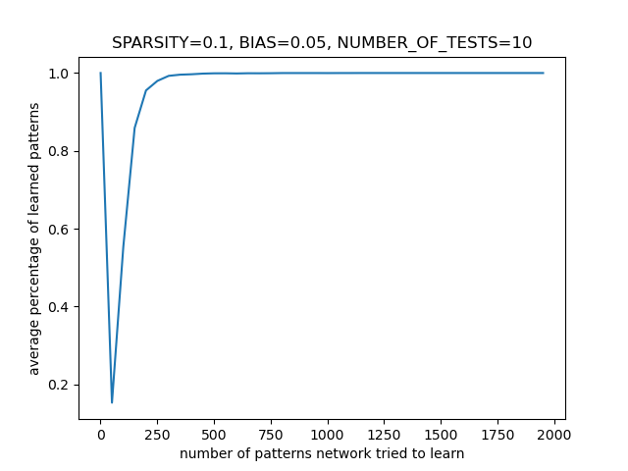
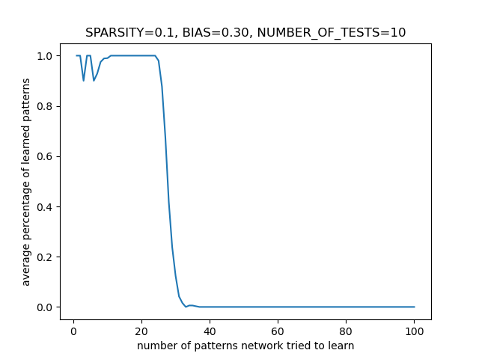
Sparse patterns: with self-connections
10% activity - network can learn up to 25 with a bias = 0.3
“saturation” (all states stable if too many patterns learnt and bias is low)
Notes:
For the final experiment we observed the ability of Hopfield networks to learn sparse patterns. We tested this on a 100-neuron network using 100-dimensional patterns. Using patterns with 10% activity allowed the network to learn about 25 such patterns which is a large amount compared in relation to the pattern dimensionality. We noticed an interesting effect when using smaller biases; if we give the network enough pattern to learn at one point it reaches a sort-of saturation in which all states become stable (the self-connections become predominant in the network). This doesn’t happen with higher bias values as the bias drags all values to 0. Using lower activity levels of 5% and 1% has similar behaviour. The network was able to learn up to 45 5% patterns and about 100 patterns using 1% activity patterns.

Slide 11
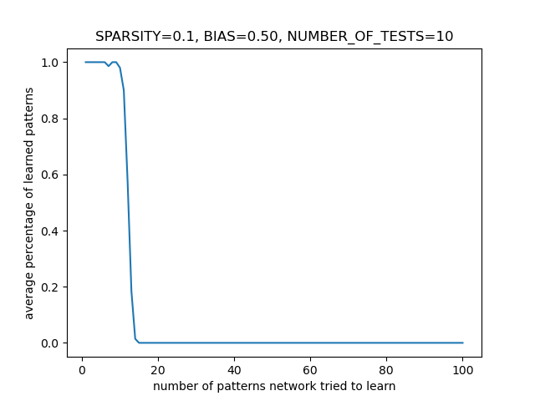
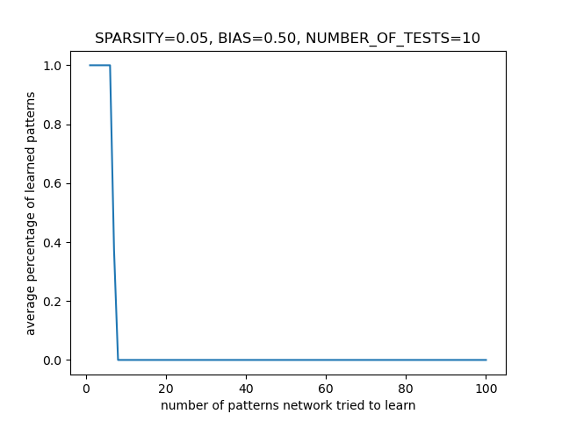
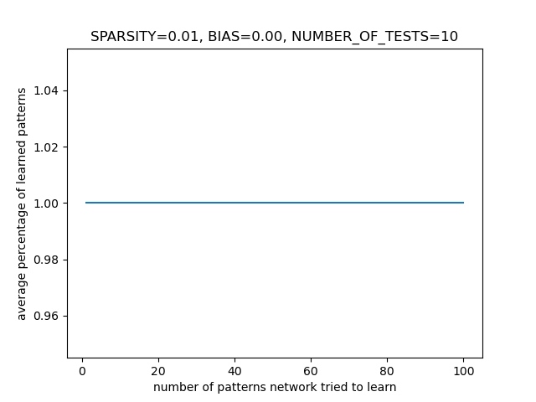
Sparse patterns: without self-connections
(10% - 10), (5% - 6), (1% - 100)
Notes:
Without self connections the sparse patterns behave differently; using pattern with 10% allowed the network to learn around 10 patterns, the network could learn about 6 5% patterns and a 100 1% patterns. The network using 1% patterns are pretty useless as adding any bias to them makes the network unable to learn anything as the weights are quite small.

Slide 12
Thank you

