Slide 1
DD2437 - ANNDA
Lab assignment 2
RBF networks and SOMs
Notes:
So… Hi. We’re group 17 and this is our presentation of the second lab assignment. This lab dealt with the implementation and performance of RBF networks and SOMs.

Slide 2
Assignment part I
RBF regression; noiseless and noisy sine wave and square functions; ballistical experiment
Notes:
In the first part of the lab, the focus was on the implementation and performance analysis of an RBF network used in a regression problem, more specifically predicting the sine wave and square functions as well as testing the the RBF networks on a 2D input 2D output problem: the ballistical experiment

Slide 3
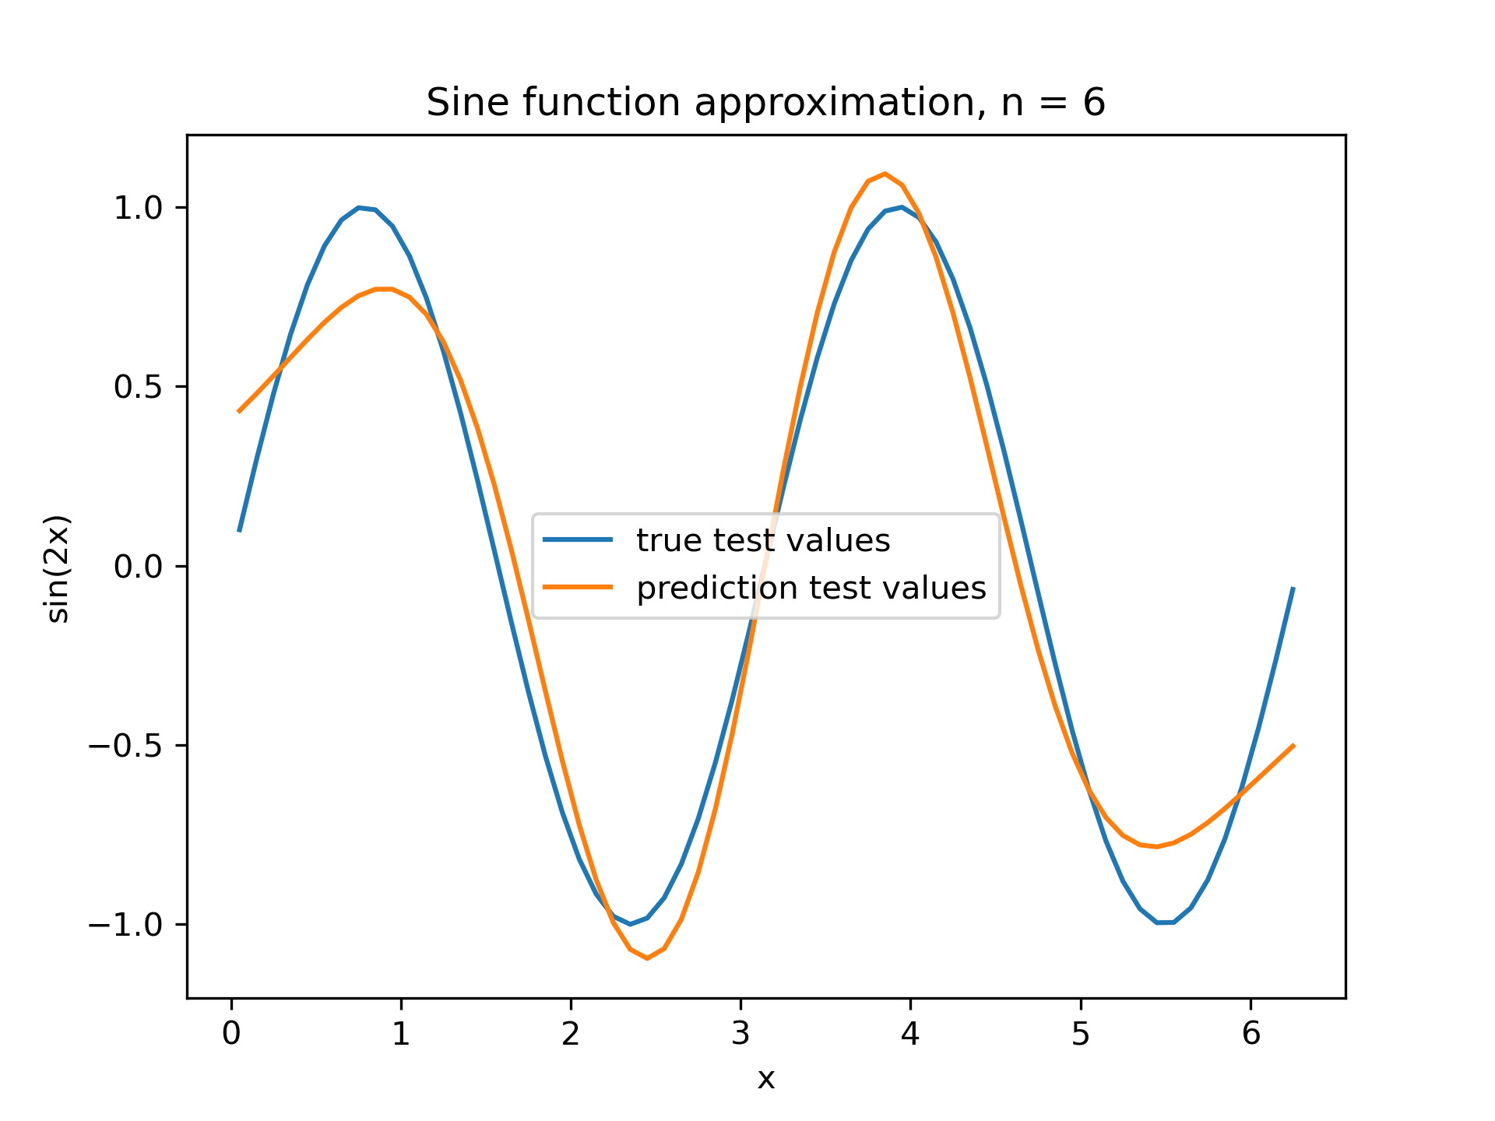
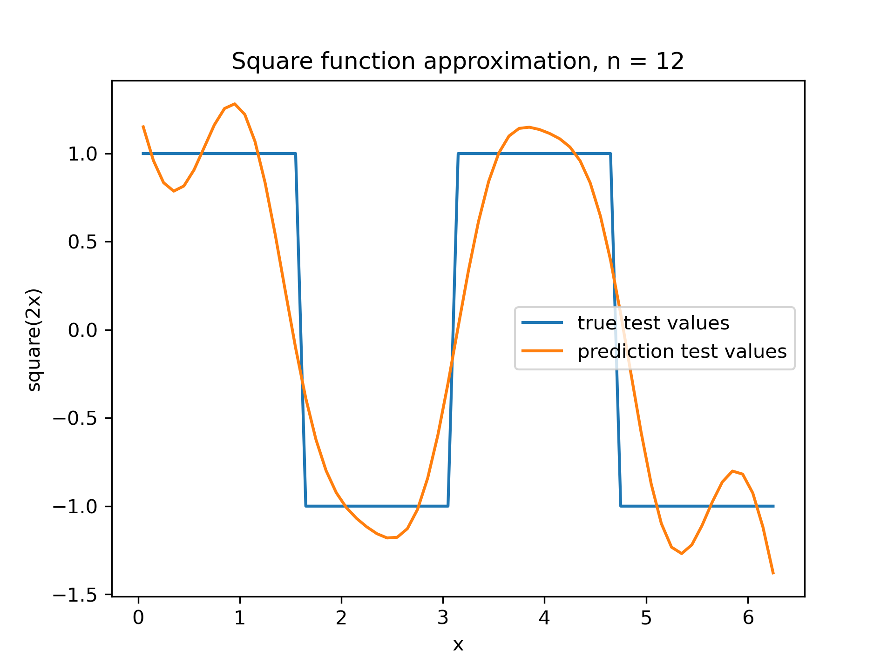
RBF regression: noiseless data
least square method
equally distributed RBF centres, variance = sqrt(distance_of_centres)
Notes:
Firstly, we’ve used an RBF network to learn and predict the sine and square wave without noise. For the RBF centres we’ve split the input space - from 0 to 2 pi - evenly and for the variance we have used the square root of the distances between each center. (2pi / (n -1). On the pictures we can see a couple of performance of the network using the least square method, firstly with 6 units for the sine wave and secondly with 12 units for the square function.

Slide 4
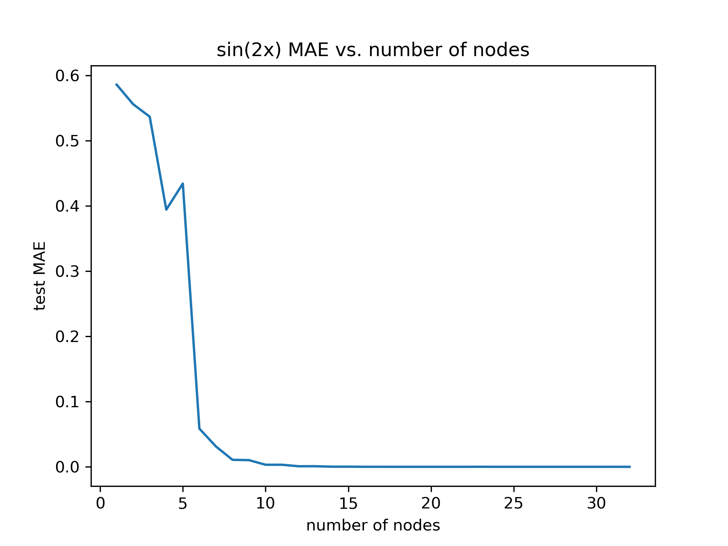
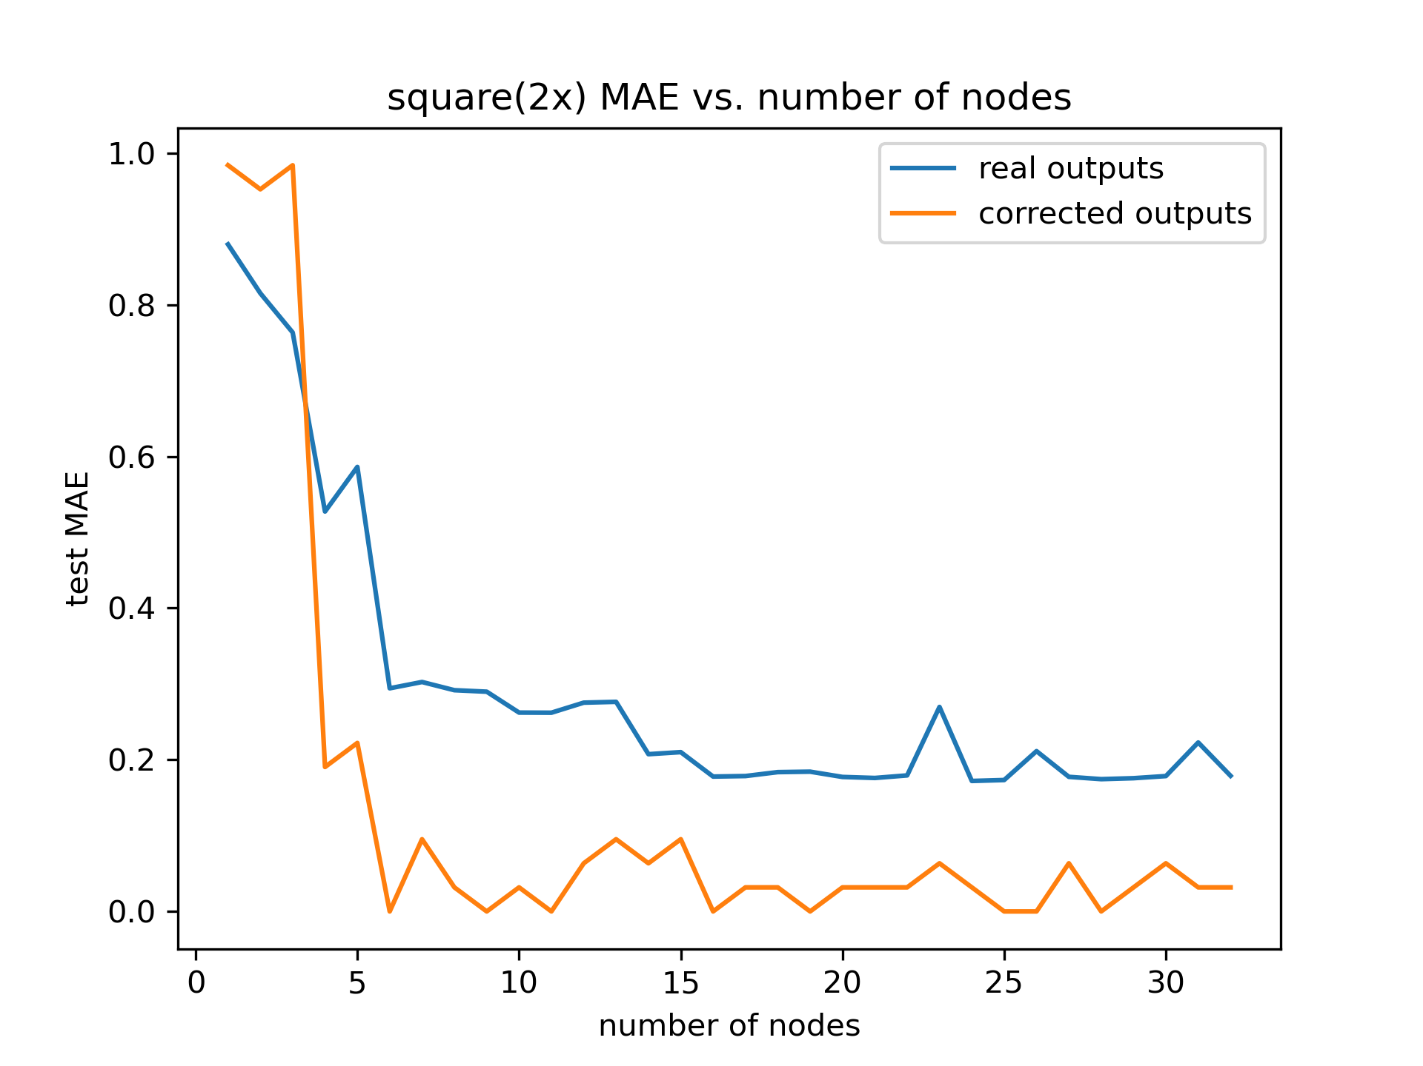
RBF regression: noiseless data
performance in relation to the number of nodes
Notes:
Here we have plotted the performances of the RBF networks in relation to the number of nodes. We can see that a bigger number of nodes does help. On the right side we have also plotted the error when using a corrected output for our square regression network, meaning we have mapped all positive outputs to 1, and all negative outputs to 0. The error often reaches 0 after using around 6 nodes.

Slide 5
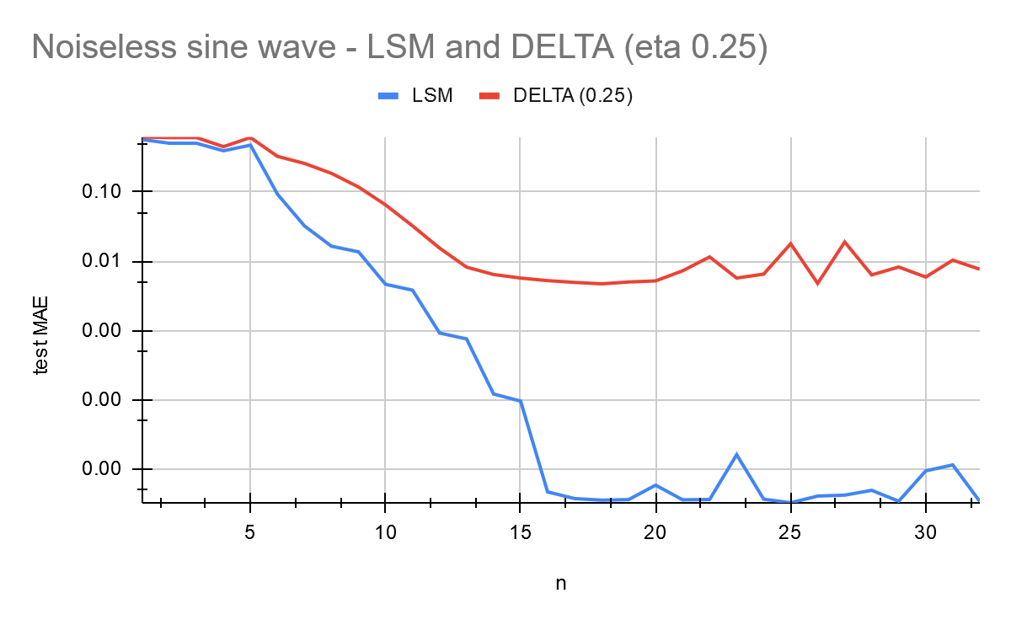
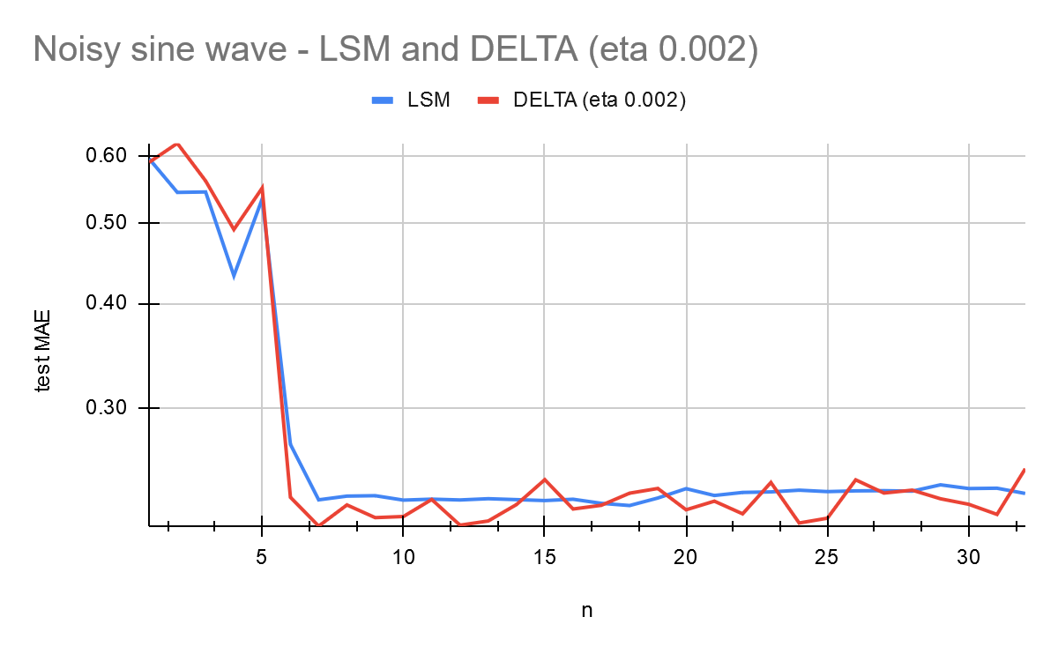
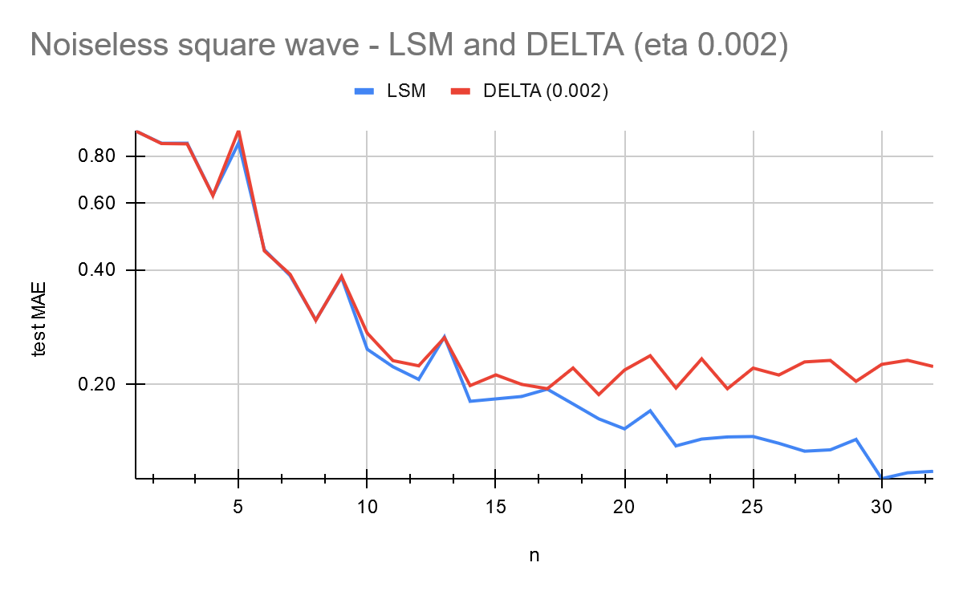
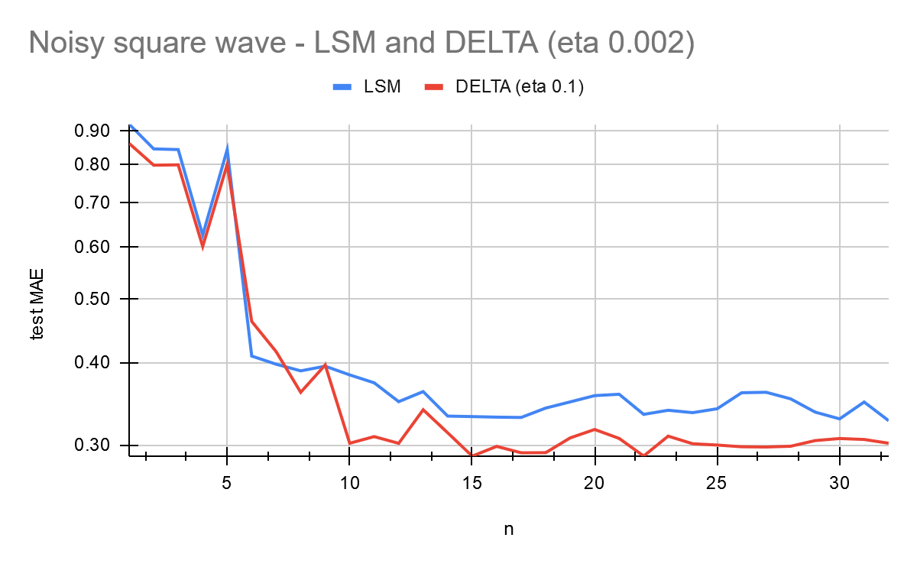
RBF regression: noiseless vs. noisy
LSM for noiseless, DR for noisy
Notes:
Next up we have added noise with a variance of 0.1 to our data and here we plotted the performance of the least square and the delta rule learning methods. WE can see that for noiseless data LSM outperforms the delta rule, but with added noise the delta rule outperforms the least square method. This is very intuitive since the least square method learns the training data perfectly, which allows for overfitting on noisy data, something delta rule, especially with early stopping, handles better.

Slide 6
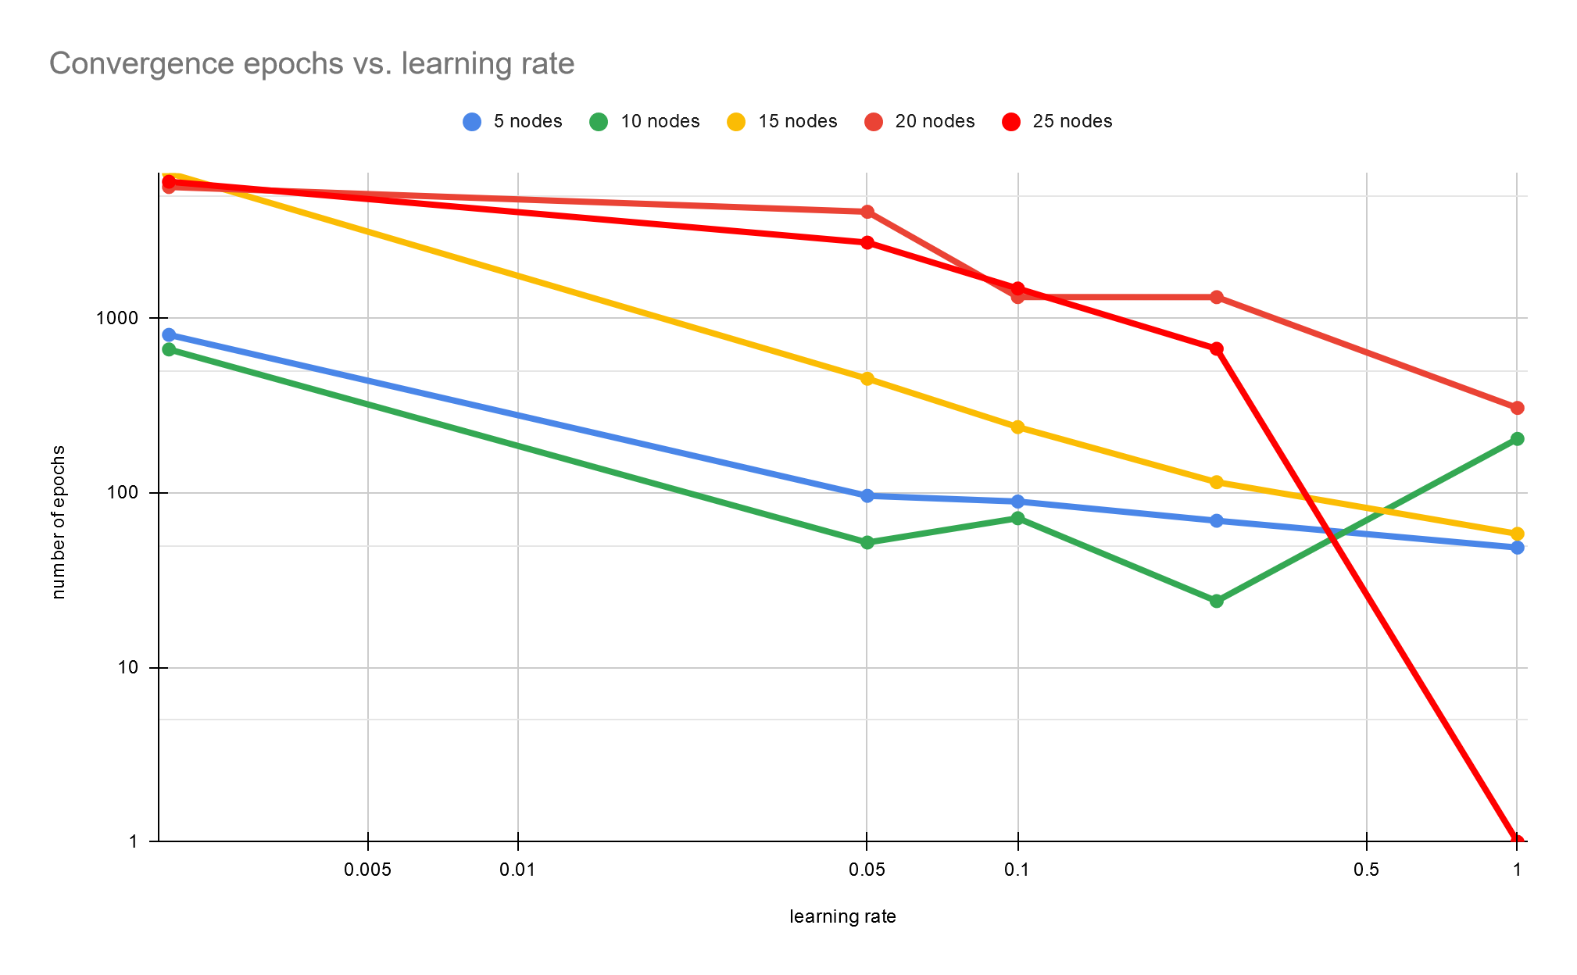
RBF regression: convergence of DR
faster for less nodes and larger learning rates (divergence!)
Notes:
We also observed the convergence rate for the delta rule concerning the learning rate eta and the number of nodes. Generally, we have observed that using a larger learning rate speeds up the convergence, but risks divergence and a larger error, as we could expect. A larger number of units/nodes also makes the learning somewhat slower.

Slide 7
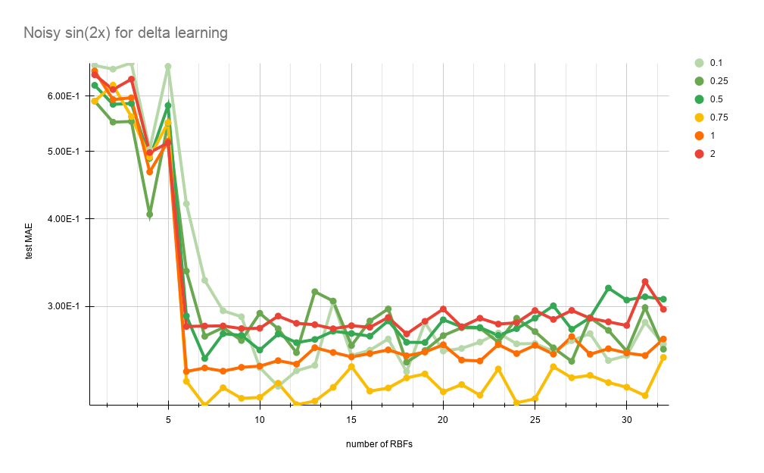
RBF regression: width influence
width not too large not to small -> describes the input space correctly
Notes:
We have also observed the influence of RBF widths on the performance of the network. Plotted here we see the delta learning for different widths with the test mean absolute error on the y, and the number of RBF units on the x axis. We can see that picking the correct width is important, and that picking too big or too small of a width does cause performance decrease. In this example the width, rather it’s square, the variance, of 0.75 performed the best, while larger and smaller values got worse results.

Slide 8
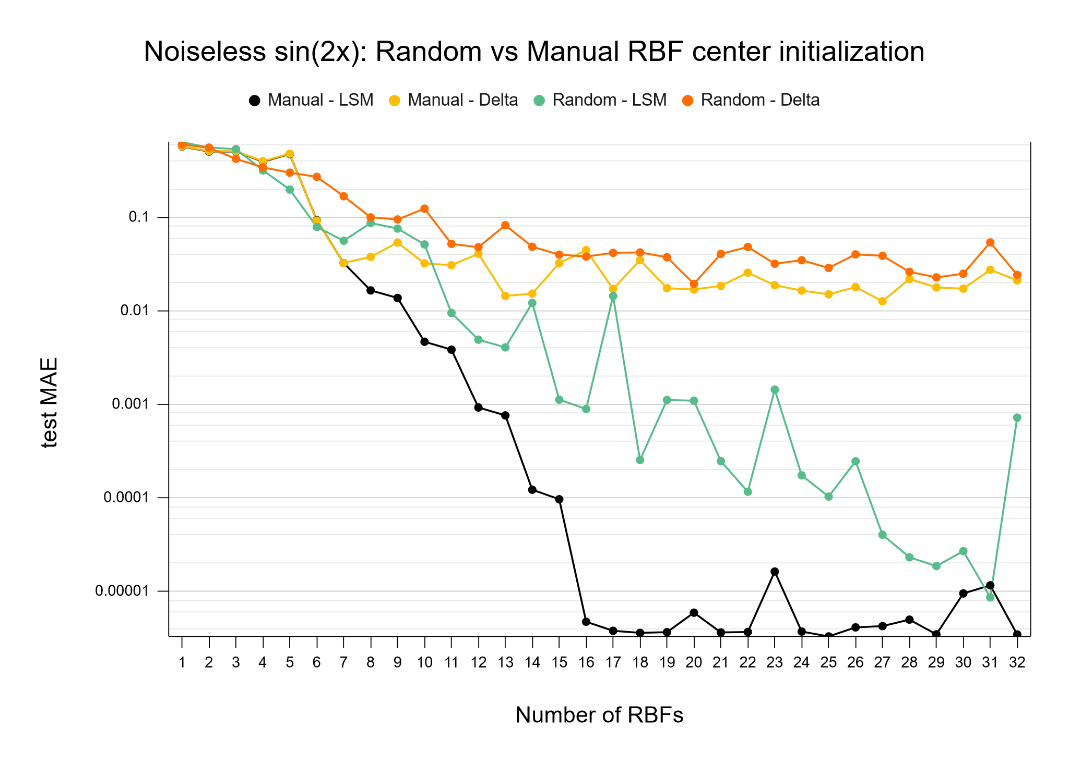
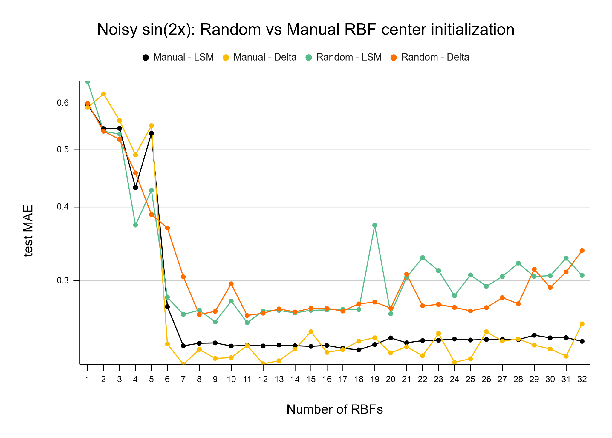
RBF regression: random vs. manual initialization
manual (uniform across input space) >> random
Notes:
Our method of picking centres was using an even distribution of centres across the input space. We have compared this to randomly picking centres in the same input space and got results that prove that our manual method was superior to the random method. We can see the results for noisless and noisy sine wave on the left and right sides, respectively. We can see that the manual picking of nodes works best for both LSM and delta rule learning in both cases...

Slide 9
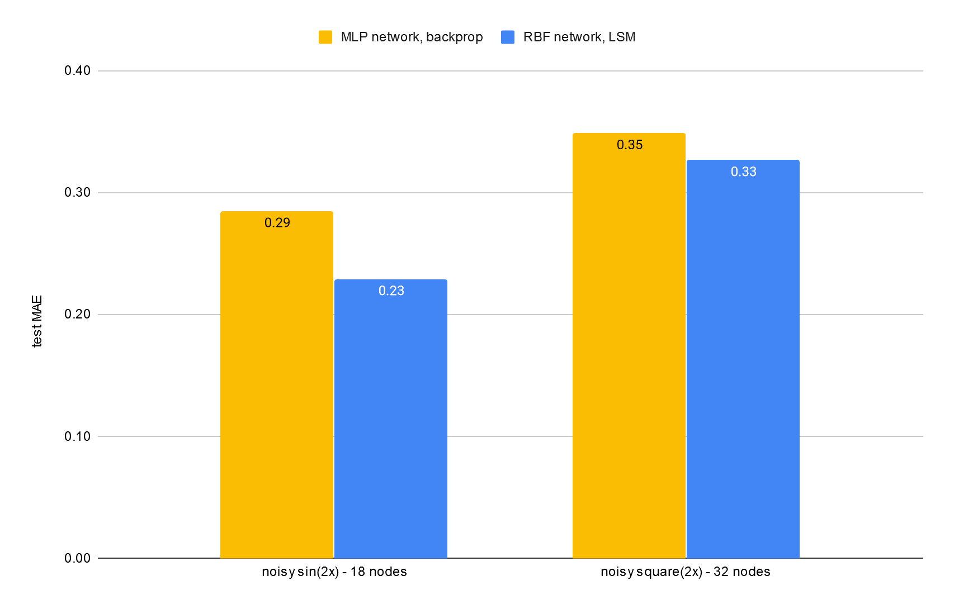
RBF regression: RBF vs. MLP
RBF slightly outperforms a two-layer MLP with the same amount of units
Notes:
Then, we’ve compared our best RBFs to two-layered perceptrons with the same amount of hidden units. We can see that in this case, our RBF networks using LSM did slightly better than the MLPs in terms of the test mean absolute error for both the noisy sine wave and the noisy square function. It’s hard to draw any other conclusions.

Slide 10
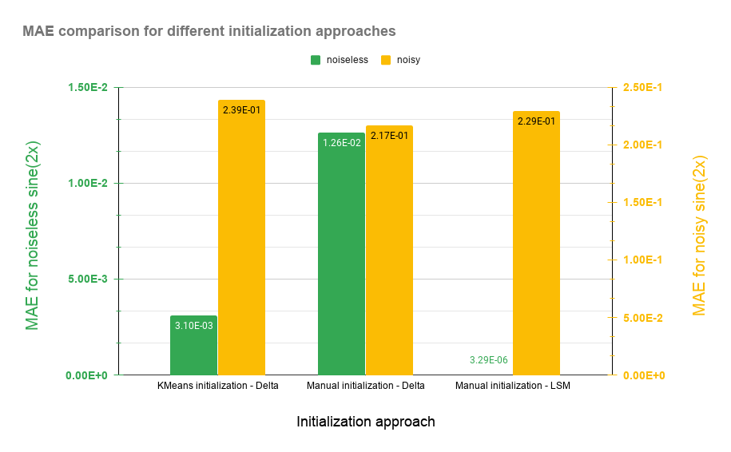
RBF competitive learning: sin(2x)
slightly underperforms compared to our manual method
Notes:
We tried using competitive learning for the initialization of the centres of RBF units. We can see that the performance of the automated centre positioning performed somewhat worse than the manual initialization approaches for noisy data, but for noiseless data worked far better than the delta with manual initialization, though not as good as manual with least squares method.

Slide 11
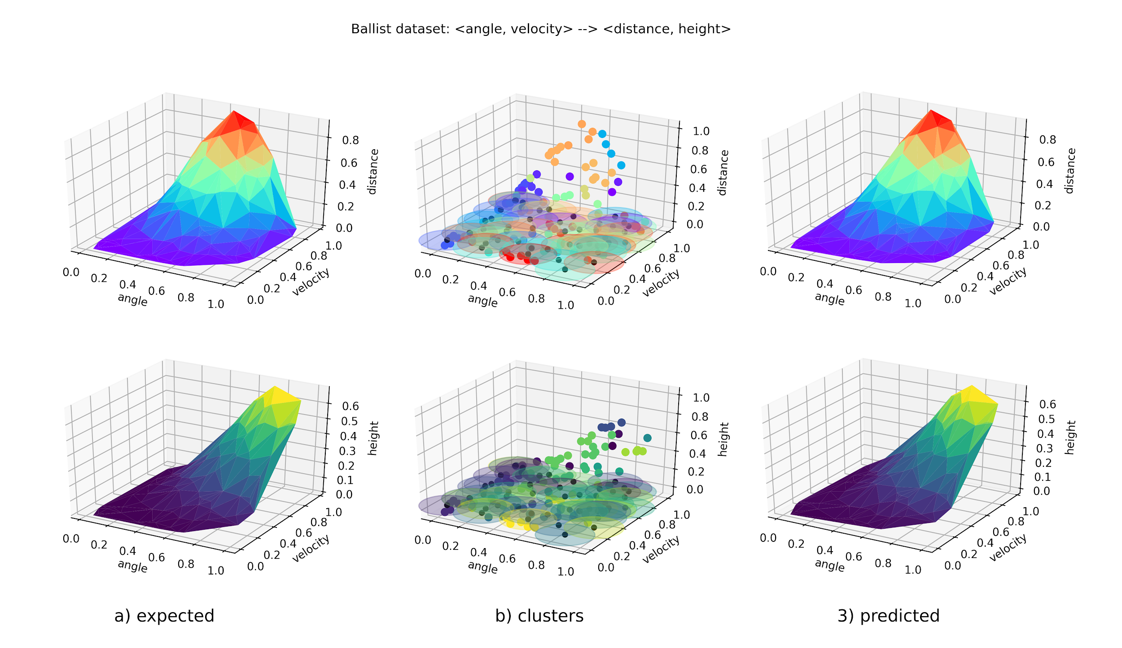
RBF competitive learning: ballistical experiments
Notes:
Finally, we use an RBF network with two inputs and two outputs, the input was the angle and the velocity of a projectile, while the outputs were the distance and height the projectile reach. We can see a really good performance on both outputs using competitive learning for clustering and determining the RBFs’ centres and the delta rule for changing of the weights of the network.

Slide 12
Assignment part II
Unsupervised learning: Self Organizing Maps
Notes:
Implemented by hand using numpy

Slide 13
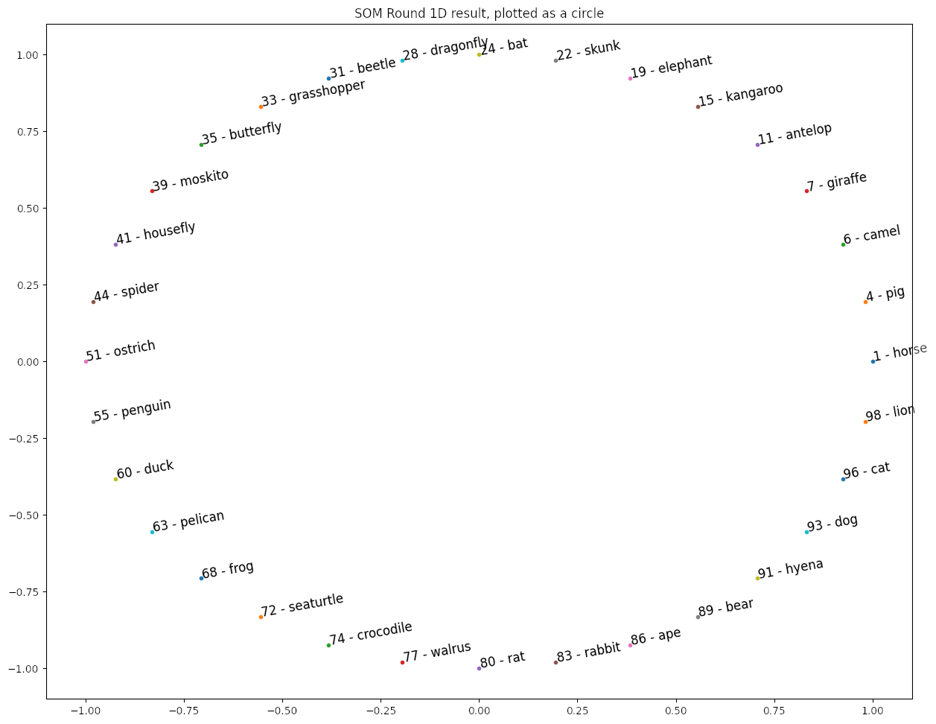
SOM
Animals, 1D
Topological structure
lr = 0.2; 20 epochs
Notes:
Trained with a round list even if it wasn’t necessary, shown as a circle here
neighborhood series: use of the harmonic series (x50) at the begining then 2s, 1s and 0s
Nice structure in the data is found
From 77 to 24: Mammals; From 62 to 71 Birds;
From 51 to to 77 Chordates; From 28 to 44 Insects (+ spider)
Cat & Lion; Hyena & Dog; Kangaroo \& Rabbit are neighbors
Egg laying animals
and much more

Slide 14
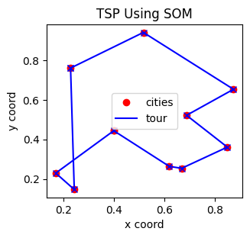
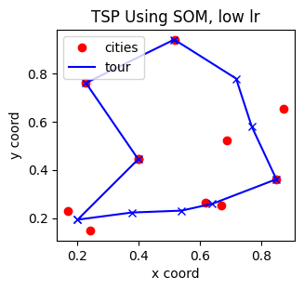
SOM
TSP, 1D
Path
lr = 0.65; 20 epochs
ns: 4-2, 6-1, 10-0
lr = 0.225; 60 epochs
ns: 12-2, 18-1, 30-0
Notes:
Random initialization all the time (doesn’t impact the experience)
Needs to tune learning rate,
Might never converge to a satisfying condition
Blocked between cities in individual updates
Then some solution for TSP, a bit counter-intuitive

Slide 15
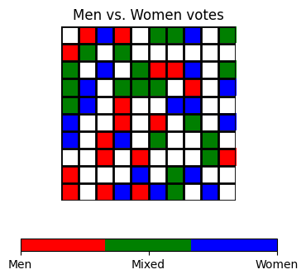
SOM
MPs, 2D (clustering)
Gender
lr=0.33; 60 epochs
ns: 10-2, 25-1, 15-0
Notes:
Manhattan distance neighborhood
Evenly spread out between men & women & mixed
MPs in sweden are not voting based on their gender
Good reputation in sweden for gender parity

Slide 16
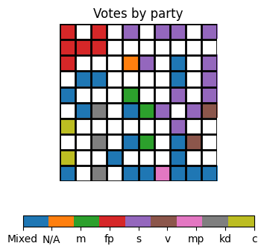
SOM
MPs, 2D (clustering)
Party
lr=0.42; 60 epochs
ns: 30-2, 10-1, 20-0
Notes:
nice party clusters,
Reflects the size (Social Democrat party which was in majority during 2004-2005).
Geometric intuitions (actual structure of parliament)
social democrat (S) party and left party (V) are close : had an agreement during this mandate.
The moderate (M) cluster is in the middle.
...
More could probably be derived but we would need a deeper understanding of swedish politics during this period
Legend:
Social Democrats (s)
Moderate Party (m)
Liberal People's Party (fp)
Christian Democrats (kd)
Left Party (v)
Centre Party (c)
Green Party (mp)

Slide 17
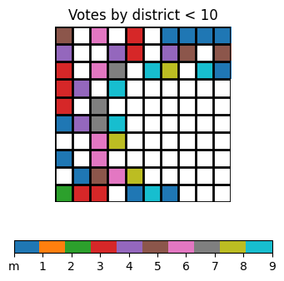
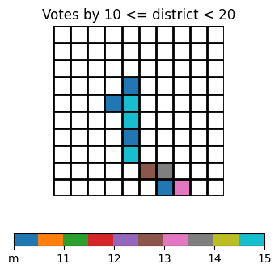
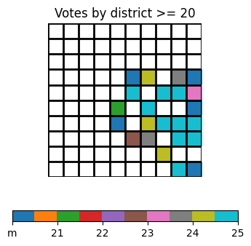
SOM
MPs, 2D (clustering)
Districts
lr=0.33; 60 epochs
ns: 10-2, 25-1, 15-0
Notes:
Best trains; With larger number of epochs
Split in 3 because of color limitation, plus a lot of square would go into the “mixed” category
Hard to interpret but clear separation of some districts (especially the numbers below 10 vs the one above 20)

Slide 18
Thank you

