Slide 1
The challenge
The Retail Customer Relationship managers heard about big data and start to think about all the data they had to collect and are available in the bank.
Identify new target customers for mortgages.

Slide 2
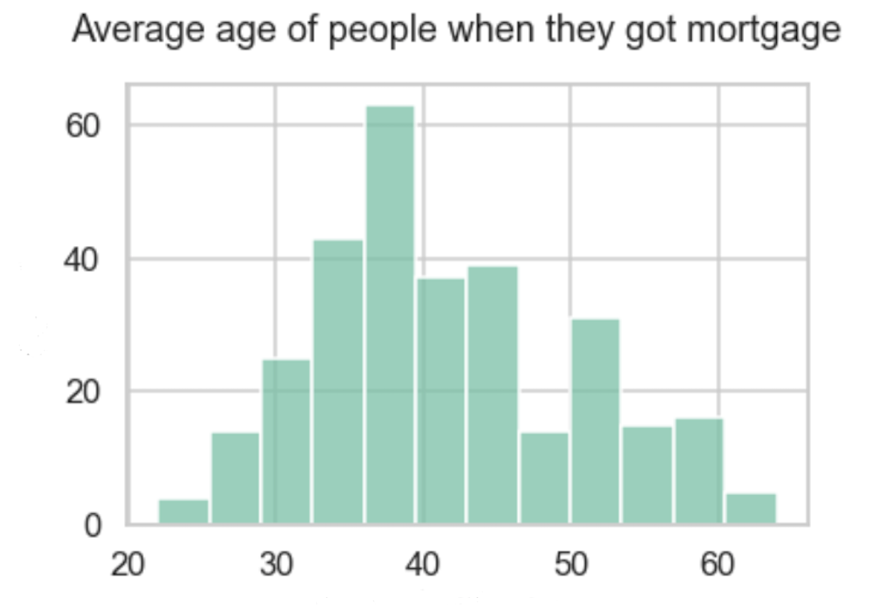
Key findings: Average age
The age of people they got accepted
for mortgage in range 35-40 years.

Slide 3
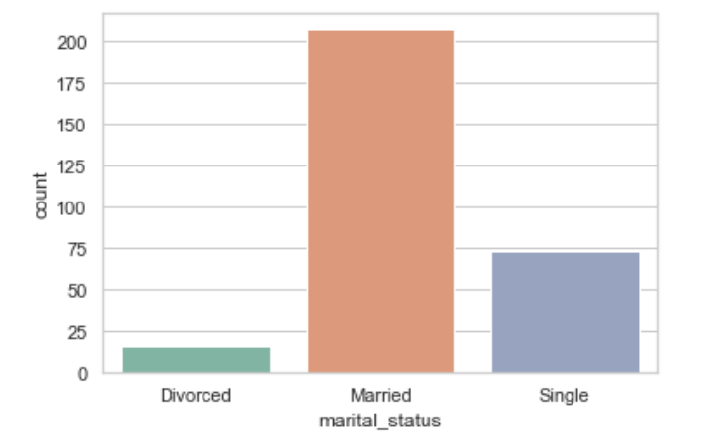
Key findings: Marital status
Married people are more likely to have mortgage.

Slide 4
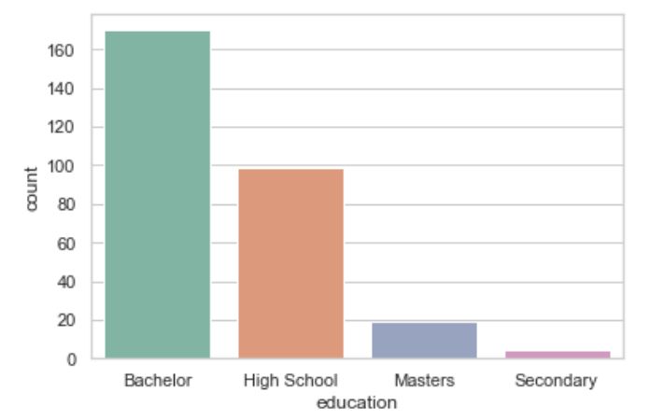
Key findings: Education
The majority of mortgage
customers have Bachelor degree.

Slide 5

Key findings: Income
Customer income and customer balance are higher for those who have mortgage, compared to ones who don’t.

Slide 6
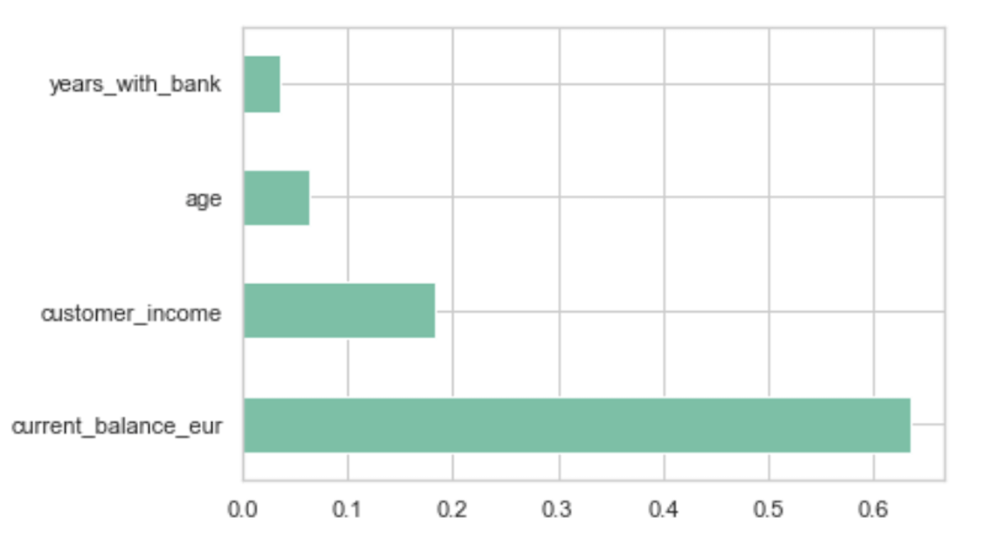
Model performance: feature importance
The most important feature
according to ML model
is customer’s current balance.

Slide 7
Model performance: implications
Different possible cases:
When we decide to target consumers, what is the probability that they respond?
What is the probability that they do not?
What about when we do not target consumers, would they have responded?

Slide 8
Next steps: Reiterating
Revaluation and further detailed analysis to uncover meaningful opportunities

