Slide 1
Factors affecting first year (college) grade point average
Mathew Itoney
Department of Data Science, Bellevue University
Professor Matthew Metzger May 8, 2023

Slide 2
Statistical question/hypothesis:
Does the verbal SAT percentile, math SAT percentile, total of verbal and math SAT percentiles, high school grade point average, and the gender of a college student have an impact on their first year (college) grade point average?

Slide 3
Variables in the dataset:
sex
sat_v
sat_m
sat_sum
hs_gpa
fy_gpa

Slide 4
Variable descriptions:
sex: Gender of the student.
sat_v: Verbal SAT percentile.
sat_m: Math SAT percentile.
sat_sum: Total of verbal and math SAT percentiles.
hs_gpa: High school grade point average.
fy_gpa: First year (college) grade point average.

Slide 5
Histogram analysis:
For each variable, a histogram will be created to visualize the distribution of data. Outliers will be removed from the data.

Slide 6
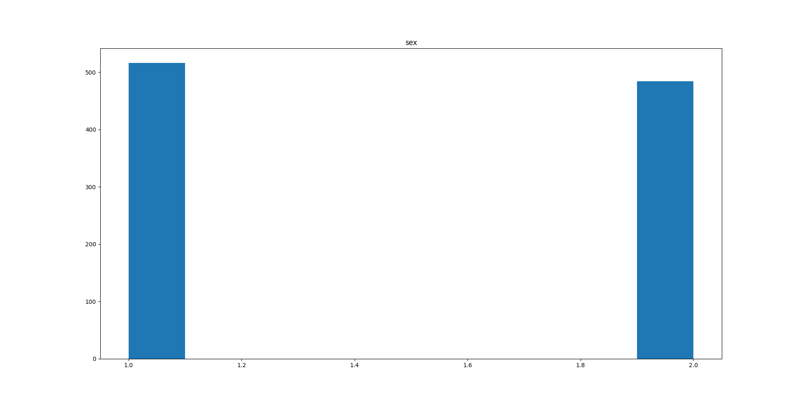
Histogram: Gender of the student

Slide 7
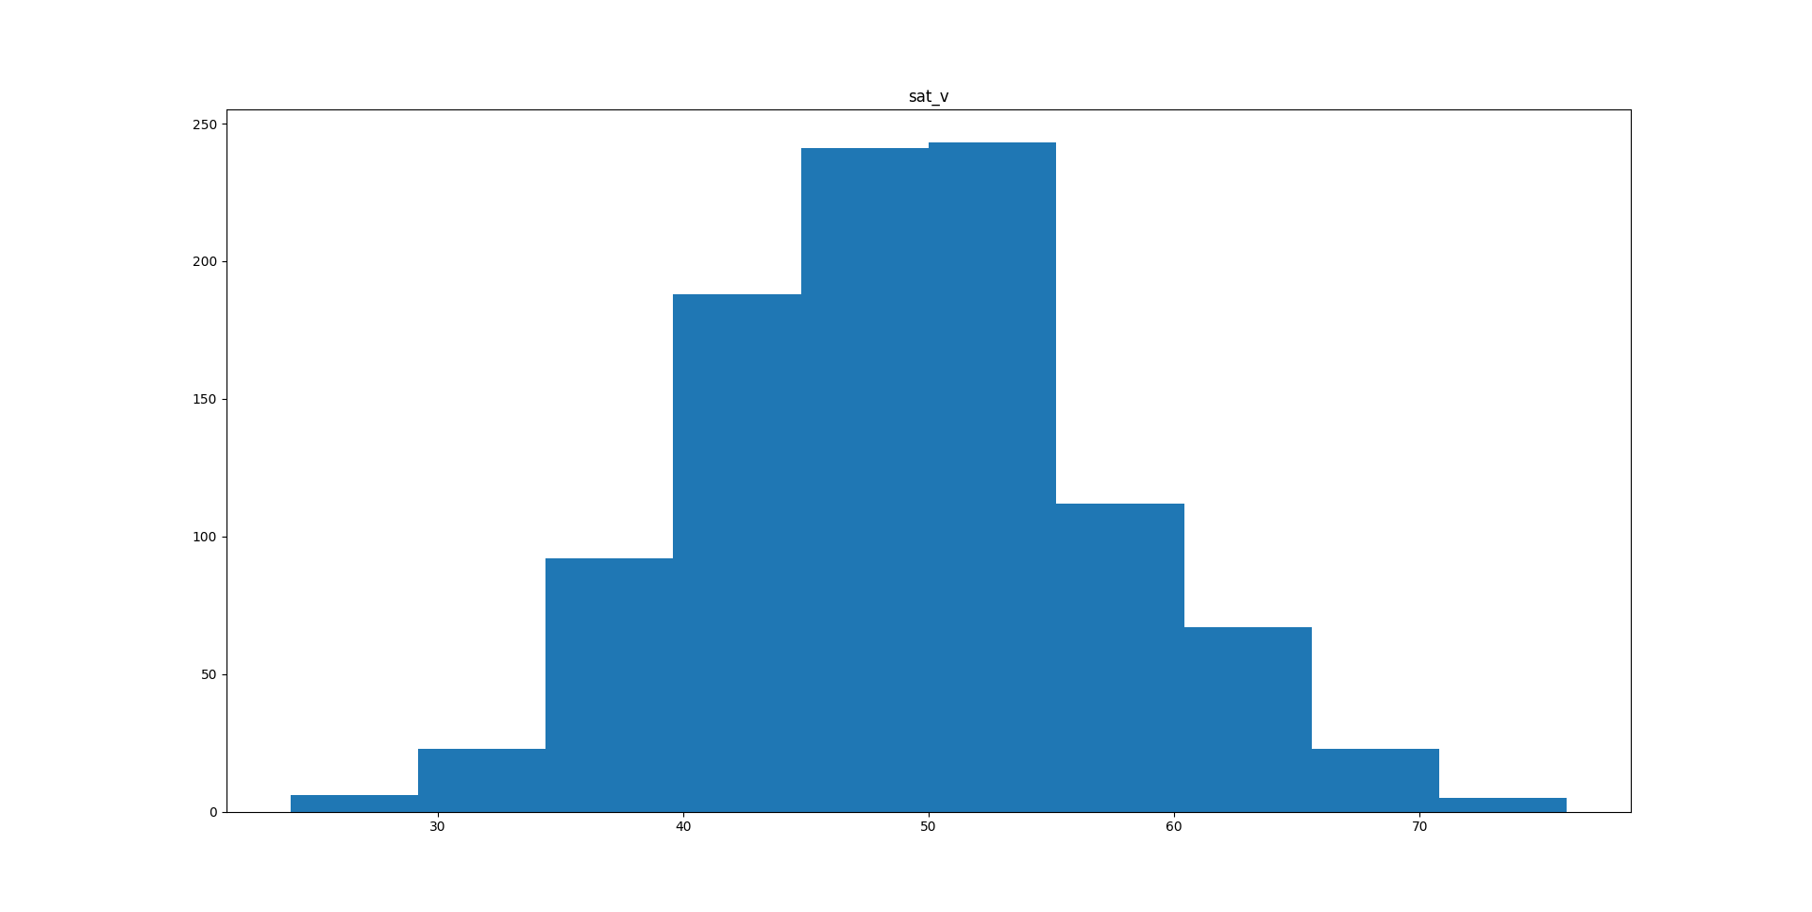
Histogram: Verbal SAT percentile

Slide 8
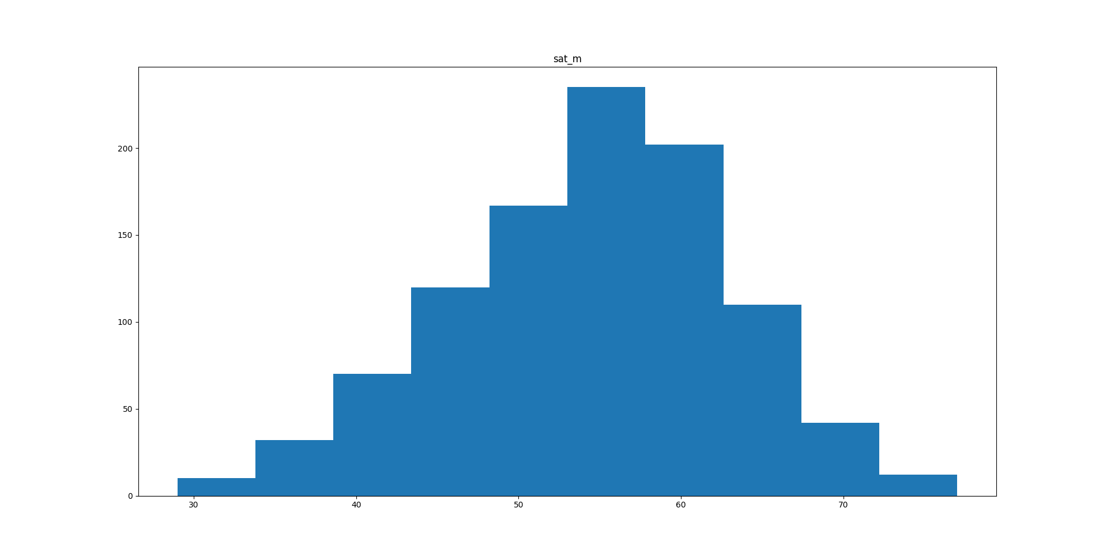
Histogram: Math SAT percentile

Slide 9
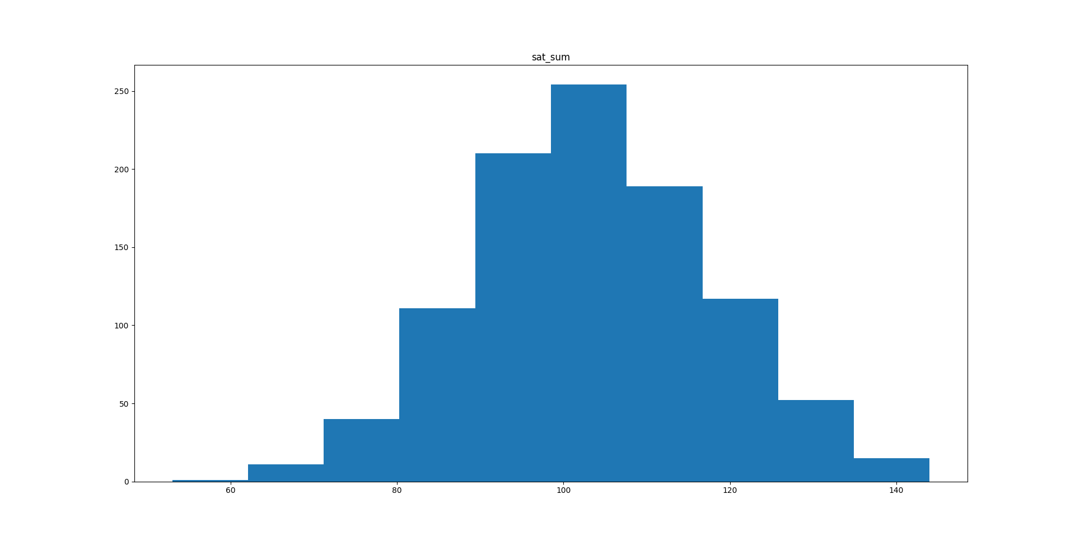
Histogram: Total of verbal and math SAT percentiles

Slide 10
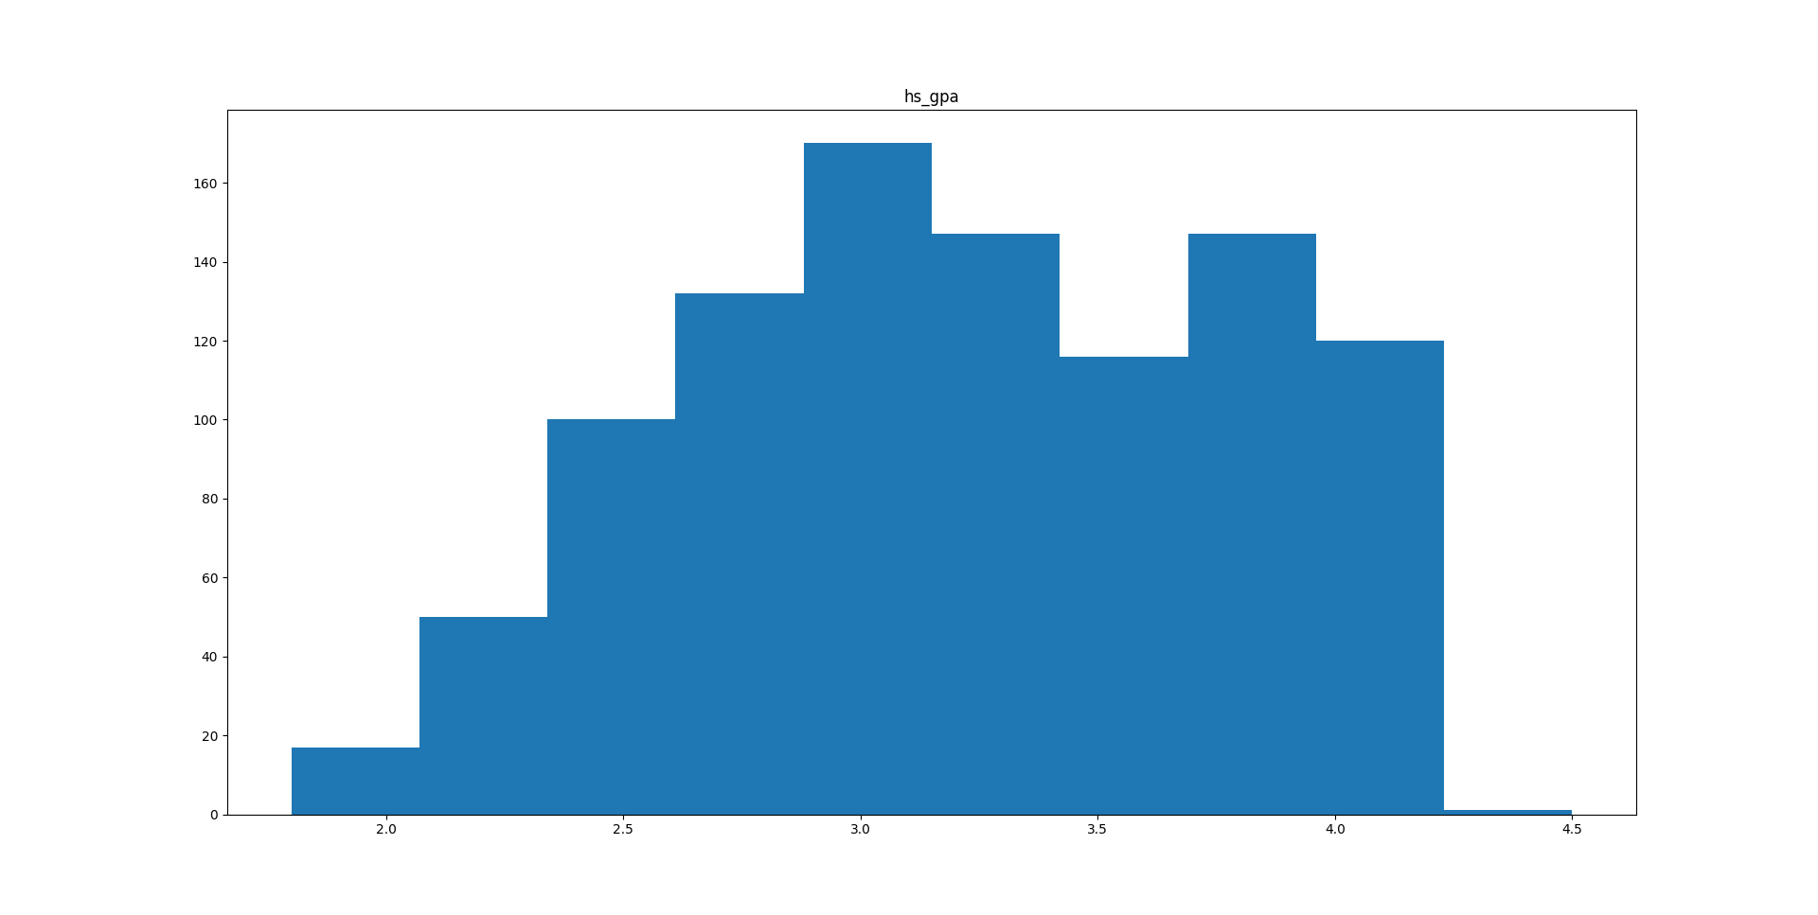
Histogram: High school grade point average

Slide 11
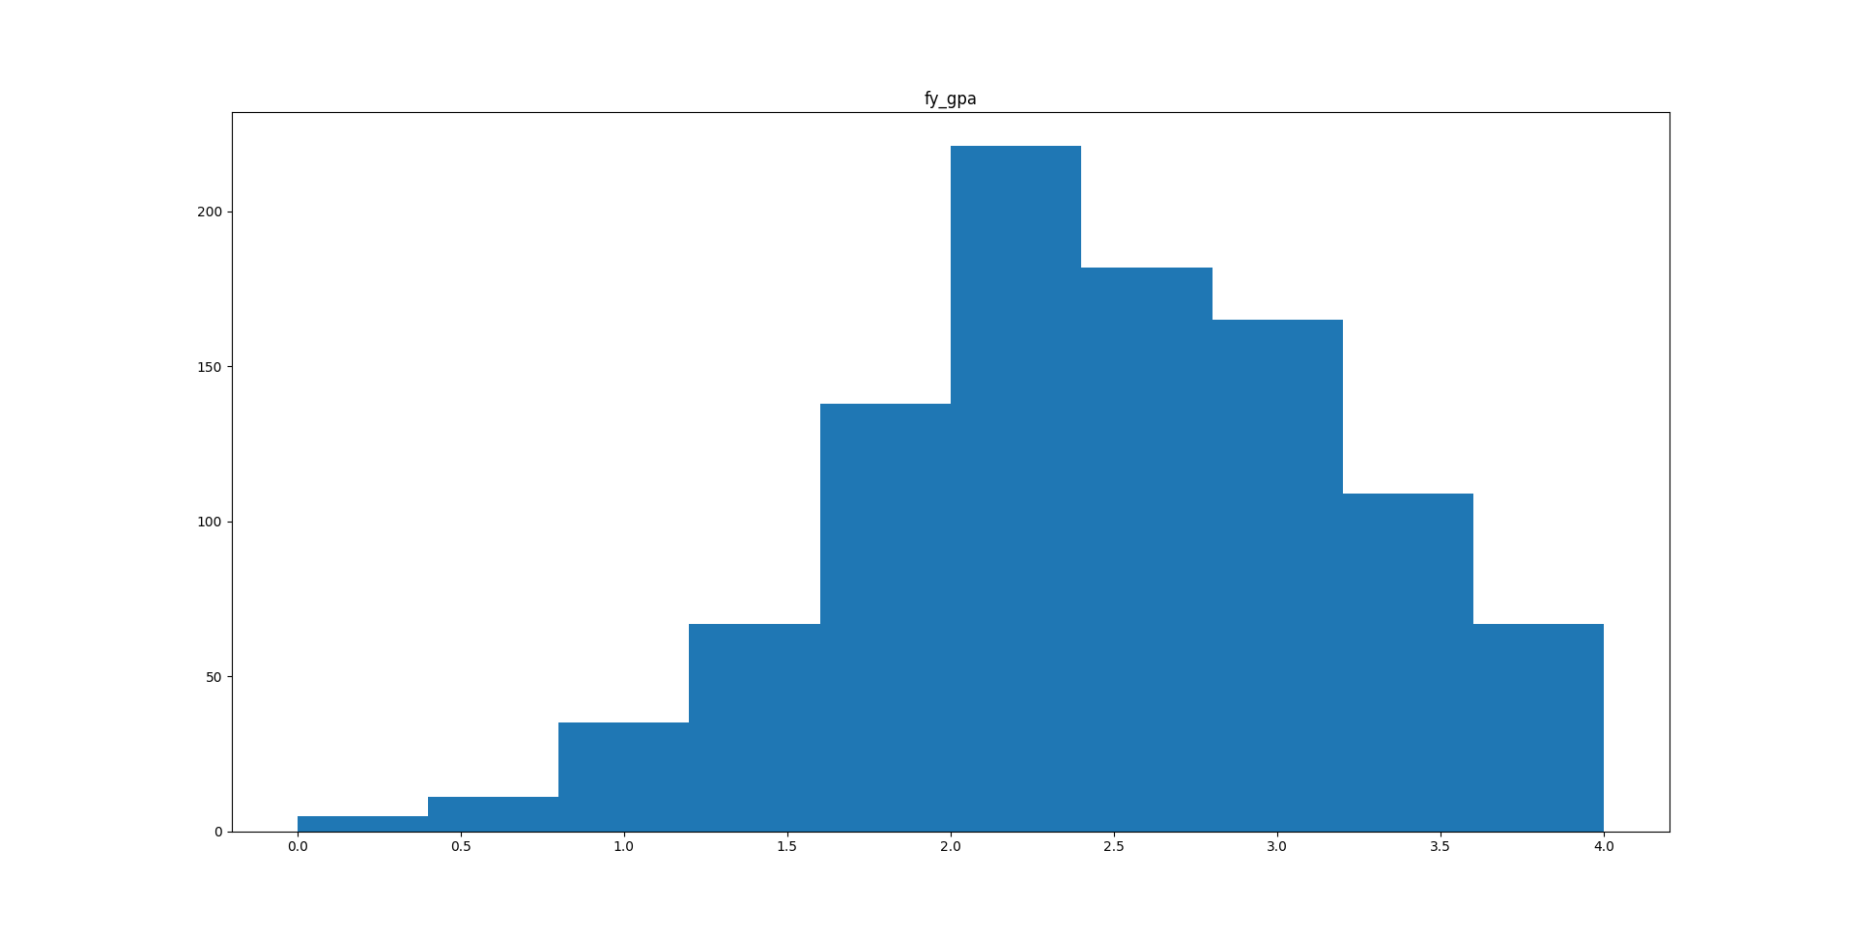
Histogram: First year (college) grade point average

Slide 12
Descriptive characteristics:
Column 'sex':
Mean: 1.48
Mode: 1
Standard Deviation: 0.50
Minimum Value: 1
Maximum Value: 2
1st Quartile: 1.00
3rd Quartile: 2.00
Interquartile Range: 1.00
Column 'sat_v':
Mean: 48.93
Mode: 49
Standard Deviation: 8.12
Minimum Value: 26
Maximum Value: 73
1st Quartile: 43.00
3rd Quartile: 54.00
Interquartile Range: 11.00

Slide 13
Descriptive characteristics:
Column 'sat_m':
Mean: 54.43
Mode: 57
Standard Deviation: 8.41
Minimum Value: 31
Maximum Value: 77
1st Quartile: 49.00
3rd Quartile: 60.00
Interquartile Range: 11.00
Column 'sat_sum':
Mean: 103.36
Mode: 103
Standard Deviation: 14.12
Minimum Value: 65
Maximum Value: 144
1st Quartile: 93.00
3rd Quartile: 112.75
Interquartile Range: 19.75

Slide 14
Descriptive characteristics:
Column 'hs_gpa':
Mean: 3.20
Mode: 4.0
Standard Deviation: 0.54
Minimum Value: 1.8
Maximum Value: 4.5
1st Quartile: 2.80
3rd Quartile: 3.70
Interquartile Range: 0.90
Column 'fy_gpa':
Mean: 2.47
Mode: 2.24
Standard Deviation: 0.73
Minimum Value: 0.36
Maximum Value: 4.0
1st Quartile: 1.98
3rd Quartile: 3.02
Interquartile Range: 1.04

Slide 15
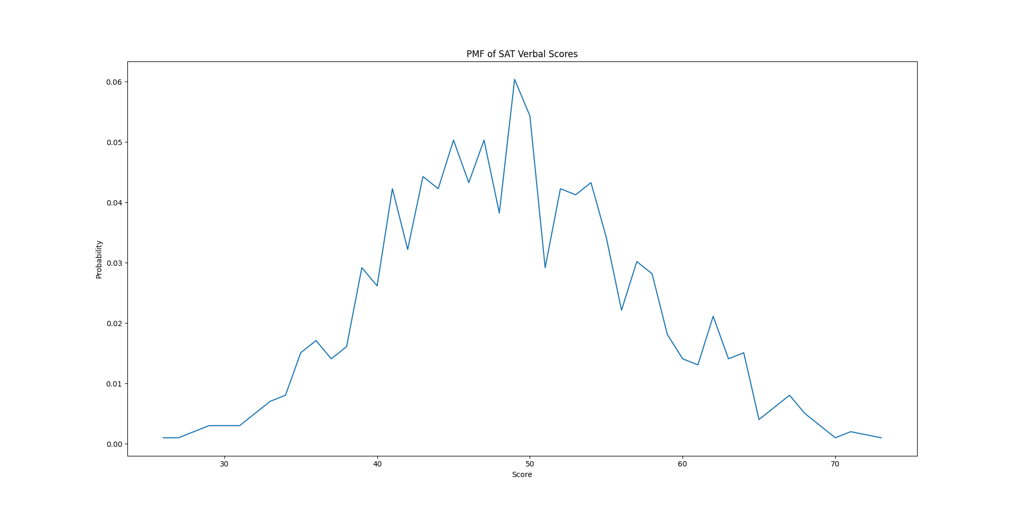
PMF comparison: Verbal SAT percentile

Slide 16
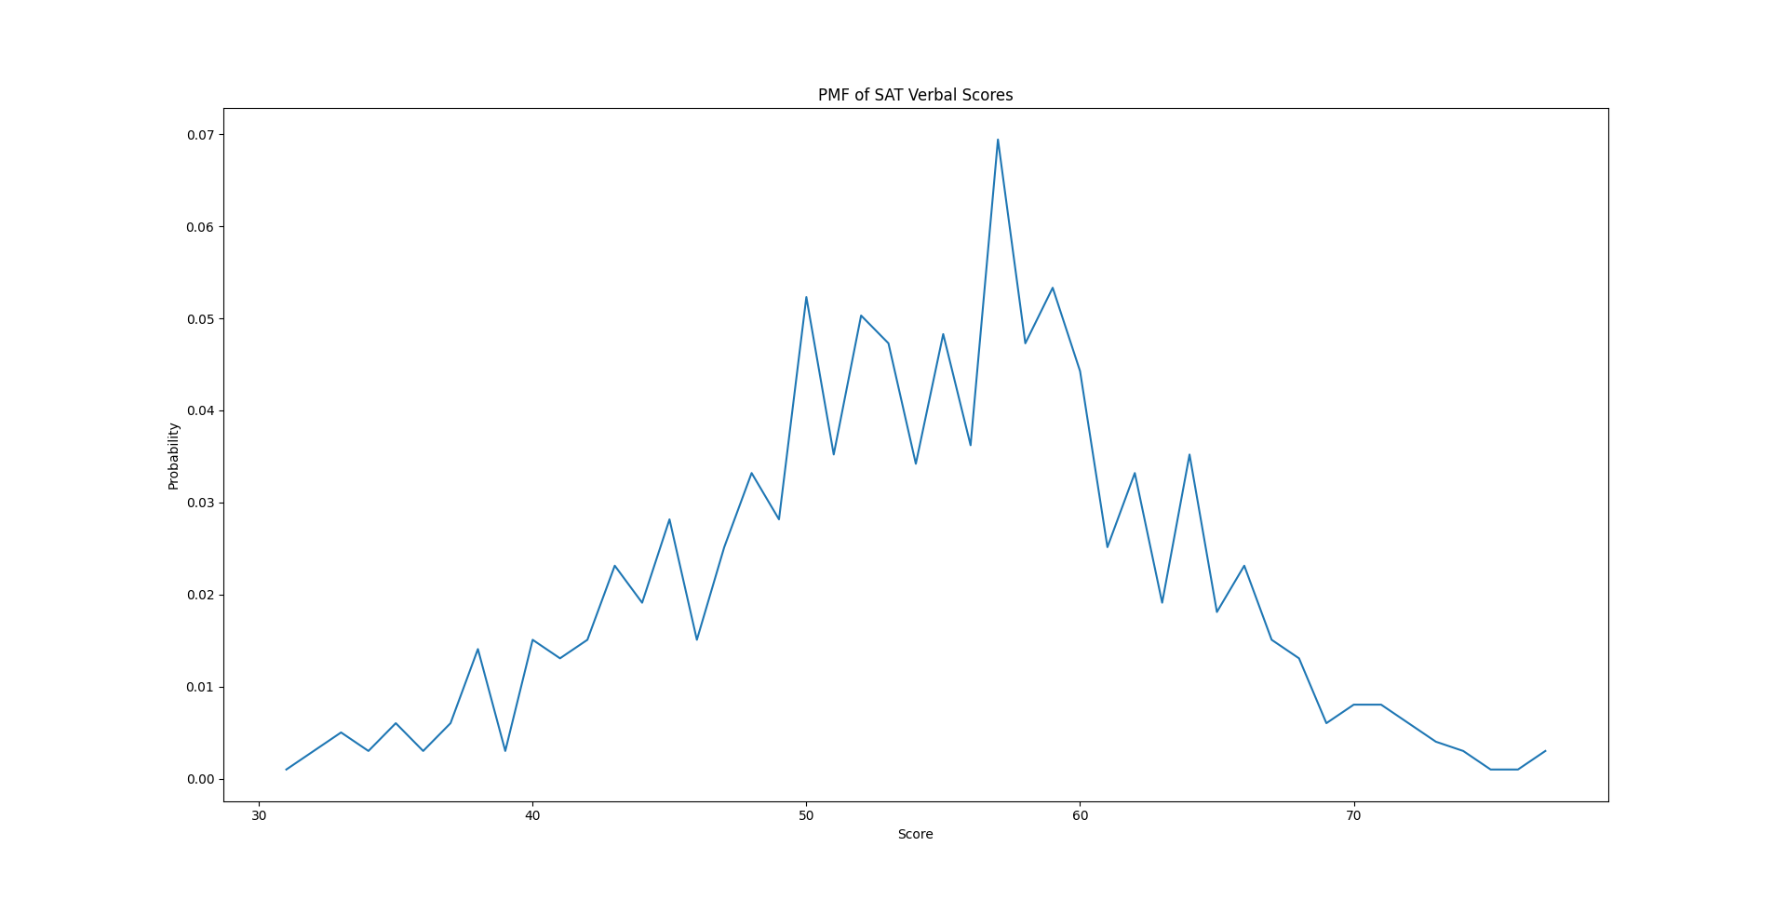
PMF comparison: Math SAT percentile

Slide 17
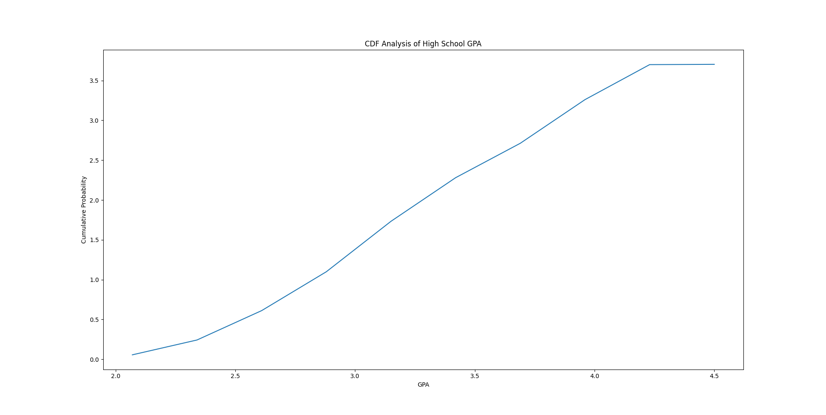
CDF analysis: High school grade point average

Slide 18
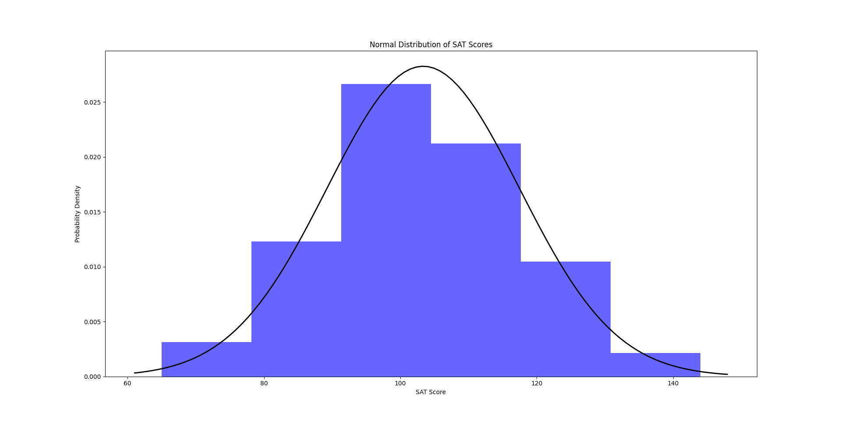
Analytical distribution: Total of verbal and math SAT percentiles

Slide 19
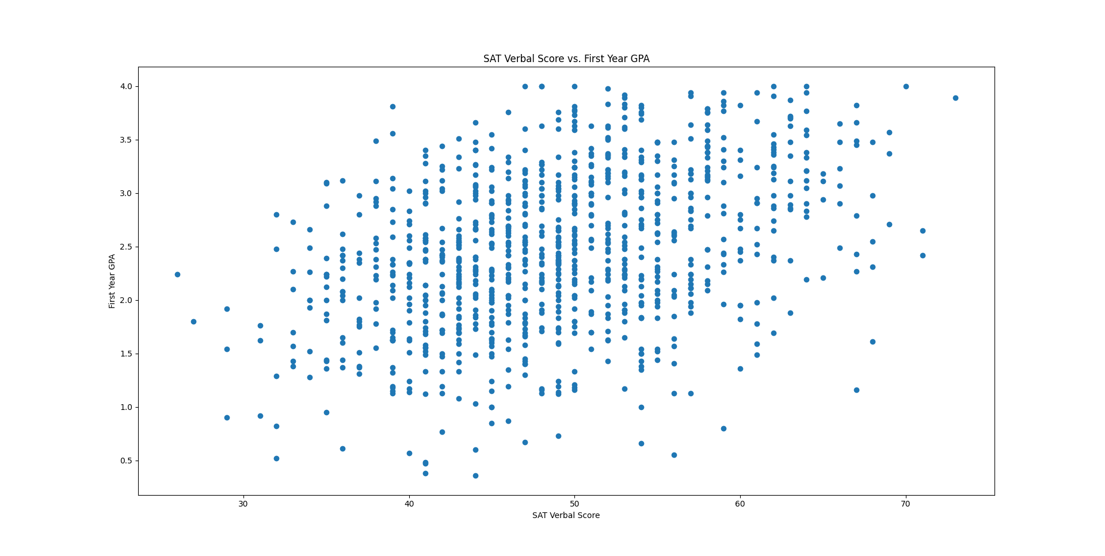
Scatter plot analysis: SAT Verbal Score vs. First Year GPA

Slide 20
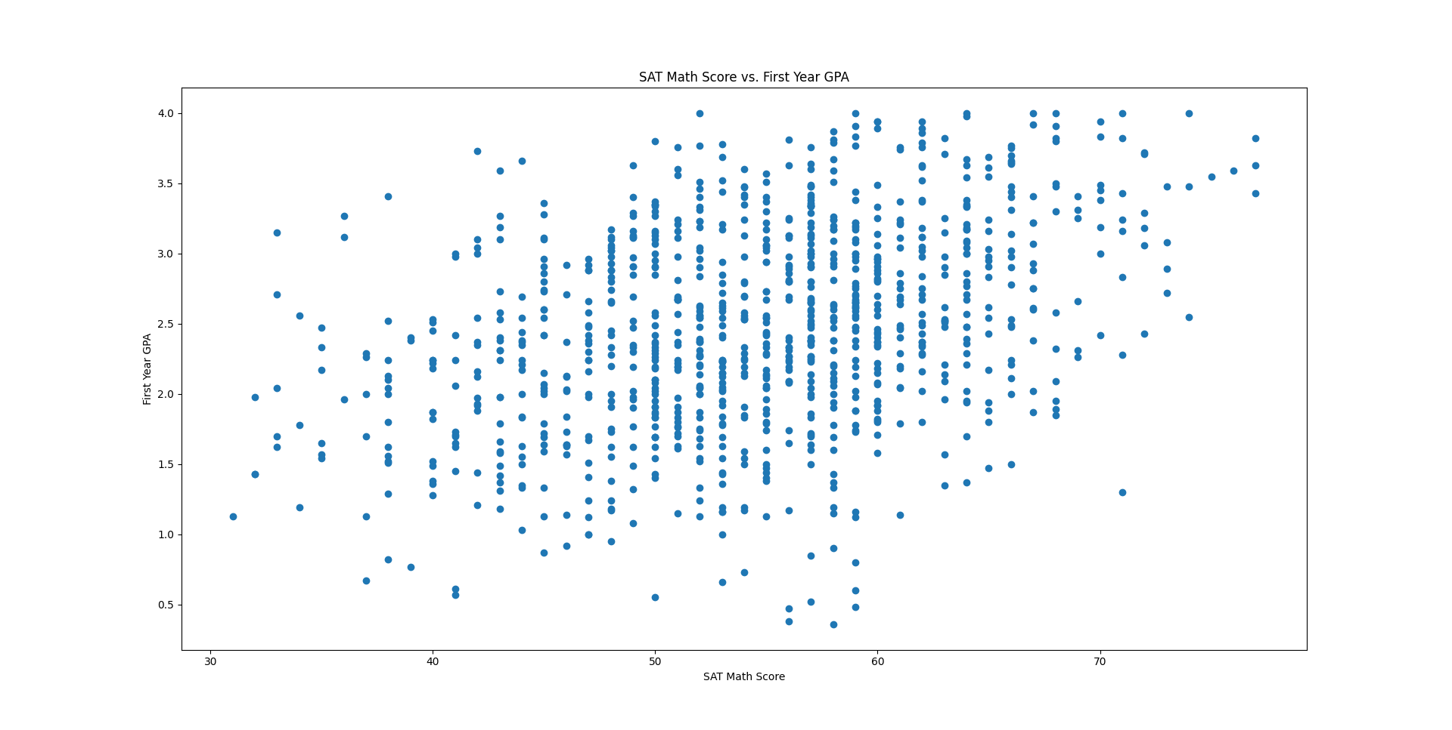
Scatter plot analysis: SAT Math Score vs. First Year GPA

Slide 21
Hypothesis testing: correlation coefficients
fy_gpa | 1.000000
sex | 0.102209
sat_v | 0.393295
sat_m | 0.384160
sat_sum | 0.454933
hs_gpa | 0.535207

Slide 22
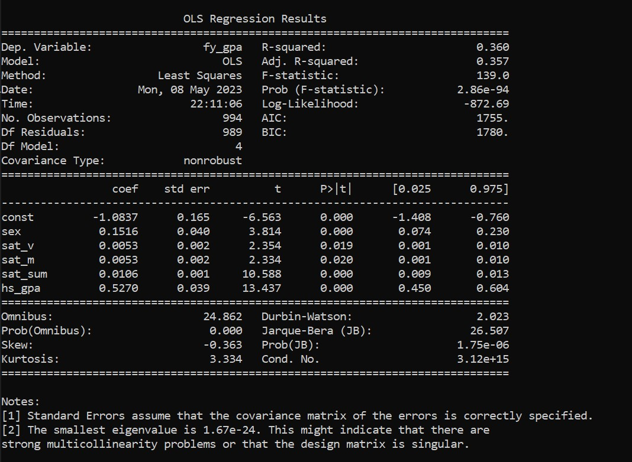
Regression analysis:

