Slide 1
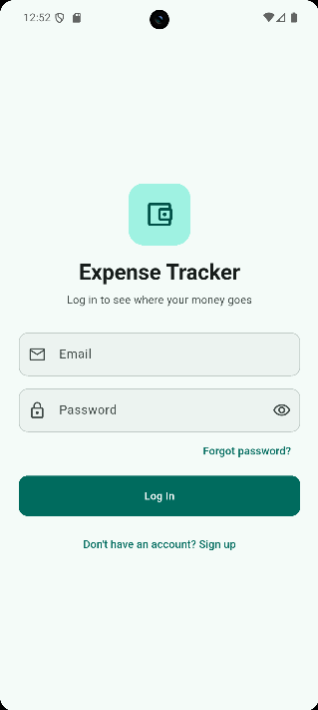
Expense Tracker
FINAL PROJECT PRESENTATION
A secure mobile application for tracking personal expenses
Presented by: Maram Sharaf
Flutter Internship Program · October 2026
Notes:
(20 s) Good morning, everyone. Thank you for joining me. My name is Maram Sharaf, and today I am presenting my final project from the Flutter internship: Expense Tracker, a secure mobile application that helps people record their daily expenses and understand where their money goes.

Slide 2
Today’s presentation · 25 minutes
AGENDA
01
Introduction: problem and solution · 2 min
04
Work division, Git workflow and learnings · 3 min
02
Live demo: features, user flow, edge cases · 10 min
05
Questions and answers · 5 min
03
Technical: architecture, challenges, code · 5 min
Expense Tracker · Final Project Presentation
02
Notes:
(20 s) The presentation takes about twenty-five minutes and has five parts. First, a short introduction to the problem and my solution. Then the main part, a ten-minute live demo with all features, a full user flow and the edge cases. After that, five minutes of technical discussion: architecture, the challenges I solved and some code. Then how I organised the work and used Git, and finally your questions.

Slide 3
Small daily expenses are easy to lose track of
01 · INTRODUCTION · THE PROBLEM
Low visibility
High effort
Privacy concerns
Individually small purchases accumulate into a large share of monthly income without being noticed.
Notebooks and spreadsheets are slow to update, so most people stop recording after a short time.
Financial data is personal and must remain secure and accessible only to its owner.
Objective: build a fast, secure and easy-to-use mobile application for recording and analysing personal expenses.
Expense Tracker · Final Project Presentation
03
Notes:
(40 s) Most people know their income, but not exactly where it is spent. Small daily purchases such as coffee, transport and deliveries add up without being noticed. Notebooks and spreadsheets take effort, so people usually stop using them. And financial data is personal, so it must be protected. My objective was to build a fast, secure and easy-to-use mobile app for recording and analysing personal expenses.

Slide 4






Six core capabilities
01 · INTRODUCTION · THE SOLUTION
Secure accounts
Expense management
Monthly summary
Sign up, log in and password reset by email.
Add, view, edit and delete expenses across six categories.
Current month, all-time total and a breakdown by category.
Search and filters
Safe deletion
Personalisation
Search, filter by period and category, and sort four ways.
Swipe to delete with an Undo option and confirmation dialogs.
Light, dark and system themes, remembered between sessions.
Expense Tracker · Final Project Presentation
04
Notes:
(40 s) Expense Tracker answers this with six capabilities: secure accounts with sign-up, login and password reset; complete expense management in six categories; a monthly summary with a category breakdown; search, filters and sorting; safe deletion with Undo; and light and dark themes. Let me show you how it works.

Slide 5
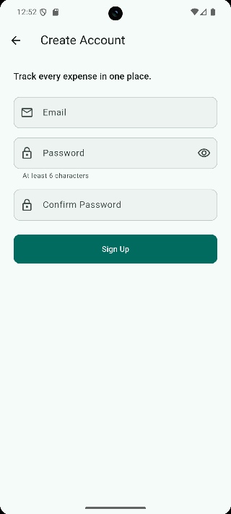
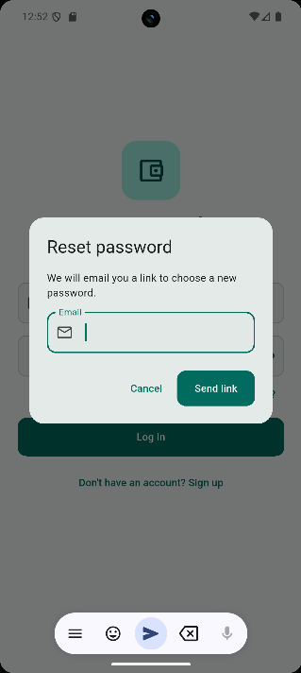
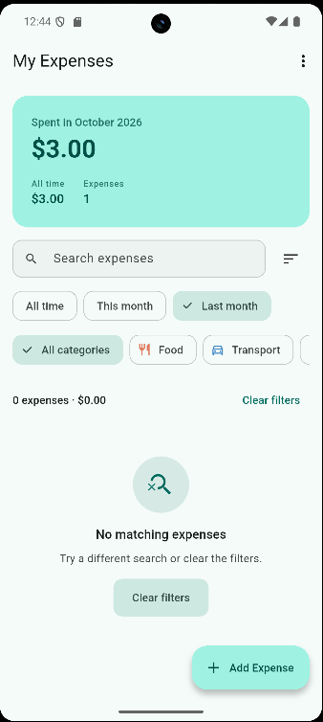
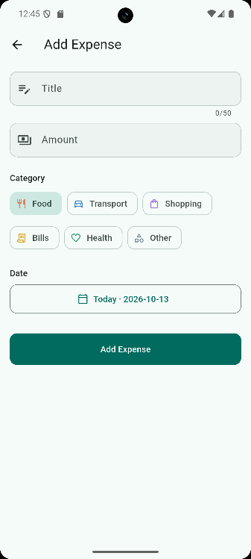
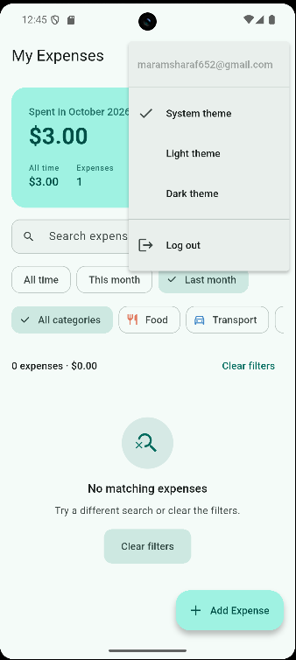
From sign-in to daily tracking
02 · LIVE DEMO · THE SCREENS
Login
Create account
Reset password
Home
Add expense
Theme and logout
Expense Tracker · Final Project Presentation
05
Notes:
(30 s) These are the main screens: login, account creation, password reset, the home screen with the summary and filters, the add-expense form, and the menu for theme and logout. Now let me show them live.

Slide 6
The application in use
1
Sign up, log in and password reset
02 · LIVE DEMONSTRATION
2
Monthly summary and category breakdown
3
Add, edit and delete with Undo
4
Search, filters and sorting
Release build on Android · about 10 minutes
5
Dark theme and log out
6
Edge cases: bad input, wrong password, offline
Notes:
(20 s) The demo has two parts. First I will walk through every feature as one realistic user journey. Then I will deliberately try to break the app, to show how it handles edge cases. I am using the release build on an Android device.

Slide 7
One complete user journey, end to end
02 · LIVE DEMO · USER FLOW
1
2
3
4
Sign up
Log in
Add expense
Review summary
Create an account
Session is remembered
Validated form
Month total, category bar
5
6
7
8
Search & filter
Sort & edit
Delete & Undo
Theme & log out
Period, category, text
Highest first, then edit
Swipe left, tap Undo
Dark mode, safe sign-out
Demo account: 7 seeded expenses in 5 categories over two months, so filters show real data.
Expense Tracker · Final Project Presentation
07
Notes:
(20 s on the slide, then about 6 min on the phone) This is the journey I will follow: from creating an account to logging out. Switch to the phone now and follow Part A of the demo script in PRESENTATION.md. The demo account already has seven expenses, so the summary and filters show real data.

Slide 8
How the app handles the unexpected
02 · LIVE DEMO · EDGE CASES
Accounts and forms
Data and network
!
Wrong password
!
Amount: abc, -5, 1e5, NaN, 12.345
A clear message, never a technical error
Rejected; 12,50 and 1,250.00 accepted
!
Email already registered
!
No internet or slow server
Duplicate sign-up is detected and explained
20 s timeout, friendly message, list kept
!
Short or mismatched password
!
Leaving a form with changes
Inline error under the field
“Unsaved changes” warning
!
Empty form submitted
!
Accidental delete
Each field says what is required
Undo restores it; a failed delete puts it back
Expense Tracker · Final Project Presentation
08
Notes:
(10 s on the slide, then about 2 min 40 s on the phone) Now the second part: what happens when things go wrong. Follow Part B of the demo script: wrong password, duplicate email, empty form, invalid amounts, airplane mode, unsaved-changes warning and Undo. Then return to the slides: 'Let me now explain how the application is built.'

Slide 9
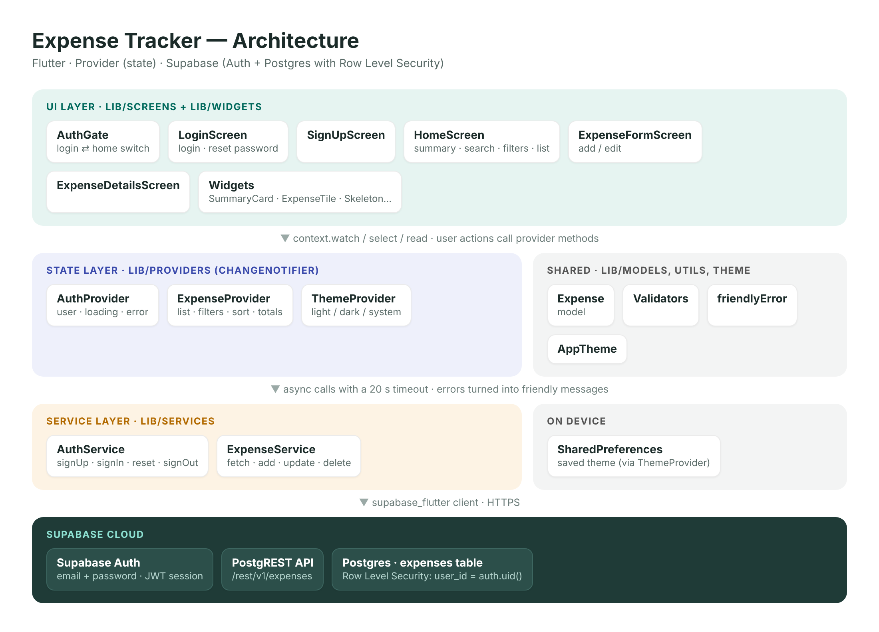
A layered design with a secure backend
03 · TECHNICAL · ARCHITECTURE
Presentation layer
Screens and widgets render the interface only.
State layer
Providers hold application state and business logic.
Service layer
The only code that communicates with Supabase.
Row Level Security
Each user can access only their own records.
Expense Tracker · Final Project Presentation
09
Notes:
(1 min) The app follows a layered architecture. The UI layer, screens and widgets, only draws the interface. The state layer uses Provider to hold the app state and business logic. The service layer is the only code that talks to the backend. The backend is Supabase: authentication plus a PostgreSQL database. Security is enforced in the database itself with Row Level Security, so each user can only access their own rows, even if someone calls the API directly.

Slide 10
Tools and technologies
03 · TECHNICAL · TECHNOLOGY STACK
Area | Technology | Purpose
Framework | Flutter · Dart 3.13 | One codebase for Android and iOS
State management | Provider | Shares state between screens
Backend | Supabase | Authentication and REST API
Database | PostgreSQL | Stores expenses with Row Level Security
Local storage | SharedPreferences | Remembers the selected theme
Quality | flutter_test · flutter_lints | Automated tests and static analysis
Expense Tracker · Final Project Presentation
10
Notes:
(30 s) Briefly, the stack: Flutter for one codebase on Android and iOS, Provider for state, Supabase for authentication and a REST API on PostgreSQL, SharedPreferences for the theme choice, and the official test and lint packages for quality.

Slide 11
Three problems I had to solve
03 · TECHNICAL · CHALLENGES SOLVED
1
Parsing the amount
2
Hidden duplicate sign-ups
3
Release-only network bug
PROBLEM
PROBLEM
PROBLEM
Users type 12,50 or 1,250.00, while Dart’s double.tryParse also accepts NaN, Infinity and 1e5.
For privacy, Supabase does not return an error when an email is already registered, so the user thought sign-up had worked.
The app worked in debug, but the release APK showed “No internet connection”.
SOLUTION
SOLUTION
SOLUTION
A custom validator normalises separators and allows only positive numbers with up to two decimals, max 1,000,000. Covered by unit tests.
Supabase returns a user with no identities instead of an error, so the app checks for that and shows “An account with this email already exists.”
The INTERNET permission was only in the debug manifest. I added it to the main manifest and re-tested the 51.3 MB APK on a Pixel 7a.
Expense Tracker · Final Project Presentation
11
Notes:
(1 min 15 s) Here are three real problems I solved. First, parsing money: people type commas or dots, and Dart's parser also accepts values like NaN and 1e5, so I wrote my own validator, which I will show next. Second, Supabase hides duplicate sign-ups for privacy: it returns a user with no identities instead of an error, so the user thought registration worked. I check for that and show a clear message. Third, the release APK could not reach the internet, because the INTERNET permission was only in the debug manifest. I fixed it and re-tested on a real phone. The lesson: always test the release build.

Slide 12
Validating money input
03 · TECHNICAL · CODE WALKTHROUGH 1/2
lib/utils/validators.dart · excerpt
1
Normalise the separator
static final RegExp _amountRegex =
RegExp(r'^(\d+(\.\d{0,2})?|\.\d{1,2})$');
/// Returns null for NaN, Infinity, 1e5 and -3,
/// which double.tryParse would accept.
static double? parseAmount(String? value) {
var v = _normalizeAmount(value);
if (!_amountRegex.hasMatch(v)) return null;
if (v.startsWith('.')) v = '0$v';
if (v.endsWith('.')) v = '${v}0';
return double.tryParse(v);
}
/// One comma + 1-2 digits = decimal comma (12,50).
/// Any other comma = thousands separator (1,250.00).
static String _normalizeAmount(String? value) {
final v = (value ?? '').trim().replaceAll(' ', '');
final commaParts = v.split(',');
final isDecimalComma = !v.contains('.') &&
commaParts.length == 2 &&
commaParts[1].isNotEmpty &&
commaParts[1].length <= 2;
return isDecimalComma ? v.replaceAll(',', '.')
: v.replaceAll(',', '');
}
12,50 becomes 12.50 and 1,250.00 becomes 1250.00, so users can type either way.
2
Whitelist with a regex
Only digits with up to two decimals pass, so NaN, 1e5 and -3 are rejected by one rule.
3
One source of truth
amount() adds the limits (> 0, at most 1,000,000), and the unit tests use the same code.
Expense Tracker · Final Project Presentation
12
Notes:
(45 s) This is the real code from validators.dart. First, normalizeAmount decides what a comma means: one comma followed by one or two digits is a decimal comma, like 12,50; any other comma is a thousands separator, like 1,250.00. Then parseAmount checks a strict regular expression: only digits with up to two decimals. This whitelist rejects NaN, Infinity, 1e5 and negative numbers with one rule, instead of chasing special cases. Finally, the amount validator adds the business limits: greater than zero and at most one million. The form and the unit tests use exactly the same code.

Slide 13
Security in the database, state in the app
03 · TECHNICAL · CODE WALKTHROUGH 2/2
schema.sql · Row Level Security
lib/providers/expense_provider.dart · saving
create table public.expenses (
id uuid primary key
default gen_random_uuid(),
user_id uuid not null default auth.uid()
references auth.users (id)
on delete cascade,
title text not null,
amount numeric(10, 2) not null
check (amount > 0),
category text not null,
date date not null default current_date
);
alter table public.expenses
enable row level security;
create policy "Users can read their own expenses"
on public.expenses for select
using (auth.uid() = user_id);
-- + the same rule for insert, update, delete
Future<bool> addExpense(Expense expense) {
return _save(() async {
final created = await _service
.addExpense(expense).timeout(_timeout);
_expenses.insert(0, created);
});
}
Future<bool> _save(Future<void> Function() action) async {
if (_isSaving) return false;
_isSaving = true;
_actionError = null;
notifyListeners();
try {
await action();
_recompute();
return true;
} catch (e) {
_actionError = friendlyError(e);
return false;
} finally {
_isSaving = false;
notifyListeners();
}
}
Expense Tracker · Final Project Presentation
13
Notes:
(1 min) On the left is the database side. user_id has the default auth.uid(), so the database fills it, not the app. Row Level Security is enabled, and every policy checks that auth.uid() equals user_id, for select, insert, update and delete. On the right is the app side. addExpense calls the service with a 20-second timeout and inserts the result. The shared _save method prevents double submits, sets isSaving so the button shows a spinner, recalculates the totals once, turns any error into a friendly message, and the finally block always resets the loading state.

Slide 14
Verified through testing and analysis
03 · TECHNICAL · QUALITY ASSURANCE
40
0
20 s
13
Automated tests passed
Static analysis issues
Request timeout
Bugs fixed
Unit and widget tests for validators, providers and screens.
Strict lint rules, including no debug prints.
Network errors become clear, friendly messages.
Found and resolved during feature completion.
Input validation covers edge cases such as NaN, 1e5, negative values and decimal commas.
Expense Tracker · Final Project Presentation
14
Notes:
(30 s) To make sure it all works: 40 automated unit and widget tests pass, static analysis reports zero issues, every request has a 20-second timeout, and I found and fixed 13 bugs during feature completion. I also tested the release APK on a Pixel 7a with a 24-step manual checklist.

Slide 15
An individual project: I owned every role
04 · COLLABORATION · WORK DIVISION
1
Planning & UX
Delivered in three milestones
User flows, screens, categories
v1.0
Core app
2
Flutter development
Login, sign-up and expense CRUD with Supabase
UI, widgets, Provider state
3
Backend
v1.1
Feature completion
Supabase schema and RLS policies
Search, filters, sort, summary, Undo, dark mode, tests
4
Testing
40 automated tests, 24-step manual check
v1.2
Release & documentation
Release APK, INTERNET fix, README, API docs
5
Release & docs
APK, README, API docs, diagrams
Each daily task was reviewed by the program mentors.
Expense Tracker · Final Project Presentation
15
Notes:
(1 min) This was an individual project, so I covered every role myself: planning and UX, Flutter development, the Supabase backend, testing, and release and documentation. The work came as daily tasks from the program, and I delivered it in three milestones: version 1.0 with the core app, 1.1 with feature completion and tests, and 1.2 with the release build and full documentation. The mentors reviewed each task, and I used their feedback in the next one.

Slide 16
Version control with Git and GitHub
04 · COLLABORATION · GIT WORKFLOW
1
2
3
4
5
Pick the task
Build locally
Check
Commit
Push
Daily program task
Small, focused change
analyze + test
Clear message
GitHub repository
Good practice I followed
How I would work in a team
Milestones marked as versions 1.0, 1.1 and 1.2
Secrets kept out of Git with .gitignore (key.properties, *.jks)
Only the publishable Supabase key in the repo
README and docs updated in the same repository
A feature branch for every task
Pull requests with code review before merging
CI running analyze and tests on every pull request
Merge conflicts resolved by rebasing on main
Expense Tracker · Final Project Presentation
16
Notes:
(1 min) For version control I used Git with a GitHub repository. For each task I built a small change locally, ran flutter analyze and flutter test, committed with a clear message and pushed. The milestones are versions 1.0, 1.1 and 1.2. Secrets such as the signing key are excluded with .gitignore. Because I worked alone, I did not need pull requests, but in a team I would use a feature branch for every task, pull requests with code review, CI running the tests, and rebasing on main to resolve conflicts. [Adjust this slide to match exactly how you used Git.]

Slide 17
What I learned and what comes next
04 · COLLABORATION · LEARNINGS
Key lessons
Future work
Separate an application into clear layers
Enforce data security at the database level
Handle edge cases and errors before release
Always test the release build on a device
Plan in milestones and commit small, clear changes
Write documentation as part of the work, not after it
Monthly budgets with alerts
Spending charts over time
Receipt photo attachments
Excel export and offline synchronisation
Expense Tracker · Final Project Presentation
17
Notes:
(1 min) The most important things I learned: separate an app into clear layers; enforce security in the database, not only in the app; handle edge cases before release; always test the release build on a real device; plan in milestones and commit small changes; and write documentation as part of the work. Next, I would like to add monthly budgets with alerts, spending charts, receipt photos, and Excel export with offline sync.

Slide 18
Thank you
05 · QUESTIONS AND ANSWERS
I would be happy to answer your questions.
Maram Sharaf
Flutter Internship Program · October 2026
Notes:
(5 min Q&A) Thank you for your attention. I would be happy to answer your questions. Prepared answers are in PRESENTATION.md, section 6. If you do not know an answer: 'That is a good question. I have not tried that yet, but this is how I would approach it...'

