Slide 1
Routers and firewalls
John Johnson

Slide 2
Interfaces
SSH
Web Portal

Slide 3
Special Considerations
Do not usually show up in ping sweeps
Like super incredibly important that we secure and don’t lose these because traffic can be sent anywhere
Must implement encryption
Wireless routers must implement WPA-2
Any machine can be a router/firewall
Think linux iptables

Slide 4
Why are we here?
Doesn’t every machine know where every other machine is?
So it turns out that the answer is no…
However, I hope that routes will be set up when we get there

Slide 5
A Quick Lesson in Subnetting
CIDR
What is the IP range for
192.168.1.0/24
192.168.2.32/27

Slide 6
Default Gateway
There are routing/forwarding rules
The default gateway is the default case

Slide 7
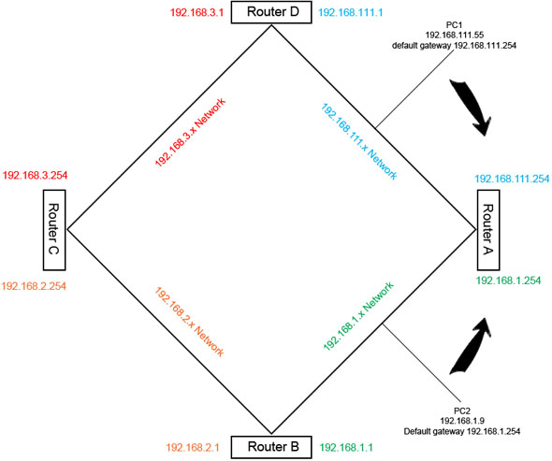
Look at this picture

Slide 8
What did we do?
On PC1:
route add 192.168.3.0 mask 255.255.255.0 192.168.111.1

Slide 9
Takeaway
Routers on our network need static routes
You either need to tell the router where to send subnet traffic or the default gateway does

Slide 10
Firewalls vs. Routers
Routers can act as firewalls
Both can allow/block IPs/ports
Firewalls sometimes look for keywords in packet data
Also domains
Certain services
Firewalls can only accept/deny traffic, not route

Slide 11
Paradigms
First, block everything
Route traffic to appropriate subnets
This requires understanding of network map
Firewall rules
Always ask, “what needs to access what?”
No added trust because a machine is inside the network

Slide 12
Examples
Userland Firewall
Block everything?
Destination ports out should be 80/443/21
RDP/SSH in/out only from/to our 8 machines
Services firewall
Destination ports in should be 80/443/21
Source ports out should be 80/443/21
RDP/SSH in/out only from/to our 8 machines
DB Firewall
Should only talk to 1 other machine

Slide 13
Blacklisting
When we determine an IP is malicious, drop it at incoming router or firewall
Do not blacklist a machine in 192.168.X.X
May be done temporarily if compromised
Some rules need not be repeated if we just put them on the right firewall
If every service goes down, we blacklisted the wrong IP
Assuming routing is configured properly
If one service goes down it could be blacklist or local firewall rules

Slide 14
Order
It matters
Seriously, precedence can be really important
Difference between?
Deny all traffic, then allow port 21 out
Allow port 21 out, then deny all traffic

Slide 15
Signatures
Implement signature screening at firewalls
Can enable alerts

Slide 16
A final note
This is not how the internet or even large networks really work
Routers that deal with a lot of traffic have protocols to determine the fastest route to places
Those networks are constantly changing and want to avoid problems with routers going down
We will be implementing static routes

Slide 17
Traffic Monitoring
John Johnson

Slide 18
To Begin…
Continuous monitoring of systems will indicate compromise for 1 box at that moment
Seeing what caused/tried to compromise our boxes will lead to future security of the network
We need to pass traffic monitoring results off to firewalls/routers

Slide 19
Collection
May have an IDS
Definitely have firewalls
All machines can run tcpdump in some form, but going through traffic that way may suck

Slide 20
Filters
Signature based
Host based
See where our computers are going
What outside computers are sending in packets

Slide 21
Signatures
May or may not be easily available
We can collect file hashes and names and block that traffic
Look for metasploit and empire signatures
Anything malicious found on boxes should be used to aid the firewall

Slide 22
Hosts/Domains Visited
We can check IPs that host websites and determine if they have malicious content
Obviously be careful, have to do this in a sandbox
Probably just look at traffic to/from websites

Slide 23
Malicious Websites
Domain
Slight misspellings
gogle.com/yahooz.com/bankofamurica
Obviously bad
illegal.com/hacks4daz3.com
Page Name
download.php
*.bat/*.exe/*.pdf

Slide 24
Malicious Websites (Cont.)
Data may be encoded or even encrypted
Large volume of response means something was downloaded
A new connection pops up right after visiting a website

Slide 25
Malicious Downloads
Email/Phishing
We can read emails, may be tedious
Remember the firewall rules, only let users visit ports with common services
Doesn’t stop everything, but it is a good start

Slide 26
Scanning
First thing red team will do (probs)
Need to alert on large volumes of traffic
Block that IP range

