Slide 1


Improving Hybrid Fuzzing Using Debug Information
Theodor Arsenij Larionov-Trichkine
HSE University, MIEM, IS, 2023
Scientific Advisors: Kuts Daniil, Petrenko Alexander

Slide 2
Plan
Software Vulnerabilities
Dynamic Analysis – Hybrid Fuzzing
The Problem – Symbolic Execution Limitations
Proposed solution
Results
Conclusion
Notes:
Why are we Doing all this?
Dynamic Analysis – Hybrid Fuzzing
Symbolic Execution and Hybrid Fuzzing
Symbolic Execution limitations
The Problem - Hybrid Fuzzing Limitations
Precisely Calculating Boundaries For a Memory Access
Existing Approaches
Proposed solution
Results
Conclusion

Slide 3
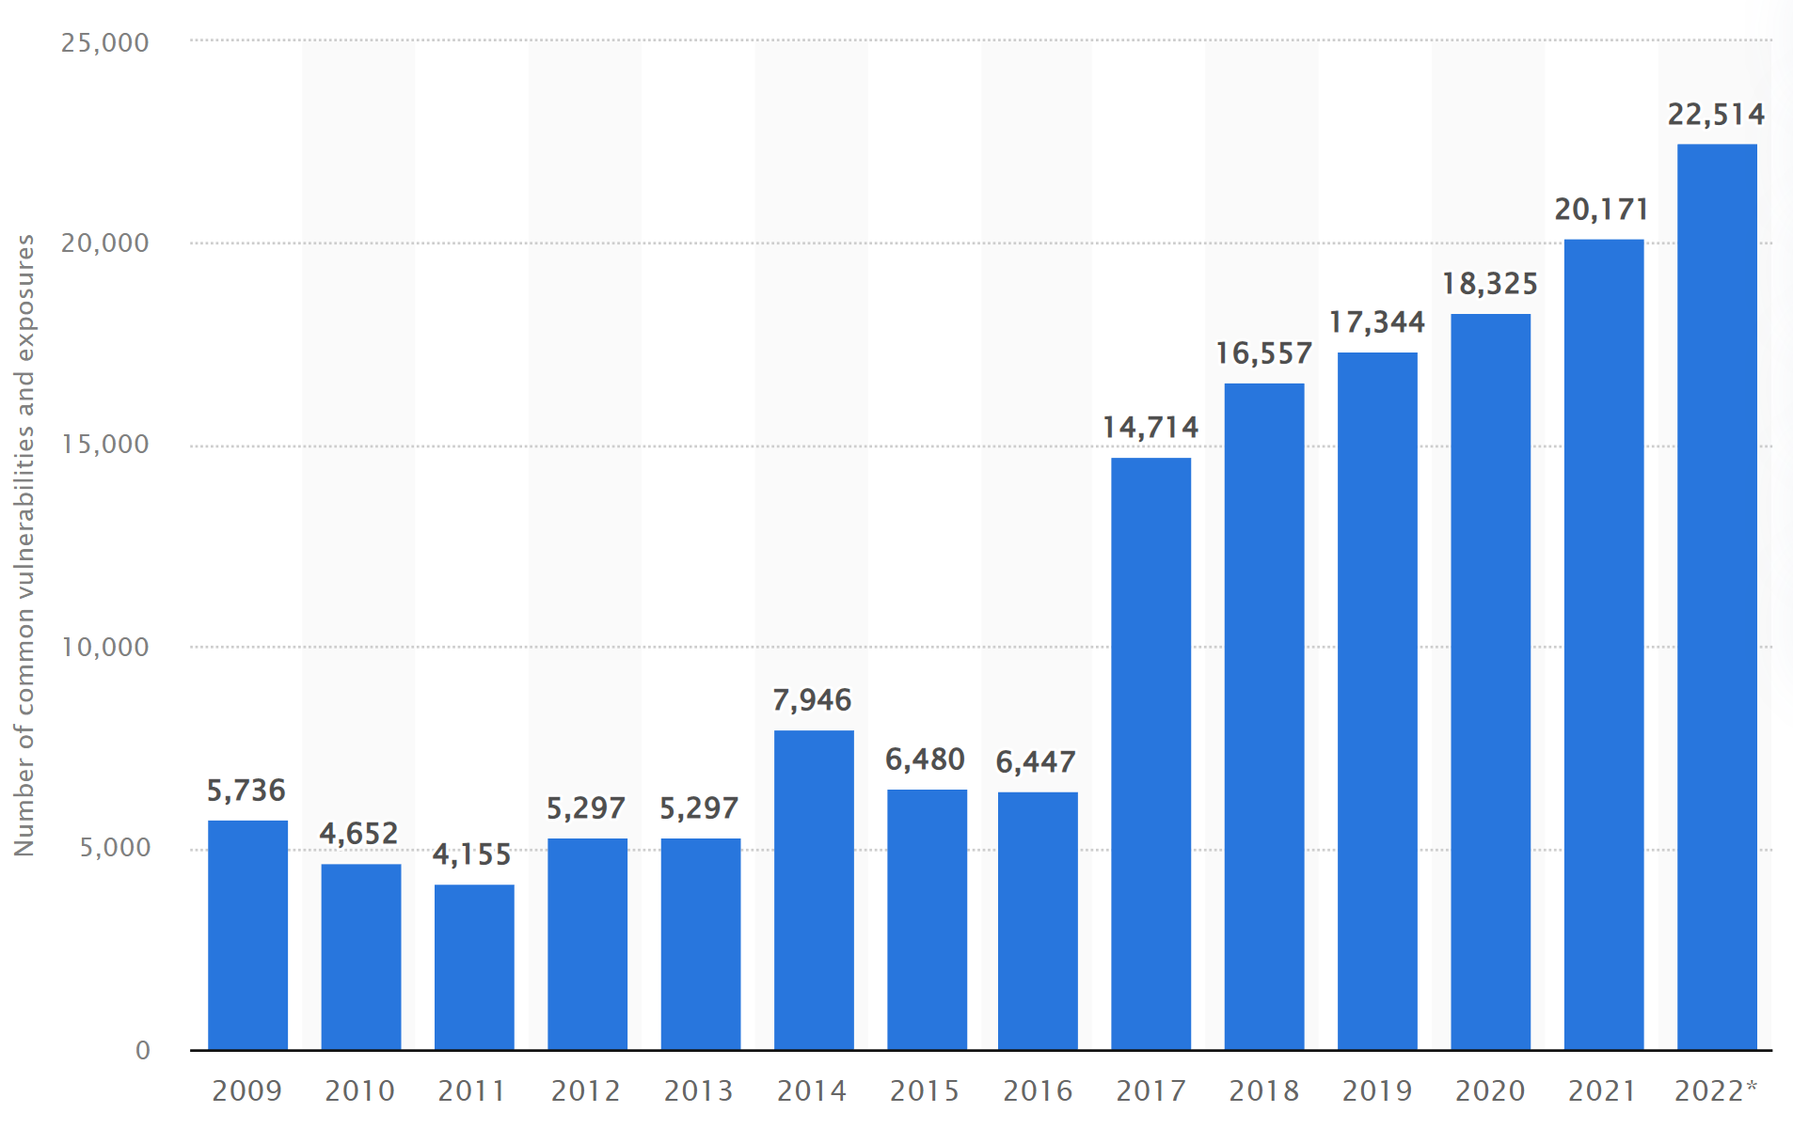
Software Vulnerabilities
Notes:
Rapid development. Software complexity.
Security vulnerabilities emerge.
Need for secure software development practices.

Slide 4

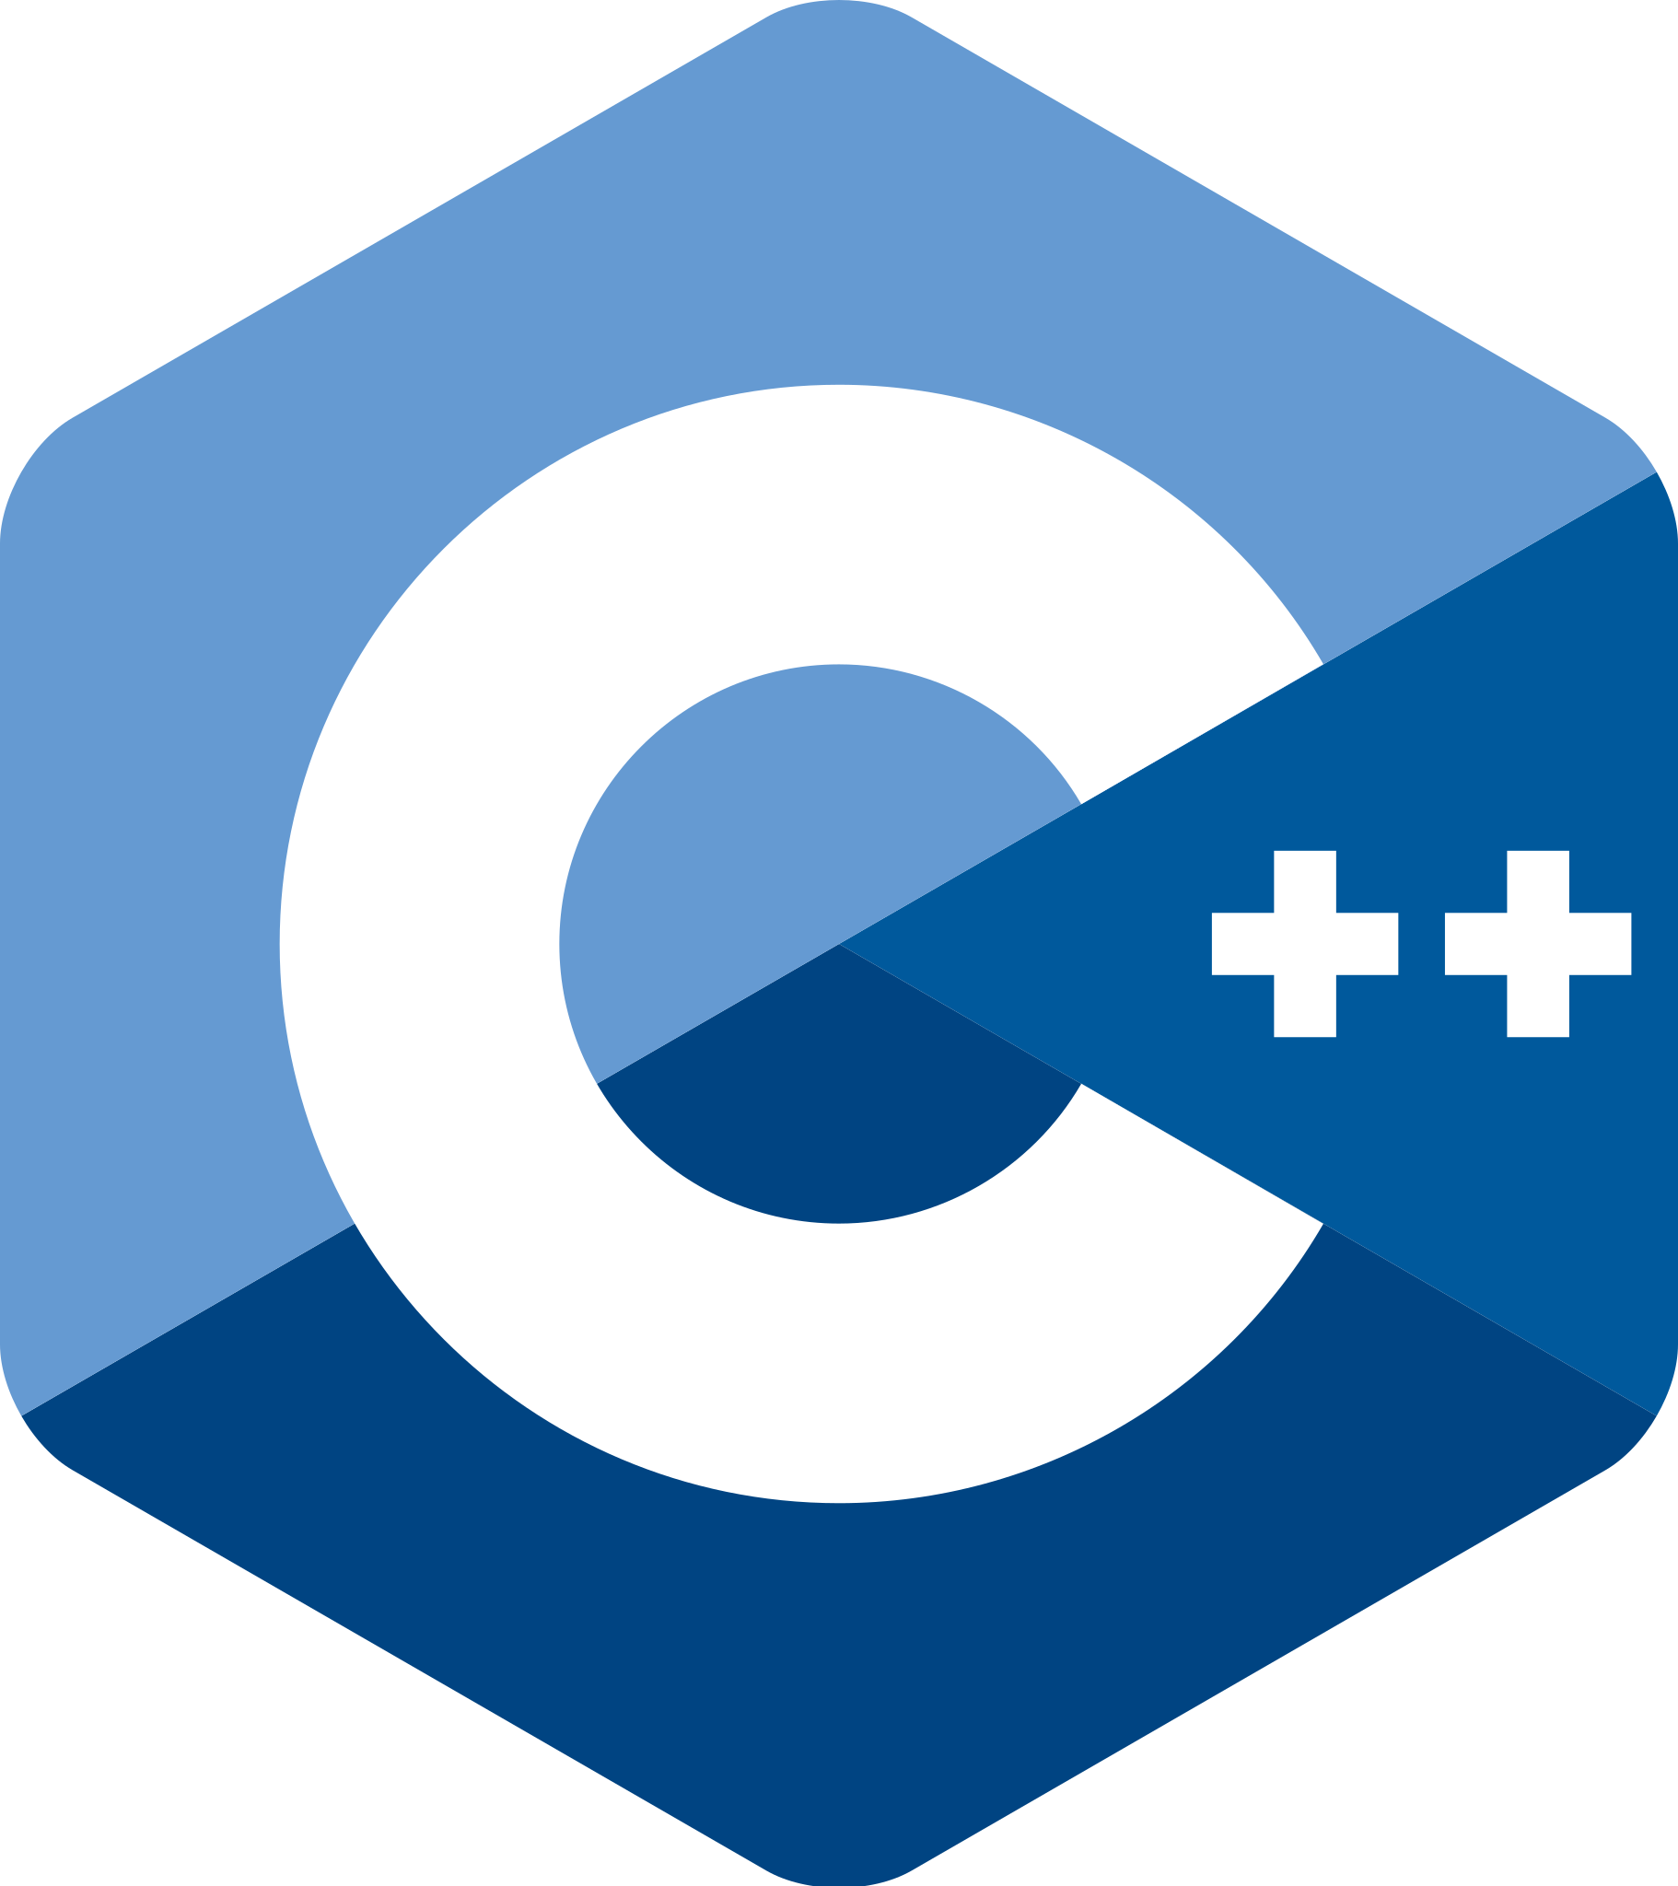
Software Vulnerabilities
Notes:
One specific area of concern in software security is memory safety, particularly in the context of programming languages. Memory-unsafe languages, such as C and C++, are known to impose significant vulnerabilities due to their low-level nature and lack of automatic memory management [1], [2]. These vulnerabilities can range from buffer overflows to use-after frees and beyond, and often lead to full system compromise. To address these issues, a variety of techniques have been developed, including static and dynamic analysis.

Slide 5
Hybrid Fuzzing
void vuln(int key) {
if (key * 0x142a2d == 0xdeadbeef) {
error();
}
}
Notes:
A hybrid fuzzing is a set of techniques that employs symbolic execution and classic fuzzing to solve program’s constraints and find new execution paths.

Slide 6
Hybrid Fuzzing
void vuln(int SYM_VAR) {
if (SYM_VAR * 0x142a2d == 0xdeadbeef) {
error();
}
}
SYM_VAR = 0xdeadbeef / 0x142a2d
SYM_VAR = 0xb0b

Slide 7

Hybrid Fuzzing
vuln(0xb0b)
Notes:
Sounds good and all! We’ve found a bug in a controllable environment! That means we can now patch this drawback and no adversary will be able to exploit it!
That’s cool, however, there are some limitations. In general, symbolic execution is slow, really slow. Moreover, sometimes we have to deal with much more complicated examples.

Slide 8
The Problem
1. uint16_t crc_ibm_table[256] = {
2. 0x0000, 0xc0c1, 0xc181, 0x0140, ...
3. };
4. 5. uint16_t crc_ibm_byte(uint16_t crc, const uint8_t c)
6. {
7. uint8_t sym_idx = (crc ^ c) & 0xFF;
8. return crc_ibm_table[sym_idx] ^ (crc >> 8);
9. }
10. 11. if (crc_ibm_byte(0, buf[0]) == 0x1337) {
12. error();
13. }
Notes:
Consider this one, with indirect dependencies.
So, first of all, it might look a little intimidating, however the only essential part here is that we have indirect dependency in the form of an access to the array crc_ibm_table using symbolic variable sym_idx.
It might look like it’s not a big deal, however The devil is in the details. In theory access to the variable crc_ibm_table might read data from anywhere inside the computer memory. And symbolic execution engine have no idea about specific boundaries for this access.
Without precise boundaries for a memory access we need to model the whole memory which is unfeasible.
That’s the problem I’m trying to combat.

Slide 9
The Problem
1. uint16_t crc_ibm_table[256] = {
2. 0x0000, 0xc0c1, 0xc181, 0x0140, ...
3. };
4. 5. uint16_t crc_ibm_byte(uint16_t crc, const uint8_t c)
6. {
7. uint8_t sym_idx = (crc ^ c) & 0xFF;
8. return crc_ibm_table[sym_idx] ^ (crc >> 8);
9. }
10. 11. if (crc_ibm_byte(0, buf[0]) == 0x1337) {
12. error();
13. }
Notes:
Consider this one, with indirect dependencies.
So, first of all, it might look a little intimidating, however the only essential part here is that we have indirect dependency in the form of an access to the array crc_ibm_table using symbolic variable sym_idx.
It might look like it’s not a big deal, however The devil is in the details. In theory access to the variable crc_ibm_table might read data from anywhere inside the computer memory. And symbolic execution engine have no idea about specific boundaries for this access.
Without precise boundaries for a memory access we need to model the whole memory which is unfeasible.
That’s the problem I’m trying to combat.

Slide 10
The Problem
1. uint16_t crc_ibm_table[256] = {
2. 0x0000, 0xc0c1, 0xc181, 0x0140, ...
3. };
4. 5. uint16_t crc_ibm_byte(uint16_t crc, const uint8_t c)
6. {
7. uint8_t sym_idx = (crc ^ c) & 0xFF;
8. return crc_ibm_table[sym_idx] ^ (crc >> 8);
9. }
10. 11. if (crc_ibm_byte(0, buf[0]) == 0x1337) {
12. error();
13. }
Notes:
Consider this one, with indirect dependencies.
So, first of all, it might look a little intimidating, however the only essential part here is that we have indirect dependency in the form of an access to the array crc_ibm_table using symbolic variable sym_idx.
It might look like it’s not a big deal, however The devil is in the details. In theory access to the variable crc_ibm_table might read data from anywhere inside the computer memory. And symbolic execution engine have no idea about specific boundaries for this access.
Without precise boundaries for a memory access we need to model the whole memory which is unfeasible.
That’s the problem I’m trying to combat.

Slide 11


The Problem. Existing Methods.
A Survey of Symbolic Execution Techniques
Sydr
Mayhem
…
Notes:
Of course, there are already some approaches.
For example, in the paper: “A survey of symbolic execution techniques” several different methods of working with symbolic pointers were proposed:
Fully symbolic memory (Speed), but as I already stated it is infeasible
Address Concretization, but it lacks Accuracy
…
A commercial tool Mayhem uses index-based memory model with memory objects and SMT-Solver to find left/right boundaries, but it lacks the performance.
And the last tool – SYDR uses heuristic based approach to find the base of a symbolic memory access, but is not able to determine the upper bound.

Slide 12
Proposed Solution
Let’s use debug information!
Notes:
Essentially it gives us memory boundaries for different entities in the program for free.

Slide 13
Proposed Solution
1. uint16_t crc_ibm_table[256] = {
2. 0x0000, 0xc0c1, 0xc181,
3. 0x0140, ...
4. };
5. 6. crc_ibm_table[sym_idx];
Notes:
So, for this example we might query debug information and extract the exact size of the crc_ibm_table variable, which saves us from modelling the whole memory as we know that in normal circumstances this access will not be able to address anything else except these 256 elements.
With this approach we don’t need to send the whole memory contents, we can just send a small chunk of memory and it will be enough to accurately model the program.

Slide 14
Proposed Solution
1. uint16_t crc_ibm_table[256] = {
2. 0x0000, 0xc0c1, 0xc181,
3. 0x0140, ...
4. };
5. 6. crc_ibm_table[sym_idx];
Notes:
Moreover, as now we know the exact boundaries we might build a formula for this memory access. With this formula we might ask an SMT-solver to generate an input that will lead to an access outside of a defined boundaries for the crc_ibm_table.

Slide 15
Proposed Solution
crc_ibm_table[sym_idx];
Solve(sym_idx > len(crc_ibm_table)?)
Notes:
If solver succeeds in generating such an input, it means that we’ve found a security issue.

Slide 16
Results
The method has already been implemented as a part of the Sydr tool, and a number of preliminary experiments are in progress
The proposed method makes it possible to find new classes of errors (local/global out-of-bounds accesses)

Slide 17
Thanks for listening

Slide 18
Questions?

Slide 19
References
“Chromium project memory safety report,” https://www.chromium.org/Home/chromium-security/memory-safety/, accessed: 2023-02-12.
A. V. Vishnyakov, A. Fedotov, D. O. Kuts, A. A. Novikov, D. Parygina, E. Kobrin, V. Logunova, P. Belecky, and S. F. Kurmangaleev, “Sydr: Cutting edge dynamic symbolic execution,” CoRR, vol. abs/2011.09269, 2020. [Online]. Available: https://arxiv.org/abs/2011.09269
D. O. Kuts, “Towards symbolic pointers reasoning in dynamic symbolic execution,” CoRR, vol. abs/2109.03698, 2021. [Online]. Available: https://arxiv.org/abs/2109.03698
R. Baldoni, E. Coppa, D. C. D’elia, C. Demetrescu, and I. Finocchi, “A survey of symbolic execution techniques,” ACM Comput. Surv., vol. 51, no. 3, may 2018. [Online]. Available: https://doi.org/10.1145/3182657
S. K. Cha, T. Avgerinos, A. Rebert, and D. Brumley, “Unleashing mayhem on binary code,” in IEEE Symposium on Security and Privacy, SP 2012, 21-23 May 2012, San Francisco, California, USA. IEEE Computer Society, 2012, pp. 380–394. [Online]. Available: http://doi.ieeecomputersociety.org/10.1109/SP.2012.31

