Slide 1
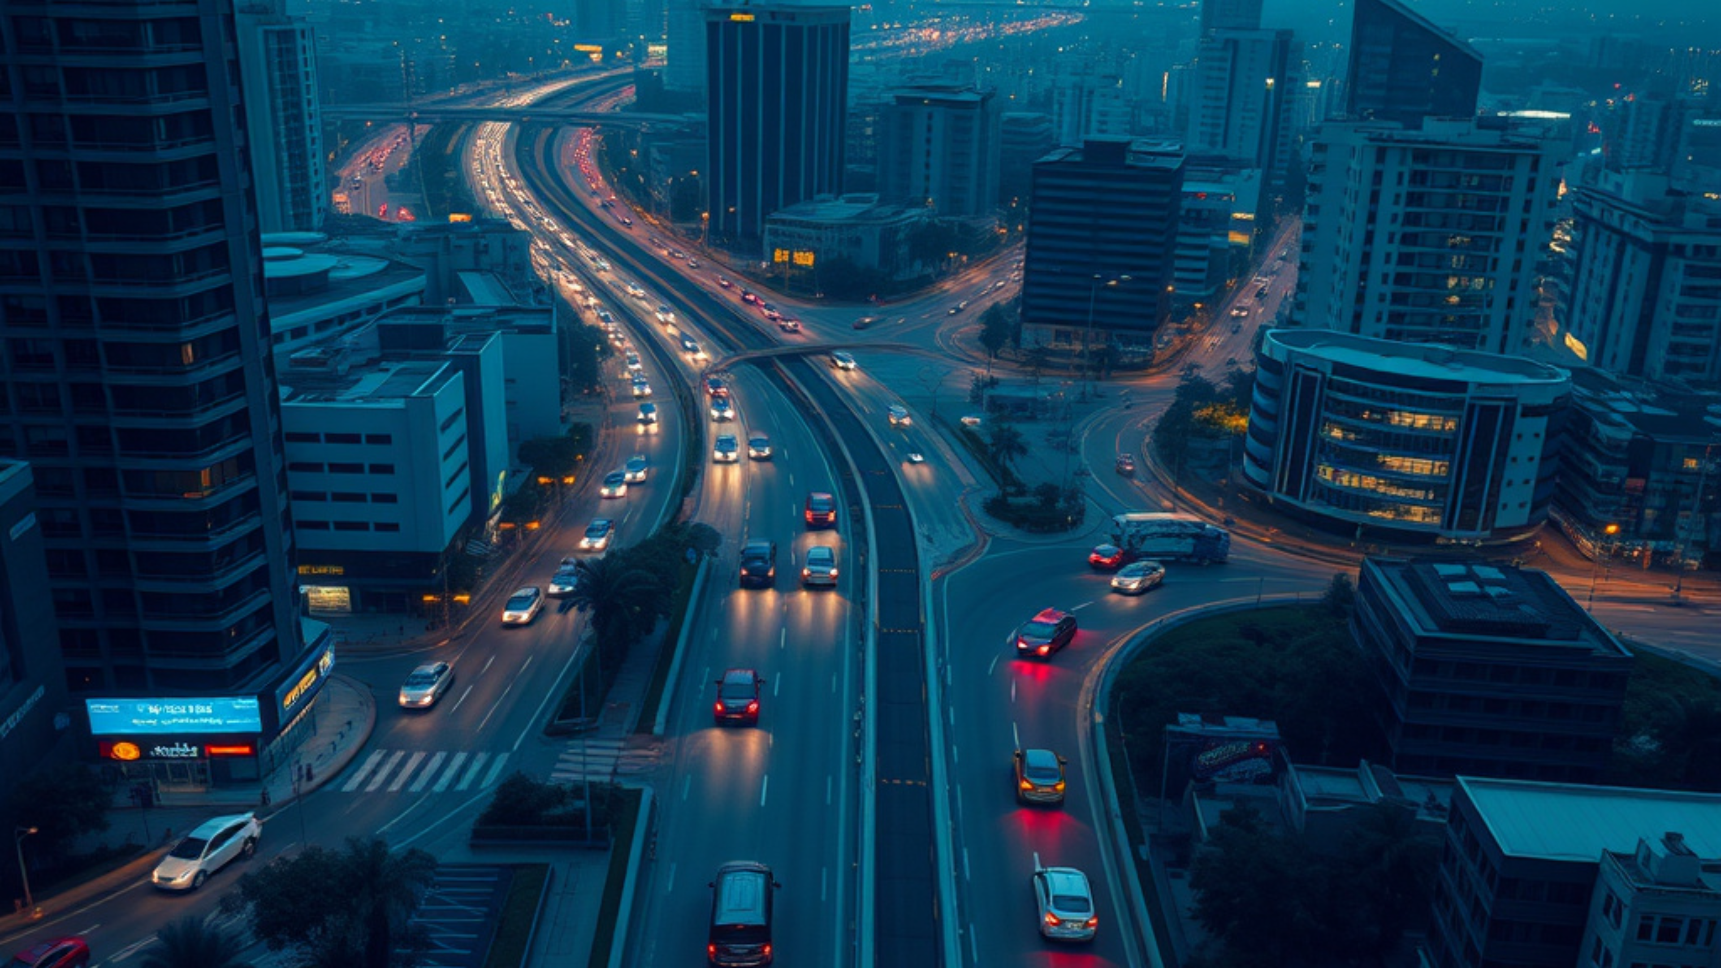
ARGUS
Civic Safety & Urban Infrastructure Intelligence
Turning city signals into safer, smarter public action.
PHASE 1
Review 1
Team · Satyam Tiwari · Arunesh Sharma · Manikya Nariyal · Palak Kulshrestha

Slide 2




PROBLEM STATEMENT
Delayed reporting leaves everyday hazards unresolved:
Small gaps in the reporting workflow become visible risks across the city.
Where the current process breaks down
Hazards stay exposed longer
Potholes, fallen trees, and damaged roads go unaddressed.
Duplicate reports create noise
Citizens often report the same issue without shared visibility.
Manual triage slows action
Prioritization takes time before response and repair can begin.

Slide 3




PROJECT SCOPE
Project Scope & Feasibility
Start with a tightly controlled pilot, then scale the intelligence layer across wider geographies.
Phase 1 Pilot
Future Expansion
Focused, field-ready validation
Broader coverage, richer context
01
Geofenced to Kothri and VIT Bhopal campus
01
Core platform identifies, verifies, and prioritizes hazards
02
Boundary supports high-quality ground-truth collection
02
Satellite imagery and GIS data extend the operating picture
Prove accuracy before expanding reach
Scale the same decision engine beyond the pilot

Slide 4




LITERATURE FINDINGS
Research & Literature Review
What the field already offers
The unresolved gap
Open Earth-observation datasets, including Sentinel-2 and MODIS imagery, provide broad spatial coverage for monitoring environmental change and visible infrastructure risk.
Current systems lack multimodal verification.
Few solutions combine ground photos with satellite context.
Historical civic reports add a critical local layer: they reveal recurring hazard hotspots that satellite imagery alone may not explain.
RESEARCH OPPORTUNITY
The evidence base is rich—but distributed across sources.
Connect place-based testimony with scalable earth observation.

Slide 5






CIVIC INTELLIGENCE / METHODOLOGY
Methodology & AI Pipeline
From a citizen report to a trusted, location-aware safety signal.
Signal processing path
Public safety by design
WHY THIS PIPELINE MATTERS
Every layer adds confidence.
01 Capture the real-world signal
Citizen submits a photo with GPS location and timestamp.
Human input starts the signal. AI and geospatial context make it useful for action.
02 Understand and de-duplicate
OpenCV and PyTorch classify hazards; embeddings and GPS proximity find repeat reports.
Trust architecture
Evidence → interpretation → prioritization
03 Add context and prioritize
Satellite context turns the signal into severity and safety scores.
Transparent inputs support safer public decisions.
Built for responsible civic response
Result: one actionable record, grounded in place and time.

Slide 6




TECH STACK & RESOURCES
A stack built for real-world scale
Modern geospatial, backend, and AI capabilities — engineered for scalable, containerized deployment.
Frontend
Backend
AI / ML
A responsive interface for exploring live geospatial intelligence with clarity.
A dependable data and service layer designed for resilient operations.
Practical computer vision and machine learning for actionable insights.
•Next.js + React foundation
•FastAPI service layer
•Scikit-learn + PyTorch models
•Leaflet and Mapbox mapping
•PostgreSQL/PostGIS + Docker
•OpenCV computer vision
Containerized by design — ready to scale from prototype to production.

Slide 7
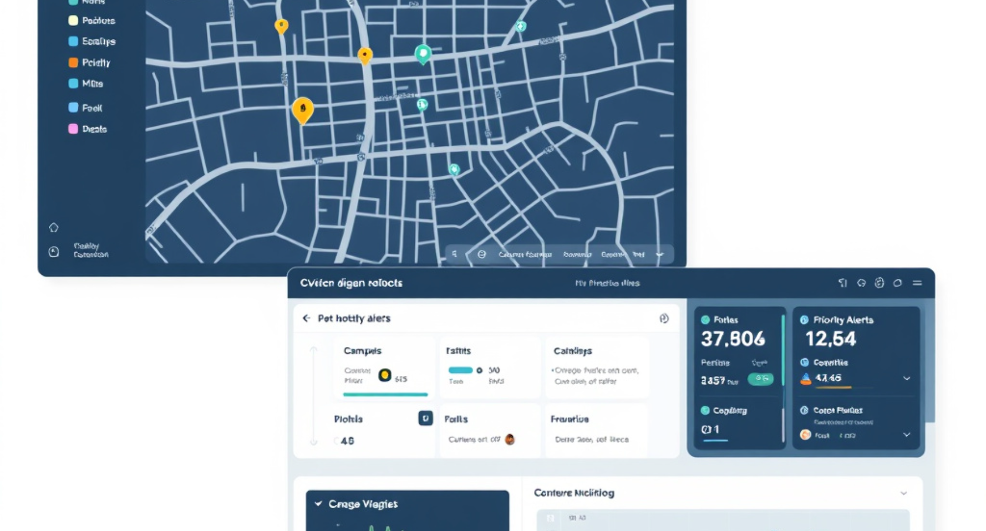



PROTOTYPE EVIDENCE
Initial Prototypes & Work Done
From field imagery to a working civic-safety dashboard concept.
Prototype workspace
EARLY BUILD
What moved from idea to evidence
Field image collection
Initial image data gathered around Kothri and campus.
MVP dashboard drafted
Live map, hotspots, baseline classification, and backlog views are taking shape.
A usable foundation for the next validation cycle
Screens and workflows are ready to test against real field conditions.

Slide 8




PROJECT PROGRESS
Adherence to Project Plan
From validated foundations to predictive maintenance and dashboard analytics.
PLAN TRAJECTORY
01
Completed
Build the evidence first. Scale the intelligence next.
Problem definition, literature review, and data gathering
02
Review 2 focus
Finalize the report and show CV components
03
Phase 2
The next milestone connects documented findings to an operational analytics view.
Predictive maintenance and dashboard analytics

Slide 9




CONCLUSION
Feasibility → trust → scale
A credible path from pilot to public value
THE CLOSING CASE
“A focused pilot turns uncertain signals into reliable ground truth—then builds the confidence to deploy at municipal scale.”
Start focused
Earn trust
Build to scale
A focused pilot enables reliable ground-truth learning.
Multimodal verification improves trust and prioritization.
Phase 1 builds toward scalable municipal deployment.
A practical foundation for safer, smarter civic operations

