Slide 1
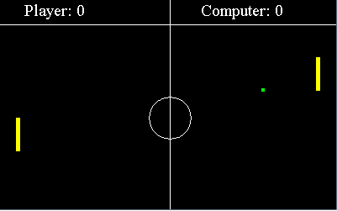
Ping Pong Game Team Endor

Slide 2
Project purpose
Creating simple one-player game
GUI used - Swing and Abstract Window Toolkit (AWT)
Similar to tennis - consists of 2 boards and a ball
Left board is moved by the player by Up and Down Arrows
Right board is moved by the computer

Slide 3
Project purpose(2)
The aim is to defeat the opponent by earning a higher score
The size of the board becomes bigger when the player or the computer wins a point
The player can shoot 3 times, and if it hits computer’s board, its size decreases

Slide 4
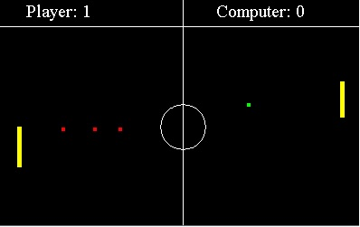
Project purpose(3)
When score of 5 is reached, the speed of the ball increases
The game is over at 10 points, then “Game over” screen apprears and new game starts

Slide 5
Structure of the game – 8 classes
Pong – main class
GamePanel
Render of all objects
Update of all positions
KeyListener for pressed keys
ActionListener for update and repaint

Slide 6
Structure of the game – 8 classes(2)
Ball
Paint
Update
Check for collision
Check of the ball is behind the panel
Increase speed
Computer
Paint
Update

Slide 7
Structure of the game – 8 classes(3)
Player
Paint
Update
Decrease size
Paint score
Score
Increase
Get

Slide 8
Structure of the game – 8 classes(4)
Screens
Player win
Computer win
Magic
Paint
Update
Check for collision
Check if it’s behind the panel

Slide 9
Team Endor Members
m4r71n85 - Мартин
katya86 - Катя
AlexKondov - Алекс
Dzhuliya - Джули
Vesivl - Веселина
Rforce12 - Калин

Slide 10
Each member contribution
m4r71n85
Game Panel
Magic
katya86
Ball
Presentation

Slide 11
Each member contribution(2)
AlexKondov
Player
Pong
Dzhuliya
Computer
Documentation

Slide 12
Each member contribution(3)
Vesivl
Score
Rforce12
Screen

Slide 13
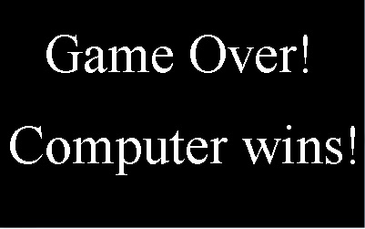
Thank you!

