Slide 1
SUPERMARKET SALES
By Sam Brumwell, Mariona Casasnovas, Sergi Flores, Anna Galstyan, Núria López and Joan Riera
Delivery:
28/05/24

Slide 2

1. INTRODUCTION
2. PREPROCESSING
4. SAMPLING
3. DESCRIPTIVE ANALYSIS
Description of the preprocessing steps
Database structure, variables, goals, data sources and topics addressed
Uni and bivariate descriptive analysis and of some variables
Sampling process of our data

Slide 3
5. CONFIDENCE INTERVAL
6. HYPOTHESIS TEST
7. REGRESSION MODEL
8. CONCLUSION
Fictitious scenario with a question, justification of the test, statistics and results for each HT
Parameter, statistic, procedure, results and interpretation for each CI
Results and interpretation of the regression model
Comparison and synthesis of the discussion, conclusion and scheduling

Slide 4
01.
INTRODUCTION
Database structure, variables and topics addressed

Slide 5

OUR DATABASE
Supermarket sales database
Goals
Database of sales from a series of supermarkets located in Myanmar
Database selection:
www.kaggle.com
Study our database and its variables using different statistical methods

Slide 6
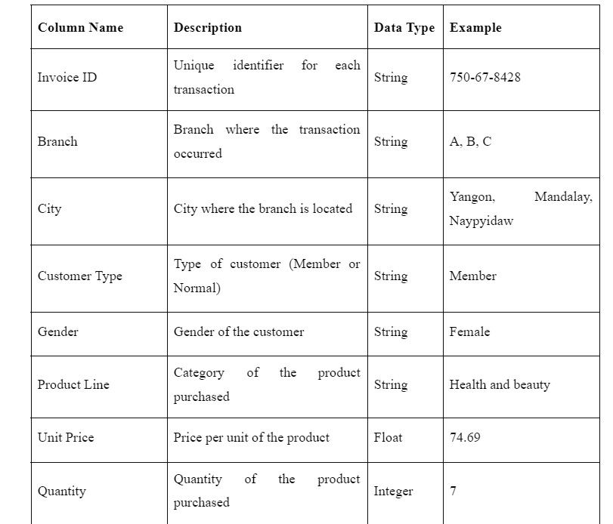
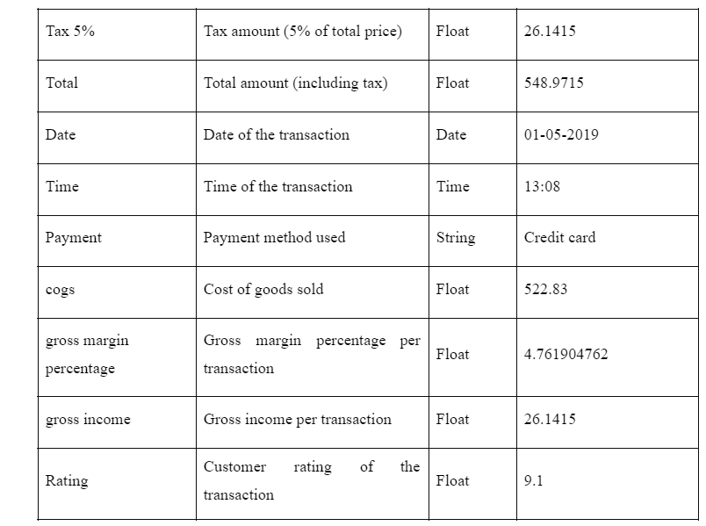
METADATA TABLE
Column Name | Description | Data Type | Example
Invoice ID | Unique identifier for each transaction | String | 750-67-8428
Branch | Branch where the transaction occurred | String | A, B, C
City | City where the branch is located | String | Yangon,Mandalay, Naypyidaw
Customer Type | Type of customer (Member or Normal) | String | Member
Gender | Gender of the customer | String | Female
Product Line | Category of the product purchased | String | Health and beauty
Unit Price | Price per unit of the product | Float | 74.69
Quantity | Quantity of the product purchased | Integer | 7
Tax 5% | Tax amount (5% of total price) | Float | 26.1415
Total | Total amount (including tax) | Float | 548.9715
Date | Date of the transaction | Date | 01-05-2019
Time | Time of the transaction | Time | 13:08
Payment | Payment method used | String | Credit card
cogs | Cost of goods sold | Float | 522.83
gross margin percentage | Gross margin percentage per transaction | Float | 4.761904762
gross income | Gross income per transaction | Float | 26.1415
Rating | Customer rating of the transaction | Float | 9.1

Slide 7
The variables of our database
CATEGORICAL
CITY
BINARY
Yangon
Mandalay
Naypyitaw
CUSTOMER TYPE
NOMINAL
Normal / Member
GENDER
Female / Male
PAYMENT
ORDINARY
Credit card
Ewallet
Cash
PRODUCT LINE
Sports and travel
Food and beverages
Health and beauty
Fashion accessories
Electronic accessories
Home and lifestyle
RATING
Satisfaction with the services in a scale from 1 to 10
‹#›

Slide 8
The variables of our database
NUMERICAL
TOTAL
UNIT PRICE
The amount of money spent including the tax
Average price for unit
CONTINUOUS
TAX
COST OF GOODS
The 5% tax correspondent from each purchase
The sum of every article price
GROSS INCOME
DISCRETE
An individual’s total earnings before taxes or other deductions
QUANTITY
‹#›
Amount of articles purchased

Slide 9
SOME VARIABLES
mutually and very closely related
The statistical relationship between our numerical variables.
Total, cost of goods (Cogs) , Tax, Gross Income and even quantity are

Slide 10
02.
PREPROCESSING
Description of the preprocessing steps

Slide 11
PREPROCESSING
Decimals:
Dot
Comma
MM/DD/YY
Date:
DD/MM/YY
+2 new categorical variables: Time of day & time of month

Slide 12
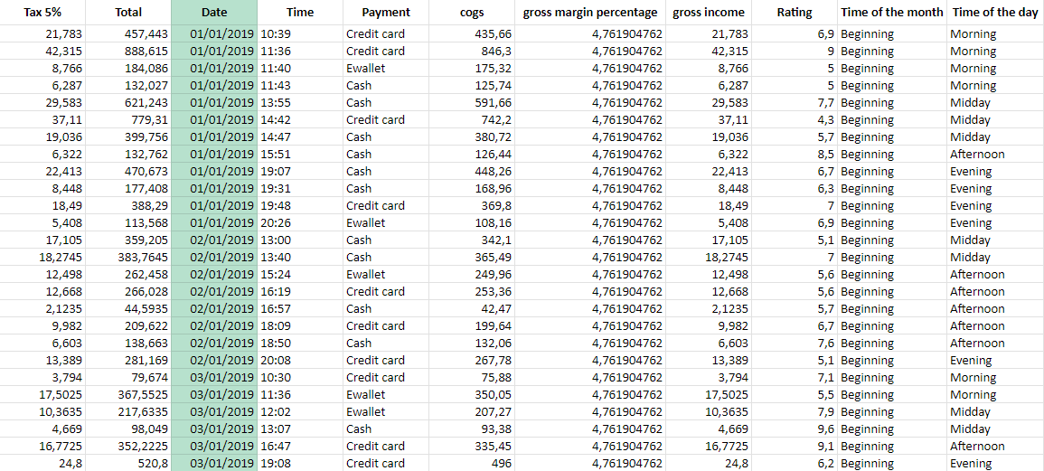
PREPROCESSING

Slide 13
03.
DESCRIPTIVE ANALYSIS
Uni and bivariate statistical descriptive analysis and descriptive analysis of some variables

Slide 14
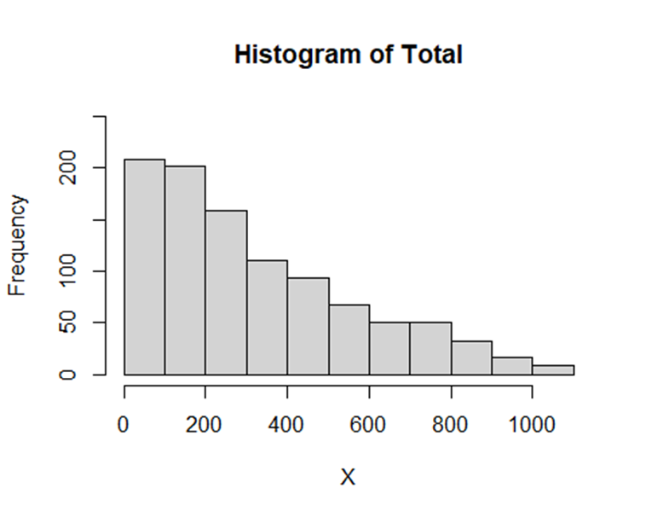
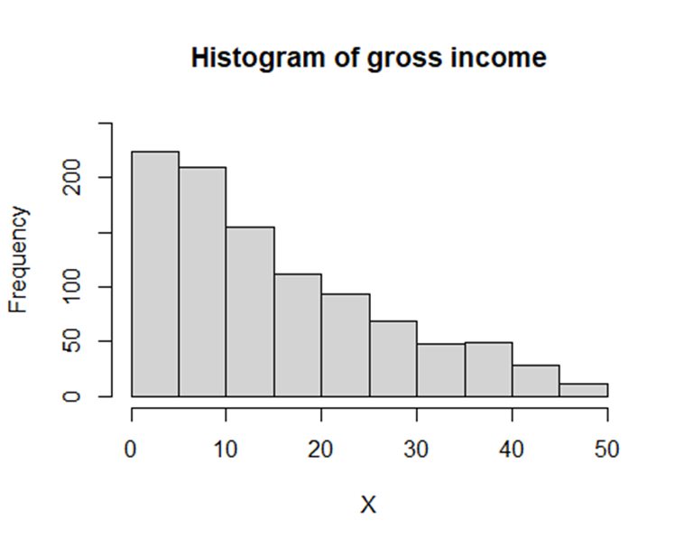
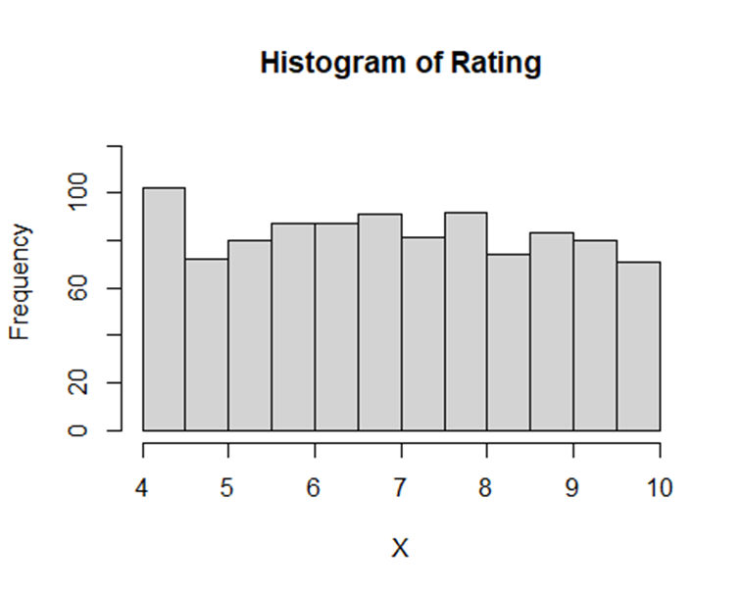
GENDER AND PRODUCT LINE
Mutually dependent and follow a gamma distribution
Tends to a normal

Slide 15
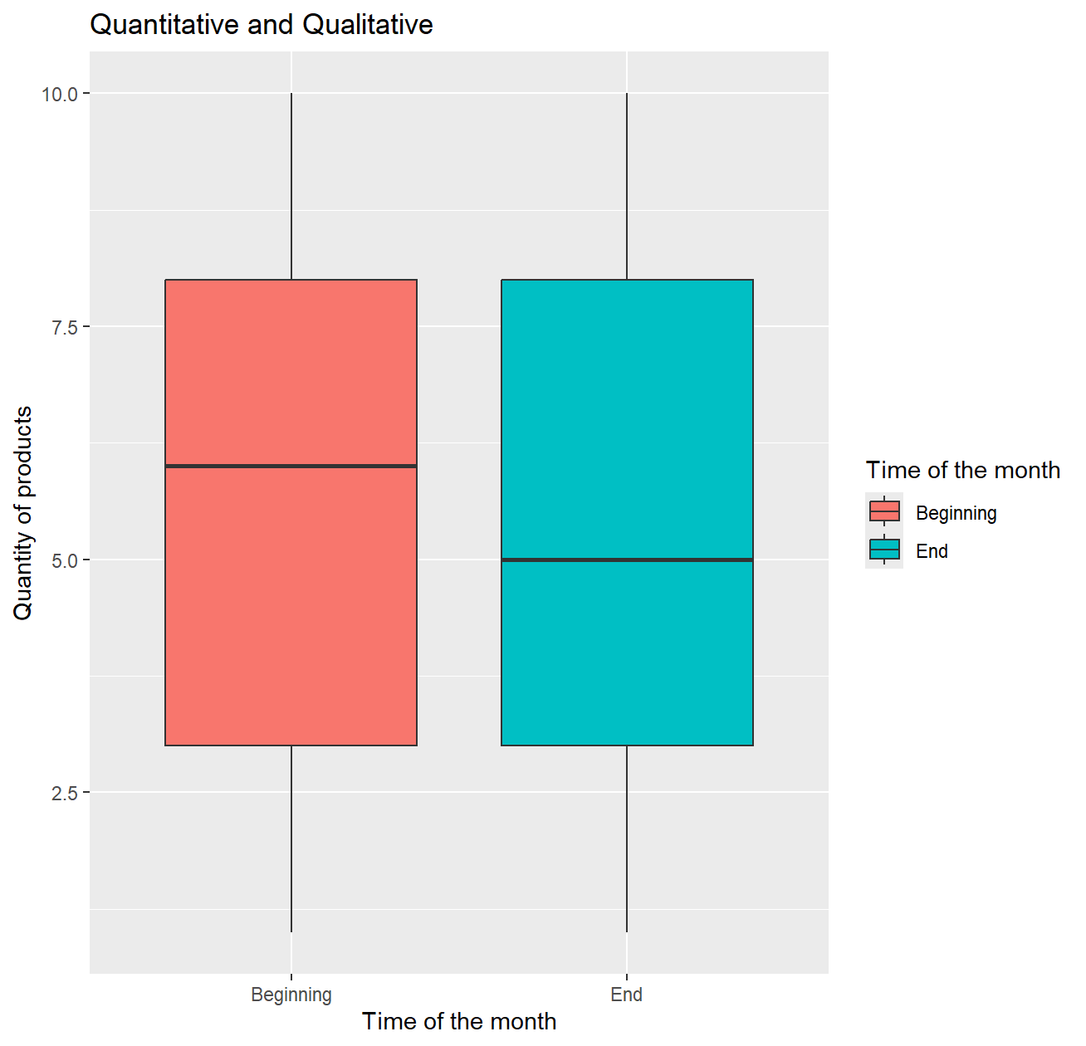
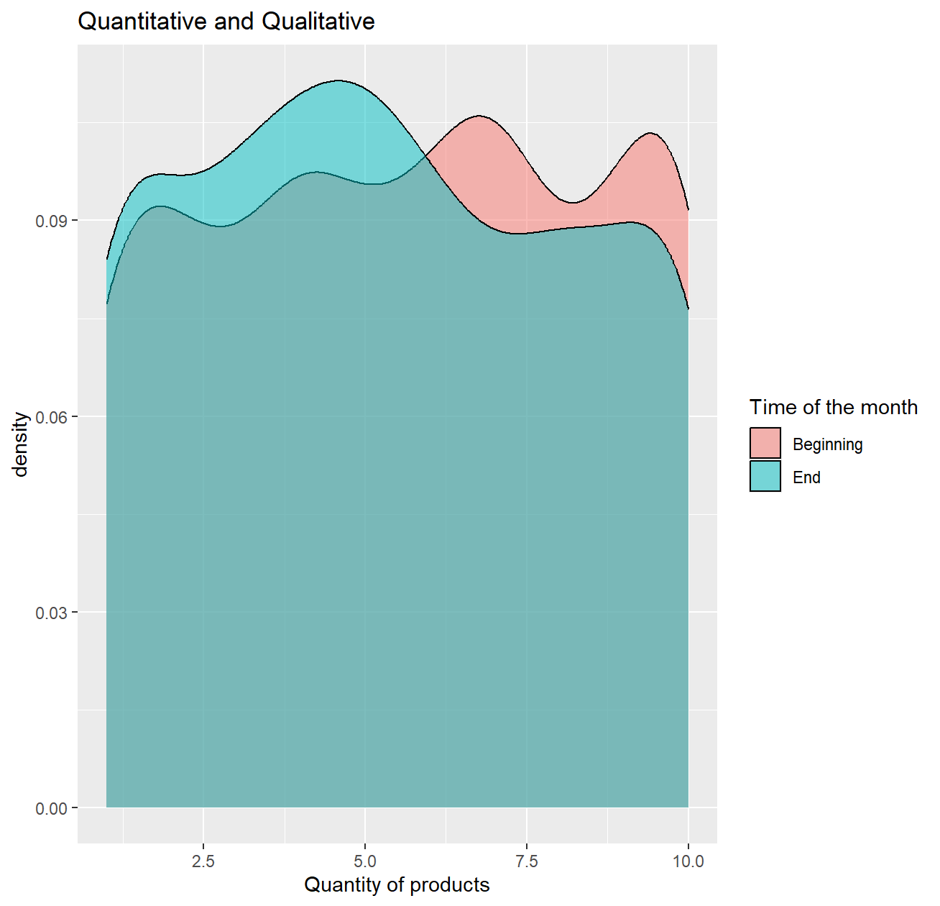
TIME OF THE MONTH AND QUANTITY
5.65
5.36

Slide 16
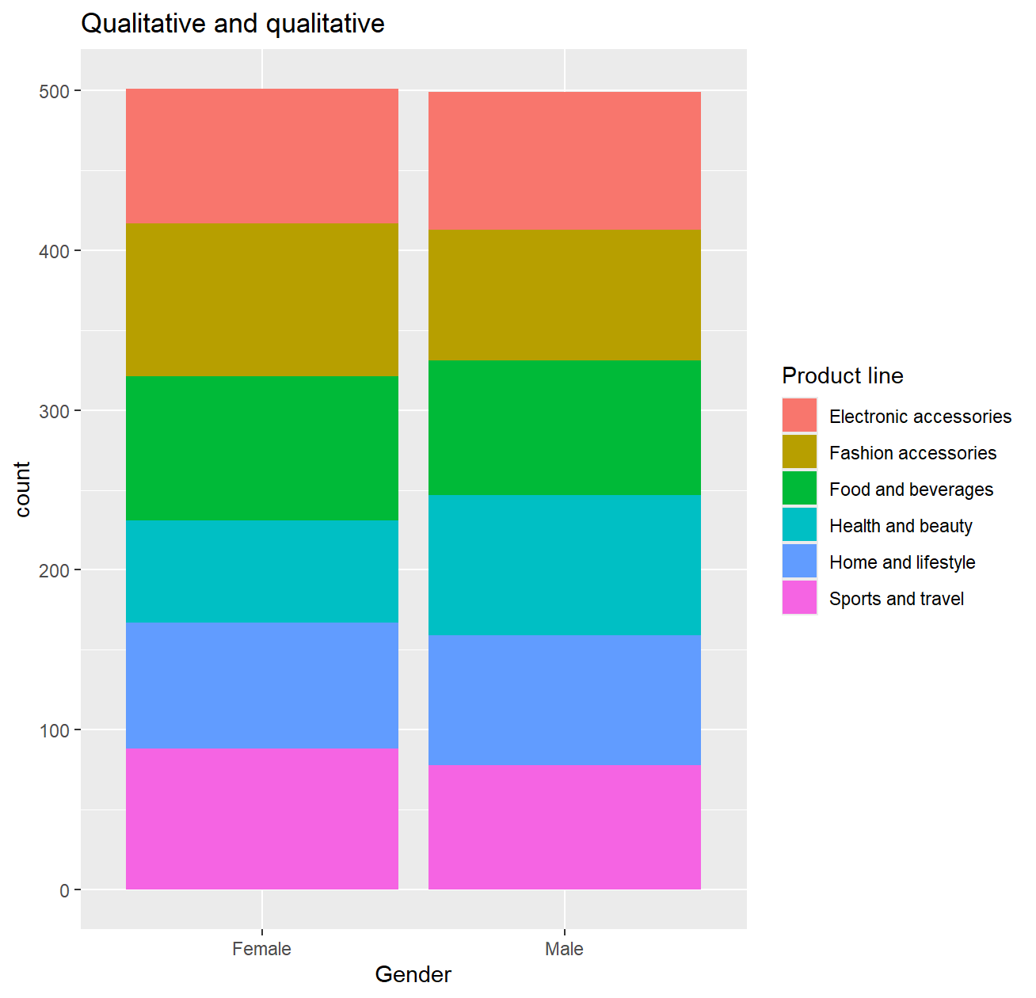
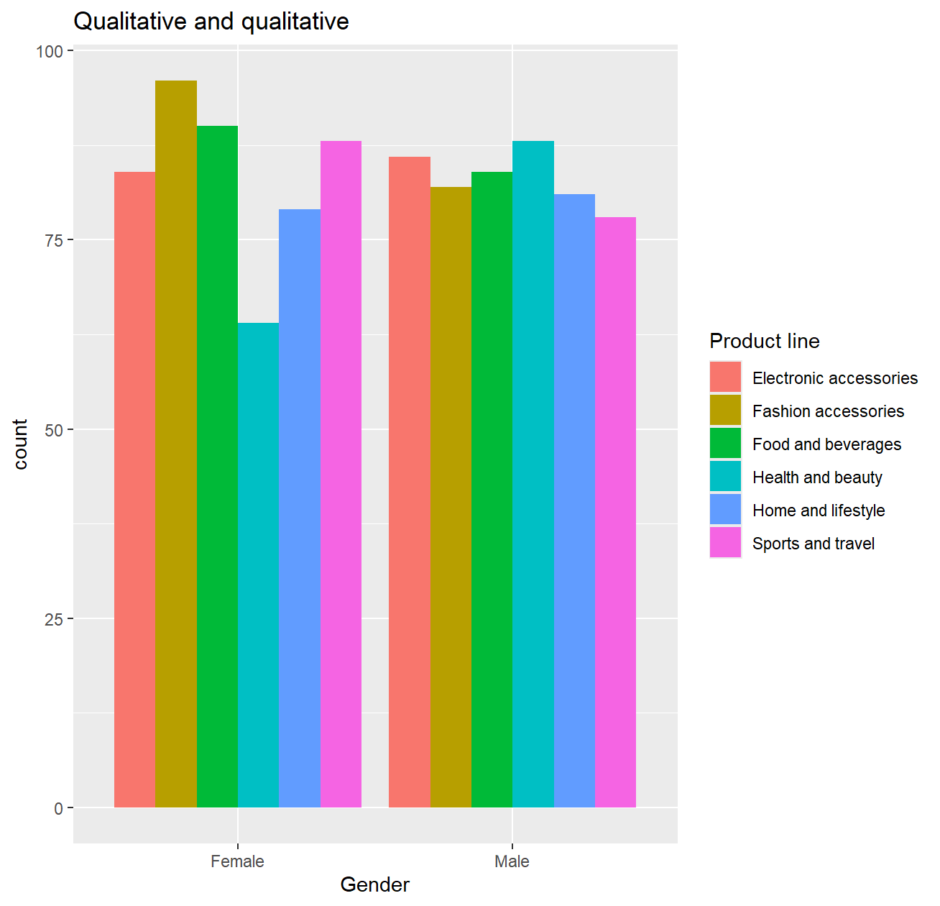
GENDER AND PRODUCT LINE
96
82
64
88

Slide 17
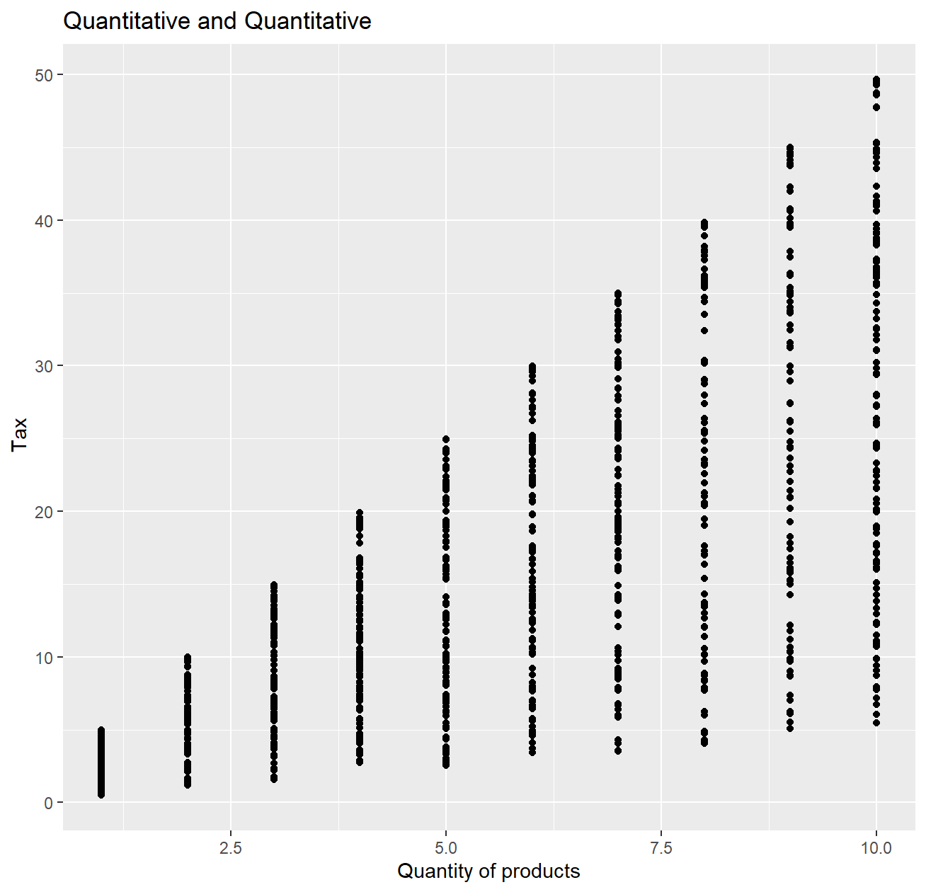
TAX AND QUANTITY

Slide 18
04.
SAMPLING
Sampling process of our database

Slide 19
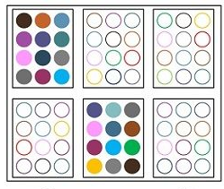
OUR DATABASE
Cluster random sampling
As our database is heterogeneous we decided this type of sampling.
df <- data.frame(tour = rep(1:10, each=80), experience = rnorm(800, mean=7, sd=1))
clusters <- sample(unique(df$tour), size=80, replace=F

Slide 20
05.
CONFIDENCE INTERVAL
Parameter to be estimated, why to estimate it, which statistic and procedure is used, results and interpretation for each confidence interval

Slide 21
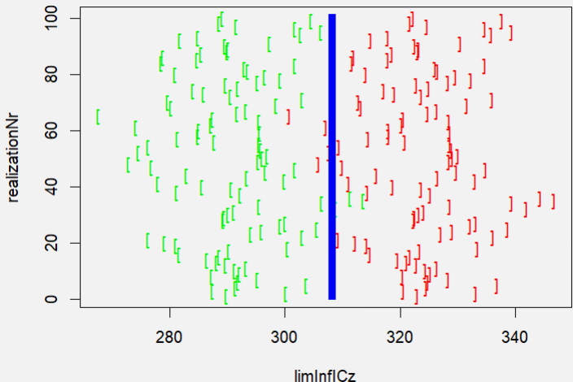
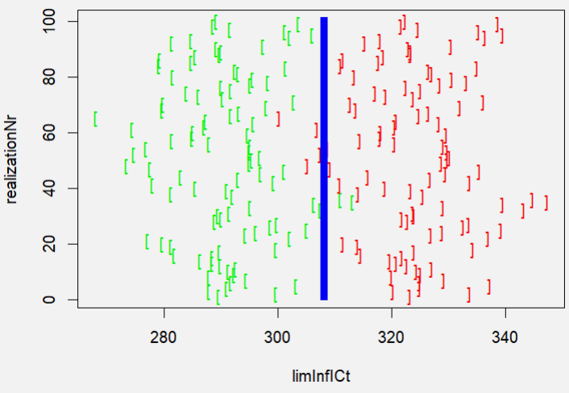
Z-distribution
T-distribution
Results

Slide 22
06.
HYPOTHESIS TEST
Fictitious scenario with a question to be answered, justification of the test, statistics involved and results for each HT

Slide 23
FIRST SCENARIO
The average number of products that customers buy is greater than 5.
H0: mean≤5
HA: mean>5
Sample mean = 5.39875.
Numerical variable -> t.test
t-value = 3.8143
p-value = 7.35e-5 < 0.05
Sample mean > hypothesized mean
Strong evidence to reject H0

Slide 24
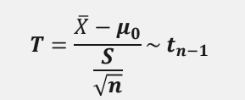
FIRST SCENARIO
HYPOTHESIS | SIGNIFICANCE
Ho = mean ≤ 5 H = mean > 5 | 𝝰 = 0.05
t.value | t
 | t = 3.8143
p.value | CONCLUSION
P(T≥t) = 7.35e-5 | p.value: 7.35e-5 < 0.05 -> The null hypothesis is rejected.

Slide 25
SECOND SCENARIO
There is a relationship between the gender of the customers and the type of products they buy.
H0: No relationship
HA: Relationship
Categorical variables -> chi-squared test
chi square = 9.5402
p-value = 0.089 > 0.05
Insufficient evidence to reject H0

Slide 26
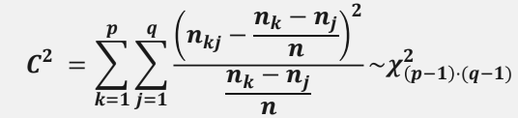
SECOND SCENARIO
HYPOTHESIS | SIGNIFICANCE
Ho = No relationship H = Relationship | 𝝰 = 0.05
chi square | c
 | c = 3.8143
p.value | CONCLUSION
P(C≥c) = 0.089 | p.value: 0.089 > 0.05 -> The null hypothesis is not rejected.

Slide 27
THIRD SCENARIO
There is a relationship between the time of the month of and the quantity of products bought.
H0: No relationship
HA: Relationship
Num. and cat. variable -> ANOVA test
p-value = 0.183 > 0.05
Insufficient evidence to reject H0

Slide 28
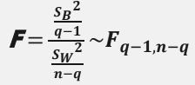
THIRD SCENARIO
HYPOTHESIS | SIGNIFICANCE
Ho = No relationship H = Relationship | 𝝰 = 0.05
f.value | f
 | f = 1.776
p.value | CONCLUSION
P(F≥f) = 0.183 | p.value: 0.183 < 0.05 -> The null hypothesis is not rejected.

Slide 29
07.
REGRESSION MODEL
Results and interpretation of the regression model, quality indicators, the graphical residual analysis and the process of simplification of the model

Slide 30
REGRESSION MODEL
Y = β0 + β1 X + ϵ
Gross Income
Coefficient
Error
Intercept
Total

Slide 31
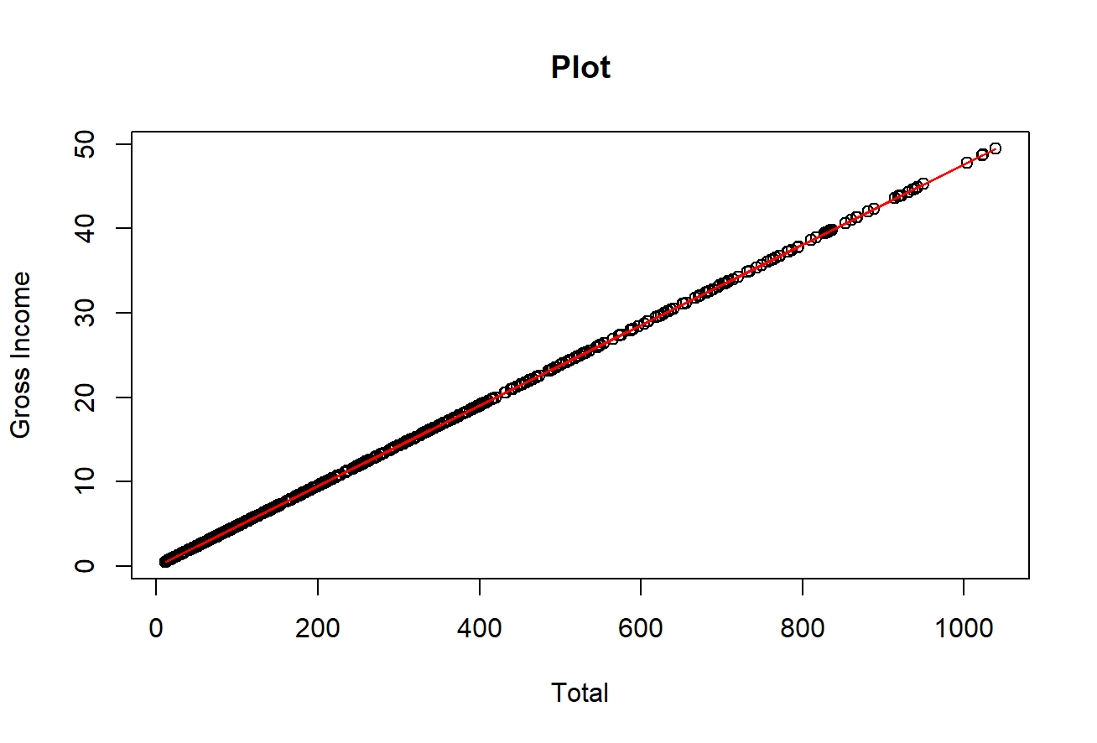
THIS IS A MAP
Intercept = -2.814e-14
Coefficient = 0.04762
Standard errors= 1.688e-15 and 1.688e-15
P-values < 2e-16

Slide 32
RESIDUALS
Min 1Q Median 3Q Max
-7.962e-13 -8.000e-17 6.900e-16 1.620e-15 2.232e-13
Standard error = 2.932e-14
F-statistic = 1.213e+32
Multiple and Adjusted R-squared = 1
P-value < 2.2e-16

Slide 33
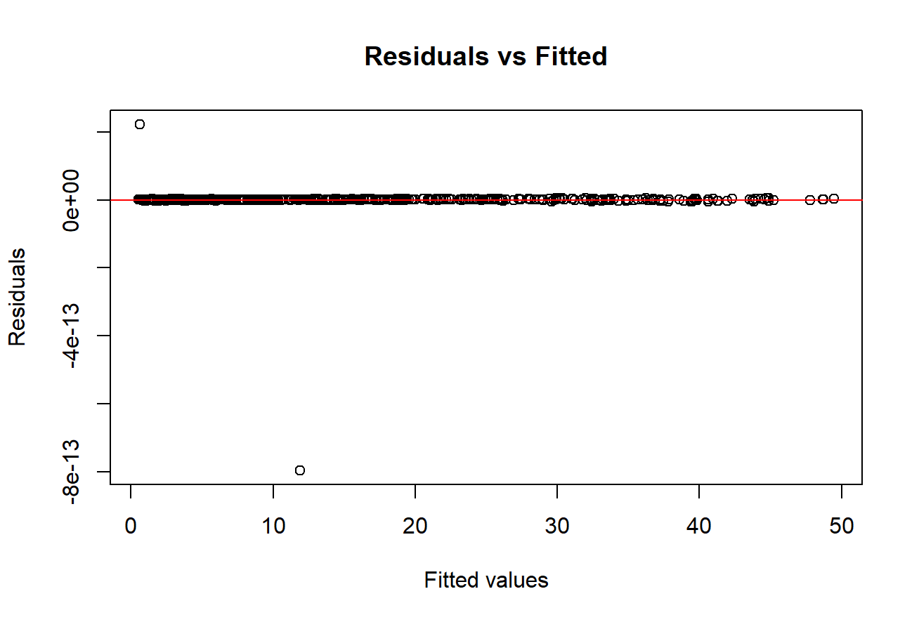
RESIDUAL VS FITTED

Slide 34
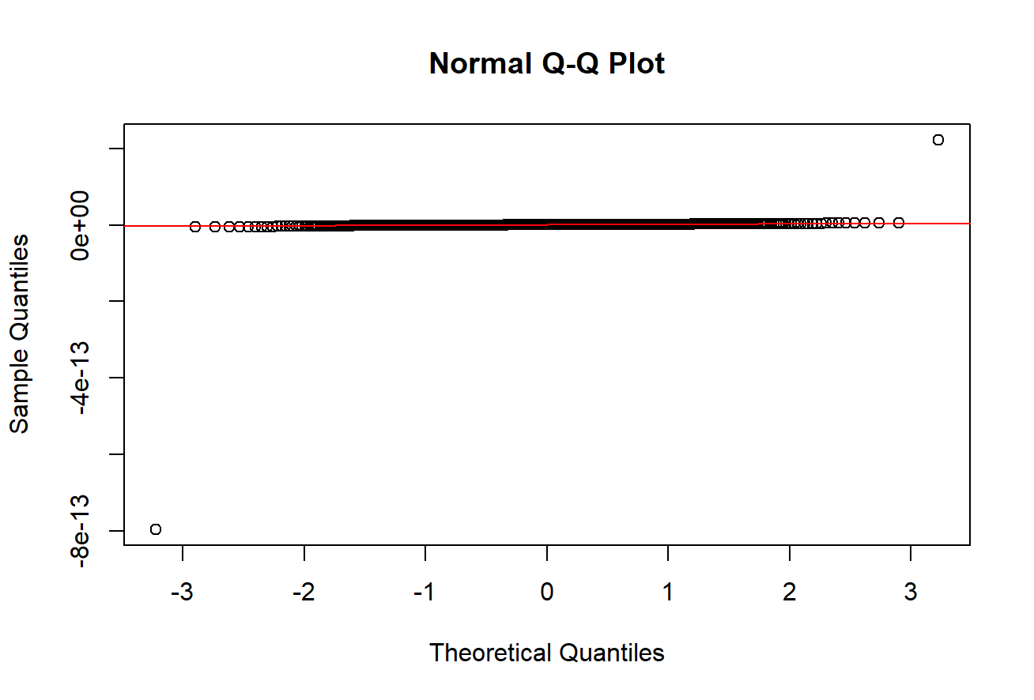
NORMAL Q-Q PLOT

Slide 35
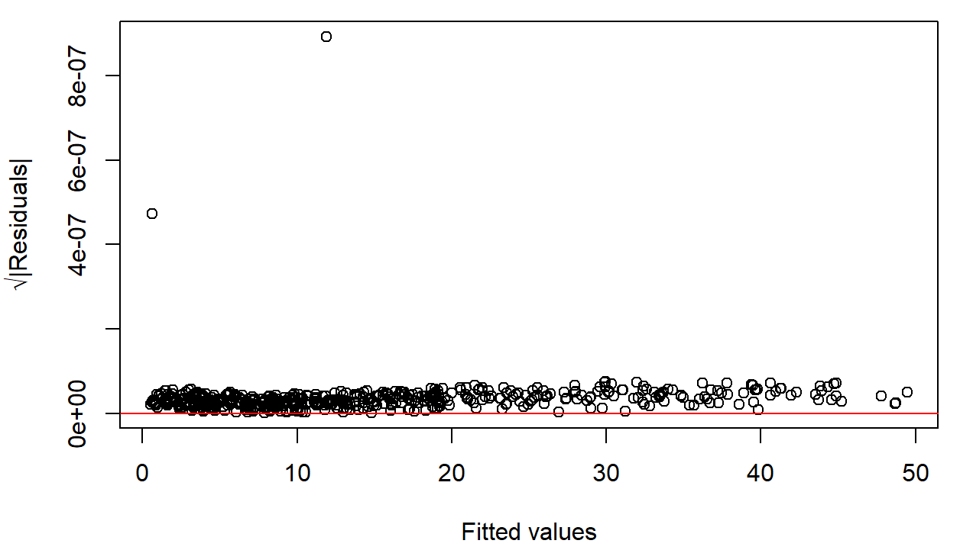
SCALE-LOCATION

Slide 36
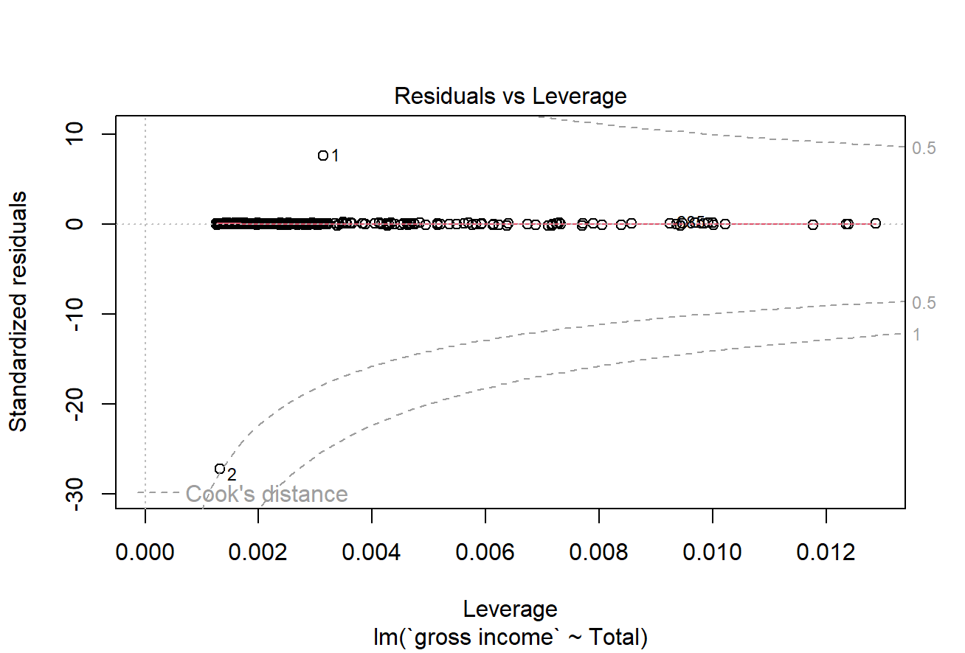
RESIDUAL VS LEVERAGE

Slide 37
PREDICTION
Use the regression model to predict data

Slide 38

PREDICTION
Use the regression model to predict data
On average, the difference between the values of the regression model and our real values is less than 2*10-14

Slide 39
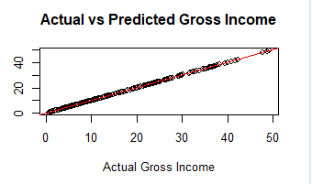
PREDICTION

Slide 40
08.
CONCLUSIONS
Comparison and synthesis of the discussion, conclusion and scheduling

Slide 41
CONCLUSIONS
REGRESSION MODEL
HYPOTHESIS
The average number of products that customers buy is greater than 5.
There is no relationship between the gender and the type of products they buy.
There is no relationship between the time of the month of and the quantity of products.

Slide 42
THANKS FOR YOUR ATTENTION
IF YOU HAVE ANY DOUBTS FEEL FREE TO ASK !

