Slide 1

Tracker Application
Final Project for the Service-Oriented Software Engineering Course
Group 3 (Al-Bustani, Caradio, Juha)

Slide 2
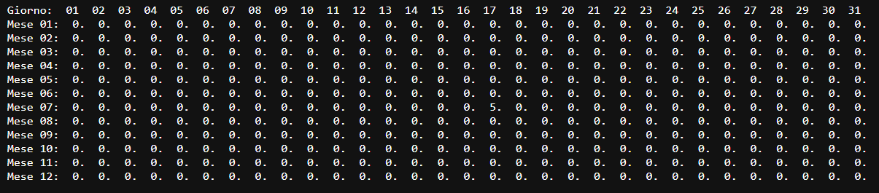
Introduction What is this application for?
The application is designed to track specific metrics every day for a full year
It can be used it to monitor things like:
🌦️ Weather
😊 Mood
☕ Coffee consumption
💤 Sleep hours
The main goal is to store and visualize data day by day, allowing users to analyze their habits or conditions over time.

Slide 3


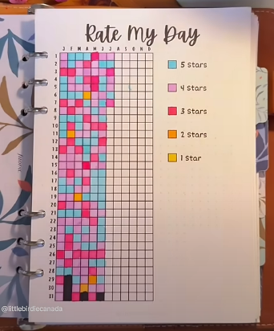
Introduction How we imagined it
This is how we originally imagined the app’s design. Unfortunately, we didn’t implement it, so the app looks pretty ugly!

Slide 4
Introduction Limitations
No authentication: Omitted to keep the code simple and highlight stateless service interaction.
- All users currently write to the same tracker, which is unrealistic, this is just for demo purposes. - With authentication, multi-user tracking will be possible.
No service discovery or load balancing: Avoided Eureka and related config to preserve CXF service structure.
Asynchronous logic: Implemented mainly to improve performance; real asynchronous needs were minimal due to app simplicity.

Slide 5
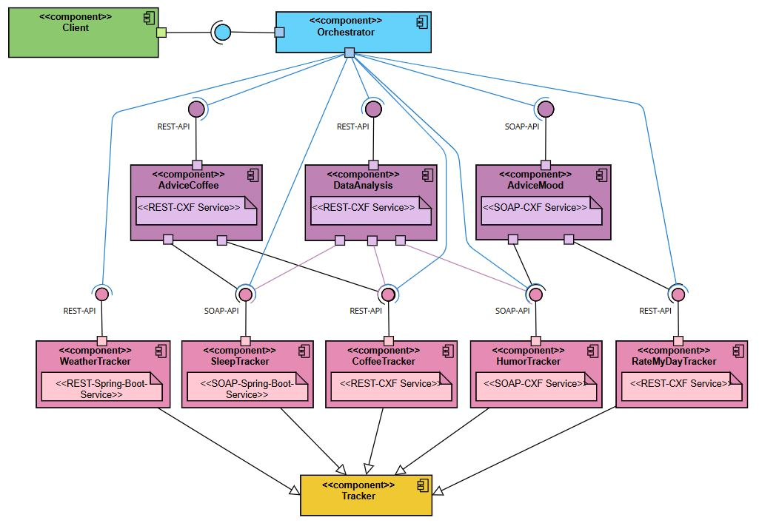
Architecture Starting Architecture
✅ Pro: - Reusability
Maintainability
❌ Cons: - Increasing complexity - Tight coupling - Low scalability
- Low availability
Notes:
✅ Pros
Reusability: Common logic and properties are centralized in the Tracker class, reducing code duplication across different tracker types.
Maintainability: Changes to shared logic only need to be made in the Tracker class, simplifying updates and bug fixes.
❌ Cons
Increasing complexity: As more tracker types are added, the base Tracker class may become too generic or overly abstract, making it harder to manage.
Tight coupling: Subclasses are tightly dependent on the Tracker superclass. Changes to the base class can inadvertently break the subclasses.
Limited scalability: Extending the application with new tracker features or behaviors may be constrained by the existing class hierarchy.
Low availability: If the Tracker class needs to be modified or refactored, all dependent services may become temporarily unavailable or unstable.

Slide 6
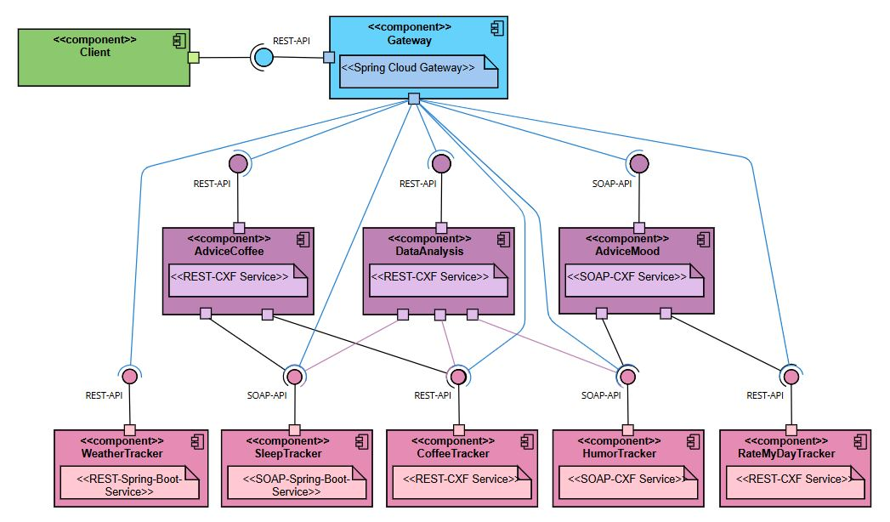
Architecture Final Architecture
✅ Pro:
- High Modularity - High Availability
- High Scalability
- Loose coupling
❌ Cons: - Low reusability
- Maintanability
Notes:
✅ Pros
High Modularity: Each service is fully independent, with its own logic and responsibilities.
High Availability: Changes or maintenance can be performed on a single service without shutting down the entire system.
High Scalability: New features or services can be added easily without modifying the existing architecture.
Loose Coupling: Services are loosely connected and interact only through well-defined web interfaces (e.g., REST or messaging protocols).
❌ Cons
Low Reusability: Common logic may be duplicated across multiple services, increasing redundancy.
Lower Maintainability: If shared logic needs to be updated, changes must be applied to each tracker individually, which can be time-consuming and error-prone.

Slide 7
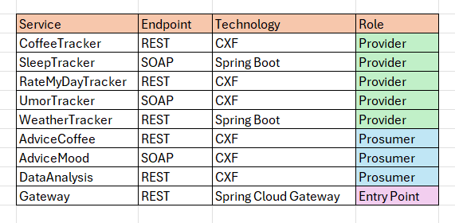
Services Overview
Total Services:
5 Providers
3 Prosumers
3 Asynchronous Services
Technology Stack:
All services are Java-based
Maven is used for build and dependency management
- Services are deployed as indipendent units using containers

Slide 8
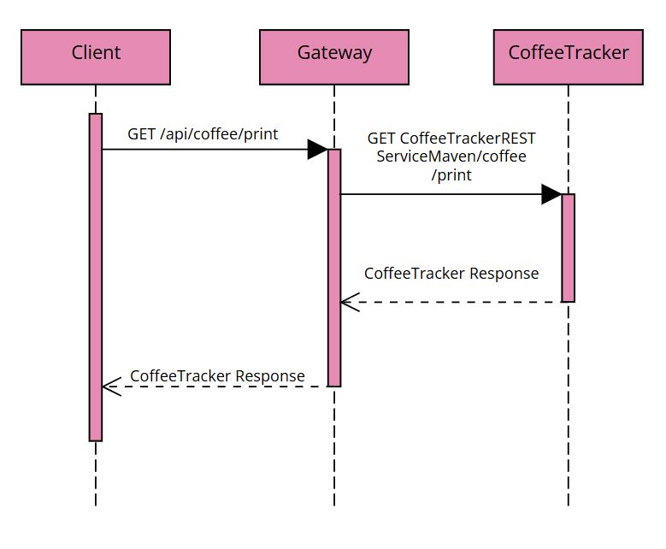
Services Coffee Tracker
Tracks the number of coffees consumed per day by a user.
Provider: expose endpoints to other services or clients
RESTful API
Apache CXF for REST service implementation
Java-based, packaged and deployed via Maven
Supports the following operations:
- print(): Returns the entire history
- add(int a): Adds the number of coffee consumed today
- lastValues() Returns the values of the last 7 days, excluding today

Slide 9
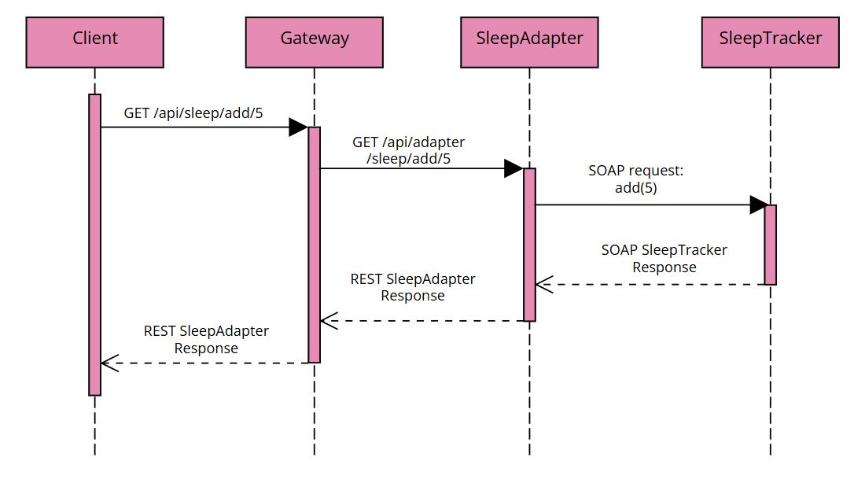
Services Sleep Tracker
Tracks the number of slept hours by a user.
Provider: expose endpoints to other services or clients
SOAP API
Spring Boot for SOAP contract-first implementation (Web-Services)
Java-based, packaged and deployed via Maven
Supports the following operations:
- print(): Returns the entire history
- add(int a): Adds the number of slept hours for today
- lastValues(): Returns the values of the last 7 days, excluding today

Slide 10
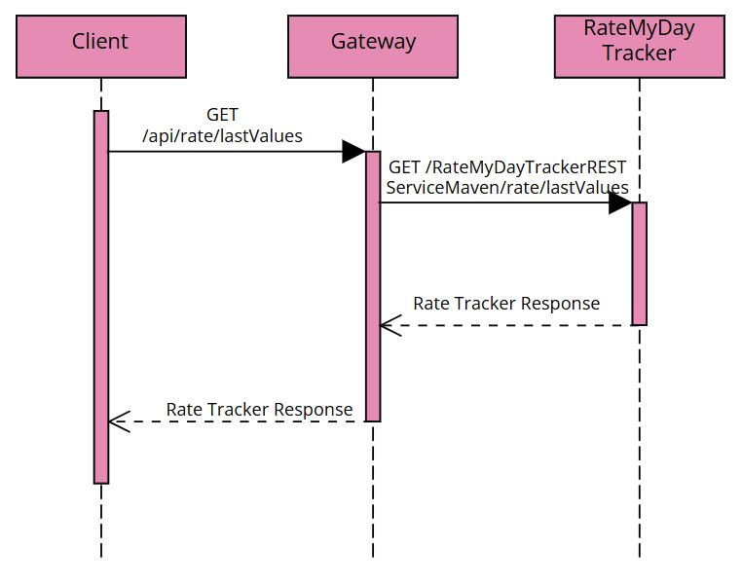
Services Rate My Day Tracker
Tracks the user's daily self-assessed rating, on a scale from 1 to 5 stars
Provider: expose endpoints to other services or clients
RESTful API
Apache CXF for REST service implementation
Java-based, packaged and deployed via Maven
Supports the following operations:
- print(): Returns the entire history
- add(int a): Adds the today’s days rating
- lastValues() Returns the ratings of the last 7 days, excluding today

Slide 11
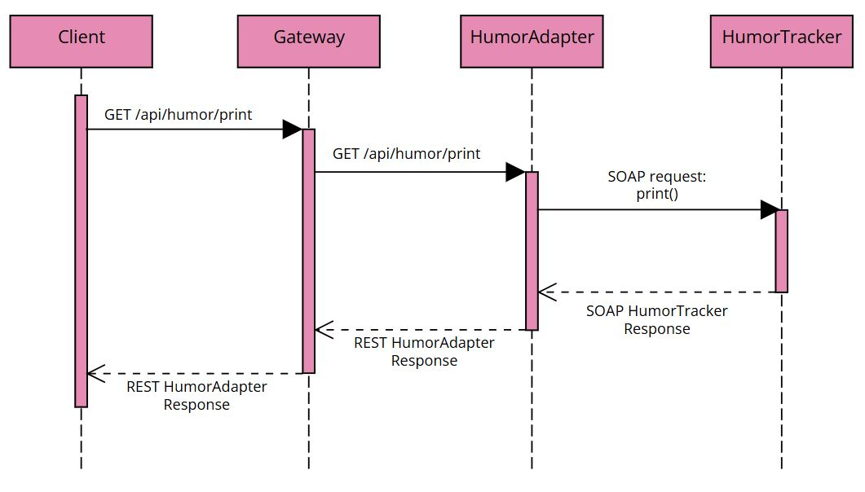
Services Umor Tracker
Tracks the user's self-reported mood, recorded once per day.
Provider: expose endpoints to other services or clients
SOAP API
Apache CXF for SOAP service implementation
Java-based, packaged and deployed via Maven
Supports the following operations:
- print(): Returns the entire history
- add(int a): Adds the value of the user’s mood today
- lastValues() Returns the values of the last 7 days, excluding today

Slide 12
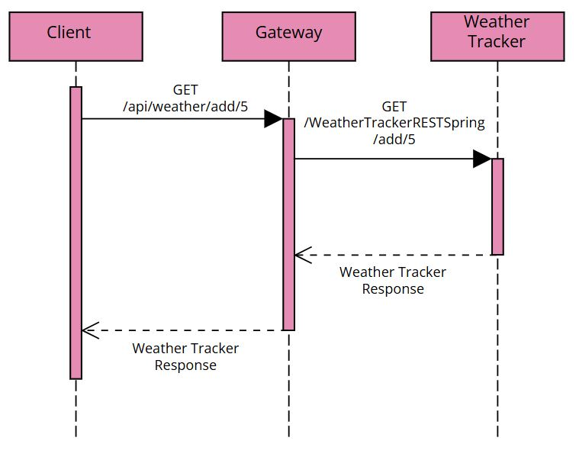
Services Weather Tracker
Tracks the daily weather values reported by the user.
Provider: expose endpoints to other services or clients
RESTful API
Spring Boot for REST service implementation (Web)
Java-based, packaged and deployed via Maven
Supports the following operations:
- print(): Returns the entire history
- add(int a): Adds the today’s weather value
- lastValues() Returns the values of the last 7 days, excluding today

Slide 13
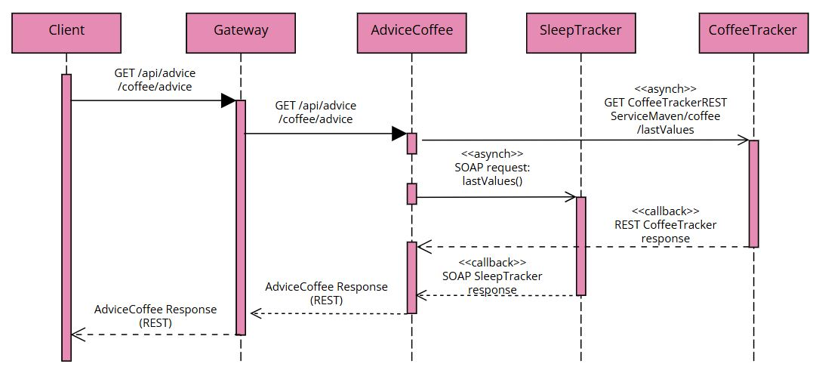
Services Advice Coffee Tracker
Provides sleep and coffee advice based on the last 7 days of tracked values.
Prosumer
Asynchronous call
RESTful API
Apache CXF for REST
Java-based deployed via Maven
Supports the following operation:
- advice(): Print the advice

Slide 14
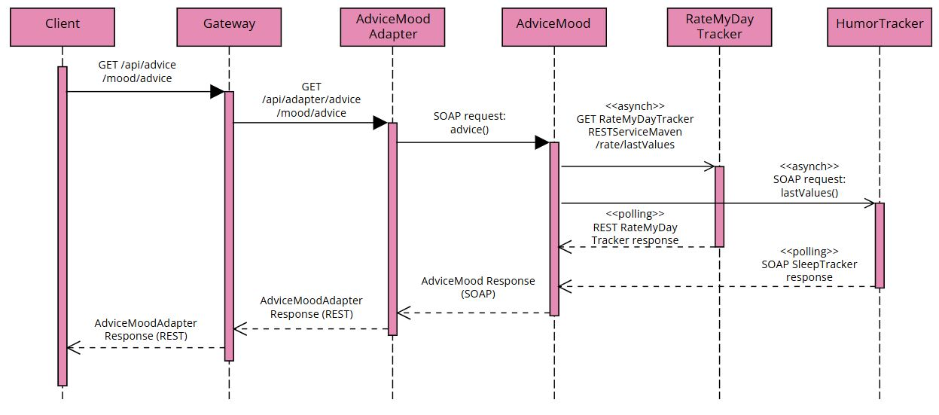
Services Advice Mood Tracker
Provides sleep and coffee advice based on the last 7 days of tracked values.
Prosumer
Asynchronous call
SOAP API
Apache CXF for SOAP
Java-based deployed via Maven
Supports the following operation:
- advice(): Print the advice

Slide 15
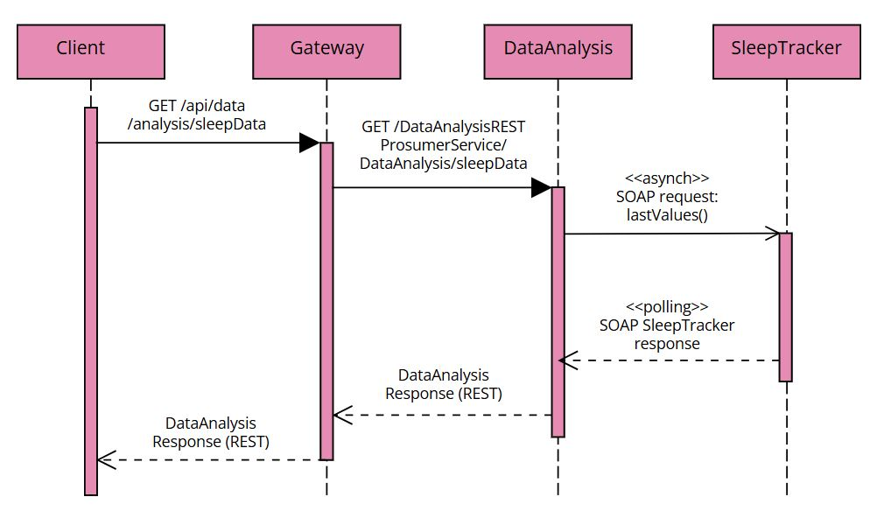
Services Data Analysis
Provides basic analysis (sum, mean, min and max) for different trackers.
- Prosumer
- Asynchronous call
REST API
Apache CXF for REST
Java-based deployed via Maven
Supports the following operation:
humorData(): Returns analysis of humor tracker data
sleepData(): Returns analysis of sleep tracker data
coffeeData(): Returns analysis of coffee tracker data

Slide 16
Gateway Introduction
Spring Cloud Gateway has been used as REST API Gateway and single entry point for routing requests and rewriting paths.
While it supports load balancing, rate limiting, and service discovery with Eureka, these features were not implemented to avoid modifying the CXF services structures that is not directly supported.
Authentication and login were also excluded to stay aligned with the project specification and keep the code focused on core functionality.

Slide 17
Gateway Use with Docker
To simplify service startup, we used Spring Cloud Gateway and Docker Compose to orchestrate all services and manage path rewriting.
We containerized only the JARs (Spring Boot) and WARs (CXF), not the full services, keeping the setup lightweight but not fully automated.
After any change, the project must be recompiled using: mvn clean package javadoc:javadoc -DskipTests

Slide 18
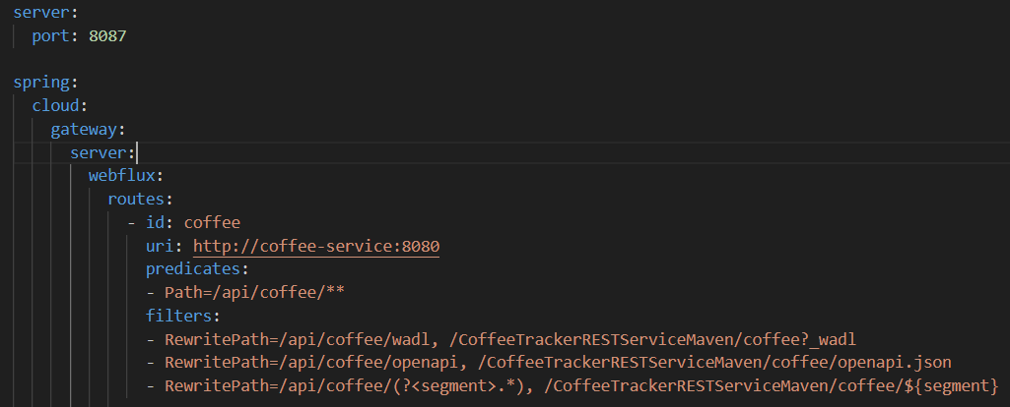
Gateway Use with Docker
We rely on two main configuration files to run the entire project:
1. Application.yml: In the Gateway project, this file is responsible for mapping and rewriting routes to all backend services.

Slide 19
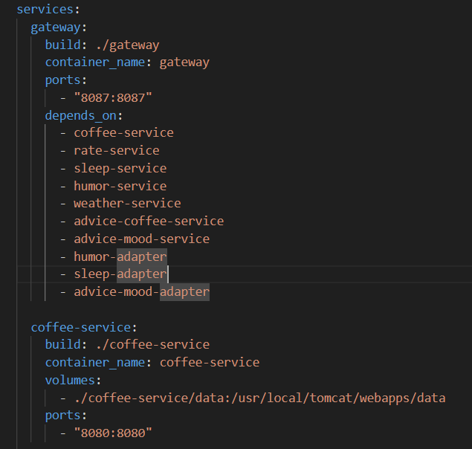
Gateway Use with Docker
We rely on two main configuration files to run the entire project:
2. docker-compose.yml: Located in the project root, this file orchestrates the startup of all microservices, handles their build and launch, and manages networking between containers.

Slide 20
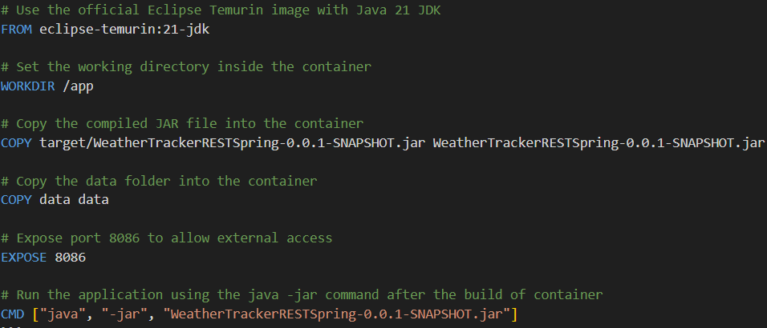
Gateway Execution of services
Services run in containers based on their file type: mainly JAR and WAR files.
1. For JAR files, we use the following Dockerfile:

Slide 21
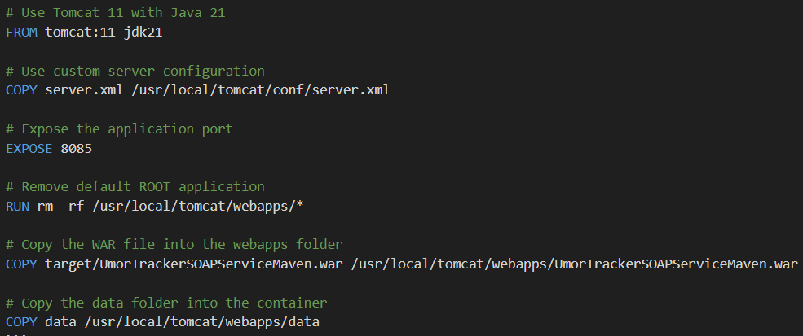
Gateway Execution of services
Services run in containers based on their file type: mainly JAR and WAR files.
2. For WAR files, we use the following Dockerfile:

Slide 22
Gateway Requirement & Execution
Requirements:
Docker Desktop (recommended version 4.43.1 or higher)
Execution:
From the project root Microservices-application run: docker-compose up –build
All application paths will be accessible:
Backend services at their own ports
Gateway with rewritten paths
🌐 Endpoint: localhost:8087
☕ Coffee Tracker
/api/coffee/print
/api/coffee/add/{value}
/api/coffee/lastValues
📊 Other Trackers
/api/rate/print
/api/sleep/print
/api/humor/print
/api/weather/print
💡 Advice & Analytics
/api/advice/mood/advice
/api/advice/coffee/advice
/api/data/analysis/sleepData
/api/data/analysis/coffeeData
/api/data/analysis/humorData

Slide 23
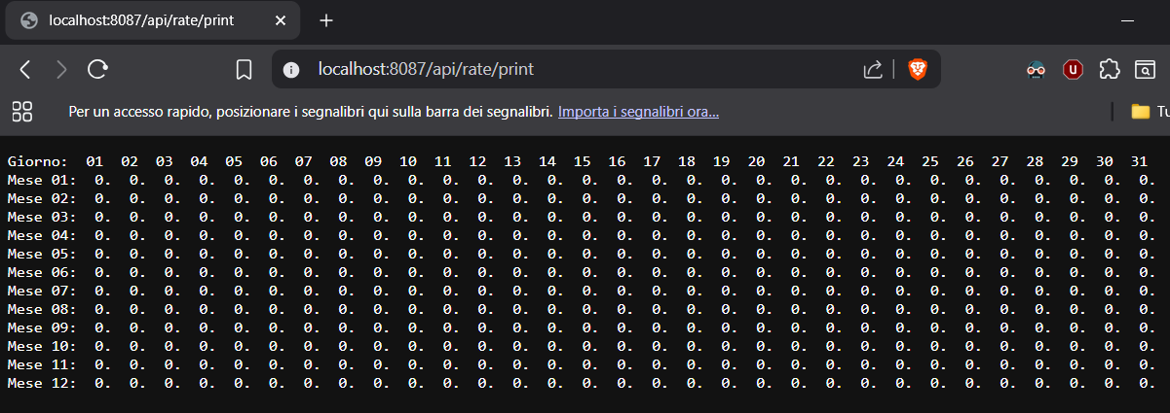
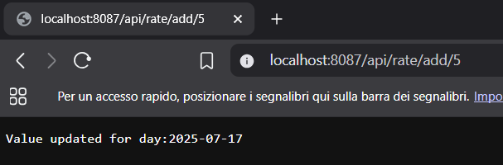
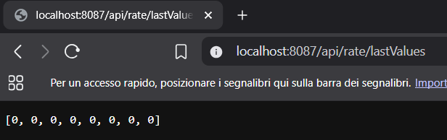
Screenshot

Slide 24
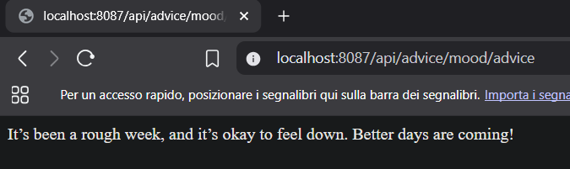
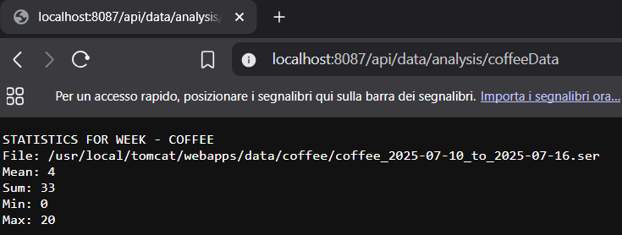
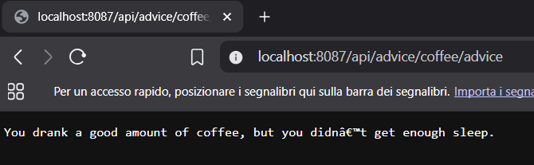
Screenshot

Slide 25
Documentation
A general documentation file is included in the project in the /documentation folder in the project ZIP.
Javadoc is available for each service at: <service-name>/target/site/apidocs/index.html
WADL files for REST services and WSDL files for SOAP services are inside the /documentation/wsdl-wadl-openAPI folder in the project ZIP.
WADL, WSDL, and OpenAPI definitions are also accessible directly from the services—full paths and configurations are detailed in the documentation.

Slide 26
Thank you!

