Slide 1
Final project
Name: Mohammad Askari
Student Number: 810198441

Slide 2
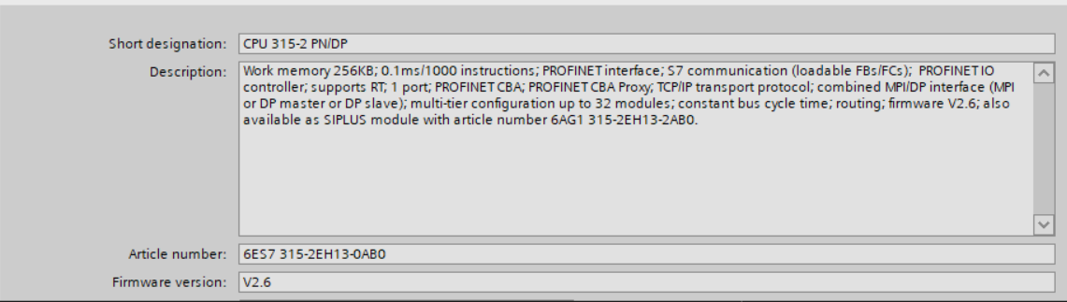
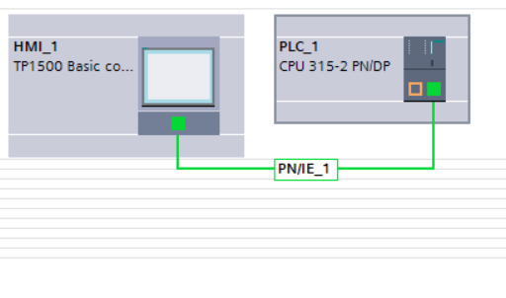
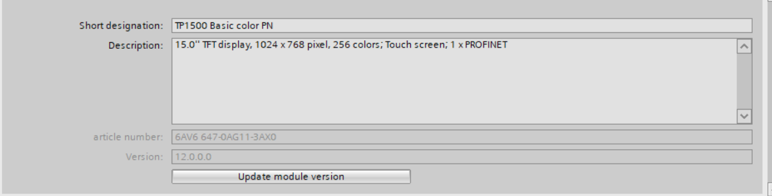
Plc & hmi selection

Slide 3
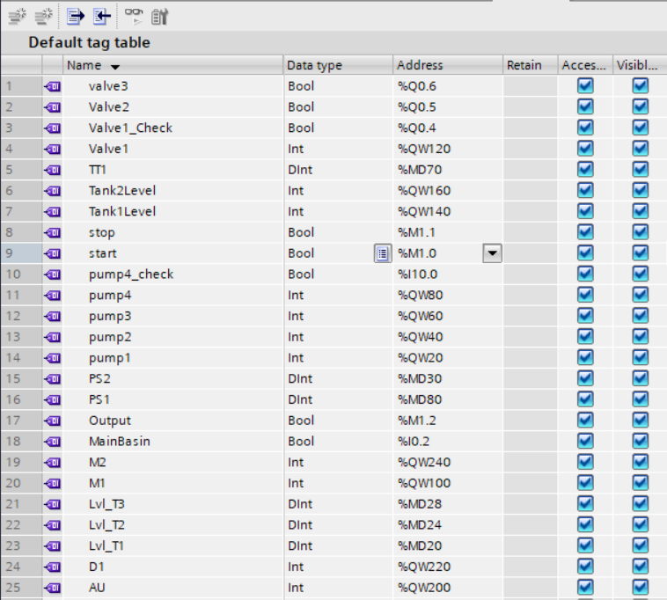
Tags

Slide 4
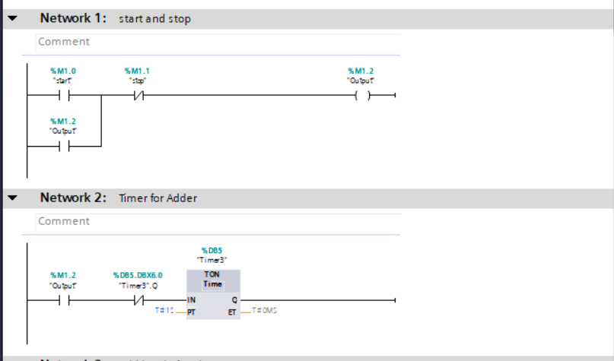
Start and Stop

Slide 5
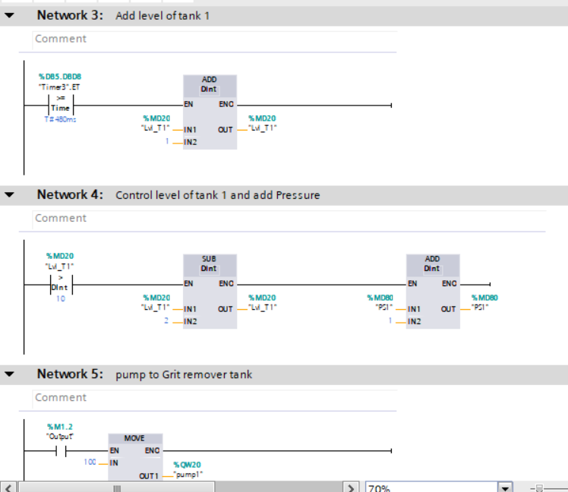
Level control

Slide 6
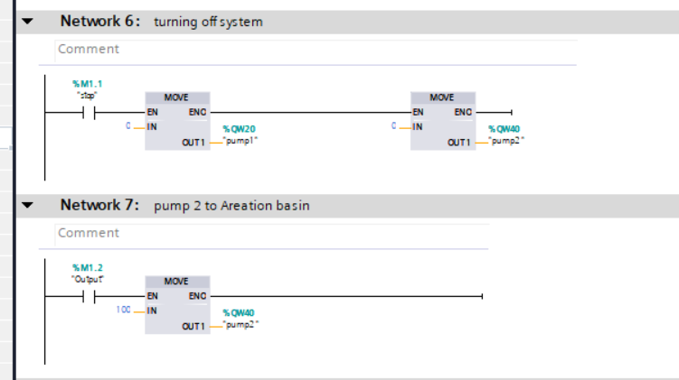
Turn off & Turn on

Slide 7
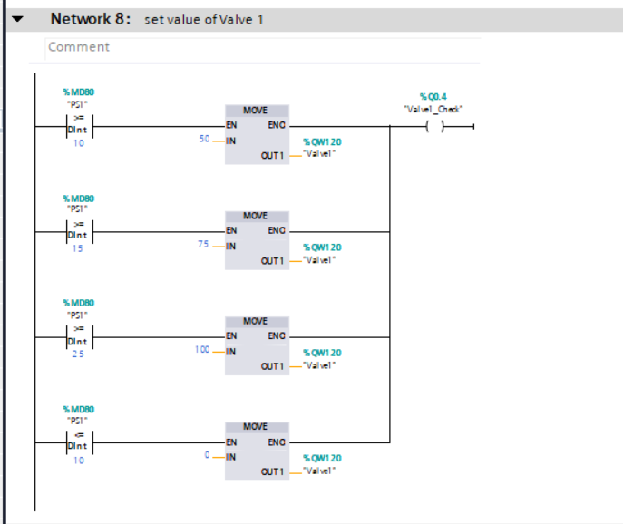
Valve control

Slide 8
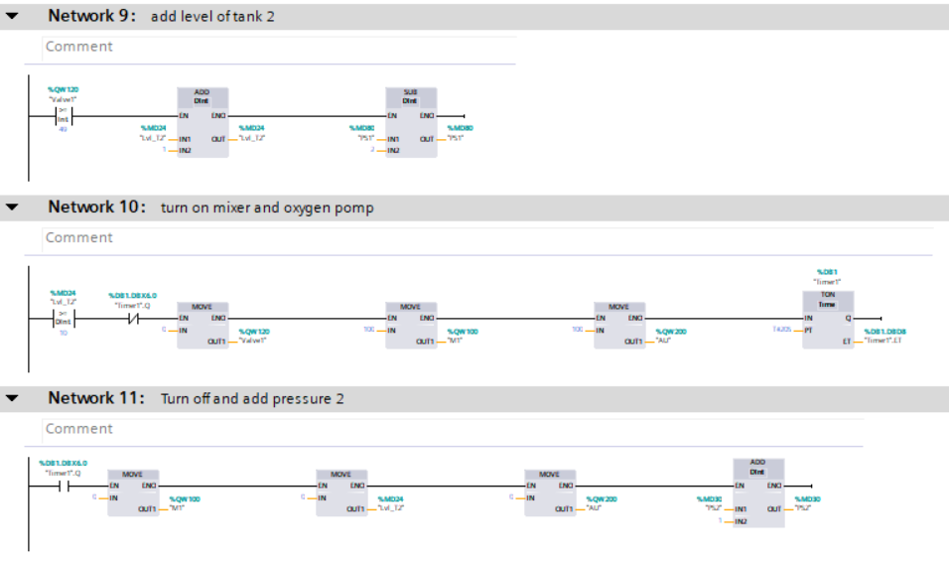
Areation basin actions

Slide 9
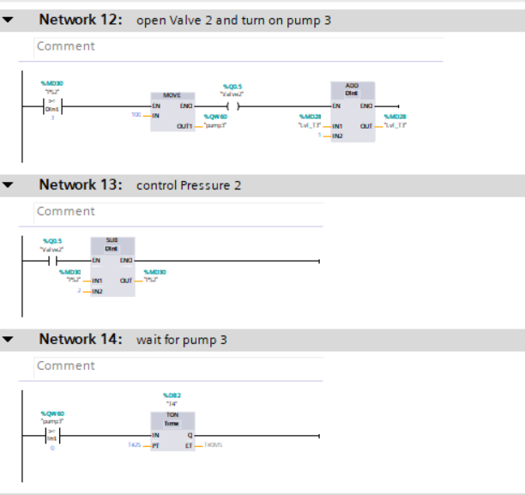
Gravity Filter Actions

Slide 10
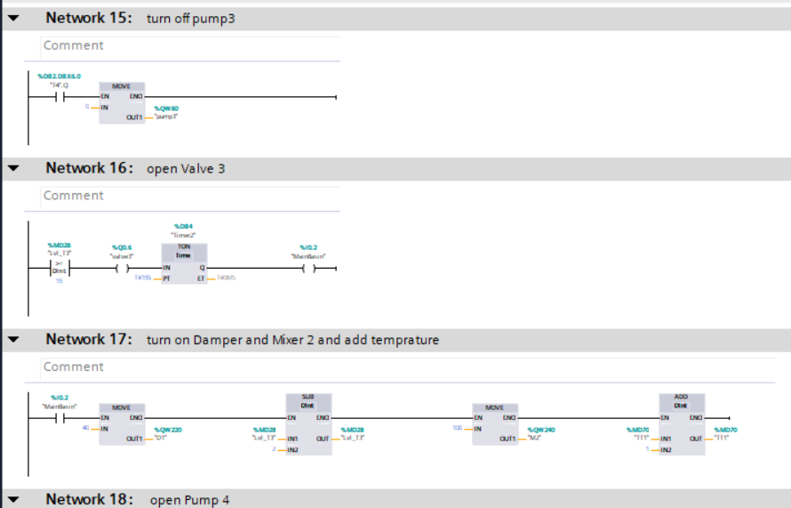
Main Basin Actions

Slide 11
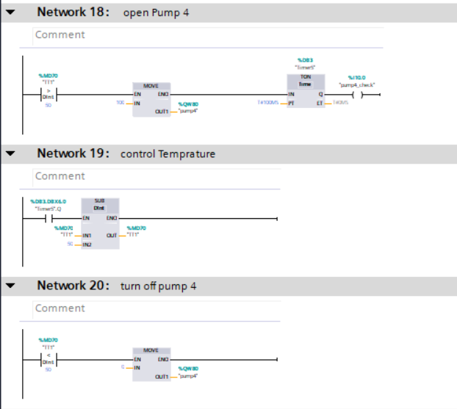
Boiler Actions

Slide 12
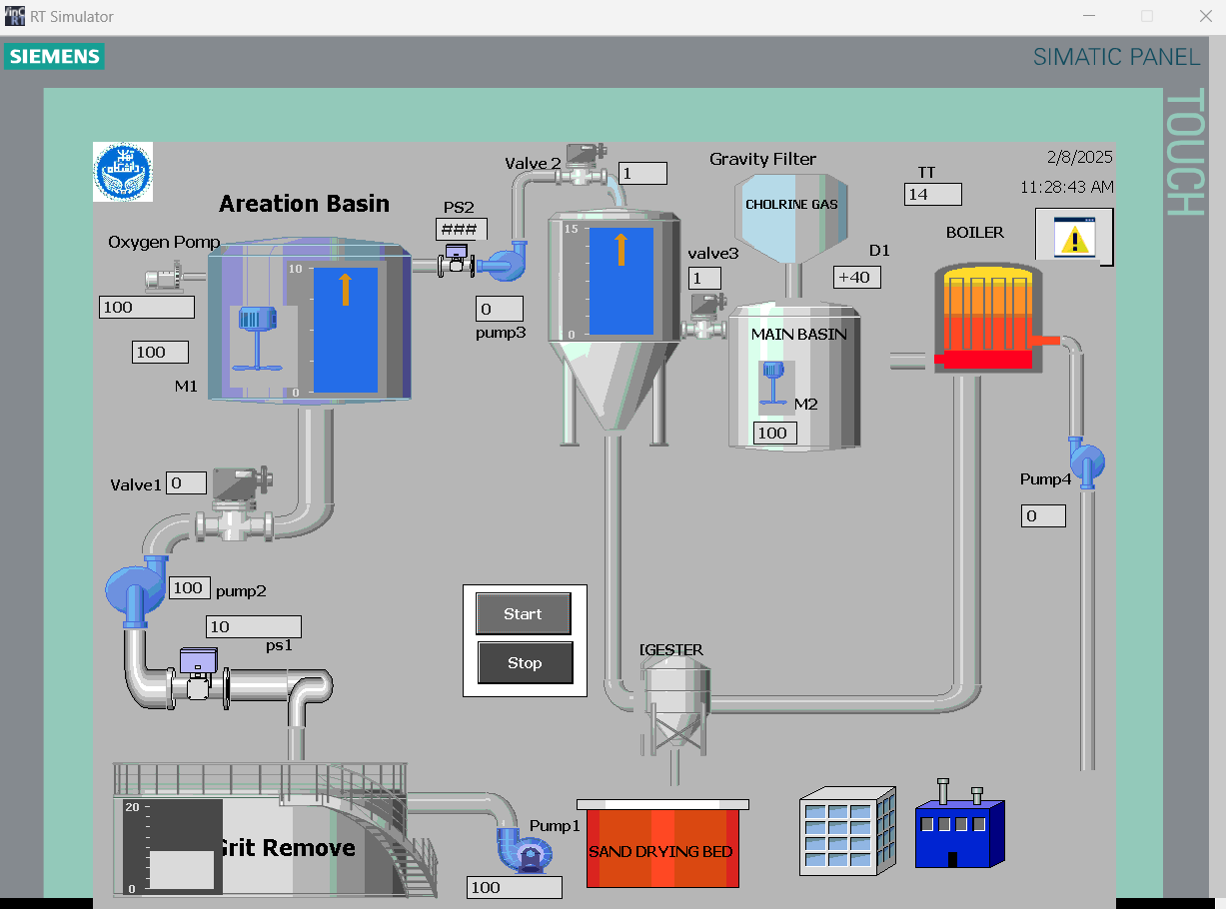
Hmi view

Slide 13
Thank you for Your attention!

