Slide 1
Location-Routing Problem with Pick-up Stations
Mathematical Model, Branch-and-Price, and Branch-and-Cut with Minimal Cover Inequalities
Based on Wang, Zhang, Bell, and Miao (EJOR 2022)
Computational implementation and experiments
LRP-PS: Branch-and-Price vs Branch-and-Cut with MCI
1

Slide 2
Roadmap
OVERVIEW
Problem definition: delivery options, cost components, and assumptions.
Compact mathematical formulation: objective function and all constraint groups.
Paper decomposition: set-partitioning master, feasible columns, and pricing subproblems.
Solution algorithms: paper Branch-and-Price and Branch-and-Cut with MCI.
Data generation and experimental considerations.
Comparison of objective values, runtimes, MCI counts, and service shares.
Code availability and reproducibility.
LRP-PS: Branch-and-Price vs Branch-and-Cut with MCI
2

Slide 3
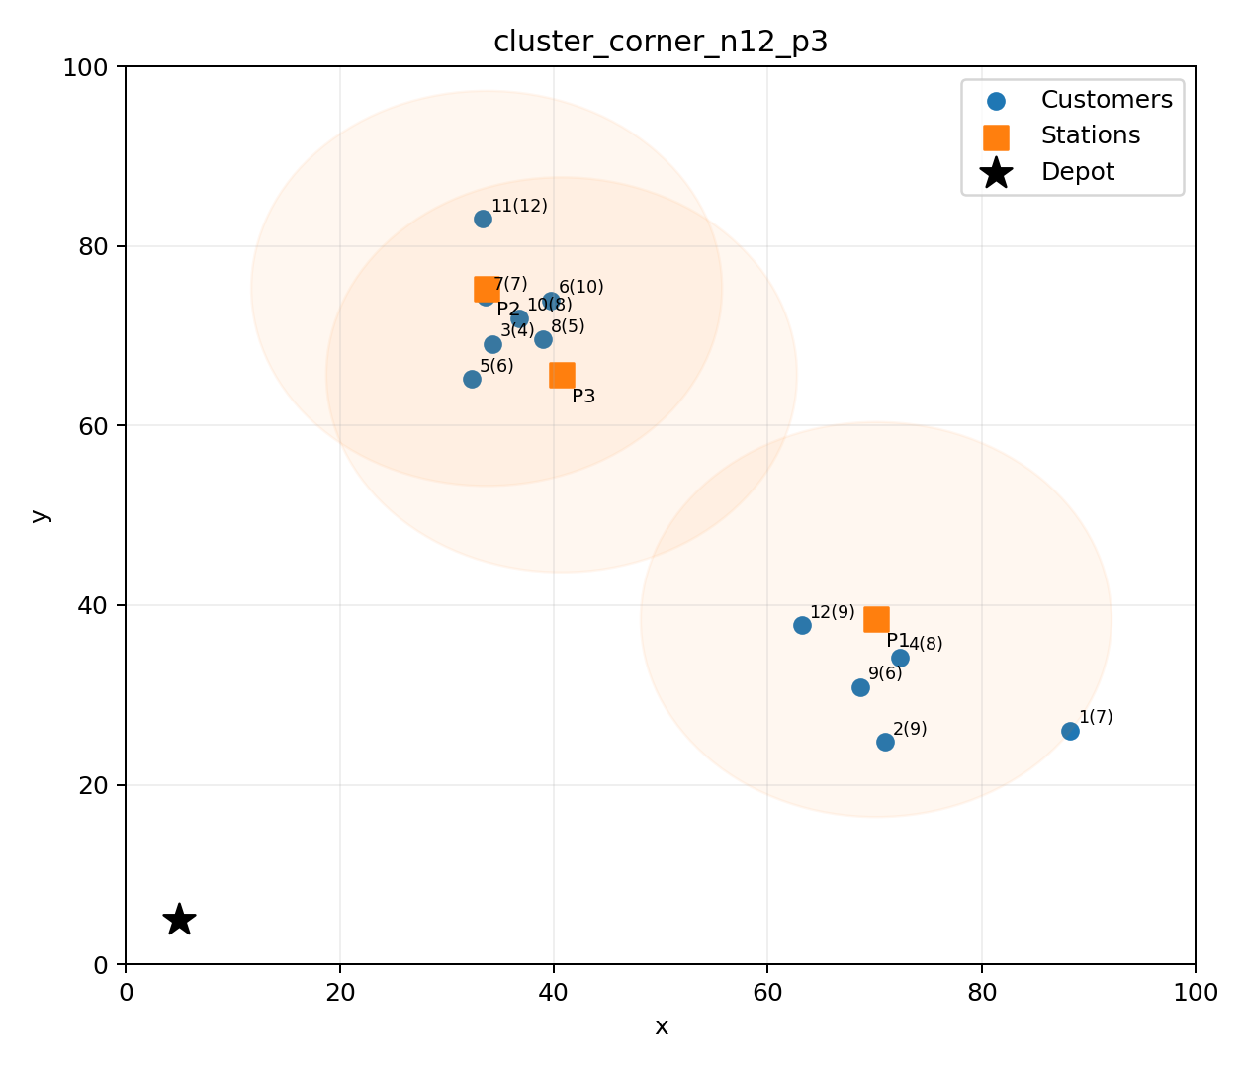
Problem Statement: LRP-PS
PROBLEM
Network
Depot 0, customer set Vc, and candidate pick-up station set Vl.
Delivery rule
Every customer demand is satisfied exactly once: either by one opened station or by a small green vehicle route.
Large GV assumption
Large green vehicles do not visit customer demand points. They only replenish opened stations, represented by the effective fixed station cost.
Separate strategy: facility service and direct customer routing are modeled separately.
LRP-PS: Branch-and-Price vs Branch-and-Cut with MCI
3

Slide 4
Notation
MODEL
Sets
Parameters
Decision variables
0: depot Vc: customers Vl: candidate pick-up stations A: small-GV arcs among depot and customers only
q_i: customer demand Q_l: station capacity Q_e: small-GV capacity B: battery range r_l: station coverage radius c_ij: travel cost f_l, a_l: station opening/handling costs phi: large-GV route saving factor
v_l: station opened z_il: customer i assigned to station l w_i: customer i served by small GV x_ij: small GV traverses arc (i,j) f_ij: load flow b_i: remaining battery
LRP-PS: Branch-and-Price vs Branch-and-Cut with MCI
4

Slide 5
Objective Function
MODEL
The first term opens and replenishes pick-up stations.
The second term charges handling cost for packages assigned to stations.
The third term charges the fixed cost of each used small GV.
The fourth term charges the travel cost of small-GV customer routes.
Large-GV travel saving is modeled by phi; if phi = 0.1, only 10% of the station round trip is charged to LRP-PS.
LRP-PS: Branch-and-Price vs Branch-and-Cut with MCI
5

Slide 6



Assignment and Facility Constraints
MODEL
(2) Exactly one delivery mode
(4) Station capacity
(3) Coverage and station opening
If v_l = 0, no customer can be assigned to station l.
A station can serve only customers inside its coverage radius.
Total assigned demand cannot exceed station accommodation capacity.
These constraints are the source of minimal cover inequalities.
LRP-PS: Branch-and-Price vs Branch-and-Cut with MCI
6

Slide 7




Small-GV Routing Constraints
MODEL
Depot balance and fleet limit
Customer flow conservation
Load flow and capacity
Battery range
The x, f, and b variables model only small-GV customer routes. Large GVs are not allowed to visit demand points.
LRP-PS: Branch-and-Price vs Branch-and-Cut with MCI
7

Slide 8
Paper Decomposition: Main Idea
PAPER METHOD
Dantzig-Wolfe Reformulation
Pattern columns
Route columns
Replace arc-level routing and assignment details by feasible columns. The master problem selects columns that cover all customers exactly once.
A station pattern p is a feasible subset of customers assigned to one station l. It must satisfy coverage and station capacity.
A route r is a feasible elementary small-GV route starting and ending at the depot. It must satisfy load and battery resources.
LRP-PS: Branch-and-Price vs Branch-and-Cut with MCI
8

Slide 9
Master Problem (Set Partitioning)
PAPER METHOD
α_ip = 1 if customer i appears in station pattern p.
β_ir = 1 if customer i is visited by small-GV route r.
The master chooses a mutually consistent station-route system.
LRP-PS: Branch-and-Price vs Branch-and-Cut with MCI
9

Slide 10

Feasible Pattern Columns and PSCSP
PAPER METHOD
A feasible station pattern p for station l:
Pricing subproblem PSCSP-l:
contains only customers inside the coverage radius;
respects the station accommodation capacity;
charges one handling cost term for each assigned demand unit.
LRP-PS: Branch-and-Price vs Branch-and-Cut with MCI
10

Slide 11
Feasible Route Columns and SPPBDRC
PAPER METHOD
A feasible route r starts at the depot, visits a subset of customers, and returns to the depot.
The route is elementary: no customer is repeated.
Total demand on the route is at most Q_e.
Total energy consumption is within battery range B.
The route cost is c_r = c_e + travel distance.
Reduced arc costs:
Pricing: find a negative reduced-cost elementary shortest path with load and battery resources.
Known problem class: ESPPRC / resource-constrained shortest path.
LRP-PS: Branch-and-Price vs Branch-and-Cut with MCI
11

Slide 12
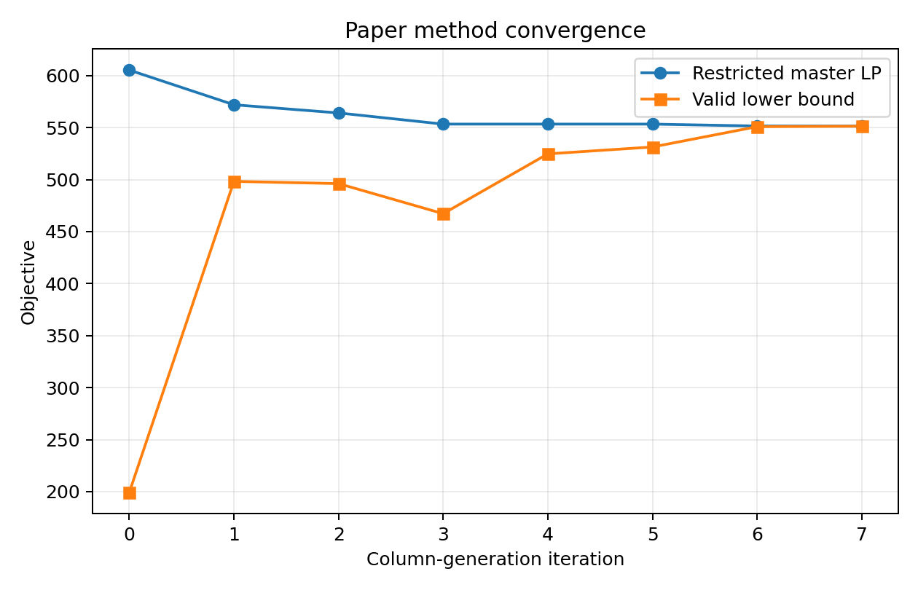
Column Generation and Branching
PAPER METHOD
Start from a restricted master problem.
Solve the LP relaxation and read dual variables μ, τ, η.
Solve PSCSP and SPPBDRC pricing problems.
Add columns with negative reduced cost.
Repeat until no improving column exists.
Branch when the master solution is fractional.
The implemented benchmark completes route columns exactly for small instances and then solves the integer master.
LRP-PS: Branch-and-Price vs Branch-and-Cut with MCI
12

Slide 13
Branch-and-Cut with Minimal Cover Inequalities
B&C + MCI
If v_l = 0, no assignment to station l is possible.
If v_l = 1, at most |C|-1 customers from an over-capacity cover can be assigned.
The inequality is valid for all integer feasible solutions and can cut fractional node relaxations.
LRP-PS: Branch-and-Price vs Branch-and-Cut with MCI
13

Slide 14
B&C + MCI Algorithm
B&C + MCI
1. Build the compact MIP with exact preprocessing.
2. Enumerate minimal covers for each station-capacity constraint.
3. Run Gurobi Branch-and-Bound on the integer compact model.
4. At a fractional MIP node, evaluate each candidate cover:
if sum z*_il > (|C|-1)v*_l, add the user cut sum z_il <= (|C|-1)v_l.
5. Continue branching and cutting until the global MIP gap is zero.
The B&C model is exact because MCI cuts are globally valid.
LRP-PS: Branch-and-Price vs Branch-and-Cut with MCI
14

Slide 15
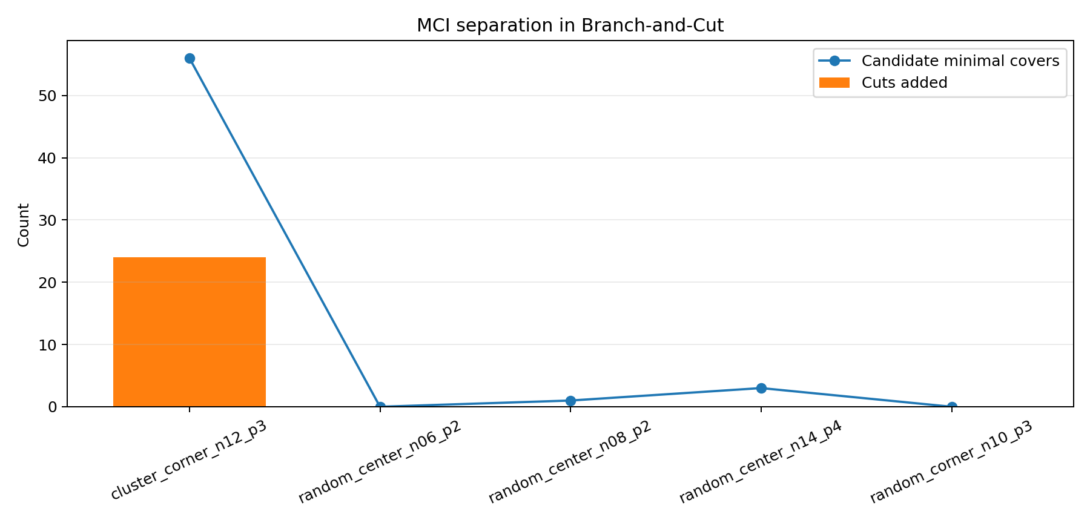
Why MCI Counts Differ Across Instances
B&C + MCI
Many MCIs appear when several customers are eligible for the same station and their combined demand exceeds Q_l.
Few or zero MCIs appear when station neighborhoods are small or only one/two customers are eligible.
A candidate MCI is added only if it is violated at a fractional node.
Therefore, candidate count depends on geometry and demand/capacity, while added-cut count depends on the LP relaxation path.
The clustered instance has many nearby customers around stations, so it generated 56 candidates and 24 active cuts.
LRP-PS: Branch-and-Price vs Branch-and-Cut with MCI
15

Slide 16
Data Generation and Modeling Considerations
EXPERIMENTS
Instance | n | p | Demand | Qe | Ql | r | Ne
random_center_n06_p2 | 6 | 2 | 45 | 13.000 | 20.000 | 22.000 | 5
random_center_n08_p2 | 8 | 2 | 60 | 17.000 | 20.000 | 22.000 | 5
random_corner_n10_p3 | 10 | 3 | 81 | 23.000 | 20.000 | 22.000 | 5
cluster_corner_n12_p3 | 12 | 3 | 91 | 26.000 | 20.000 | 22.000 | 5
random_center_n14_p4 | 14 | 4 | 128 | 36.000 | 20.000 | 22.000 | 5
Customer coordinates are generated with three spatial structures: central-random, corner-random, and corner-clustered.
Stations are placed near demand centers, then coverage is tightened: r_l = clip(0.14B, 12, 22).
The number of small GVs is explicitly capped: N_e = ceil(total demand / Q_e) + 1.
Large-GV station replenishment is represented through f_bar_l and the phi travel-saving factor.
LRP-PS: Branch-and-Price vs Branch-and-Cut with MCI
16

Slide 17
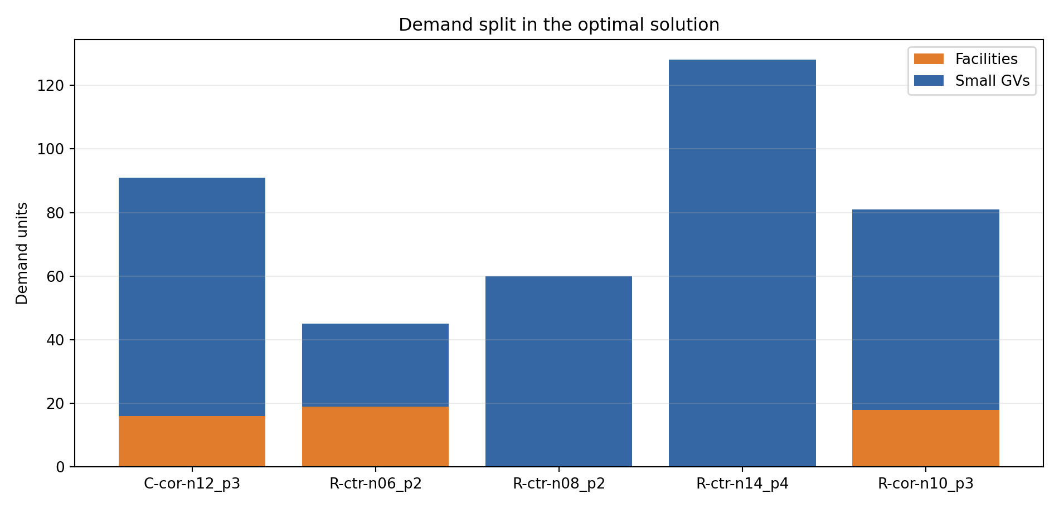
Optimal Demand Split and Large-GV Saving
EXPERIMENTS
Instance | Fac.% | Small.% | Routes | Ne | LGV saving
cluster_corner_n12_p3 | 17.582 | 82.418 | 3 | 5 | 131.740
random_center_n06_p2 | 42.222 | 57.778 | 3 | 5 | 77.986
random_center_n08_p2 | 0.000 | 100.000 | 5 | 5 | 0.000
random_center_n14_p4 | 0.000 | 100.000 | 4 | 5 | 0.000
random_corner_n10_p3 | 22.222 | 77.778 | 3 | 5 | 158.631
The fleet cap is respected in all optimal solutions.
LRP-PS: Branch-and-Price vs Branch-and-Cut with MCI
17

Slide 18
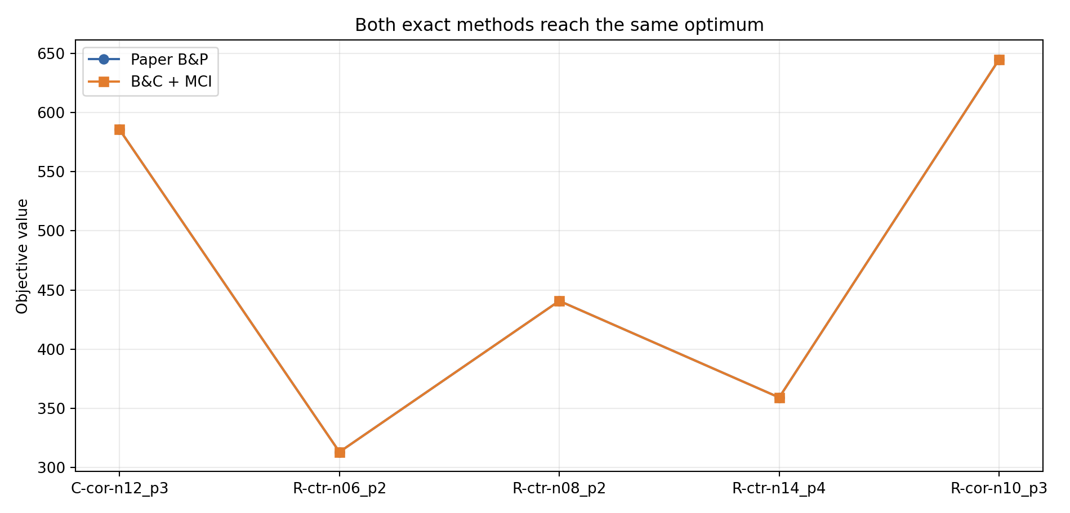
Objective Values: Two Exact Methods
RESULTS
Instance | Paper B&P | B&C + MCI | |Diff|
cluster_corner_n12_p3 | 585.444 | 585.444 | 0.000
random_center_n06_p2 | 313.214 | 313.214 | 0.000
random_center_n08_p2 | 440.807 | 440.807 | 0.000
random_center_n14_p4 | 359.238 | 359.238 | 0.000
random_corner_n10_p3 | 644.648 | 644.648 | 0.000
Both algorithms reach the same certified optimum on every instance.
LRP-PS: Branch-and-Price vs Branch-and-Cut with MCI
18

Slide 19
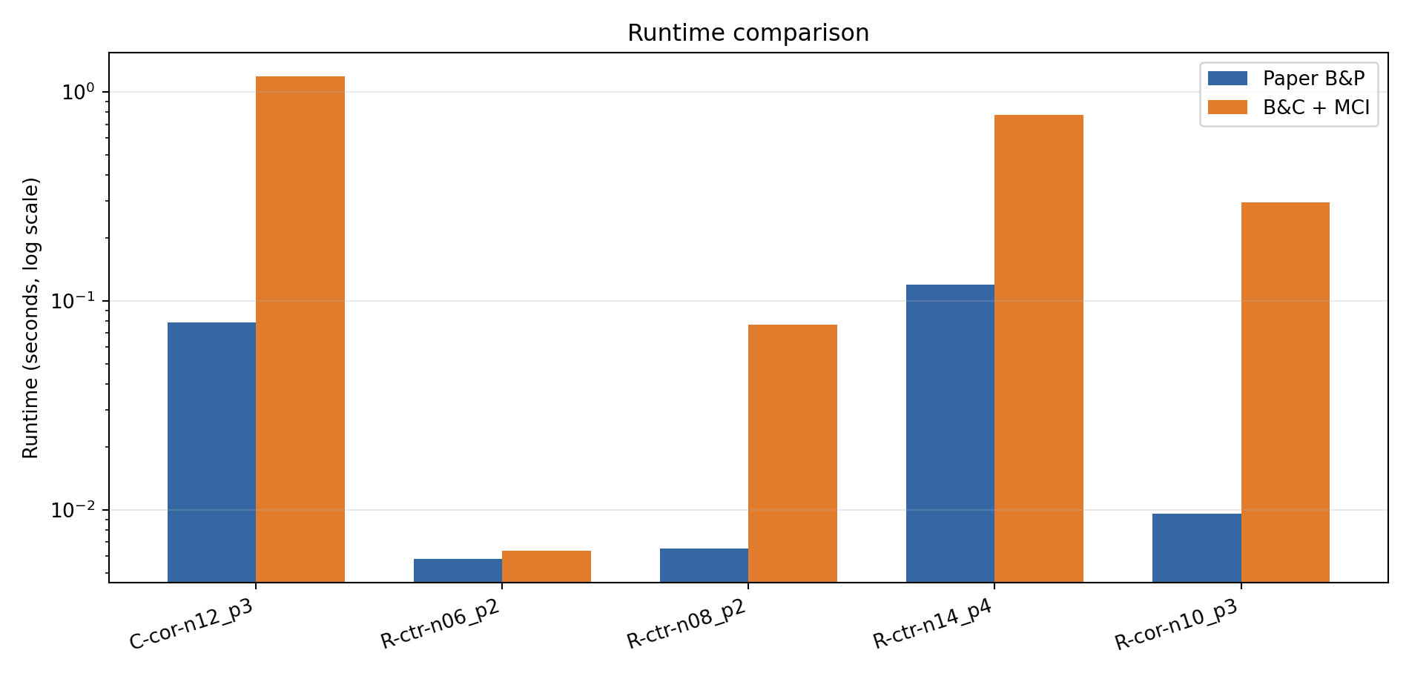
Runtime Comparison
RESULTS
Instance | B&P sec | B&C sec | Ratio
cluster_corner_n12_p3 | 0.079 | 1.182 | 14.981
random_center_n06_p2 | 0.006 | 0.006 | 1.091
random_center_n08_p2 | 0.007 | 0.077 | 11.762
random_center_n14_p4 | 0.119 | 0.773 | 6.485
random_corner_n10_p3 | 0.010 | 0.297 | 31.009
The paper decomposition is faster because it optimizes over feasible patterns/routes directly instead of branching on many arc variables.
LRP-PS: Branch-and-Price vs Branch-and-Cut with MCI
19

Slide 20
Root LP Effect of MCI
RESULTS
Instance | MCI | Raw gap % | MCI gap % | Improvement %
cluster_corner_n12_p3 | 56 | 16.979 | 16.748 | 0.231
random_center_n06_p2 | 0 | 21.201 | 21.201 | 0.000
random_center_n08_p2 | 1 | 43.470 | 43.470 | 0.000
random_center_n14_p4 | 3 | 47.522 | 47.522 | 0.000
random_corner_n10_p3 | 0 | 26.760 | 26.760 | 0.000
MCI improved the root LP bound only for the clustered instance.
This does not make MCI invalid; it means the violated cover structure was absent or inactive at the root in other instances.
MCI is more useful inside Branch-and-Cut when fractional node solutions violate station capacity-cover structure.
LRP-PS: Branch-and-Price vs Branch-and-Cut with MCI
20

Slide 21
Conclusions
CONCLUSION
The corrected model keeps large GVs away from demand points; they only replenish opened facilities.
The paper's Branch-and-Price is the best-performing exact method in these experiments.
Branch-and-Cut with MCI is exact and reaches the same optimal objectives, but it is slower on harder instances.
MCI activity is highly instance-dependent: many nearby customers plus tight station capacity create many covers.
Demand split, fleet cap compliance, and large-GV travel saving are explicitly reported for each instance.
The code is prepared for GitHub publication with reproducible data generation, experiments, plots, and tests.
GitHub repository link: to be added after remote repository creation and push.
LRP-PS: Branch-and-Price vs Branch-and-Cut with MCI
21

