Slide 1
GRADUATION / TRAINING PROJECT
AI Research Assistant
An Intelligent Research Assistant Powered by RAG & Multi-LLM Architecture
Mustafa Ahmed Faculty of Computer Science & Artificial Intelligence Artificial Intelligence Department Beni Suef National University

Slide 2












AGENDA
Presentation Outline
1
2
3
Problem Statement
Project Objectives
System Architecture
4
5
6
Technology Stack
Knowledge Base
Retrieval-Augmented Generation
7
8
9
LangGraph Agent & Tools
Memory & Multi-LLM
Live Demo
10
11
12
Challenges
Future Work
Conclusion
AI Research Assistant
2

Slide 3



MOTIVATION
Why Did We Build This Project?
LLM Limitations
Our Solution
Hallucination — confident but incorrect answers
Build an AI Assistant capable of answering questions directly from a local research knowledge base using Retrieval-Augmented Generation (RAG).
Outdated knowledge frozen at training time
No access to private or local documents
Difficult to verify generated information
Grounded answers, verifiable sources, private knowledge — instead of relying on the model’s memory alone.
Cannot answer questions from local research papers
AI Research Assistant
3

Slide 4

GOALS
Main Objectives
Build an AI-powered Research Assistant
Reduce hallucinations using RAG
Retrieve information from research papers
Support multiple AI models
Build an intelligent tool-based agent
Create a modern conversational interface
AI Research Assistant
4

Slide 5
ARCHITECTURE
Overall System Architecture
User
How it works
The user interacts through the Streamlit interface.
Streamlit Interface
The LangGraph Agent decides which tool should handle the request.
LangGraph Agent
Decision Making
If the question needs document knowledge, it routes through the RAG pipeline.
Knowledge Base
Project Generator
Model Recommendation
Otherwise, it calls the LLM directly.
RAG Pipeline
ChromaDB
AI Research Assistant
5
Gemini → OpenRouter
Final Response

Slide 6

STACK
Technology Stack
Frontend
Backend
Frameworks
• Streamlit
• Python
• LangChain
• LangGraph
Vector Database
Embedding Model
LLM Providers
• ChromaDB
• sentence-transformers
• all-MiniLM-L6-v2
• Google Gemini
• OpenRouter
AI Research Assistant
6

Slide 7
DATA
Knowledge Base — Research Paper Collection
The assistant uses a local knowledge base containing research papers about Artificial Intelligence, indexed into ChromaDB for semantic retrieval.
ChromaDB
BERT
Transformers
Attention
Vector database that stores and indexes document embeddings for fast semantic search.
RAG
CNN
Vision Transformer
Indexes every research paper as vectors
GPT
YOLO
Deep Learning
Runs similarity search on each query
Computer Vision
Returns the most relevant document chunks
AI Research Assistant
7

Slide 8
REPRESENTATION
Text Embedding & Vector Database
Document Chunk
Embedding Model
ChromaDB
Plain text passage
all-MiniLM-L6-v2
Stored as a vector
Why Embeddings?
ChromaDB Role
Enables semantic (meaning-based) search
Stores document embeddings persistently
Fast retrieval even over large document sets
Performs semantic similarity search
High-quality similarity matching
Returns the most relevant chunks to the agent
AI Research Assistant
8

Slide 9


CORE MECHANISM
Retrieval-Augmented Generation Pipeline
Research
Papers
PDF
Loader
Text
Chunking
Embeddings
ChromaDB
Retriever
Prompt
LLM
Grounded
Answer
Why Retrieve Before Generating?
Instead of asking the LLM directly, the pipeline first retrieves the most relevant document chunks from ChromaDB, then sends both the question and the retrieved context to the model — producing an answer grounded in real research papers instead of the model’s memory alone.
AI Research Assistant
9

Slide 10
ORCHESTRATION
LangGraph Agent Workflow
Understand User Intent
Ask Knowledge Base
Retrieves grounded answers via RAG
Decide Which
Tool to Use
Recommend Models
Suggests ML models for a task
Execute Selected Tool
Generate Project Ideas
Return Final Response
Creates AI/ML project suggestions
The agent is modular and extensible — new tools can be added without changing the core graph.
AI Research Assistant
10

Slide 11
RELIABILITY
Conversation Memory & Multi-LLM Strategy
Conversation Memory
Multi-LLM Strategy
The assistant remembers previous messages in the conversation.
if unavailable
Google Gemini
(Primary)
OpenRouter
(Fallback)
Better follow-up answers
Context-aware conversations
Higher availability
More natural interactions
Better reliability
Automatic fallback — no manual switching
AI Research Assistant
11

Slide 12
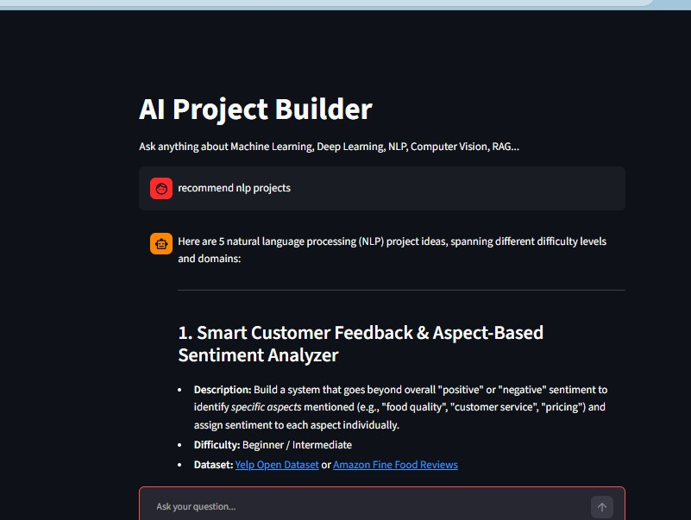
EXPERIENCE
Streamlit Chat Interface
Clean Chat UI
Conversation History
Sidebar Navigation
Example Questions
Clear Chat
Error Handling
Designed for simplicity and ease of use.
AI Research Assistant
12

Slide 13
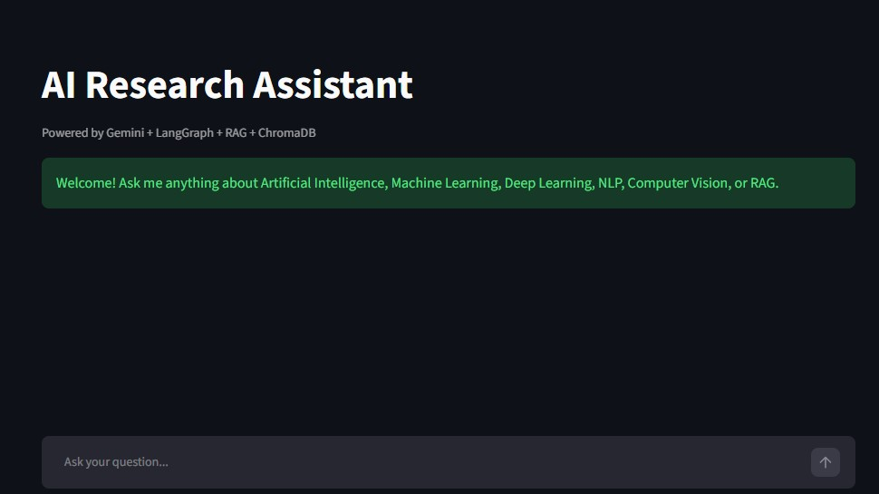
DEMONSTRATION
Live Demo
Actual app response to "Explain BERT" — answer grounded in the local research knowledge base.
Try it: "Explain BERT" • "Explain RAG" • "Recommend models for sentiment analysis" • "Generate NLP project ideas"
AI Research Assistant
13

Slide 14
LESSONS LEARNED
Challenges & Solutions
Challenge
Solution
API quota limitations
Automatic fallback between Gemini and OpenRouter
Prompt engineering
Iteratively improved and tested prompts
Retriever quality
Better chunking strategy for cleaner context
Chunk size selection
Tuned chunk size for retrieval accuracy
Multiple LLM integration
Unified interface across providers
Conversation memory
Integrated memory into the agent state
GitHub secret protection
Secure API key management via .env
AI Research Assistant
14

Slide 15



ROADMAP
Future Improvements
Streaming Responses
Source Citation
Hybrid Search
Web Search Integration
PDF Upload
Voice Assistant
Authentication
Cloud Deployment
Docker Packaging
Monitoring & Analytics
AI Research Assistant
15

Slide 16
SUMMARY
What We Achieved
We successfully built an AI-powered Research Assistant that:
Uses Retrieval-Augmented Generation
Retrieves knowledge from research papers
Reduces hallucinations
Supports multiple LLM providers
Maintains conversation memory
Provides intelligent tool-based reasoning
This project demonstrates the integration of modern AI technologies — RAG, agentic orchestration, and multi-LLM reliability — into a practical, scalable application.
AI Research Assistant
16

Slide 17
Thank You
Questions?
Mustafa Ahmed • AI Research Assistant • Beni Suef National University

