Slide 1

NLP PROJECT: MULTI-PHASE TEXT CLASSIFICATION
From Preprocessing to LLM Deployment
Prepared by Mustafa

Slide 2

PROJECT OVERVIEW: BRIDGING CLASSICAL ML AND MODERN LLMS
/
Developed a comprehensive NLP pipeline for text classification on a 20-category dataset, encompassing the entire data science lifecycle from raw data to production.
/
Implemented multiple methodologies including Traditional Machine Learning, Deep Learning with Keras, and State-of-the-Art Hugging Face Transformers.
/
Focused on comparative performance analysis to identify the most robust models, culminating in a final deployment via the Streamlit framework.
/
Successfully achieved high accuracy through rigorous feature extraction optimization and model fine-tuning on domain-specific data.

Slide 3

DATA EXPLORATION: UNDERSTANDING THE 20-NEWSGROUPS DISTRIBUTION
The dataset consists of 7,000 textual samples categorized into 20 distinct newsgroup labels, covering a wide range of topics from sports to science.
SAMPLE CLASS DISTRIBUTION
Label Name
Count
rec.sport.hockey
389
Exploratory Data Analysis (EDA) revealed slight class imbalances, with categories like hockey having higher representation than miscellaneous religion topics.
comp.windows.x
382
rec.autos
381
sci.crypt
372
7,000
talk.politics.misc
293
TOTAL SAMPLES
alt.atheism
285
20
UNIQUE CATEGORIES
*Data quality confirmed: 0 Missing Values, 0 Duplicates.

Slide 4

TEXT PREPROCESSING: TRANSFORMING RAW TEXT INTO CLEAN DATA
NORMALIZATION
CLEANING LOGIC IMPLEMENTATION
Conversion to lowercase and removal of non-alphabetic characters using Regex to eliminate noise like punctuation and numbers.
def clean_text(text): text = text.lower() text = re.sub(r'[^a-zA-Z]', ' ', text) words = text.split() words = [ lemmatizer.lemmatize(word) for word in words if word not in stop_words and len(word) > 2 ] return ' '.join(words)
TOKENIZATION & FILTERING
Splitting text into tokens and removing NLTK stop words. Tokens shorter than 3 characters are discarded to focus on semantic content.
LEMMATIZATION
Utilizing WordNetLemmatizer to reduce words to their dictionary root form, ensuring "running" and "ran" are treated as the same feature.

Slide 5
FEATURE EXTRACTION: TF-IDF VECTORIZATION STRATEGY
To transform cleaned text into a numerical format suitable for machine learning, we employed the Term Frequency-Inverse Document Frequency (TF-IDF) algorithm.
N-GRAM RANGE
(1, 3) - Unigrams to Trigrams
MAX FEATURES
30,000 Dimensions
This strategy balances the importance of a word within a specific document against its frequency across the entire corpus, effectively highlighting discriminative terms while down-weighting common noise.
MIN DOCUMENT FREQ
2 Documents
TF SCALING
Sublinear (1 + log(tf))
TF-IDF(t, d) = TF(t, d) * IDF(t)

Slide 6
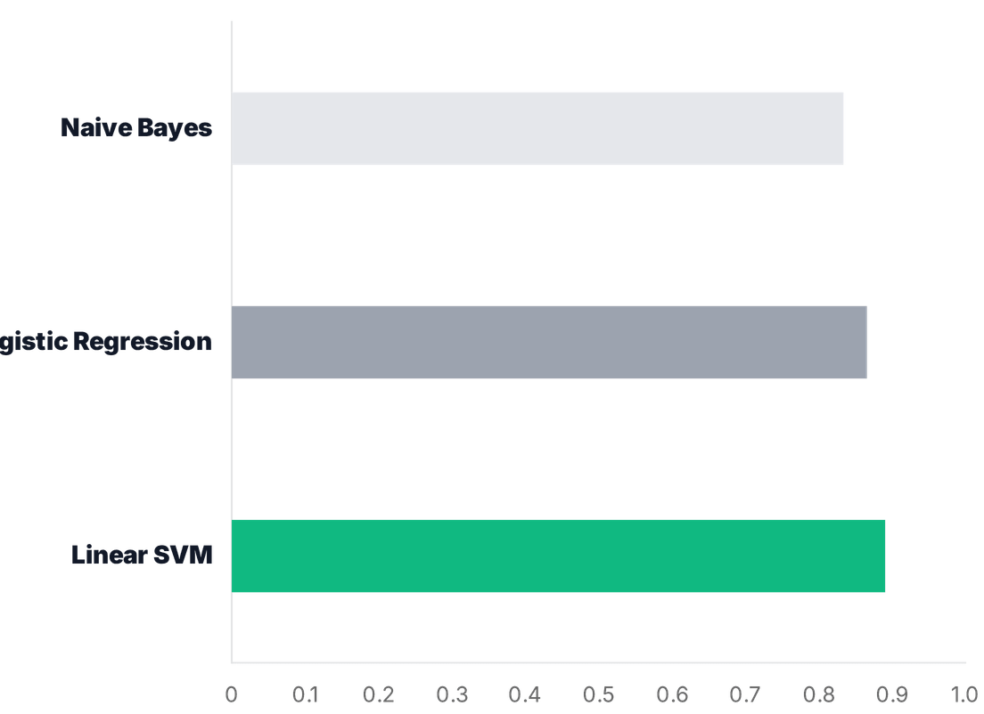
TRADITIONAL ML: COMPARING LINEAR AND PROBABILISTIC MODELS
/
Evaluated three foundational models to establish a performance baseline for the 20-category classification task.
/
Utilized a stratified 80/20 train-test split to ensure each category was represented proportionally during evaluation.
TOP PERFORMER
Linear SVM: 89.0%
Superior handling of high-dimensional TF-IDF features.

Slide 7

DEEP LEARNING: NEURAL NETWORK ARCHITECTURE FOR NLP
INPUT LAYER
The model was compiled using the Adam optimizer and Sparse Categorical Crossentropy loss. Training was managed by EarlyStopping to restore the best weights based on validation loss.
256 Neurons | ReLU Activation | TF-IDF Input Shape
REGULARIZATION
Dropout (0.3) | Prevents Overfitting
HIDDEN LAYER
128 Neurons | ReLU Activation
88.3%
REGULARIZATION
MODEL ACCURACY
Dropout (0.3) | Enhances Generalization
OUTPUT LAYER
20 Neurons | Softmax Activation | Multi-class Probabilities

Slide 8
HUGGING FACE: LEVERAGING STATE-OF-THE-ART TRANSFORMERS
THE PRE-TRAINED BASELINE
THE STRATEGIC SHIFT
Utilized the
distilbert-base-uncased
model via the
To overcome the limitations of zero-shot classification, the project transitioned to Supervised Fine-tuning. This process involves retraining the top layers of the Transformer on our custom dataset.
Hugging Face
pipeline
API. This provided a high-
level entry point for sequence classification using a
model pre-trained on the SST-2 dataset.
By aligning the model's deep semantic understanding with our specific labels, we transform a general-purpose LLM into a specialized domain expert.
CRITICAL OBSERVATION
Initial testing showed that pre-trained sentiment analysis models failed to generalize to the specific 20-category newsgroup topics, yielding "Negative/Positive" labels instead of domain-specific classes.

Slide 9

FINE-TUNING PROCESS: OPTIMIZING DISTILBERT
01. DATA TRANSFORMATION
03. HYPERPARAMETER TUNING
Converted Pandas DataFrames into Hugging Face Dataset objects. This enables efficient memory mapping and seamless integration with the Trainer API.
Configured the
TrainingArguments
to balance convergence speed
and model stability.
LR: 2e-5
EPOCHS: 3
WEIGHT DECAY: 0.01
02. TOKENIZATION STRATEGY
04. TRAINER API EXECUTION
Utilized AutoTokenizer with a maximum sequence length of 128. Applied dynamic padding and truncation to normalize input dimensions for the Transformer.
Leveraged the high-level Trainer class to manage the training loop, evaluation strategy, and checkpoint saving, ensuring the best model is retained.

Slide 10

MODEL EVALUATION: COMPREHENSIVE PERFORMANCE METRICS
CROSS-MODEL ACCURACY COMPARISON
CONFUSION MATRIX ANALYSIS
Methodology
Model Type
Accuracy
Heatmap visualization identified strong diagonal alignment, indicating high classification precision. Minor overlaps were noted between similar topics like 'Religion' and 'Atheism'.
Traditional ML
Naive Bayes
83.3%
Traditional ML
Logistic Regression
86.5%
CLASS-LEVEL ROBUSTNESS
Deep Learning
Keras MLP
88.3%
Technical categories such as sci.crypt and rec.sport.hockey achieved near-perfect F1-scores due to distinct vocabulary signatures.
Traditional ML
Linear SVM
89.0%
Transformer
DistilBERT (Fine-tuned)
High*
METRIC INTEGRATION
Evaluation relied on a holistic view of Precision, Recall, and F1-Score to ensure the model wasn't biased toward majority classes.
*Fine-tuned LLM showed superior semantic understanding in complex categories.

Slide 11

DEPLOYMENT: BRINGING THE MODEL TO LIFE WITH STREAMLIT
MODEL PERSISTENCE
INTERACTIVE WEB APPLICATION
To transition from training to production, the best-
The final model was integrated into a Streamlit application, providing a user-friendly interface for non-technical stakeholders.
performing
TF-IDF Vectorizer
Linear SVM
model and the fitted
were serialized using the
joblib
library.
joblib.dump(svm_model, 'svm_model.pkl') joblib.dump(vectorizer, 'tfidf.pkl')
REAL-TIME INPUT
Users can paste raw text directly into the browser for instant analysis.
This ensures that the exact feature space and model weights are preserved for real-time inference.
AUTOMATED PIPELINE
The app automatically applies the custom cleaning and vectorization logic.
INSTANT PREDICTION
Displays the predicted newsgroup category with high confidence.

Slide 12
CONCLUSION & NEXT STEPS
KEY FINDINGS
FUTURE ROADMAP
Methodological Comparison: Successfully benchmarked classical ML, Deep Learning, and Transformer architectures on a complex 20-class dataset.
Advanced Architectures: Transitioning to larger models like RoBERTa or DeBERTa to capture finer linguistic nuances.
Data Augmentation: Implementing synonym replacement and back-translation to balance minority classes.
Performance Leaders: Linear SVM (89%) and Fine-tuned DistilBERT emerged as the most robust solutions for high-dimensional text.
Production Focus: Optimizing LLM inference speed and exploring quantization for mobile-friendly deployment.
End-to-End Delivery: Demonstrated a complete lifecycle from raw data cleaning to a functional Streamlit deployment.
FOCUS ON LLM FINE-TUNING FOR PRODUCTION-GRADE ACCURACY.

