Slide 1



Order Screen / Picker Flow
Order
Arrives
POS
Picker goes through product list.
Suggests substitutes when required.
Finalizes the order.

Slide 2

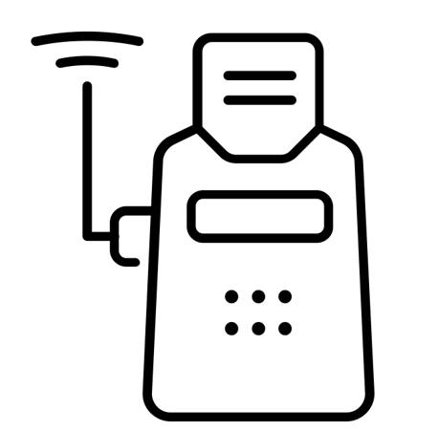

Barcode Screen / Cashier Flow
Cart
Arrives
POS
Verification
Cashier scans and totals products.
Cashier scans barcode.
Order total verified against original terms.
Payment Completed.

Slide 3



Fallback Flow
No
response
to POS
+
POS runs algorithm.
Picker enters PIN displayed by POS.
Picker’s debit card credited.
Payment made with debit card.

Slide 4


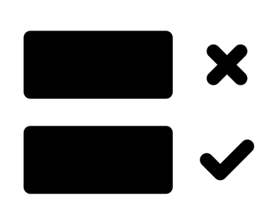
Order Flow
Hold if scheduled
Order Arrives
Order Delivered
Accept or Reject
Reserve / Pick Items
Handover to Courier

Slide 5
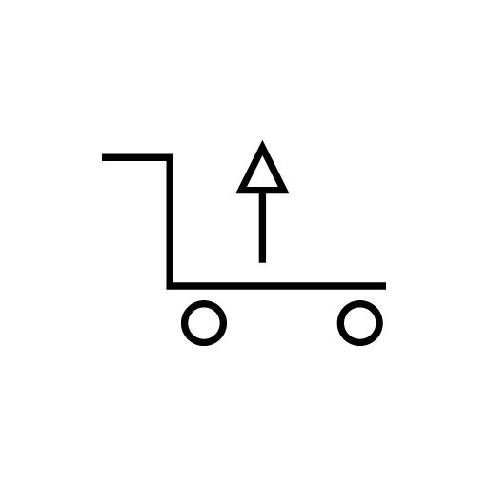





High Turnover
Regular Updates
DELTA FLOW
Pass Full Catalog
Medium/Low Turnover
Stock Availability Managed
Daily Integration
Pass Available Products

Slide 6




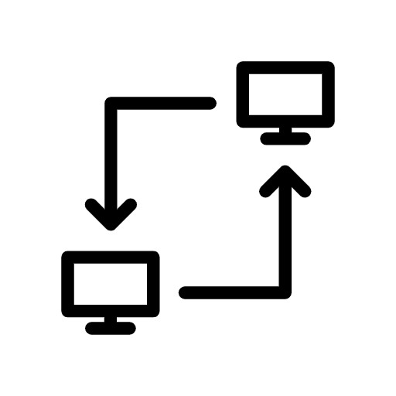
Get Started Catalog Flow
+
201
Receive access token
Test the connection
Define an update schedule
Communicate schedule
Start sending data

Slide 7
:orderId/
releaseToPicker
pickingFinished
:orderId/
delivery
:orderId/
taken
:orderId/
finish
Success Message & Unique Order ID
400 error & code for reason
OR
Time/Date of release
Picking complete
Courier-assignment
Courier-confirmation
Delivery
Complete
Picking- Completed Response
Immediate
Release to Picker
Release to Courier
Deliver to Consumer
Accept
Accept Response
Order Delivery Type
Picker delivery
Order Placed
Retailer Receives Order
Reserve / Pick items
1hr prior
Reject Response
Scheduled
Reject
Endpoint Operation Id
API Data
Retailer Webhook e.g.
www.myretailer.com/api/orders/:orderId/endpoint-id
Rappi API

