Slide 1
Gadgets
New Technology & Old Threats

Slide 2
What are Gadgets?
Evolved customizations
“Widget” type technologies
Applications running within Applications
Why should I care ?
Social Networking websites increasing use of Gadget technology. Do you FaceBook? ;-)
Desktop & Mobile Technologies increasing use of Gadget technology.
User ignorance & poor Security Model allow for attacks.

Slide 3
What did we look into?
We looked at Gadget technology affecting the popular Microsoft Desktop & Microsoft Live Services.
We did not look at OpenSocial, SideShow or Mobile Gadget technology.
We reviewed Microsoft Windows Vista Sidebar Gadgets
We reviewed Microsoft Live Web Gadgets
We found that “classic” attack signatures could be used to compromise end users or unsuspecting third parties.

Slide 4
Vista Side Bar Gadgets
The Vista Side Bar Gadget Security Model is flawed.
The use of Certificates are supported.
Precautions to prevent UAC elevation prompts being displayed by Vista Gadgets are in place.
Internet Explorer now contains “Protected Mode” – preventing modifications of files and data without user consent.
Gadgets are provided as ZIP or CAB archive files and can be downloaded from Microsoft LIVE Service or installed from 3rd Party web sites.
Gadgets have the “.gadget” extension.

Slide 5
Side Bar Gadget Capabilities
Certificate signing is not enforced, if a developer CHOOSES to sign her malware Gadget with a certificate – she enjoys reduced threat prompts from Microsoft OS.
Certificates can be purchased for around £120 with credit card details online.
UAC restrictions placed on Gadgets can be trivially bypassed.
Protected Mode does not apply to Side Bar Gadgets.
File System modification, creation and removal of files/directories, arbitrary file reading and writing.
Access potentially dangerous ActiveX components not normally available to Web content.
Network Connectivity, creation of sockets, sending/receiving data through network connections.
Execution of arbitrary code.

Slide 6
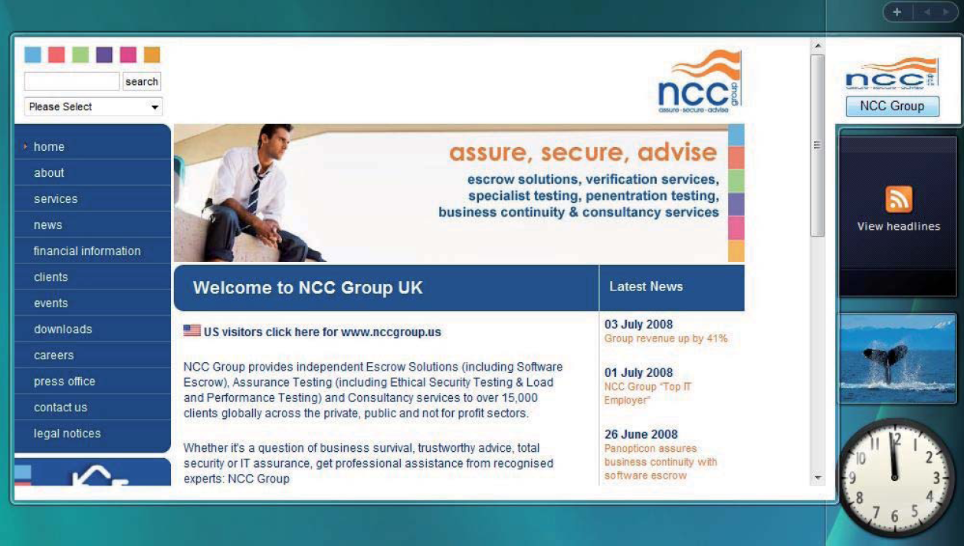
Gadget Attacks
We created a Gadget that is functional and displays a Web page when accessed. Gadgets are often used in this way (RSS, News, ...)
We then created “Trojan Horse” attack types abusing Gadget technology.

Slide 7
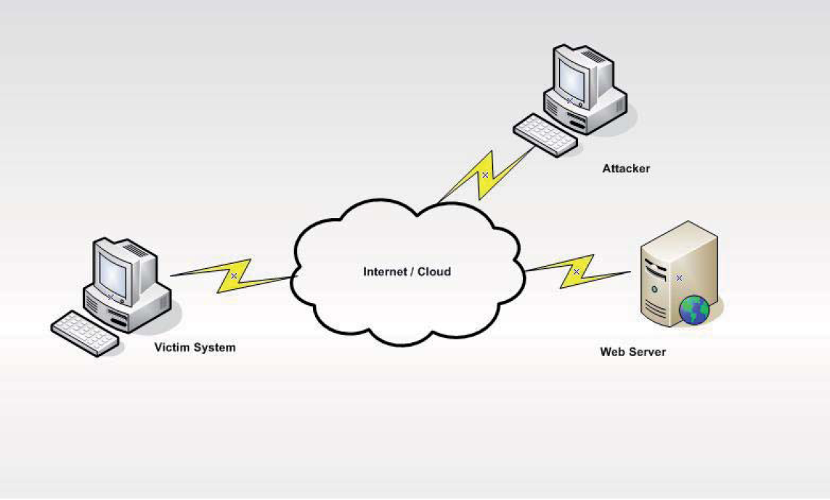
Gadget Ex#1
Using the XMLHttpRequest (XHR) functionality of JavaScript and ActiveX we created a simple Command & Control Back Door Gadget
Commands are placed on a Web Server & host executes them.
This could be used to create a Botnet of compromised hosts.
Could be obfuscated & hidden within an RSS feed.

Slide 8
Gadget Ex#2
First example useful when no Internet restrictions are in place.
Attacker would like to deliver a more complicated backdoor or rootkit with her hostile Gadget.
As Gadget is just a CAB or ZIP file, attacker can bundle any executable code in the archive.
The Path of a running Gadget is trivial to work out or obtain.
System.Shell.execute(“NCCGroupEx2.gadget\\evil.exe”);
Microsoft introduced a new .COM / .EXE – it is called .gadget!!

Slide 9
Microsoft Live
Gadgets can be hosted onto Microsoft Live service and downloaded from Microsoft servers.
Validation and FAQ’s indicate that the gadget must meet several criteria.
Criteria
Gadget must be signed with a certificate from a trusted CA.
Gadget must not fail an Anti-Virus scan.
Gadget must not contain code that causes errors or exceptions.
We have successfully hosted hostile Web Gadget technology on Microsoft servers. It is likely that hostile Gadgets can be similarly hosted @ Microsoft.

Slide 10
Web Gadgets
Microsoft Web Gadgets security model is less susceptible to attack.
Web Gadgets are customizations for Live, Spaces and Events – Web 2.0 services offered by Microsoft.
Microsoft services run on live.com but all Web Gadgets (currently) reside on start.com
This separates important DOM & cookie information from the Gadget and service.
Exceptions to the rule are “inline” gadgets which can be provided by Microsoft or its partners – not 3rd Party developers.
Debugging functionality exists that permits developers to use this functionality but errors and did not function as expected for me.

Slide 11
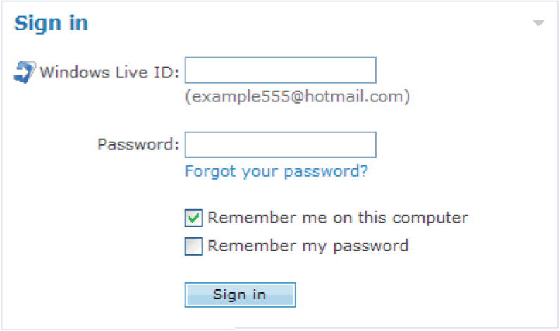
Web 2.0 Phishing with Web Gadgets
Attacker entices her victim to install a Web Gadget or alternatively hosts the gadget on a service herself.
Attack is a traditional “phishing” attack, a form is displayed on the service page that when used records input via PHP.
We were able to host my malicious gadget at http://censored.spaces.live.com after having it uploaded to Microsoft Live and validated.

Slide 12
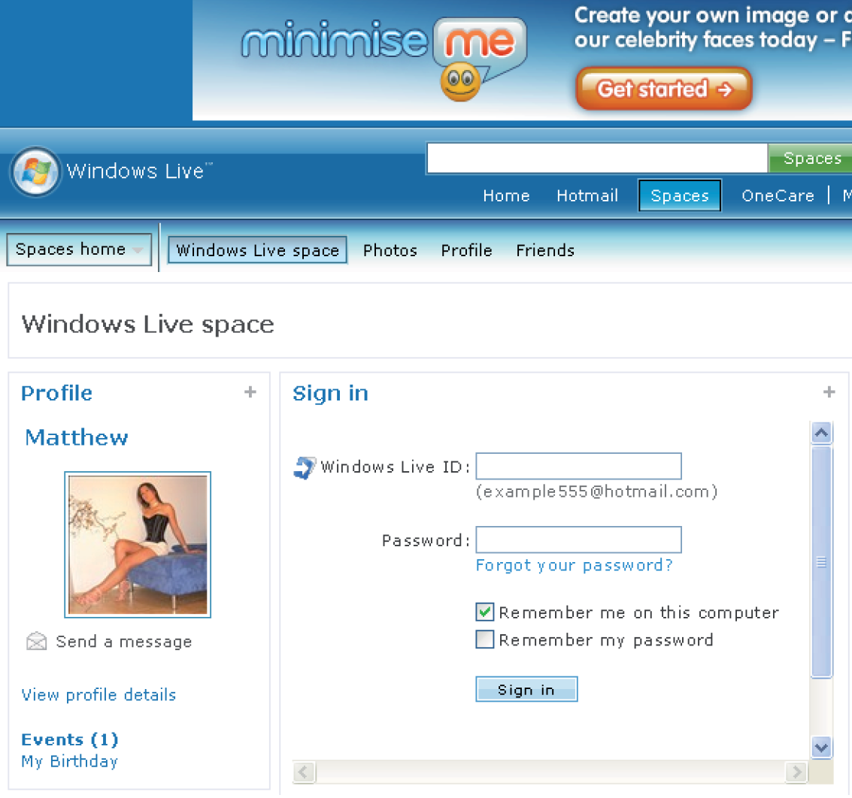
Web Gadget in the Wild
Here is how my page looked, the URL could be used in Social Engineering or SPAM attacks.

Slide 13
Conclusion
The largest weakness in computer security resides between the keyboard and the back of the chair. Many new attack vectors now exploit this weakness by using social engineering techniques to deploy the attacks and this trend seems set to continue and escalate.
Results
We produced a more detailed White Paper and toolkit with scripts for building all the attacks presented.
We also included some defence strategies and stuff not covered here.
You can download these at the Work Safe URL: http://art.siberiansluts.com
Please remember to sign-in with your Microsoft Live ID.

Slide 14
Questions?

