Slide 1
JAVA 2D/3D Project 2
Takuto ODAIRA m5281036

Slide 2
Goals
Load a 3D point-cloud using the xyz file format
Visualize the 3D point-cloud using OpenGL
Implement surface reconstruction with radial basis functions (RBF)
Implement the Marching Cubes algorithm to convert the zero level-
set of the RBF to a triangle mesh
Implement data-structures for manipulating triangle meshes
Visualize the reconstructed surface using OpenGL

Slide 3
Repository Structure
project2
├ data (xyz files)
├ docs
├ src
├ Config.java
├ MainApp.java
├ Point3D.java
├PointCloudLoader.java
├SurfceDrawer.java
├SurfceDrawerKeyListener.java

Slide 4
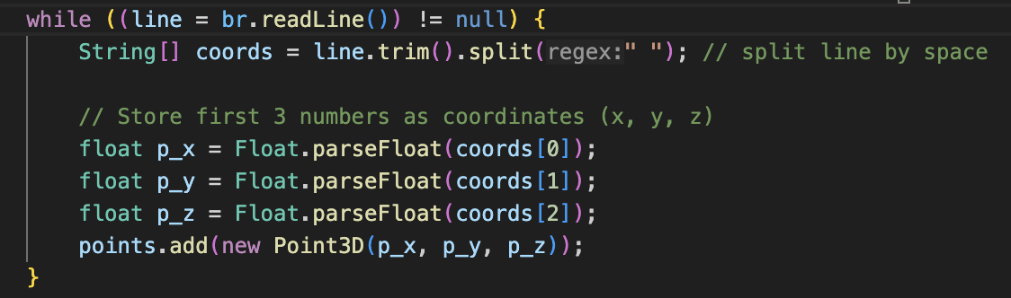
1. Loading Point Cloud
In “PointCLoudLoader” class
load line by line
stores in [p_x, p_y, p_z]
same way for the norms

Slide 5
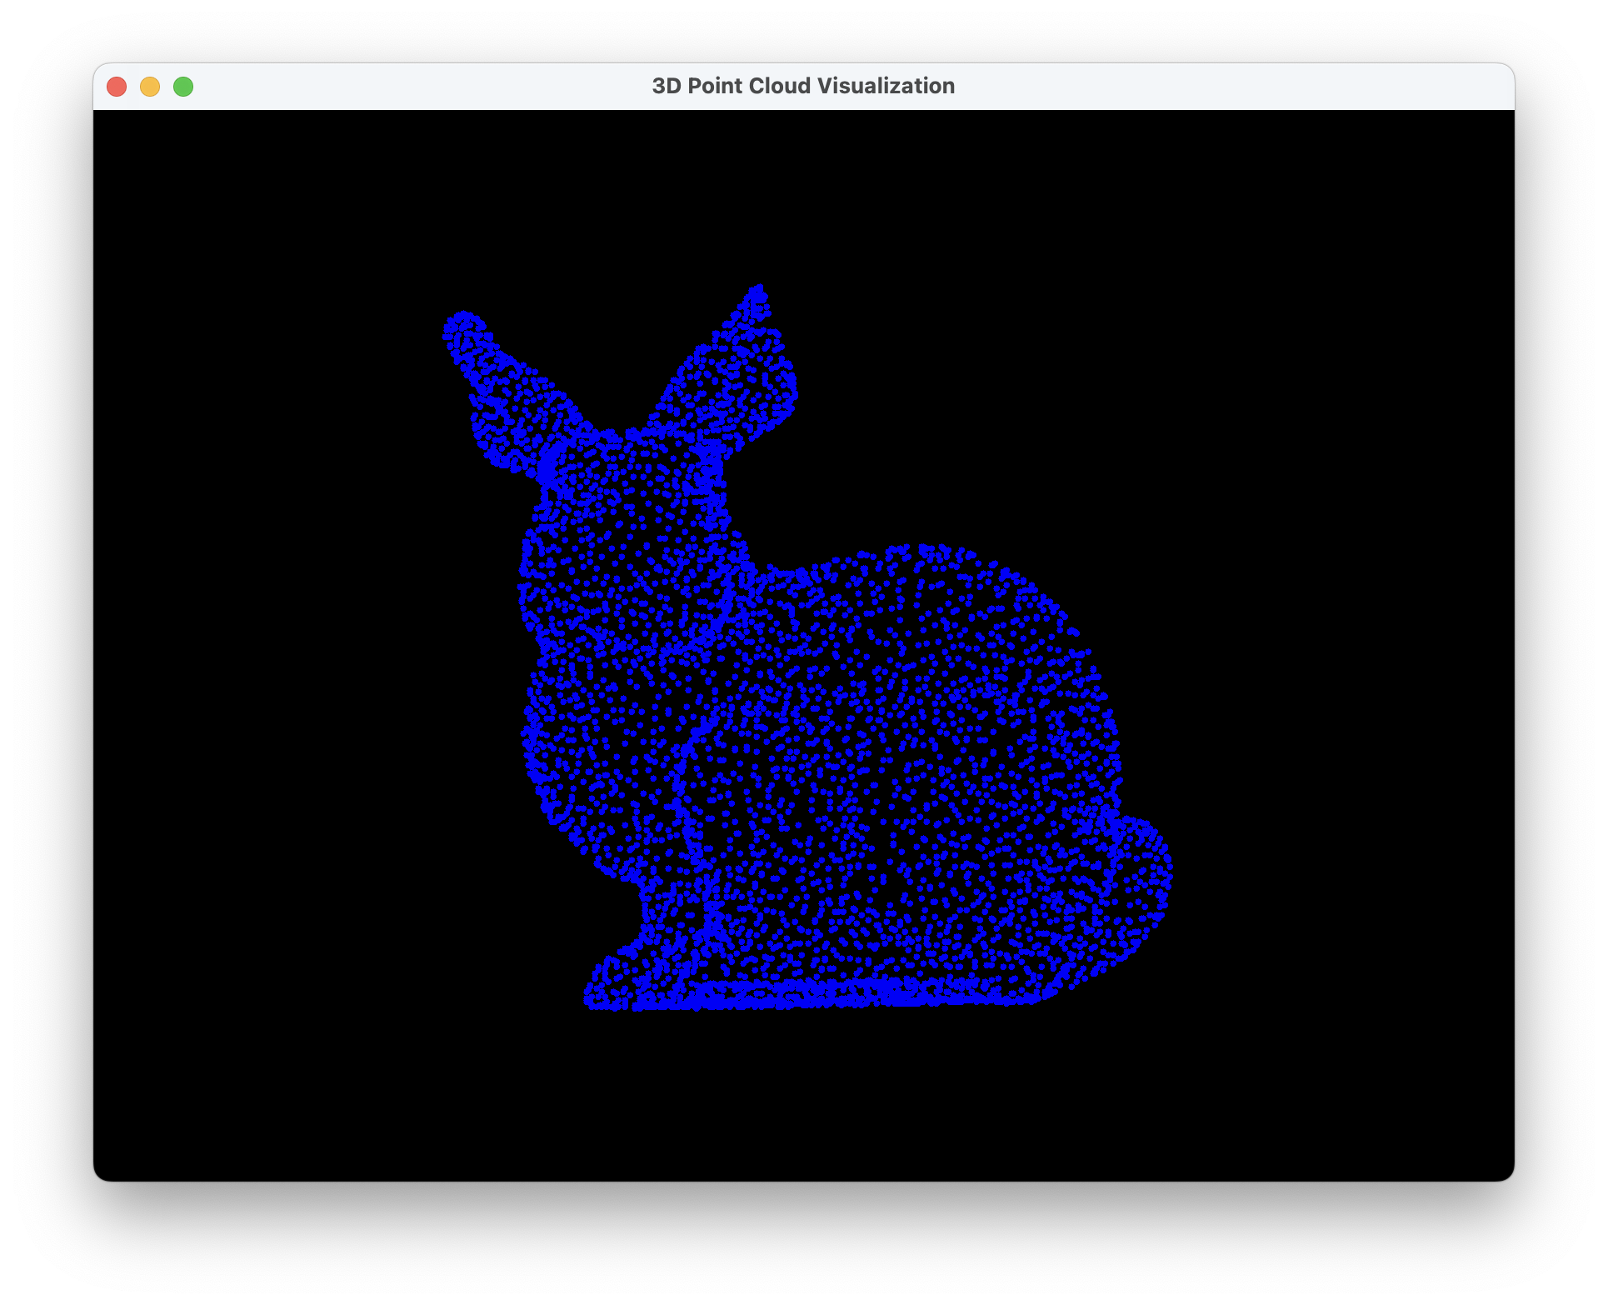
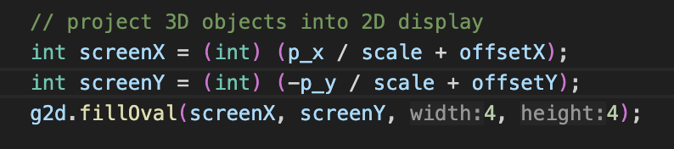
2. Visualize the 3D point-cloud using OpenGL
In “SurfaceDrawer” class
Display vertices in 3D space in 2D (by only using p_x and p_y)

Slide 6
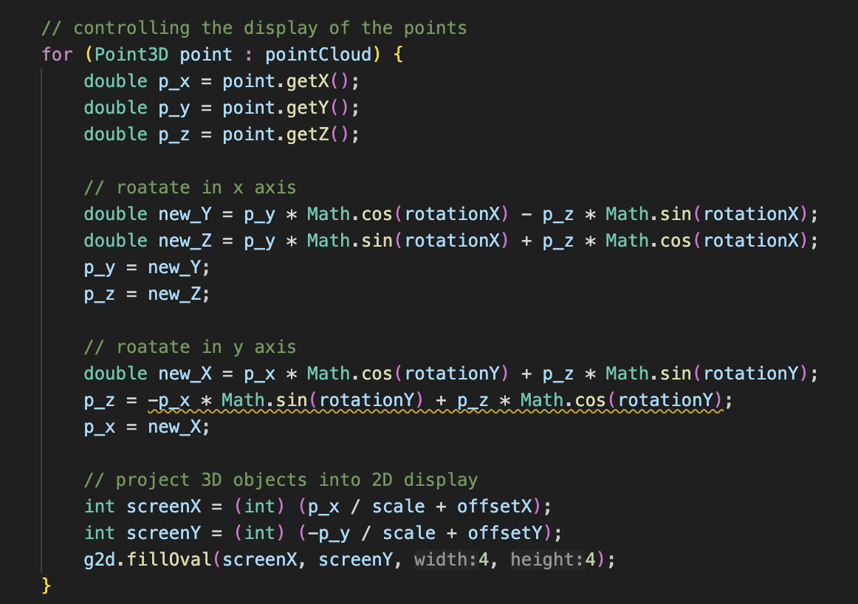
2. Visualize the 3D point-cloud using OpenGL
Manipulation of the vertices
Rotation, scaling, moving is implemented
Key input is read in “SurfaceDrawerKeyListener” class

Slide 7
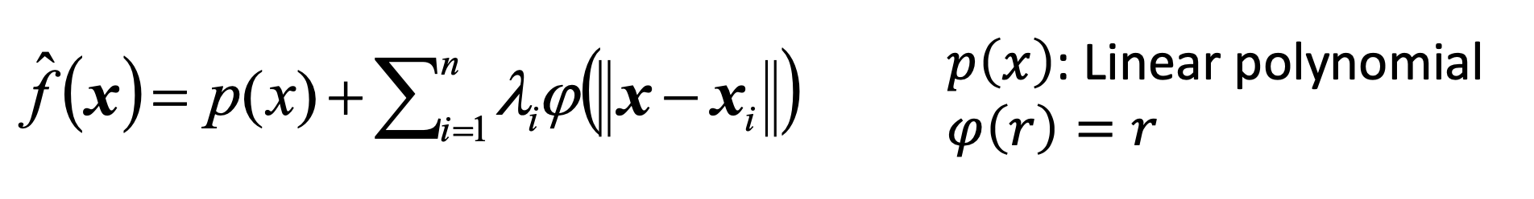
3. Computing RBF
Implemented in “RBFInterpolation” class (not successfully done)

Slide 8
Conclusion
Load a 3D point-cloud using the xyz file format ✅
Visualize the 3D point-cloud using OpenGL ✅
Implement surface reconstruction with radial basis functions (RBF)
Implement the Marching Cubes algorithm to convert the zero level- set of the RBF to a triangle mesh
Implement data-structures for manipulating triangle meshes
Visualize the reconstructed surface using OpenGL

Slide 9
References
OpenGL methods:
https://registry.khronos.org/OpenGL-Refpages/gl4/
Manipulation of dots (shape):
http://www.maroon.dti.ne.jp/koten-kairo/works/Java3D/transform2.html (basic transformation method of objects)
AddKeyListener:
https://qiita.com/derodero24/items/9ea025b92ac61edf0aa4

