Slide 1
JAVA 2D/3D Project 1
Takuto ODAIRA m5281036

Slide 2
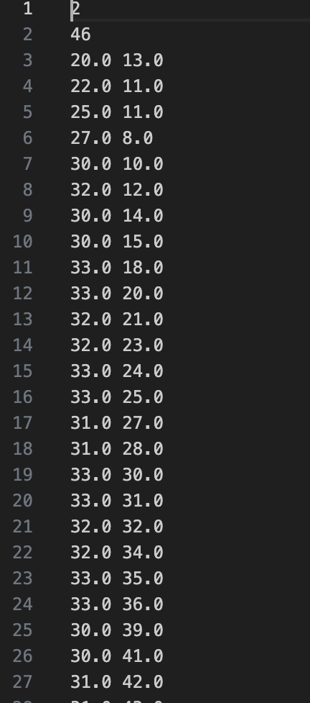

Analysis on the Given Vert Files
← 1st row: the number of shapes to be drawn
← 2nd row: the number of points in the 1st shape
← 3~n-th row: coordinates in the shape i (x, y)
2nd shape

Slide 3
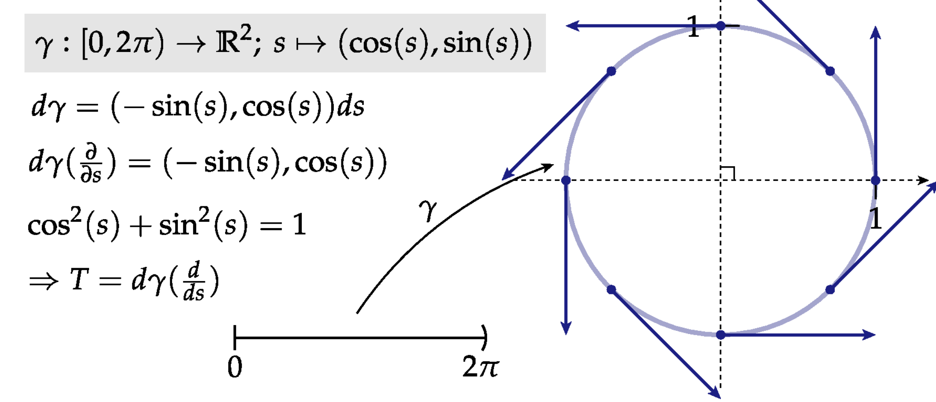
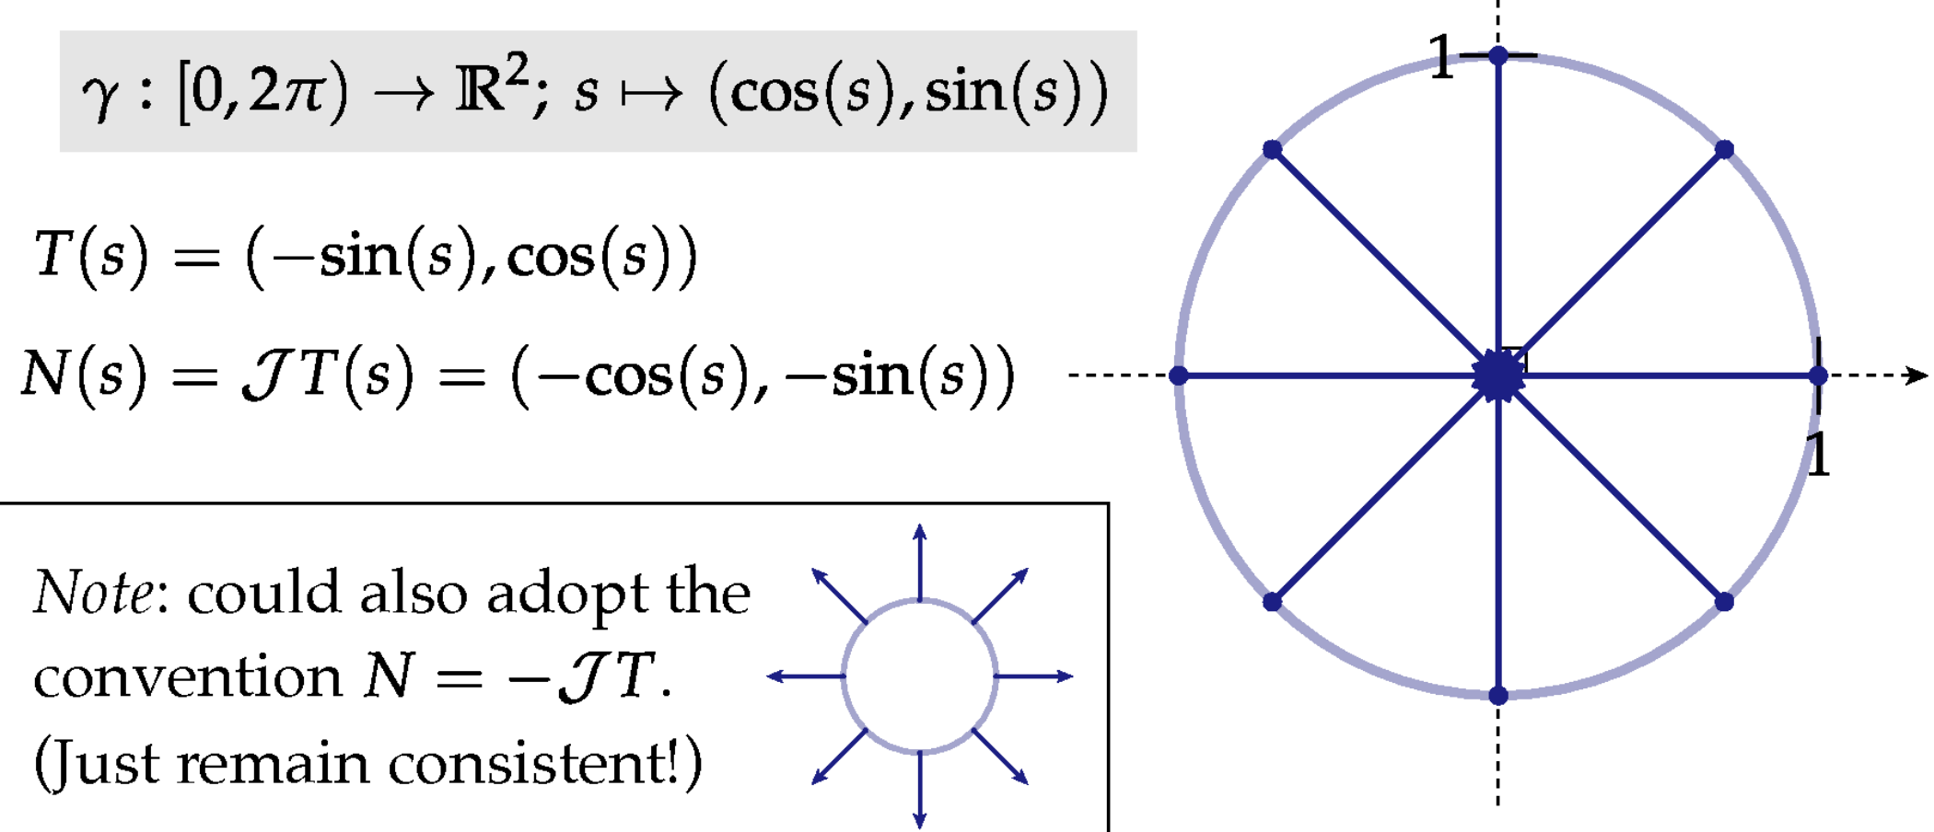
Calculation of the Unit Tangent and the Unit Normal
1. Unit tangent
2. Unit normal

Slide 4

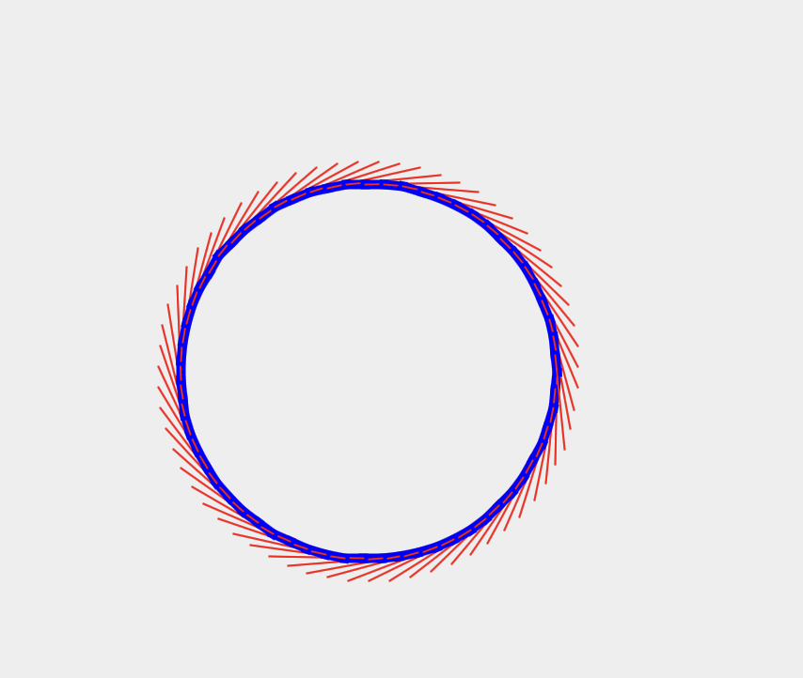

Visualization of the curve, the unit tangent, and the unit normal
1. disk.vert
Original Discrete Curve
Discrete Curve with
Unit Tangent
Discrete Curve with
Unit Normal

Slide 5
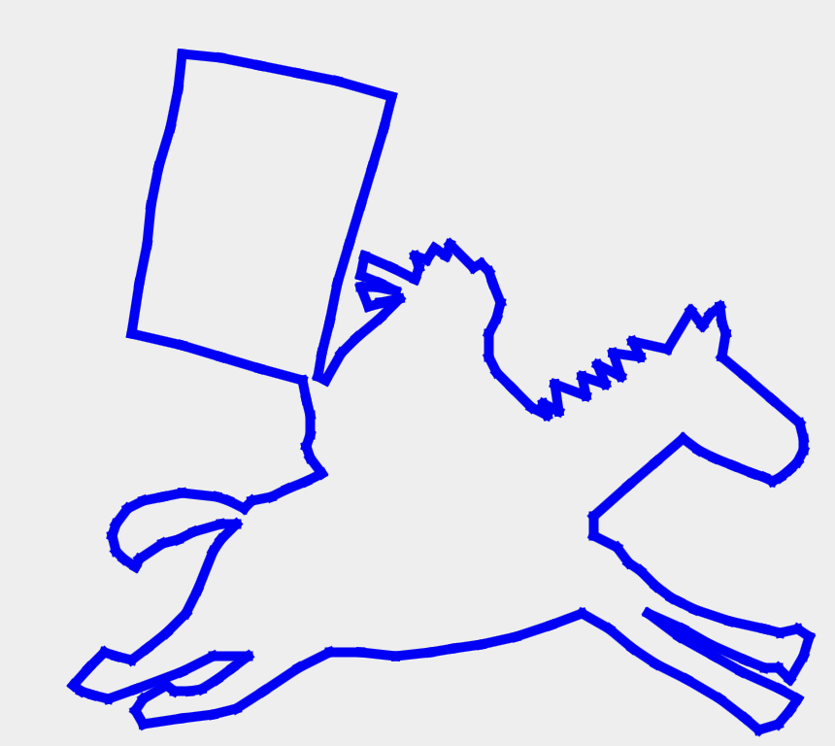
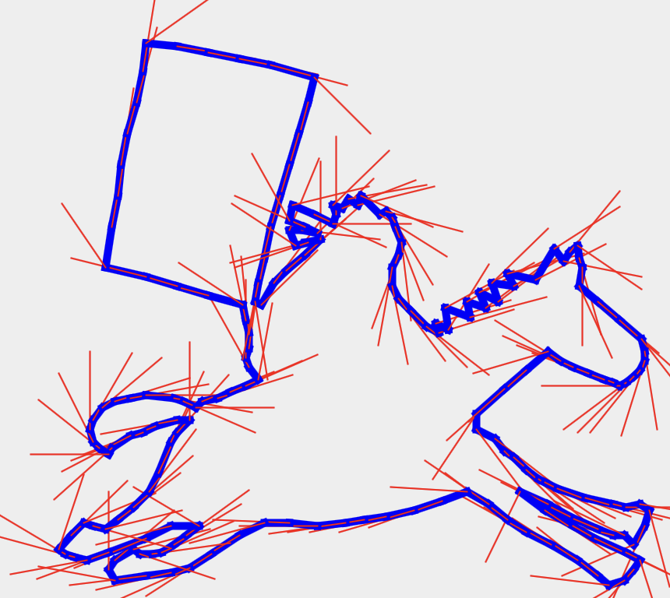
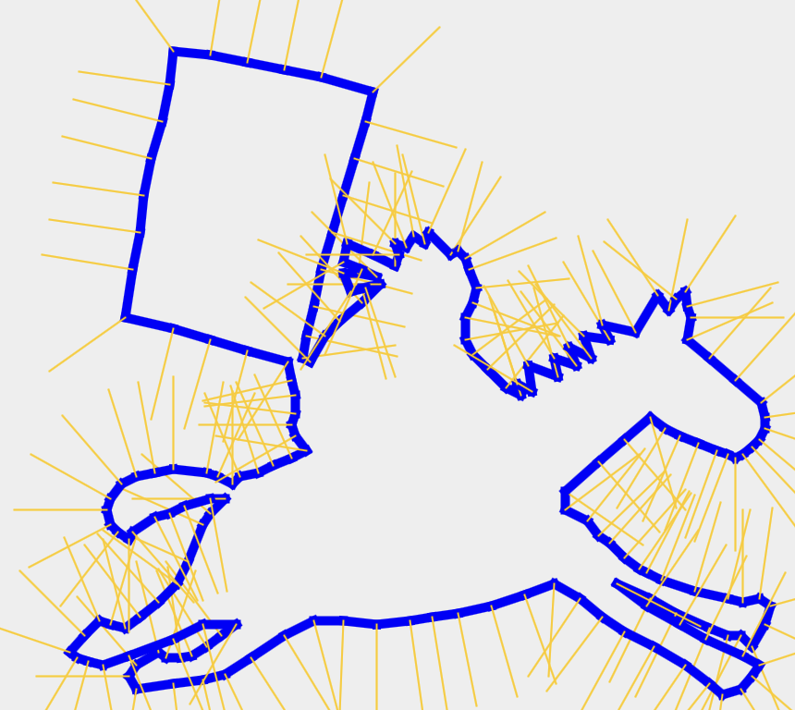
Visualization of the curve, the unit tangent, and the unit normal
2. rider.vert (flipped vertically)
Original Discrete Curve
Discrete Curve with
Unit Tangent
Discrete Curve with
Unit Normal

Slide 6

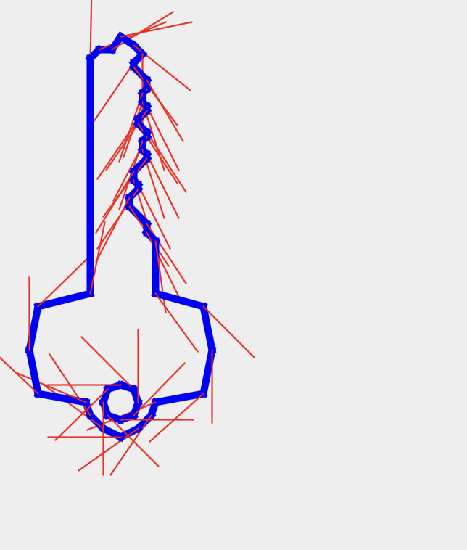

Visualization of the curve, the unit tangent, and the unit normal
3. key.vert
Original Discrete Curve
Discrete Curve with
Unit Tangent
Discrete Curve with
Unit Normal

Slide 7
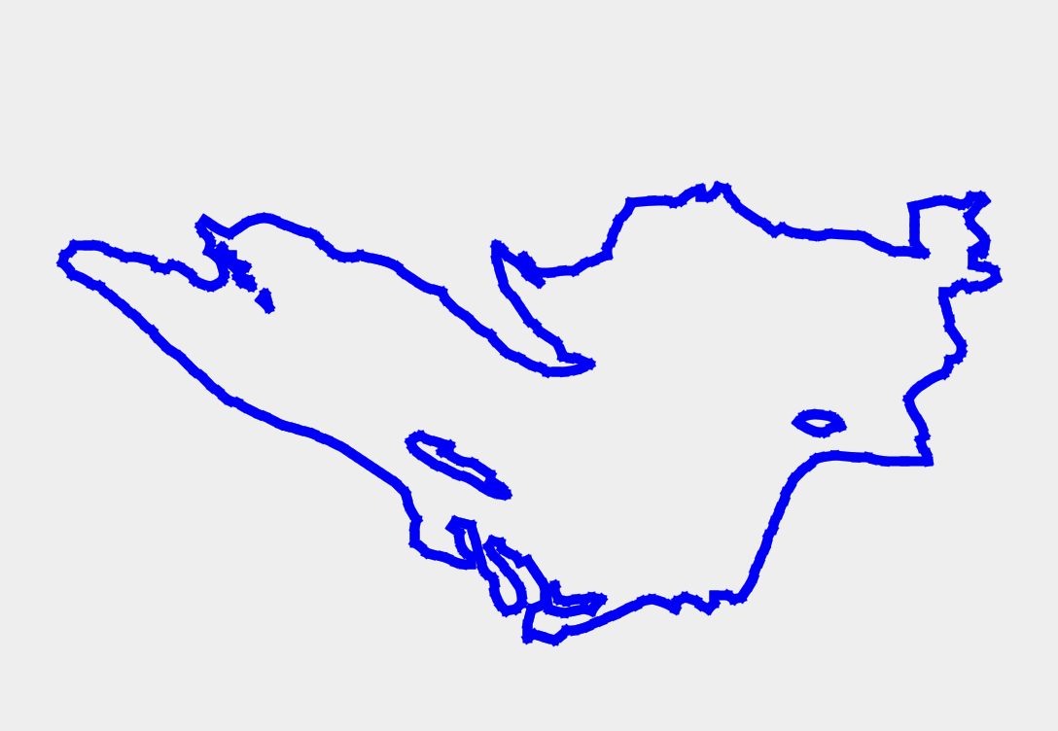
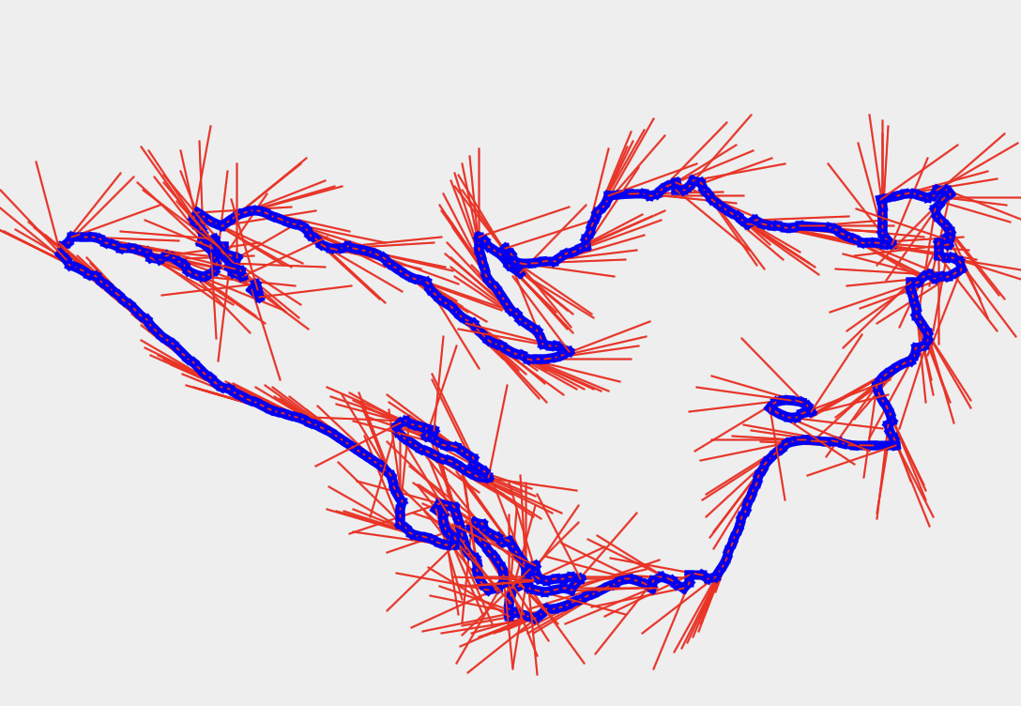
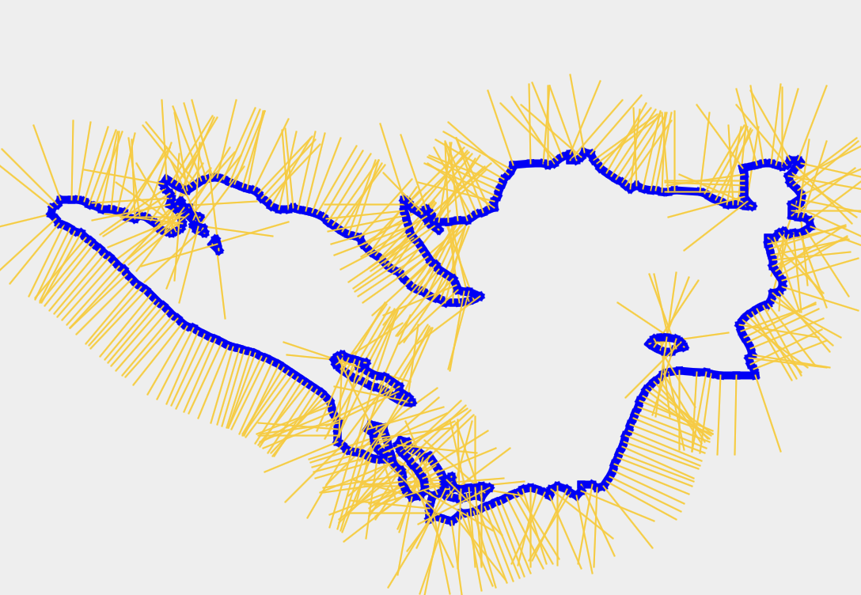
Visualization of the curve, the unit tangent, and the unit normal
4. sperior.vert
Original Discrete Curve
Discrete Curve with
Unit Tangent
Discrete Curve with
Unit Normal

Slide 8
Implementation of the evolution of the curvature flow
Not successfully implemented yet...
(To be done)

Slide 9
References
Java® Platform, Standard Edition & Java Development Kit Version 22 API Specification

