Slide 1
Reminders/Announcements
HW-02 due tomorrow 6/26
MC-05 out, due xx/xx

Slide 2
DISCUSSION SESSION
WEEK 5
C++ ARRAYS & VECTORS

Slide 3
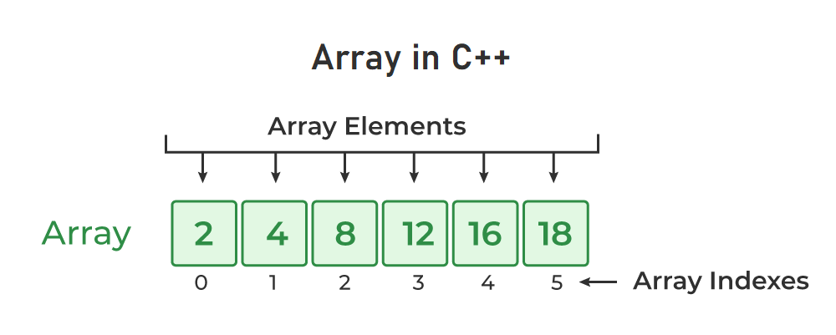
An array is a container that is used to store multiple values in a single variable, instead of declaring separate variables for each value.

Slide 4
Arrays store data (elements) of the same type (that is, an array cannot store both integers and doubles, and so on..). Elements are stored in a sequence.
Arrays are indexed from 0…size - 1
Each element in an array can be accessed using its index (inside square brackets [ ])
The size of an array must be determined at compile-time, so the compiler knows how much memory to allocate for the array elements. The size of an array cannot be changed!
Note: Arrays and Lists are two different things!

Slide 5
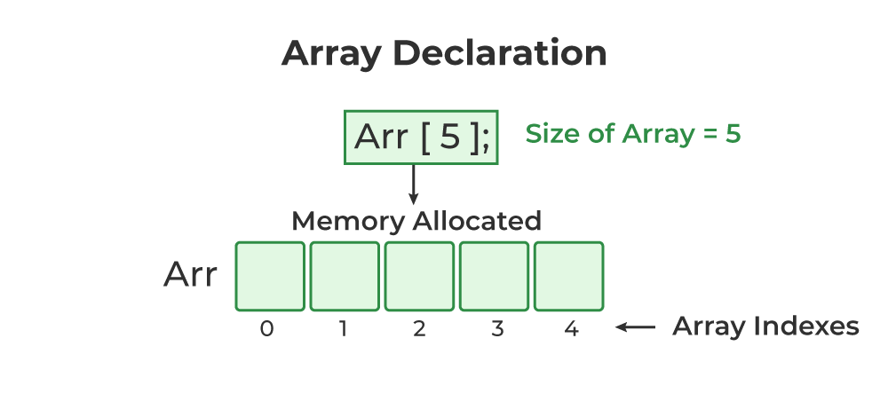
Array Declaration
Here are multiple methods to declare arrays:
Fixed-size arrays: Most basic way to declare an array
By specifying size directly
int myArray[5];
By user-specified size
int size = 5;
int myArray[size];
Notes:
As you've created this array of size 5, you cannot add a 6th element to it!

Slide 6
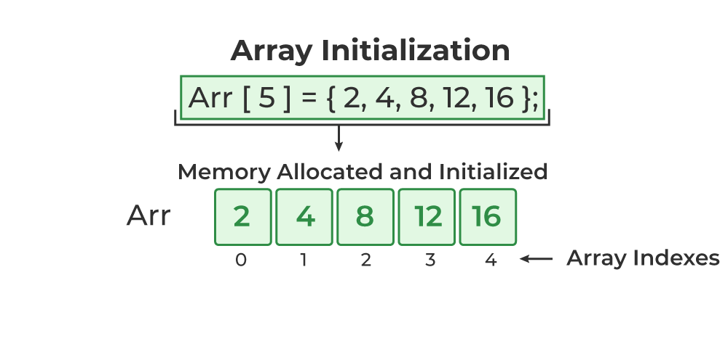
Array Declaration
2. Initialization at declaration: Arrays can be initialized at the time of declaration
Initializing a size-defined array
int myArray[5] = {2, 4, 8, 12, 16};
double myArray[4] = {1.0, 2.0};
Automatic size determination
int myArray[ ] = {4, 5, 3, 6, 9, 2};
Notes:
Does anyone know what initialization means?
double myArray[4] = {1.0, 2.0}: Here the compiler creates an array of length 4 and initializes the first two elements.
int myArray[ ] = {4, 5, 3, 6, 9, 2}: Here, because a size is not specified, the compiler determines that the size of the array is the number of elements inside. So, in this case, the compiler determines that the size of the array is 6.

Slide 7
Array Accessing/Indexing
An element of an array can be accessed using an index, which is a number that represents the position of the item in the array.
int arr[4] = {3, 6, 2, 7};
std::cout << arr[0]; std::cout << arr[1];
std::cout << arr[2]; std::cout << arr[3];
If this array had a larger size (say 300), how would we print out all elements of the array? Definitely not 300 print statements! What’s the alternative?

Slide 8
Array Accessing/Indexing
A loop can also be used to iterate through the items in an array!
int arr[4] = {3, 6, 2, 7};
for(int i = 0; i < 4; i++) {
std::cout << arr[i] << std::endl;
}

Slide 9
Array Element Modification
std::string cities[3];
cities[0] = "Boston";
cities[1] = "San Francisco";
cities[2] = "Salt Lake City";
Change San Francisco to Phoenix?
cities[1] = "Phoenix"; ✅

Slide 10
Passing Array into Function
Arrays are automatically passed into functions by reference. So, any changes made to the array within the function will be reflected in the original array.
In the function parameters, it’s best to use empty brackets and pass in the array size separately as another parameter.
void func(int myArr[ ], int arrSize) {
// some code..
}
void func(int myArr[5], int arrSize) {
// some code..
}
Notes:
In the second example, yes you can pass in a number in the square brackets. But in the case where the user defines the size of the array, you may not know what that number is, so it is best to follow the first example.

Slide 11
Passing Array into Function
When providing the argument in the function call, use the vector name:
int main( ) {
int myArr[7];
func(myArr, 7);
}

Slide 12
Exercise (5 minutes)
In main, declare myArr (an integer array of size 5).
Pass the array into a function. Within that function:
Use a loop to set each element of myArr to the value of its index multiplied by 2.
Print each element of myArr separated by a whitespace (using another loop!)
Now, print out all elements of myArr in reverse order!
Expected Output:
0 2 4 6 8
8 6 4 2 0

Slide 13
VECTORS
Similar to arrays, vectors are a sequence of elements of a single type. However, unlike arrays, vectors can change in size. This is because vectors are implemented as dynamic arrays, which means that they can grow and shrink as needed. This makes vectors a very flexible and powerful data structure.
The C++ vector class is very nice because it provides us with many methods/functions that we can call on our vector objects/instances.

Slide 14
Vector Declaration
First, you must #include <vector> header in your code
std::vector<int> myVect; // creates an empty vector
Note: You absolutely cannot index an empty vector.
// Create a vector to store 20 elements
std::vector<int> myVec(20);
Note: Even though this vector is initially created to store 20 integers, you can add more numbers to the vector.

Slide 15
Vector Declaration
First, you must #include <vector> header in your code
std::vector<int> myVect = {2, 9, 3, 4, 7, 4};
Note: This initialization at declaration method is called an initializer list and only works with c++17 and later. So, if you must use it, be sure to pass (at least) a c++17 flag to your compilation process.
Notes:
Demo this!

Slide 16
Some Vector Class Methods
std::vector<double> myVec = {2.5, 3.7, 12.6, 8.2};
myVec.push_back(10.1); // appends 10.1 to the end of myVec
myVec.pop_back( ); // deletes the last element of myVec
std::cout << myVec.size( ); // prints out size of myVec
bool isEmpty = myVec.empty( );
std::cout << myVec.front( ) << " " << myVec.back( ) << std::endl;
std::cout << myVec.at(2) << " " << myVec[2] << std::endl;
myVec.clear( );
Notes:
Ask for difference between myVec.at(2) and myVec[2]:
- myVec.at(2) provides bounds checking. If the index (2 in this case) is out of the vector's range (i.e., less than 0 or greater than or equal to myVec.size()), std::out_of_range exception is thrown.
- myVec[2] accesses the element at index 2 directly without any bounds checking. If the index is out of range, it leads to undefined behavior, which can cause crashes or unpredictable results.
Demo the difference too.

Slide 17
Passing Vector into Function
void func(std::vector<int> myVec) {
// some code..
}
void func(std::vector<int>& myVec) {
// some code..
}
When providing the argument in the function call, use the vector name:
func(myVec);

Slide 18
Exercise (5 minutes)
In main, declare names (a vector of strings). Pass the vector into a void function by reference. Within that function:
Add the following names to the vector one at a time: John, Sarah, Jasmine, Damian, Mai, Ciara
Remove the last name from the vector
Back in main:
Using a loop, print out all names in the vector, one on each line
Print out the size of the vector
Delete all contents of the vector

Slide 19
2-DIMENSIONAL ARRAYS & VECTORS
A 2D array is just an array of arrays. Similarly, a 2D vector is a vector of vectors. We use multidimensional arrays to store a grid of items, like a chessboard or a spreadsheet.
The general rule of thumb is to use a 2D array if you know the size of the grid at compile time, and to use a 2D vector if you don’t.
This is because 2D arrays are more efficient, but 2D vectors are more flexible because they can grow and shrink as needed.

Slide 20
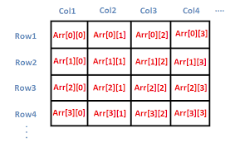
2-DIMENSIONAL ARRAY & VECTOR DECLARATION
int myArr[4][4]; // Creates a 4x4 array

Slide 21
2-DIMENSIONAL ARRAY & VECTOR DECLARATION
int rows = 3, cols = 4;
int myArr[rows][cols] = {
{1, 2, 3, 4},
{5, 6, 7, 8},
{9, 10, 11, 12}
};
std::vector<std::vector<int>> myVec = {
{1, 2, 3}, {4, 5, 6}, {7, 8, 9}
};

Slide 22
int rows = 3, cols = 4;
int myArr[rows][cols];
for(int i = 0; i < rows; i++) {
for(int j = 0; j < cols; j++) {
std::cin >> myArr[i][j];
}
}

Slide 23
std::vector<std::vector<int>> myVec = {
{1, 2, 3, 4}, {5, 6, 7, 8}, {9, 10, 11, 12}
};
for(int i = 0; i < _____; i++) {
for(int j = 0; j < _____; j++) {
std::cout << myArr[i][j];
}
std::cout << std::endl;
}

Slide 24
std::vector<std::vector<int>> myVec = {
{1, 2, 3, 4}, {5, 6, 7, 8}, {9, 10, 11, 12}
};
for(int i = 0; i < myVec.size( ); i++) {
for(int j = 0; j < myVec[0].size( ); j++) {
std::cout << myVec[i][j];
std::cout << myVec.at(i).at(j);
}
std::cout << std::endl;
}

Slide 25
2-D ARRAY & VECTOR AS FUNCTION PARAMETERS
void func(char myArr[ ][5], int rows, int cols) {
// some code..
}
The second square brackets of array declaration parameter cannot be empty
void func(std::vector<std::vector<double>>& myVec) {
// some code..
}
Notes:
At least the number of columns is required so that the compiler can calculate the memory addresses of individual elements.

Slide 26
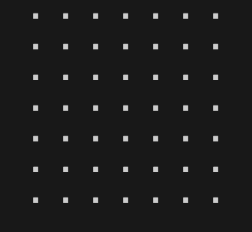
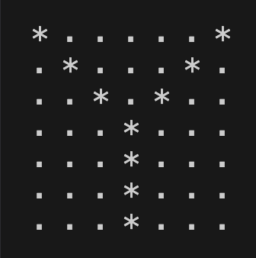
Exercise (15 minutes)
Create a void print function that takes in a char 2D array and prints out the grid.
In main, declare myGrid (a char 2D array of size 7x7).
* Fill the grid with dots
But first, we are
* Make a Y-shaped path going to make a with asterisks shape together!
Notes:
When students are done with #1, attempt #2 with them by making any easy shape like A, M, N, F; then let them attempt the Y shape if time permits.

