Slide 1
DISCUSSION SESSION WEEK 6
C++ POINTERS

Slide 2
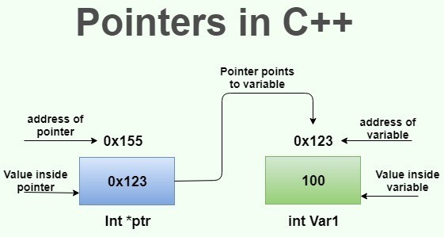
A pointer is a special type of variable representing a memory address.
A pointer should always be set equal to the memory address of another variable.
If there is nothing to set your pointer equal to, default it to NULL.

Slide 3
Pointers and References..
int a = 5;
int& b = a;
// b is a reference variable to a
If the ampersand is not included in the declaration of a variable, it is considered a get-address operator. std::cout << &a; // prints out the memory address of a
int* ptr; // declaration of a pointer expected to hold the
// memory address of an integer variable
int* ptr2 = &a; // pointer holding the address of a

Slide 4
Pointers and References..
int a = 5;
int* b = &a; // b is holding the memory address of a
If the asterisk is not included in the declaration of a variable, it is considered a dereference operator.
Dereferencing a pointer means accessing the data stored at the memory address that the pointer is pointing to.
std::cout << *b; // prints 5
std::cout << *a;
// Invalid because a is not a pointer and
// therefore cannot be dereferenced!

Slide 5
Both pointers and references use the ampersand operator (&), therefore you must be careful so you don’t mix them up!
References are declared using the ampersand
Pointers are initialized with some memory address using the ampersand

Slide 6
int a = 5;
int* ptr = &a;
Suppose we want to use the ptr variable to increment the value of a:
(*ptr)++; // makes a = 6
Note: Use parentheses because the postfix operator ++ has a higher precedence than the dereference operator. Here, we want to dereference first, then increment the value stored at the address, so we need to use parentheses.

Slide 7
Exercise (5 minutes)
Declare an integer variable x and initialize it to 10
Declare a pointer ptr and point it to x
Increment the value of x by 2 using ptr
(Hint: must dereference pointer!)
Print the modified value using ptr
Print the memory address stored by ptr
Print the memory address of ptr
Notes:
Answer on next slide.

Slide 8
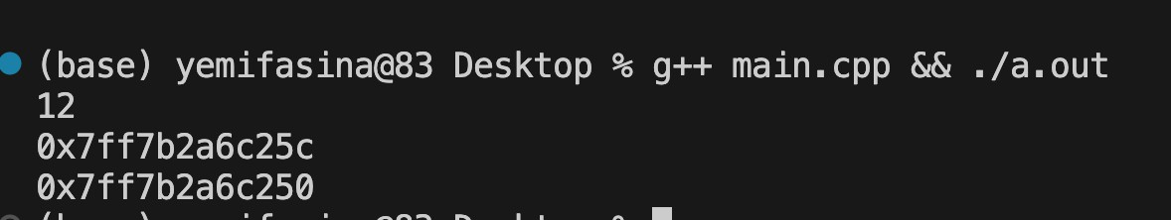
int main() {
int x = 10;
int* ptr = &x;
(*ptr) += 2; // Warning: Without the dereference operator here, you would be incrementing the actual memory address of ptr. Dereferencing gets the value at the memory address ptr is holding, in this case, 10.
std::cout << *ptr << "\n";
std::cout << ptr << "\n";
std::cout << &ptr << "\n";
}

Slide 9
Passing Pointer into Function
Function parameter is a pointer variable; argument is a memory address
double func(double a, double* b) { return a + *b;
}
int main( ) {
double a = 3.5, b = 8.5;
double sum = func(a, &b); // sets sum to 12
}

Slide 10
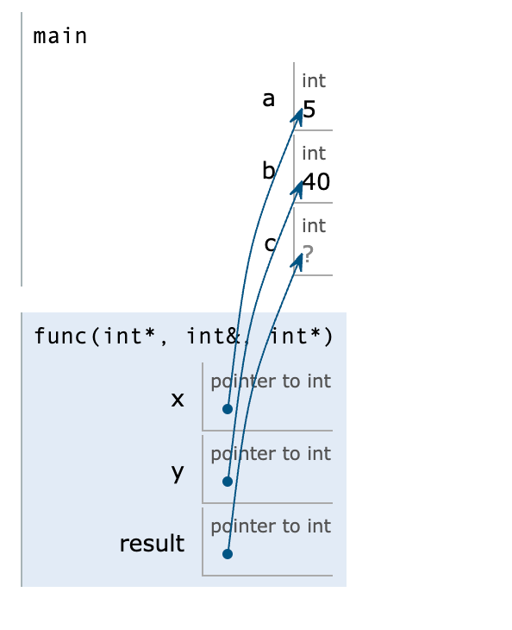
Exercise (1 minute): Use image on right to fill in the
blank arguments in main function.
void func(int*x, int& y, int* result) { y /= 10;
*result = *x * y;
}
int main( ) {
int a = 5, b = 40, c; func( , , );
std::cout << c << std::endl;
}

Slide 11
Now what’s the output?
void func(int*x, int& y, int* result) { y /= 10;
*result = *x * y;
}
int main( ) {
int a = 5, b = 40, c; func(&a, b, &c);
std::cout << c << std::endl;
}

Slide 12
Arrays and Pointers
Arrays are pointers. Array names are constant pointers that point to the base address of the array. The base address of an array is the memory address of the first element of the array.
int arr[ ] = {3, 5, 2, 7}; std::cout << arr << std::endl;
std::cout << &arr[0] << std::endl;
These two print statements will output the same memory address.

Slide 13
Pointer Arithmetic
Reminder: Elements in arrays are laid out in memory sequentially/contiguously, one right after the other. So, given the base address of an array, we can iterate through the elements of the array.
char arr[ ] = {'f', 'y', 'p', 'm', 't'};
std::cout << arr; // prints out base address of array
std::cout << *arr; // dereferences address & prints out f
If we add 1 to the base address and dereference it, we can get the next element, and so on:
std::cout << *(arr + 1); // prints out y

Slide 14
Pointer Arithmetic
char arr[ ] = {'f', 'y', 'p', 'm', 't'};
std::cout << *(arr + 1); // move to the next address and
// dereference it. prints out y
Warning: Parentheses are super important here because the dereference operator has a higher precedence than the addition operator. So, without the parentheses, we would be doing:
std::cout << *arr + 1;
which dereferences the base address and adds 1 to it. This would cause our code to perform 'f' + 1 which would output the ascii value of g. Lack of parentheses here is a logic error.

Slide 15
sizeof operator
The sizeof( ) operator returns the size of a variable or data type, in bytes.
Refresher: An int has 4 bytes. So therefore,
int arr[ ] = {6, 3, 3, 7, 8}; // an array of 20 bytes std::cout << sizeof(arr); // prints 20
How do we get the number of elements in the array? By dividing total array bytes by the bytes of one element!
std::cout << sizeof(arr) / sizeof(arr[0]); // prints 5
Warning: The sizeof operator works differently when used in a function where the array is a parameter (click to see why!) You must continue to pass in the size as a separate parameter.

Slide 16
Arrays in Functions
We previously learned to have our array parameter as follows:
void func(int arr[ ], int arraySize);
But provided that arrays are pointers, we can explicitly declare our array parameter as a pointer to the base address of the array, and still iterate through the array by indexing or by pointer arithmetic:
void func(int* arr, int size) { for(int i = 0; i < size; i++) {
std::cout << arr[i] << std::endl;
}
}
void func(int* arr, int size) { for(int i = 0; i < size; i++) {
std::cout << *(arr + i) << std::endl;
}
}

Slide 17
Another Loop Iteration Method Using Pointer Arithmetic
void func(int* arr, int size) {
for(int* ptr = arr; ptr < arr + size; ptr++) { std::cout << *ptr << std::endl;
}
}
This loop starts at the base address (arr), deferences it and prints the value, moves to the next address and repeats the process till it reaches the address of the last element in the array.

Slide 18
Dynamic Memory
Until now, we have been declaring variables using stack memory. But we can dynamically allocate memory on the heap for data structures that require variable size or longer lifetimes.
Unlike stack memory, heap memory can be flexible and can be used for data structures (like dynamic arrays) where the size is not known at compile-time. (A vector is a dynamic array—that is why it can grow and shrink as needed, without a size restriction).
Objects allocated on the heap can persist beyond the scope of the function where they were allocated, until explicitly deallocated.
Heap memory allocation is slower than stack memory. But this is almost never the right thing to worry about.

Slide 19
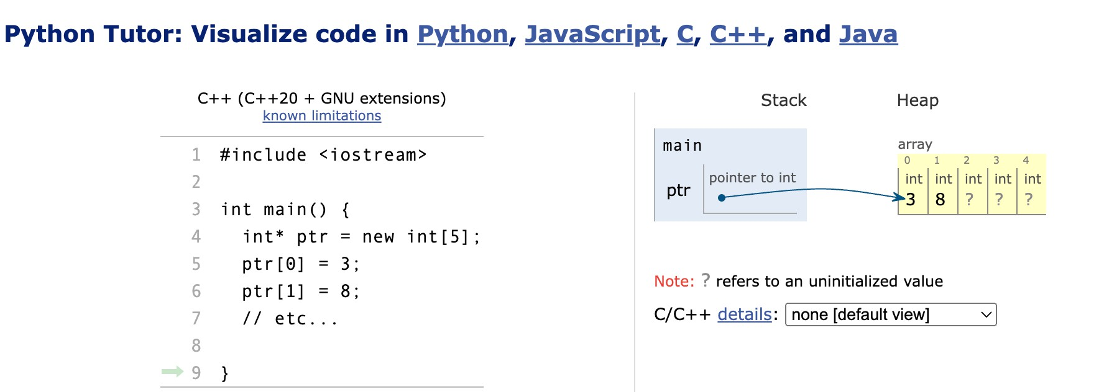
Dynamic Memory Allocation
We use the new keyword (typically with pointers) to allocate heap memory and the delete keyword to deallocate memory. It is your responsibility as a programmer to delete any dynamic memory allocation after use, so you don’t have a memory leak and undefined behavior!
int* ptr;
ptr = new int[5]; // creates heap memory for array of 5 elements
int* num = new int; // creates heap memory for an integer

Slide 20
Dynamic Memory Allocation
int* ptr;
ptr = new int[5]; int* num = new int;
After doing stuff with ptr & num and they are no longer needed, you must deallocate heap memory:
delete[ ] ptr; // square brackets because ptr is an array!
delete num; // num has dynamic memory for a single integer so no [ ]

Slide 21
Some side advice..
Pointers are a very important concept, especially when implementing data structures (CSC 212).
You must fully grasp the concept to succeed in future CS courses and in potential job or internship technical interviews.
Expectation is that it will be on Exam-02 and will be heavily weighted.
Put effort into the take-home lab to gain more practice with pointers.
“You get out what you put in.”

