Slide 2
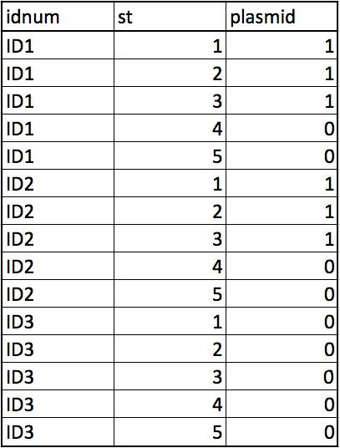
n_avgST = 5
missing = 2
Coverage 65% means 1/3 patient does not have the plasmid at all

Slide 3
Generate functions
- genfixedST
- genNULLdf
- genrandomdf
- genvarySTdf
Raw data
+
Cleaning scripts
Clean data
plasmidSTpermute function
calls
calcgroupscore function
calls
calcpatientscore function
Permutation results
- plot
- p-value

