Slide 2
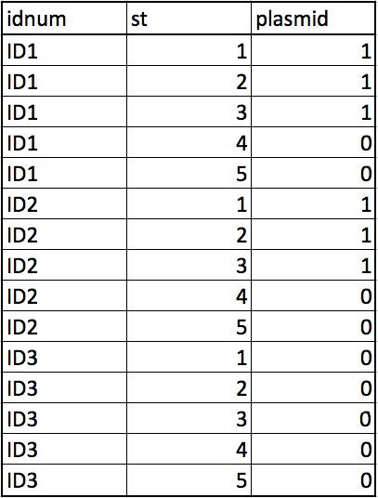
n_avgST = 5
missing = 2
Coverage 65% means 1/3 patient does not have the plasmid at all

Slide 3
Generate functions
- genfixedST
- genNULLdf
- genrandomdf
- genvarySTdf
Raw data
+
Cleaning scripts
Clean data
plasmidSTpermute function
calls
calcgroupscore function
calls
calcpatientscore function
Permutation results
- plot
- p-value

Slide 4
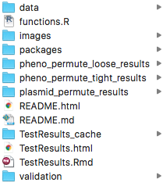
Contains csv raw data files for analysis
Functions for analysis
Images for readme
R packages dependencies
Result images for phenotype analysis from TestResult.Rmd
Result images for phenotype analysis from TestResult.Rmd
Result images for plasmid analysis from TestResult.Rmd
Html version of README generated from markdown
README
Cache files for TestResults.Rmd
Html report generated from TestResults.Rmd
R markdown file used to run results
Contains validation functions and files

Slide 5
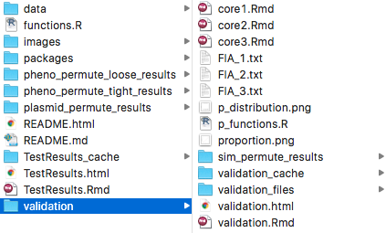
Script for generating FIA_1.txt
Script for generating FIA_2.txt
Script for generating FIA_3.txt
p-values based on null hypothesis from each core
Distribution plot of p-values for null hypothesis
Permutation functions for validation
Proportions plot for p-value distribution
Result images for simulations in validation.Rmd
Cache files for validation.Rmd
Html elements for validation.html
Html report generated from validation.Rmd
R markdown file used to run validation

