Slide 2
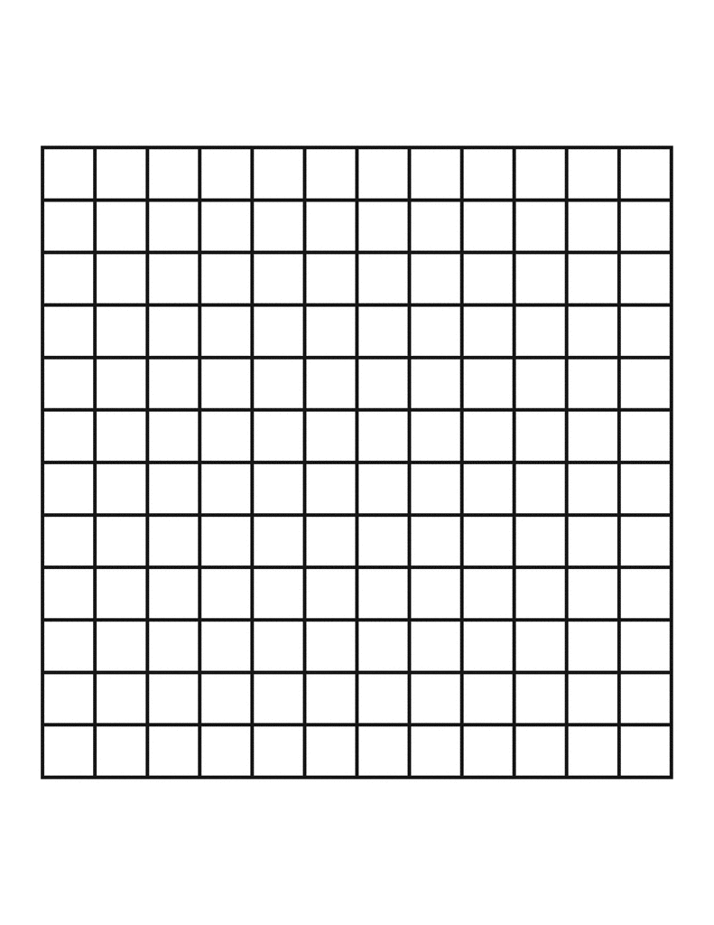
1
1
1
Ex.
Where 1 is infected
Here R = 7
1
(i,j)
1
(i,j)
1
1
0
Probability of getting infected at (i,j) is
p(i,j) = (1 – (1-p)^{R})
R = sum infected surrounding
p = probability of infection

Slide 3
Probability of infection from previous step
Positions where
prob infect > random get infected
Uniform random grid
0.0
0.1
0.0
0.0
0.1
0.0
0.3
0.3
0.1
0.9
0.5
0.9
0.0
0.1
0.1
0.9
0.1
0.1
0.4
0.1
0.1
0.8
0.9
0.1
i
>
0.1
0.1
0.8
0.3
0.5
0.0
0.6
0.4
0.0
0.5
0.2
0.8
i
i
0.0
0.1
0.9
0.2
0.6
0.1
0.9
0.7
0.7
0.6
0.6
0.5
i
0.0
0.1
0.0
0.1
0.1
0.0
0.1
0.1
1.0
0.4
0.2
1.0
*smaller grid for example

Slide 4
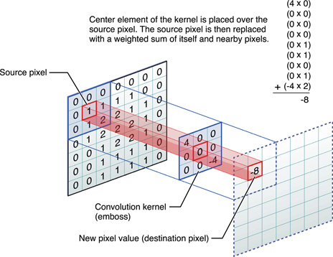
Moore neighborhood kernel
1
1
1
1
1
1
1
1
1
Neumann neighborhood kernel
0
1
0
1
1
1
0
1
0
a Weighted neighborhood kernel
0.5
0.5
0.5
0.5
0.5
0.5
0.8
0.8
0.8
0.5
0.5
0.8
1
0.8
0.5
For our case, new pixel is R
In p(i,j) = (1-(1-p)^{R})
0.5
0.8
0.8
0.8
0.5
0.5
0.5
0.5
0.5
0.5

Slide 5
Kernel neighborhood sizes
1
1
1
1
1
1
1
1
1
*moore
neighbor = 2
neighbor = 1
neighbor = 3

Slide 6
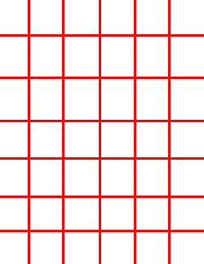
Normal non-edge case
Detect: Not corner
Grid start index = i - neighbor
Grid end index = i + neighbor
Kernel start index = 1
Kernel end index = kernel end
Edge case
Combination of normal case for x (or i) and Low number corner for y (or j).
*looking from x
Lower number corner case
Detect: i <= neighbor
Grid start index = 1
Grid end index = i + neighbor
Kernel start index = (neighbor+1) - (i-1)
Kernel end index = kernel end
Higher number corner case
Detect: i >= grid end - neighbor
Grid start index = i-neighbor
Grid end index = grid end
Kernel start index = 1
Kernel end index = (neighbor+1)+(grid end - i)

