Slide 1
Initialization Rules

Slide 2
Transition Rules

Slide 3
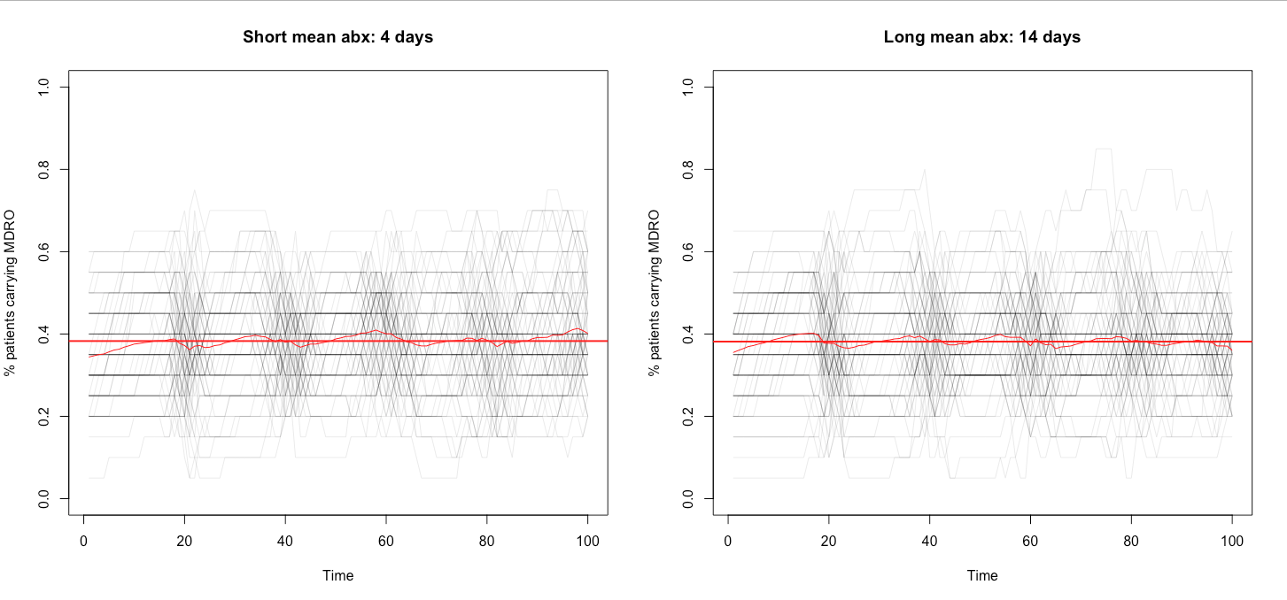
Variability between runs (same parameters)
Notes:
n.bed<-20 # n.bed= number of beds in the wardn.days<- 100 # n.days= number of days we want to observemean.max.los<-20 # mean.max.los= mean of max length of stay (normal distribution)#variable parameters ###epidemiological p.s<-0.5 # p=probability of receiving antibiotic for sensitive organismsp.r<-0.1 # p= daily probability of contracting HAI and receiving antibiotic for resistant organisms prob_StartBact<-c(0.5,0.2, 0.1, 0.05) # prob_StartBact= vector of probability of carrying c(S,Sr, sR, sr)# # possible states: S- carry sensitive organism only # Sr- carry largely sensitive organisms and small population of resistant organisms# sR- carry largely resistant organisms and small population of sensitive organisms# sr- carry small population of sensitive organisms and resistant organisms# s - carry small population of sensitive organisms ###biological pi_r1 <- 0.003 # pi_r1= probability of R transmitting to S to become Srbif<- 2 # bacterial interference factor pi_r2 <- pi_r1 * bif # pi_r2= probability of R transmitting to s to become sr # (pi_r1 < pi_r2 if being colonised with S protects colonisation by R)mu1 <- 0 # mu1= probability of clearance of Sr to become Smu2 <- 0 # mu2= probability of clearance of sr to become s abx.s<-0.2 # probability of clearing S to become s under antibiotic treatment (daily)abx.r<-0.3 # probability of clearing R to become r under antibiotic treatment (daily)repop.s1<- 0 # probability of repopulation of s to become S repop.s2<- 0 # probability of repopulation of sr to become SR repop.s3<- 0.01 # probability of repopulation of sR to become srrepop.r1<- 0 # probability of repopulation of Sr to become sR repop.r2<- 0

Slide 4
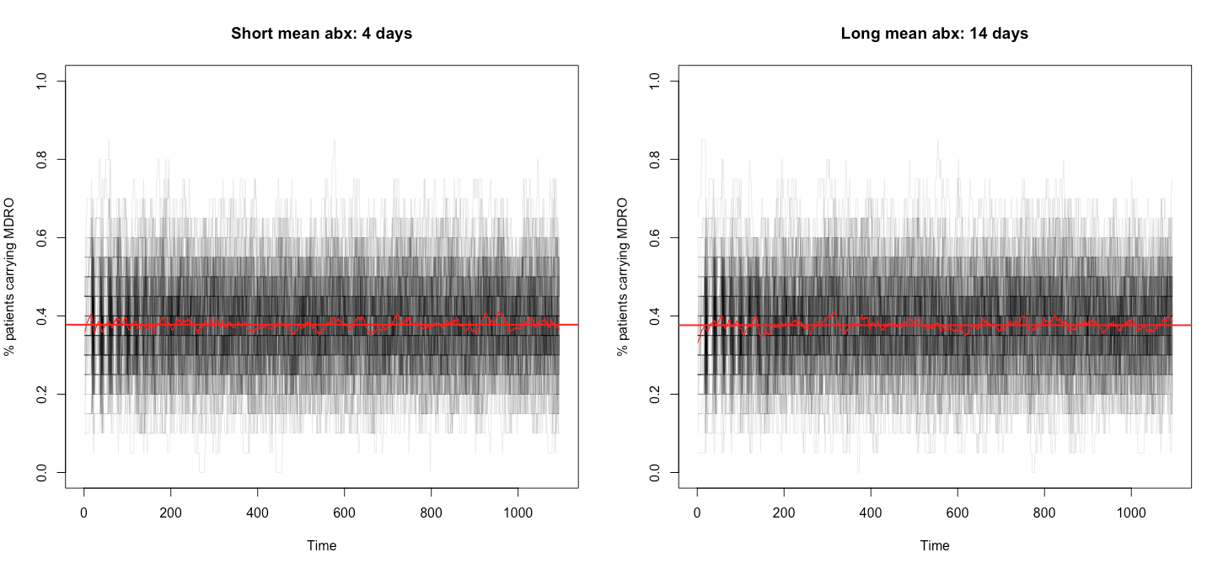
Increase duration of run (cont.)

Slide 5
Prevalence from ward perspective
Average number for scenario?
Average trajectory over time?

Slide 6
Different amount of people at each ward
Same amount of beds(space) and days(time)
Prevalence adjusted for number of people passing into ward

