Slide 1
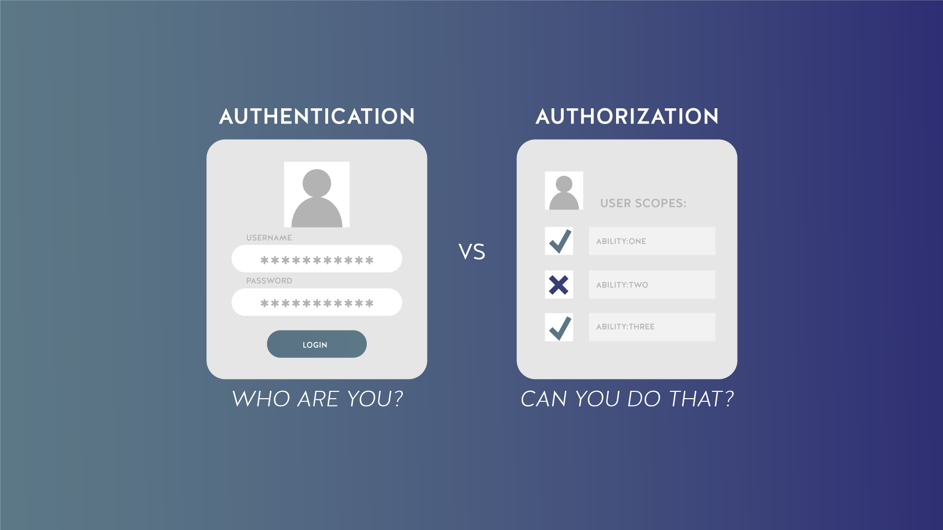
Information Encoding Standard
BDAT 1001

Slide 2
Project Summary In this project, a registered user can view all approved data and also edit data. Whereas a Manager can approve or reject user data. Furthermore administrators can approve/reject data and also view/edit data. And also if registered user forgot its password there is option to reset password using Forgot password functionality.

Slide 3

Group Members
Maitri Patel (200512654)
Dhruvish Patel (200521498)
Pinkeshkumar Patel (200497326)

Slide 4

Table of Contents
Part 1-Demonstration of Project
Part 2-Questions and Answers

Slide 5

Part 1-Demonstration of Project

Slide 6
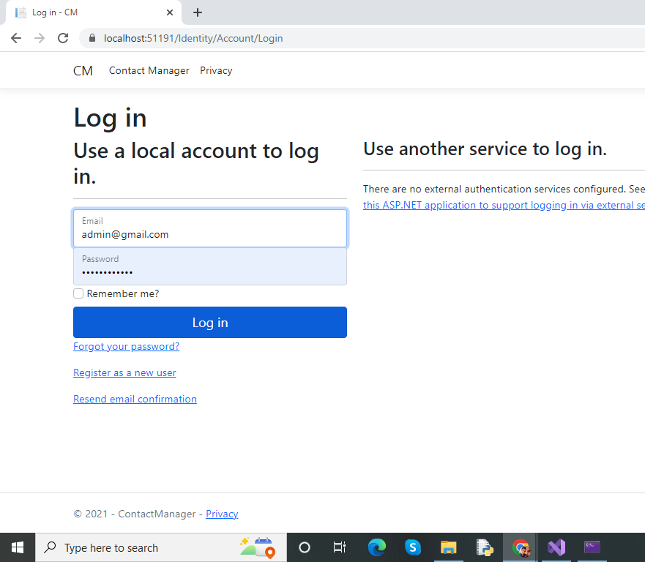
Login as Admin

Slide 7
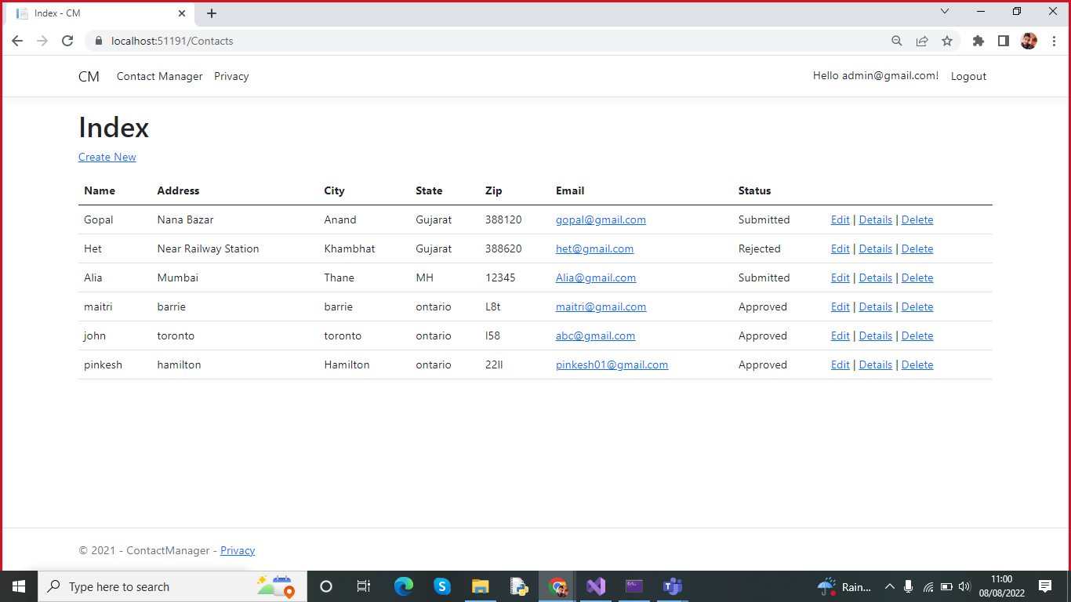
User Data After login

Slide 8
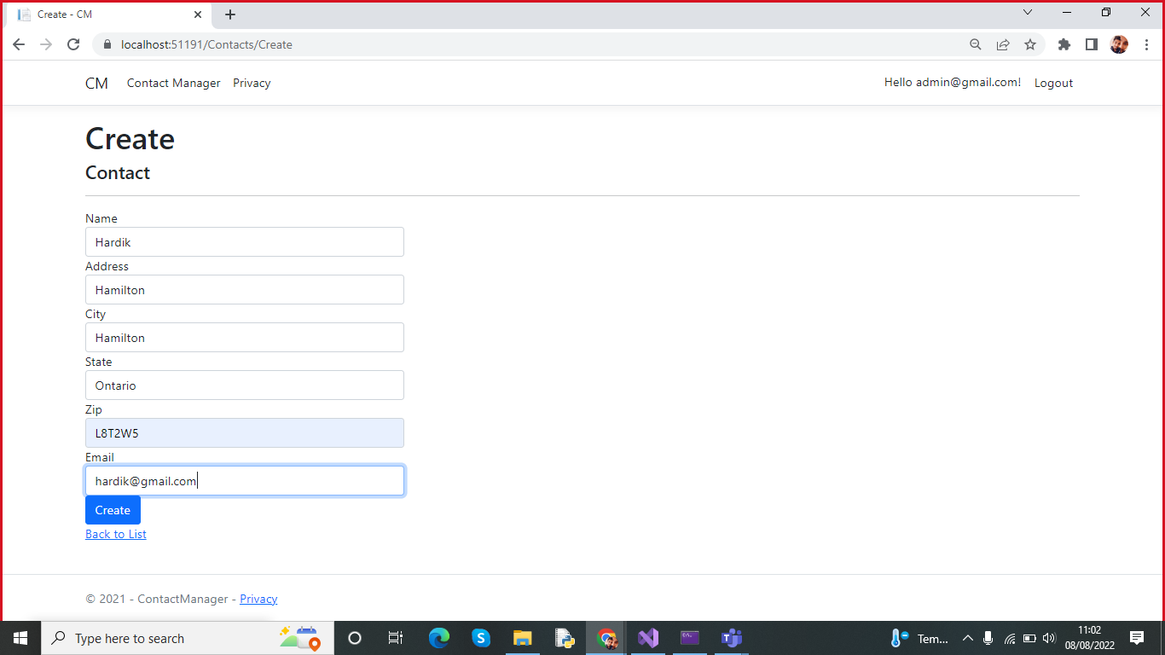
Create new user

Slide 9
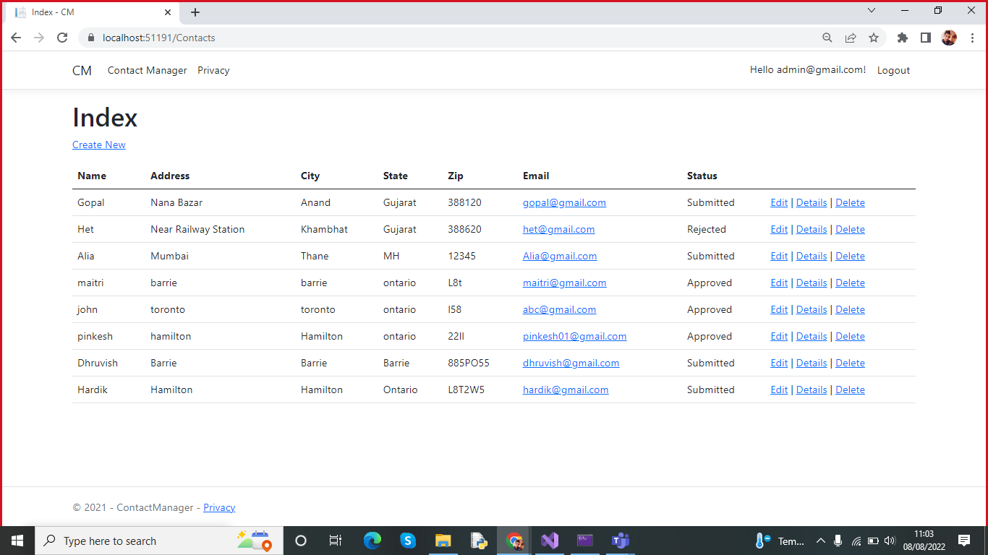
User is successfully added

Slide 10
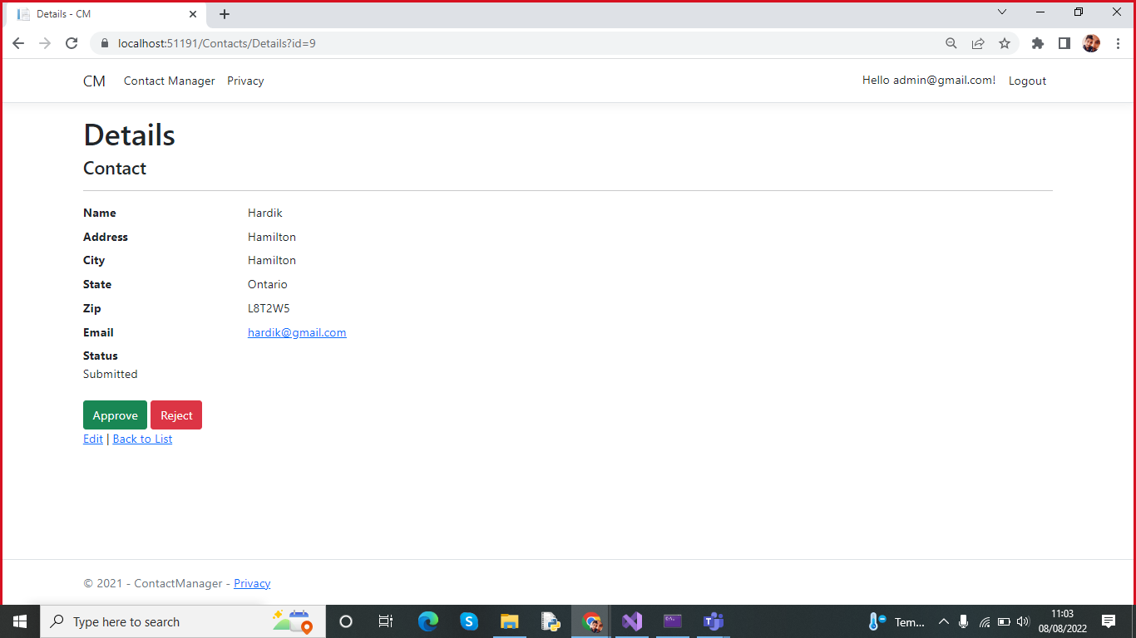
Details of User

Slide 11
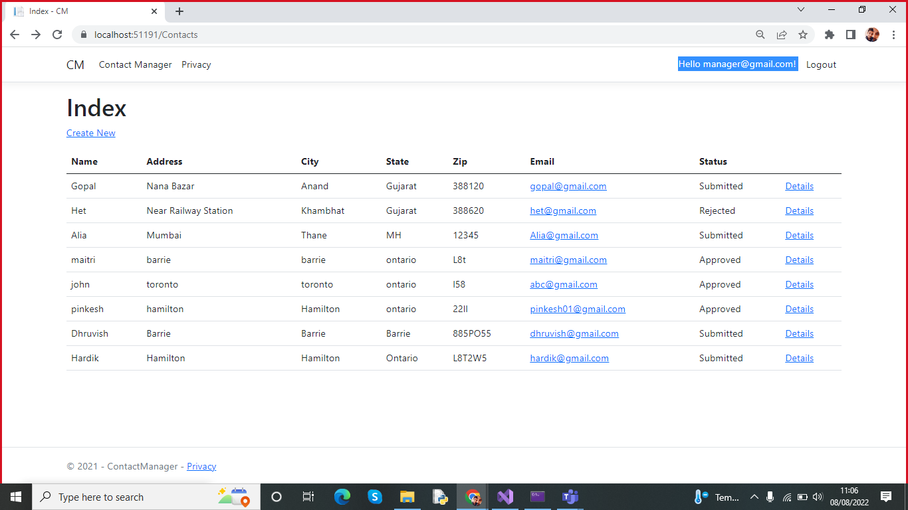
Login as a Manager

Slide 12
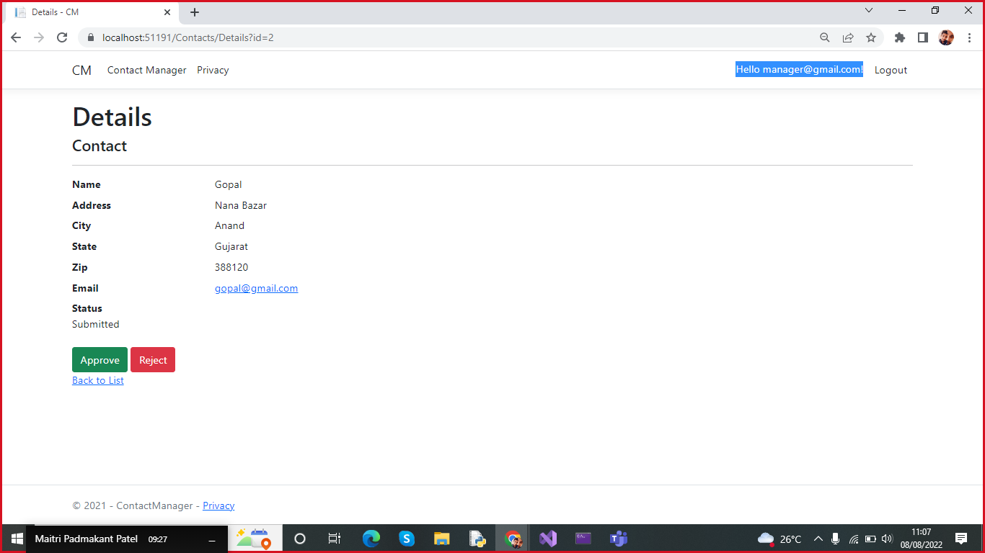
Details of User:Manager can Approve/Reject

Slide 13
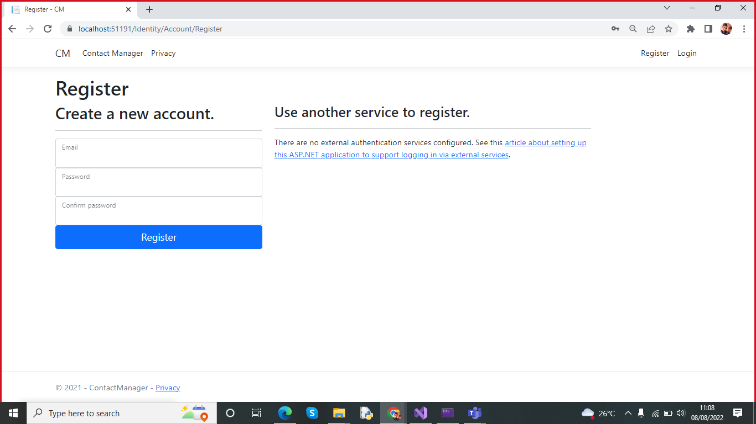
Registration of New User

Slide 14

Creating an Account

Slide 15
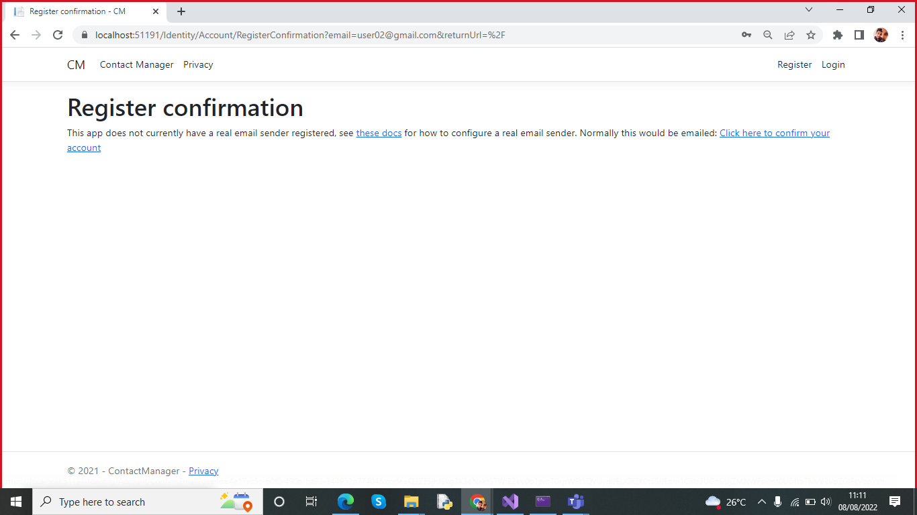
User Register Confirmation

Slide 16
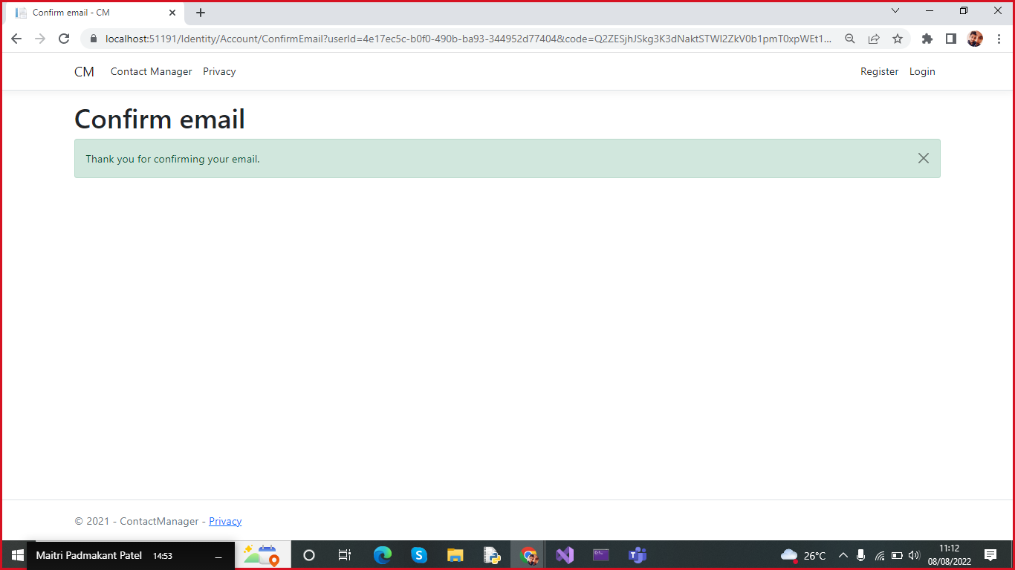
Confirmation of user

Slide 17
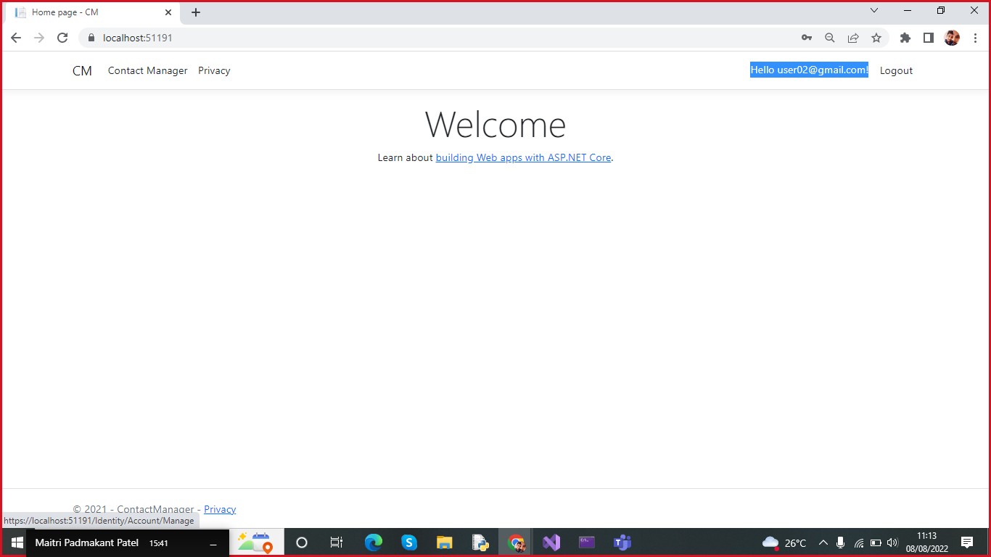
Login as user02@gmail.com as we created.

Slide 18
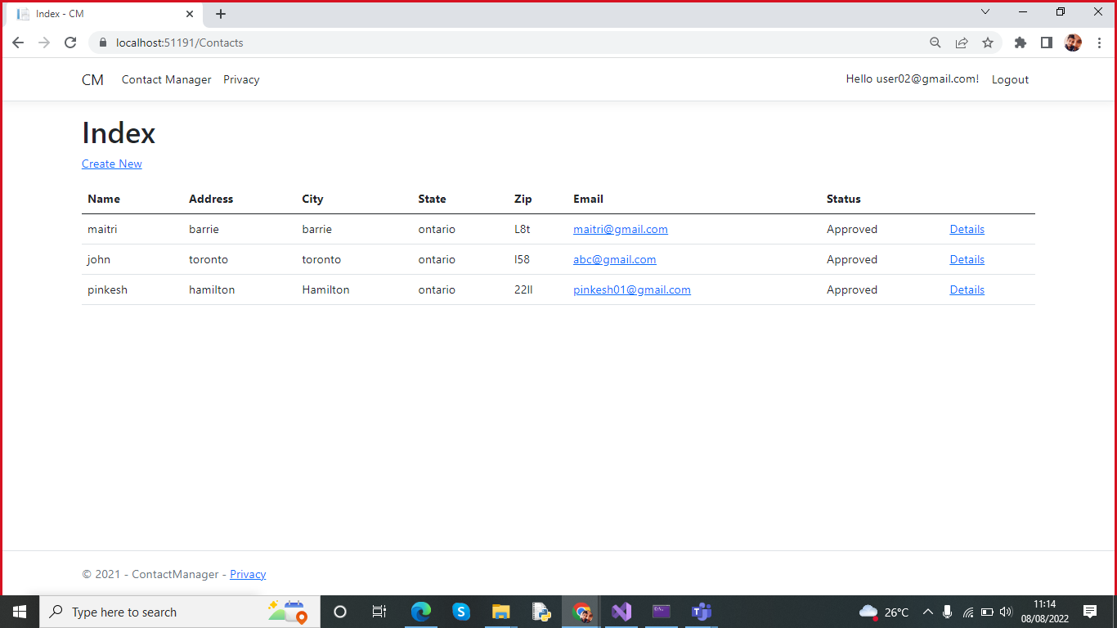
User can see approved user data

Slide 19
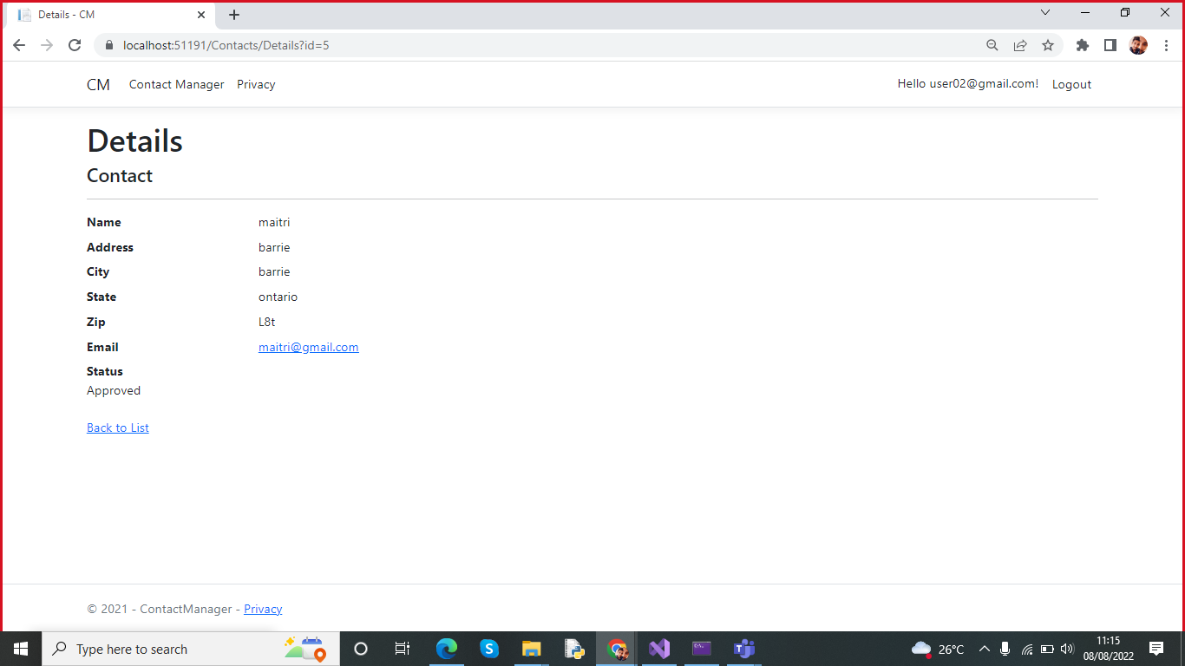
User can see their own details

Slide 20

Approval of User by Admin

Slide 21
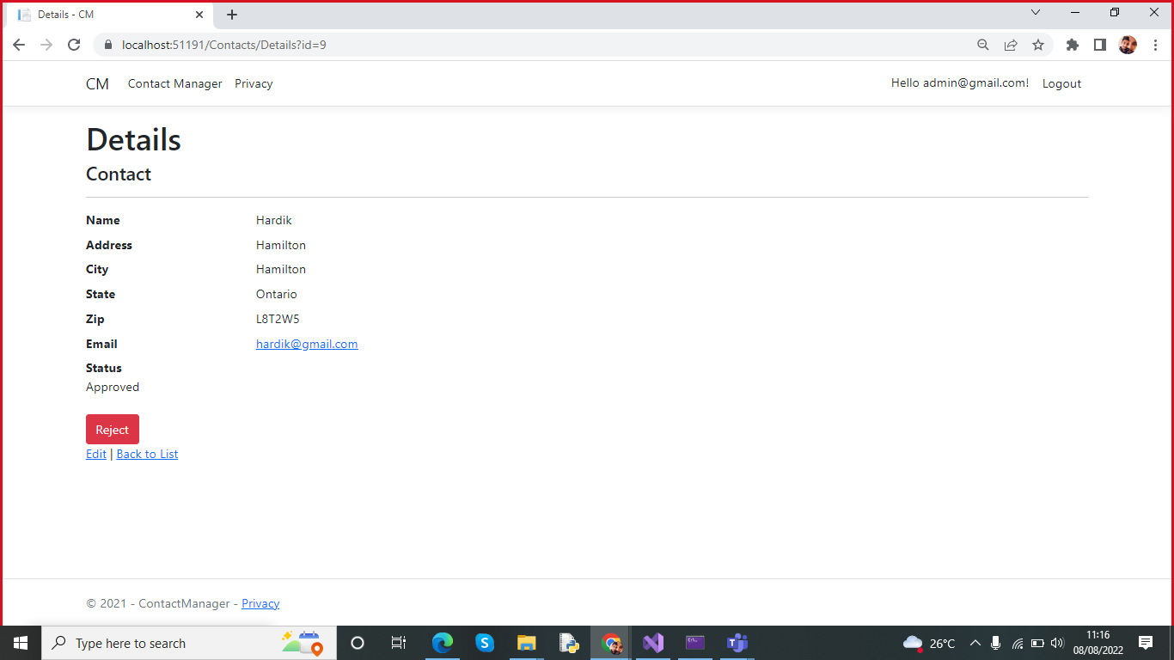
Approved User

Slide 22
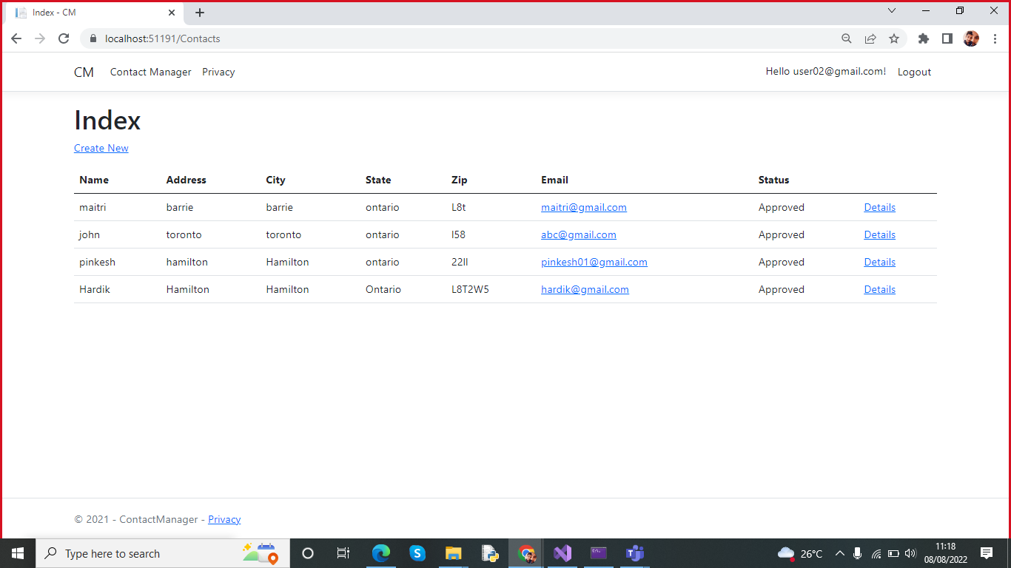
After the approval of manager. Registered user can view details.

Slide 23
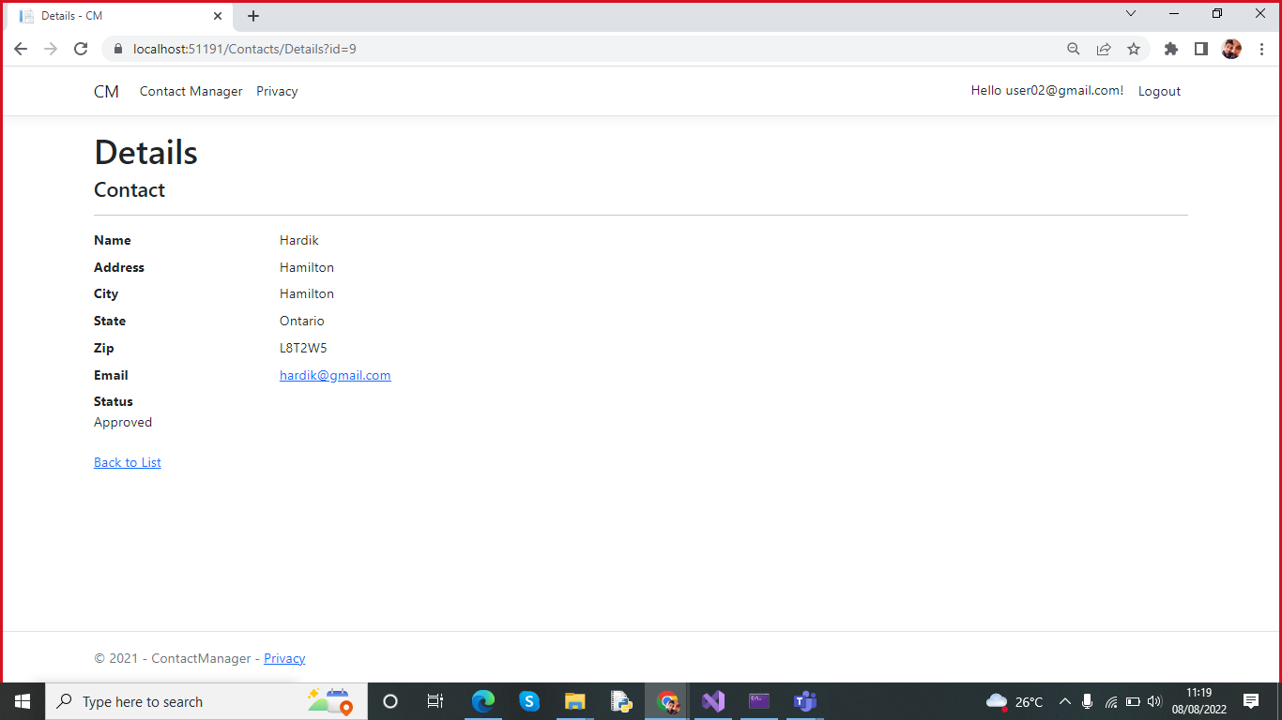
Details of Approved User

Slide 24
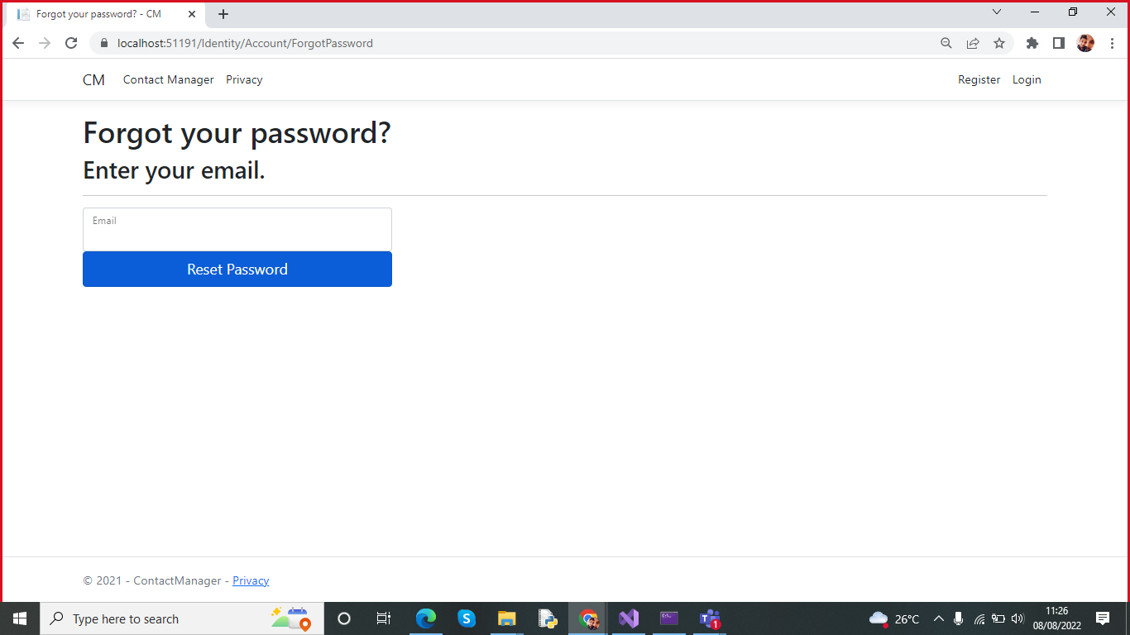
User can reset password using Forgot your password

Slide 25
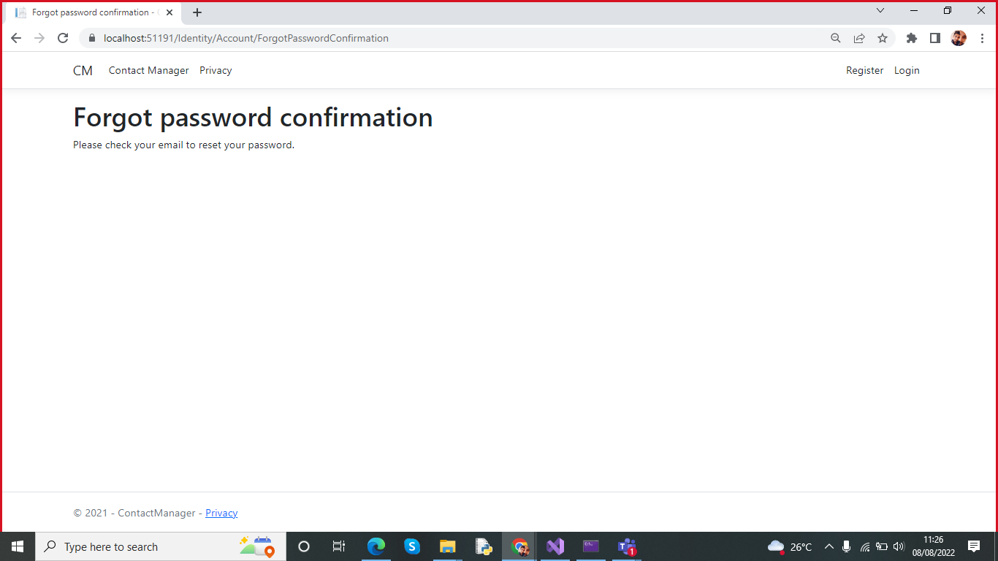
Reset password link is sent through mail

Slide 26
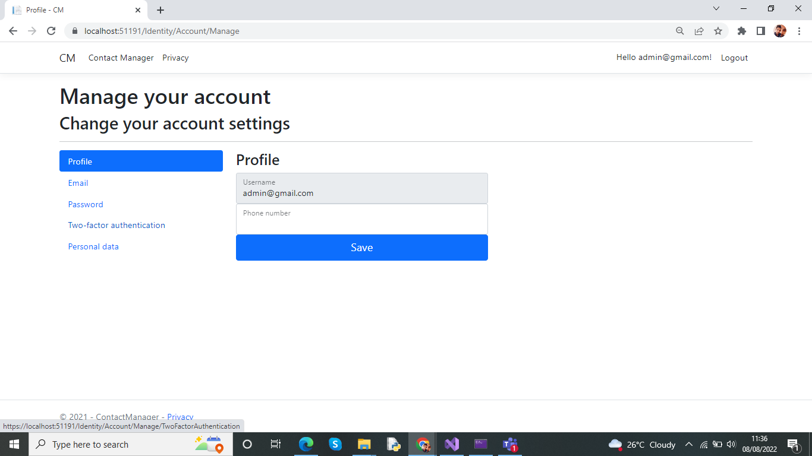
Managing Account

Slide 27

Part 2- Question & Answers

Slide 28
How can we transfer personal data securely within their network?
SSH
The SSH client programme is linked to the SSH server using the client-server architecture that is provided. It was designed to transfer data in a safe and encrypted way, such as plain text passwords. The network protocol known as SSH gives administrators a safe way to connect to a distant machine.
Encrypting data
The most straightforward and efficient strategies to safeguard your transfer. Several encryption tools are available to protect your data from cyber-attacks.
File Transfer Protocol (FTP) and Secure File Transfer Protocol (SFTP)
common network protocol that transfers files online between hosts, data can only accessed by entering password and username. We can also secure file with password before we update.
It is an important to secure file with password because the FTP is encrypted data are not.

Slide 29
Secure HyperText Transfer Protocol (HTTPS):
Hypertext files are often sent between a web server and a browser using HTTP. HTTP cannot provide any data encryption or user authentication with its default settings. We need to add encryption to the HTTP which can be done by transport layer security. It provides server side authentication and it allow server to validate the client.

Slide 30
2. What security protocol is best for transferring personal files?
The most effective method for sending personal files is the secure file transfer protocol (SFTP).
A network protocol for transmitting, maintaining, and accessing files between machines using an encrypted connection is known as secure file transfer protocol (SFTP).
It is based on FTP software and transfers data via the SSH (secure shell) protocol.
The "S" in SFTP, which stands for SSH, is used. Your SFTP transfers are protected by a privacy layer known as SSH, or "secure shell."
The connection is always safe while transferring files over SFTP. SFTP employs encryption and cryptographic hash techniques to make sure that no one can access your data while you are transferring files.
SSH keys or a user ID and password are need to connect to the server for SFTP file transfers.

Slide 31
3. Can we encode and encrypt images?
Images can indeed be encrypted and encoded.
Similar to how software encrypts words, an image may also be encrypted.
Encryption software modifies the values of the numbers in a picture in a predictable way by applying a series of mathematical operations, referred to as an algorithm, to the binary data that makes up the image.
Users must have the software key, which is created by the same programme that scrambles the image, in order to decrypt the encryption code.

Slide 32
4. Our database cannot be moved from the site and we need to be able to access it externally using a secure API. Can you explain the architecture of a secure API?
APIs are a common tool for interacting with the public sector, but when they are not adequately safeguarded, firms are more vulnerable to attack.
Additional precautions must be made to prevent the security concerns that exposure might bring since APIs disclose record systems, which typically exist within the trusted network of an enterprise.
By enabling these inquiries over the API gateway, businesses may lower a number of the hazards.
API gateways function as a sophisticated proxy server that keeps track of the traffic coming in, detects distributed DoS assaults and defends against them, and makes use of existing malware or antivirus scanning investments.
According to the security and operational requirements of the Agency, an API gateway must be able to dynamically filter requests.

Slide 33
5. Can you recommend a secure framework for coding an API?
There are many techniques for developing a secure API,
one common method is to use HTTPS for all communications.
Since all information transmitted between the client and server is encrypted, no one else will be able to intercept it and read it.
Some APIs utilise tokens or other types of authentication to increase the security of conversations.
Additionally, there are more methods can be used. For instance, you might utilise a two-way SSL authentication that needs a certificate to be presented on both ends of the API connection before they can safely communicate with one another.
We can employ two-way SSL authentication, which needs the presentation of certificates on both ends of the API connection before they can safely communicate with one another.
To better protect data, several businesses encrypt their databases.
Databases, a specific type of data storage system, may be used to store structured data. Tables have fields where data is stored and are reachable via an API.
Data transfer between two apps is made possible using API.

Slide 34
6. What data interchange format should we use while transferring data between locations?
Although there are several formats for exchanging data:
JSON and XML are two of the most often used ones.
Both JSON and XML can be sent securely over HTTPS.
1)The JSON format is compact and simple to read and write. It's constructed using a portion of JavaScript. Like XML, JSON is a text-based format that may also be used as an embedded format in other data forms.JSON does not support comments, in contrast to XML.
2)XML is simple to read and write. Parts in XML documents can contain comments, additional metadata about the entire document or specific elements within it, as well as attributes and values. For parsing its data, it is devoid of native functionalities; as a result, developers must rely on third-party libraries.

Slide 35
7. How should we store our data in our many locations?
There are several ways to store data safely, but one common one is to utilise a database.
Data can be stored in an organised fashion using a database, a sort of data storage system.
This data may be accessed via an API. To better safeguard data, several firms encrypt their databases.
A database API may be used to retrieve this data. Some firms encrypt their databases to further safeguard data.
Structured data may be kept in databases, a particular kind of data storage system. Tables have fields where data is kept and is accessible through an API.
API enables data transmission between two apps.

Slide 36
8. What are the ethical concerns related to the transmission of personal data?
It is freedom from the unauthorised accessibility to the private information.
Misuse of private informations.
Personal data belongs to the individuals who create it.
A user should be able to view the method used to create aggregate data sets if their personal information is used.
Law and ethics, as well as trust, security, and privacy, are all interconnected.
Trust is a prerequisite for privacy protection and security measures Privacy violations pose a risk, which puts security at risk.
Ethics can give context to law, but law can also offer a resolution when ethics cannot (for instance, ethics recognises that theft is bad, but the law punishes criminals) (e.g., law allows trading for the purpose of making a profit, but ethics provides input into ensuring trade is conducted fairly).
Privacy violations undermine security and cause distrust; they also expose the law to disobedience.

Slide 37
THANK YOU

