Slide 1
Home
Album
Article
Contact
Home
Title
I went to the beach which had many people there. I went to the seashore, and ….
Title
Title
I went to the beach which had many people there. I went to the seashore, and ….
I went to the beach which had many people there. I went to the seashore, and ….
Copyright©2016 H.Jin

Slide 2
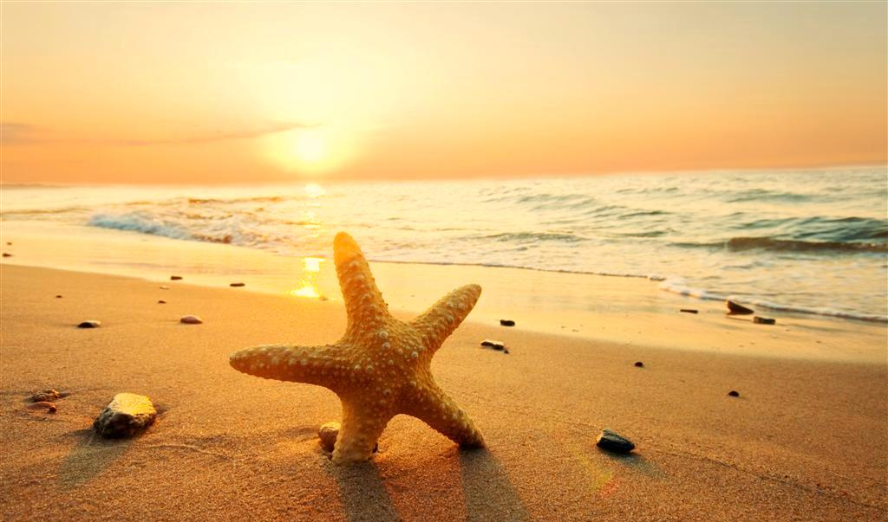
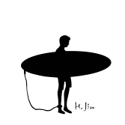
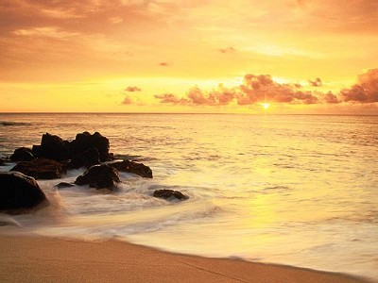
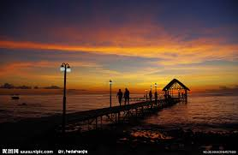
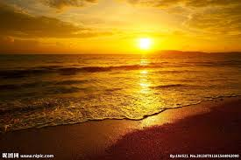
Home
Album
Article
Contact
Home
Title
I went to the beach which had many people there. I went to the seashore, and ….
Title
Title
I went to the beach which had many people there. I went to the seashore, and ….
I went to the beach which had many people there. I went to the seashore, and ….
Copyright©2016 H.Jin

