Slide 1

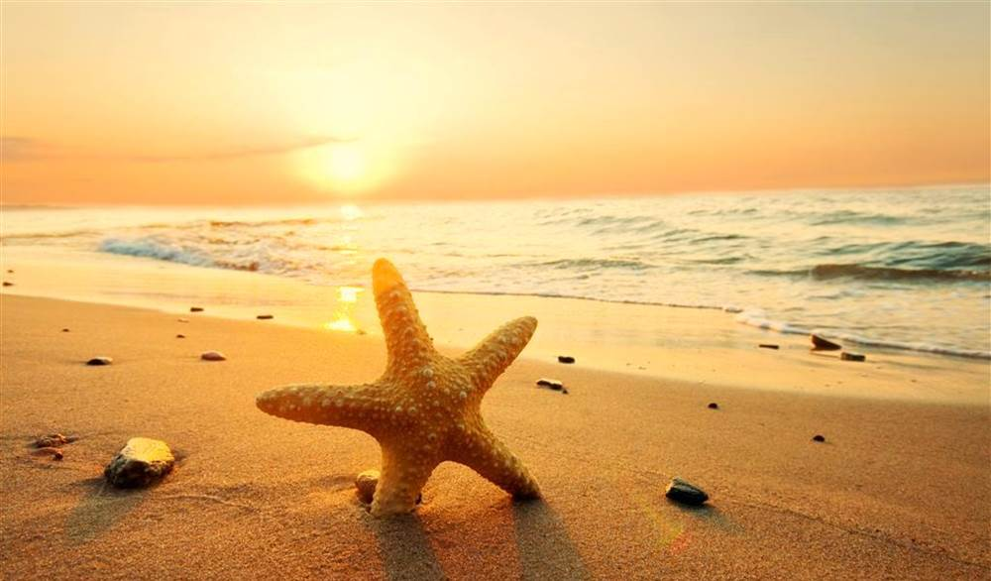
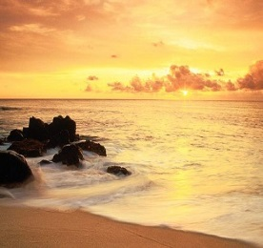
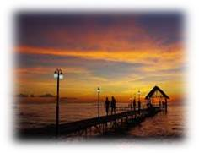
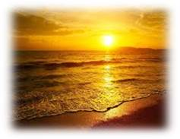
Home
Title
I went to the beach which had many people there. I went to the seashore, and ….
Title
I went to the beach which had many people there. I went to the seashore, and ….
Title
I went to the beach which had many people there. I went to the seashore, and ….
Copyright©2016 H.Jin

