Slide 1

Advanced Python Port Scanner
Welcome to the documentation for the Advanced Python Port Scanner, a powerful command-line tool designed to enhance your network security assessments. This presentation will guide you through the tool's capabilities, components, usage, and best practices to help you effectively identify open services and potential vulnerabilities on target systems.
by m8a8a8y

Slide 2





Overview
The Advanced Python Port Scanner is a command-line tool designed to scan TCP ports on a target host to identify open services. It enhances traditional port scanning through several advanced features that provide deeper insights for security assessments.
Multi-threaded scanning
Utilizes parallel processing for faster scanning across large port ranges
Banner grabbing
Attempts to identify running applications by capturing service banners
OS detection
Guesses target operating system based on ICMP ping TTL values
Pentesting guidance
Provides hints and references for common open ports to guide assessments

Slide 3
Components
The scanner is built with a modular architecture consisting of two main components that work together to deliver comprehensive port scanning capabilities.
main.py
scanner/vuln_analysis.py
Core script to run the scanner
Contains the pentesting hints database
Handles command-line arguments
Provides functions to generate hints
Manages threading and port scanning
Maps ports to typical services
Performs OS detection based on TTL
Includes common vulnerability guidance
Integrates pentesting hints
Links to trusted resources
Outputs results to console and file

Slide 4



How It Works
Port Scanning
Uses socket to attempt TCP connection on each specified port. Employs multi-threading via ThreadPoolExecutor to scan multiple ports concurrently, improving speed. On successful connection, tries to grab service banner data by sending a minimal request.
OS Detection
Sends an ICMP ping to the target and extracts the TTL (Time To Live) value from the response. Infers possible OS based on TTL ranges: ≤64 for Linux/Unix, ≤128 for Windows, and ≤255 for network devices like Cisco routers.
Pentesting Hints
After scanning, matches open ports to a database of known services. Outputs practical hints for penetration testers — where to focus, common vulnerabilities, and testing approaches. Provides references to external authoritative resources.

Slide 5
Usage Guide
The Advanced Python Port Scanner offers flexible command-line options to customize your scanning approach based on your specific requirements and target environment.
Basic Command
Available Options
Example
python main.py <target> [options]
-s, --start: Starting port number (default: 1)
Scan ports 20-1024 on 192.168.1.10 with 2-second timeout, save to scan_report.txt, using 150 threads:
Replace <target> with the hostname or IP address you want to scan.
-e, --end: Ending port number (default: 65535)
python main.py 192.168.1.10 -s 20 -e 1024 -t 2 -o scan_report.txt -w 150
-t, --timeout: Connection timeout in seconds (default: 1)
-o, --output: File path to save results (default: None)
-w, --workers: Number of concurrent threads (default: 100)

Slide 6
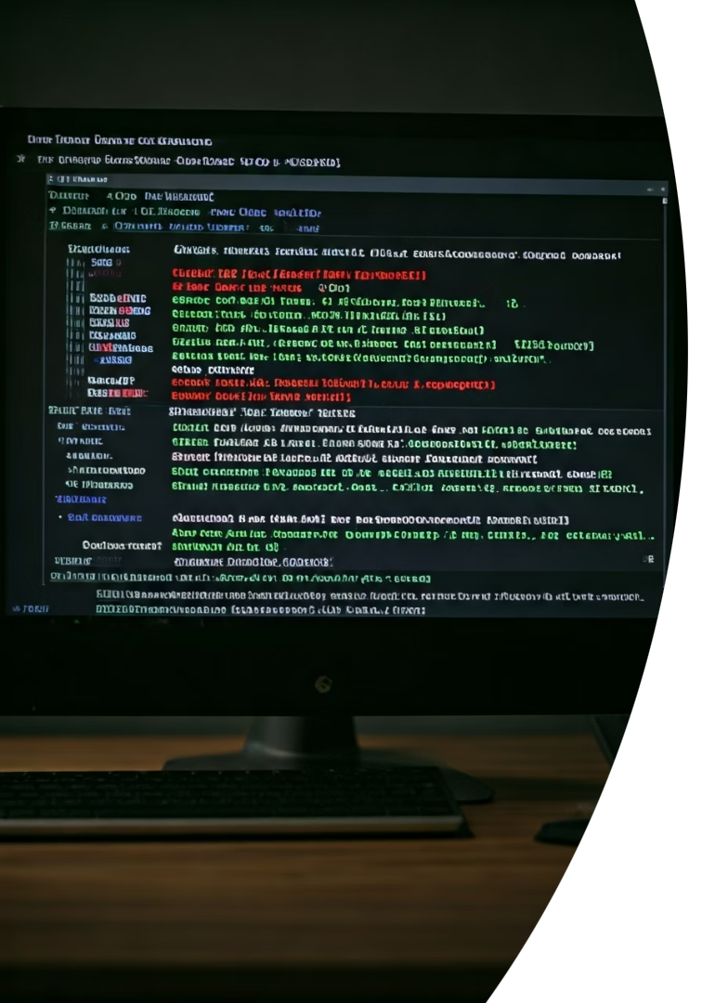




Output Explanation
The scanner provides comprehensive output that helps you understand the target system's network profile and potential security implications of open services.
Open Ports
OS Guess
Pentesting Hints
Lists all discovered open ports with any banner information gathered during the scan, helping identify running services.
Displays an operating system guess based on TTL values from ICMP responses, providing context about the target environment.
Shows practical advice for each identified service, including common vulnerabilities and testing approaches to guide your assessment.
Saved Results
Saves detailed findings to the specified output file (if provided) for documentation or further analysis.

Slide 7








Design Decisions
The Advanced Python Port Scanner was built with specific design choices to balance functionality, performance, and usability for security professionals.
Multi-threading
Basic Banner Grabbing
Enhances scanning speed but must be balanced with system and network limitations to avoid overwhelming resources
Helps identify services without relying on external tools, providing a self-contained solution
Pentesting Hints
TTL-based OS Detection
Designed as an initial guide, encouraging manual verification and further research
Simple but effective heuristic that works in most cases, though not foolproof

Slide 8




Limitations
While the Advanced Python Port Scanner offers powerful capabilities, it's important to understand its limitations to use it effectively and interpret results accurately.
Banner Grabbing Limitations
Rudimentary approach may fail on some services or require custom probes
OS Detection Accuracy
Can be inaccurate if network devices modify TTL or ICMP is blocked
Performance Constraints
Scanning all 65,535 ports can be time-consuming despite multi-threading
Ethical Considerations
For authorized use only; unauthorized scanning is illegal and unethical

Slide 9




Extending the Tool
The Advanced Python Port Scanner provides a solid foundation that can be enhanced with additional capabilities to meet more specialized security assessment needs.
Advanced Reporting
Generate reports in JSON, XML, or HTML formats
Vulnerability Integration
Include vulnerability database for live CVE lookup
Protocol Expansion
Add UDP scanning and protocol-specific probes
Tool Integration
Connect with nmap for richer service detection

Slide 10

Troubleshooting
When using the Advanced Python Port Scanner, you may encounter certain issues. Here are solutions to common problems to ensure smooth operation of the tool.
Issue
Solution
Permission errors for ping
Run as administrator/root or use alternative ping methods
Timeouts during scanning
Adjust -t timeout parameter or reduce thread count with -w
No banners detected
Services may not respond or require special probes
Slow scanning performance
Limit port range or increase threads cautiously

