Slide 1
Re&ound
An Interactive Music Streaming Platform

Slide 2
Integrated Project: Team Members
Madhav Goyal (2011981262)
Akhilesh Thakur (2111981020)
Akshita (2111981026)
Anjori (2111981033)

Slide 3
Introduction
The website Re&ound is a music streaming platform on which users can stream their favorite music.
The website has two different pages for its main window, Home and Explore, which can be accessed through the Navbar on the left.
The Home page is the first page the user lands on upon opening the website and shows the user's recently played music, recommended music and playlists, and some generally popular playlists that the user might like. The Explore page has various playlists based on moods, genres, singers and popularity, and new music for the user to explore.
The user can search for music using the Search Bar at the top. There will also be a Profile icon on the top right to update user information and change basic settings like themes.
Users can easily Log In and Log Out using the Profile icon in the top right to access their own saved music and playlists.

Slide 4
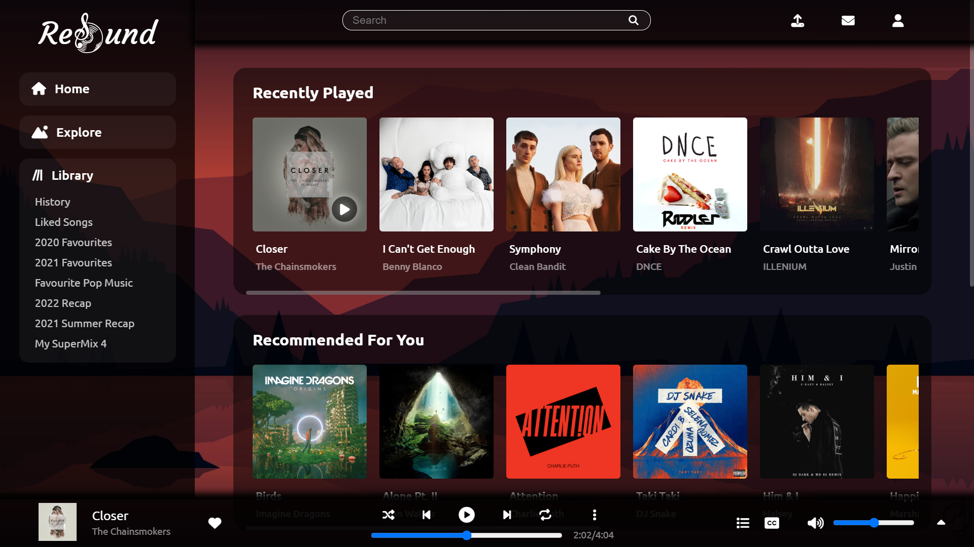
Front End Design

Slide 5
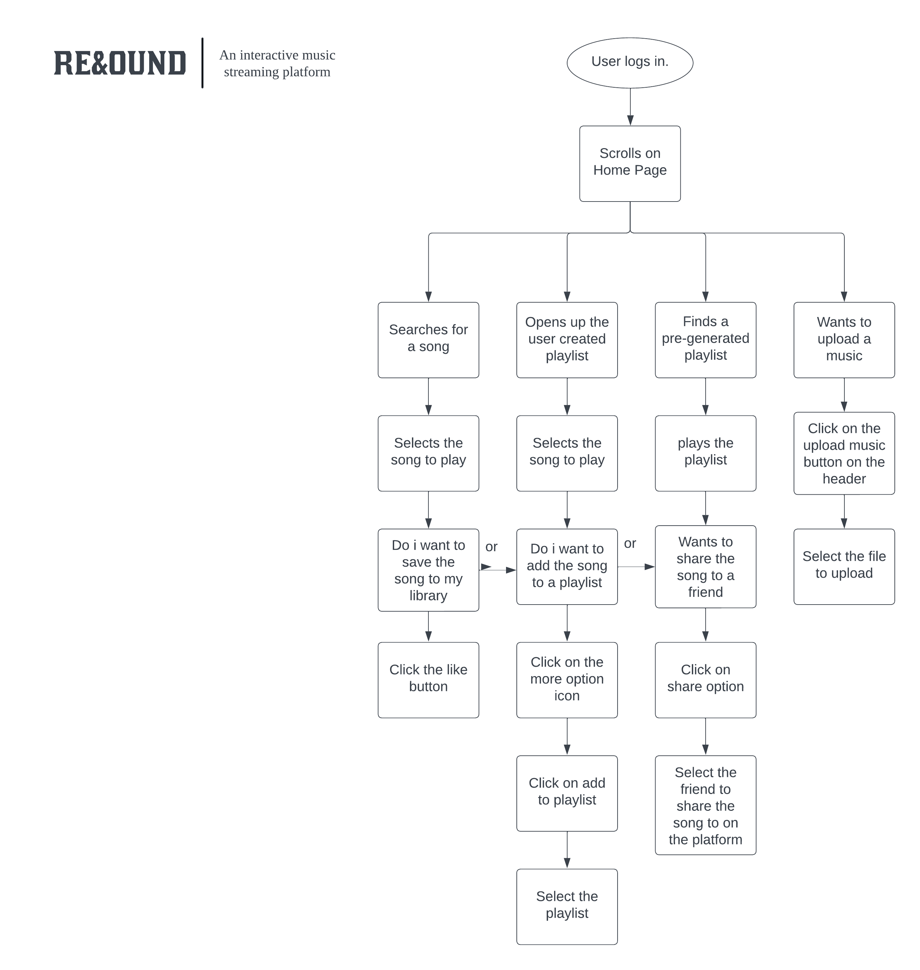
Flow Chart

Slide 6
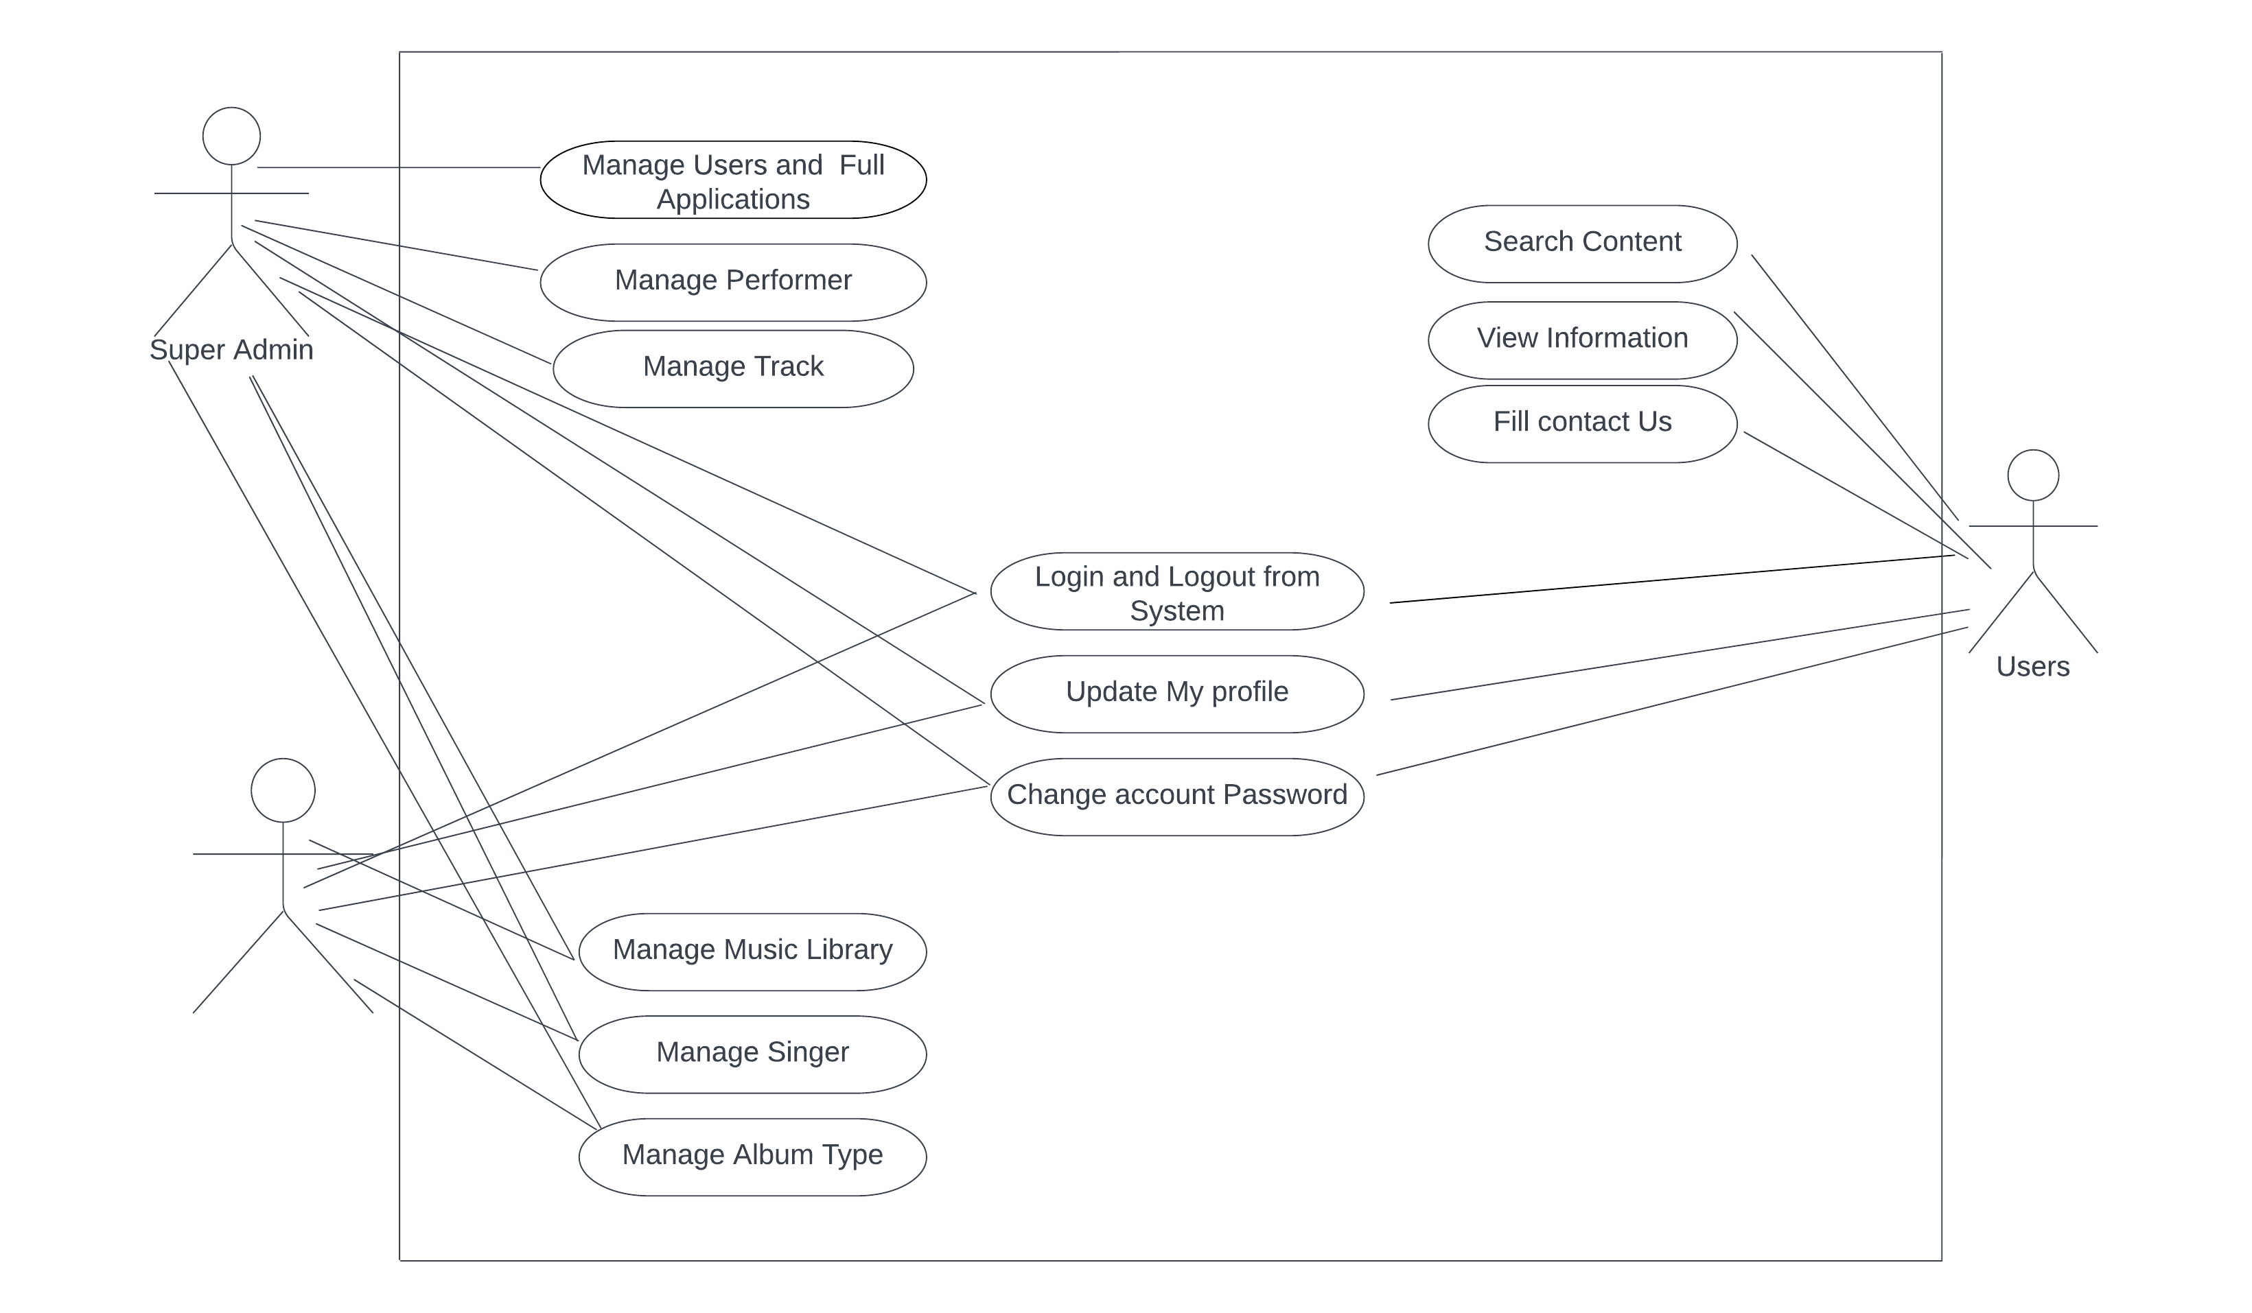
UML Diagram

