Slide 1
Lecture 8
Reflection
Garbage collection

Slide 2
Reflection
Metadata
Reflection
Type methods
Attributes

Slide 3
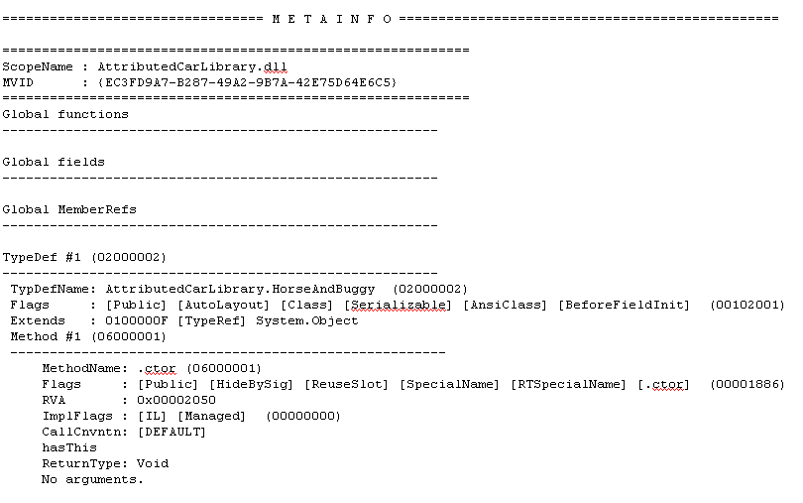
Metadata
data that provides information about other data
metadata in IL code

Slide 4
Reflection
allows programmatically access assembly metadata
located in System.Reflection namespace
typeof operator is used to get Type object

Slide 5
Type methods
IsAbstract, IsArray, IsClass, IsPublic, etc
GetMethods()
GetProperties()
GetFields()

Slide 6
Attributes
declarative tag used to convey information to runtime about the behaviors of various elements
allow to embed additional metadata
custom attributes should be derived from System.Attribute type

Slide 7
Garbage collection

Slide 8
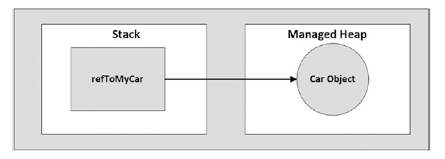
Reference type location

Slide 9
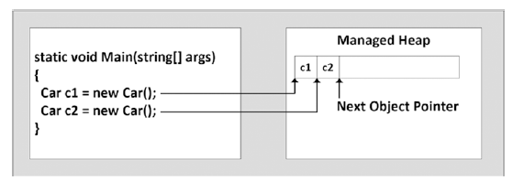
Next object pointer

Slide 10
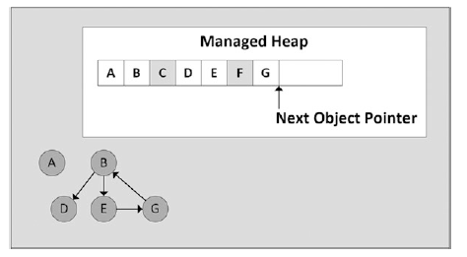
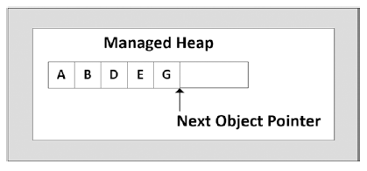
Unreachable objects

Slide 11
Object generations
Generation 0 - identifies a newly allocated object that has never been marked for collection
Generation 1 - Identifies an object that has survived a garbage collection. This generation also serves as a buffer between short-lived objects and long-lived objects
Generation 2 - Identifies an object that has survived more than one sweep of the garbage collector or a significantly large object that started in a generation 2 collection

Slide 12
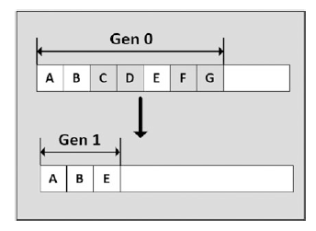
Object generations

Slide 13
IDisposable
It is a good idea to call Dispose() on any object you directly create if the object supports IDisposable
using construct can be used to implicitly call Dispose()

Slide 14
Lazy objects
used to delay creation of expensive object until caller requires it

