Slide 1
Lecture 6
Delegates
Extension methods

Slide 2
Delegates
Delegates
Anonymous functions
Lambda expression
Func, Action, Predicate

Slide 3
Delegates
delegate is the reference type data type that defines the signature
delegate type variable can refer to any method with the same signature as the delegate
delegates are implicitly derived from the System.Delegate class
can be declared outside of the class or inside the class
can be invoked using Invoke() or () operator
can be passed as argument to a function

Slide 4
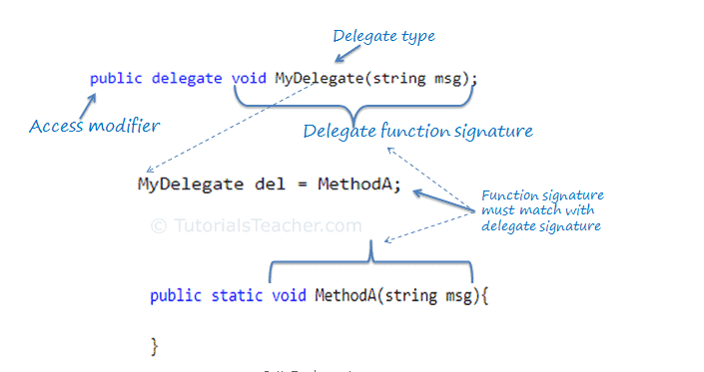
Delegates

Slide 5
Multicast delegate
delegate can point to multiple methods
multiple methods can be assigned to the delegate using "+" or "+=" operator and removed using "-" or "-=" operator
if a multicast delegate returns a value, then it returns the value from the last assigned target method.

Slide 6
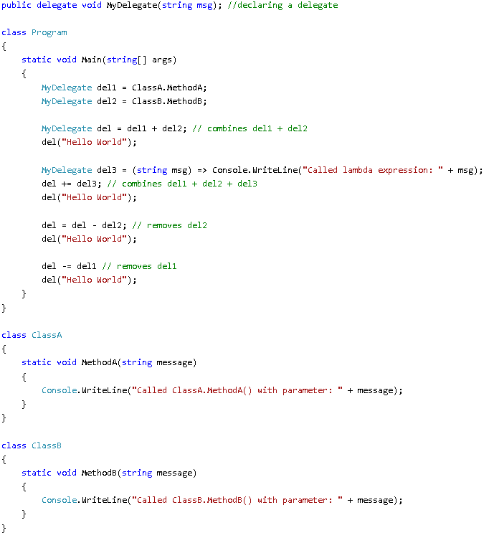
Multicast delegate

Slide 7
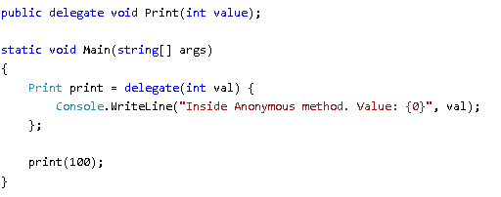
Anonymous methods
method is a method without a name
can be defined using the delegate keyword
can access variables defined in an outer function
can be passed to a method that accepts the delegate as a parameter

Slide 8
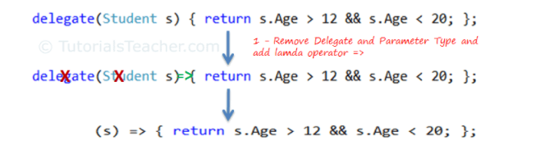
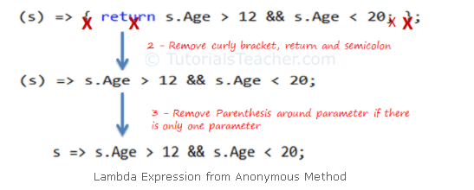
Lambda expression (arrow function)
shorter way of representing anonymous method using special syntax

Slide 9
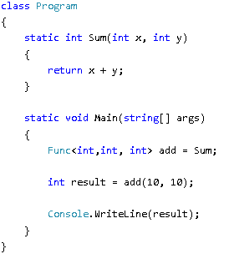
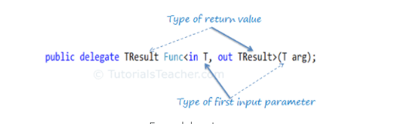
Func
build-in generic and non-generic delegate type
takes one or more (up to 16) input parameters and returns one out parameter

Slide 10
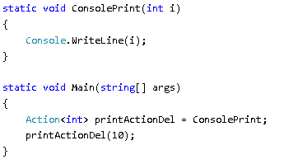
Action
build-in generic and non-generic delegate type
can be used with a method that has a void return type
accepts up to 16 input parameters

Slide 11
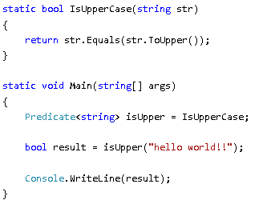
Predicate
represents a method containing a set of criteria and checks whether the passed parameter meets those criteria
takes one input parameter and has boolean return type

Slide 12
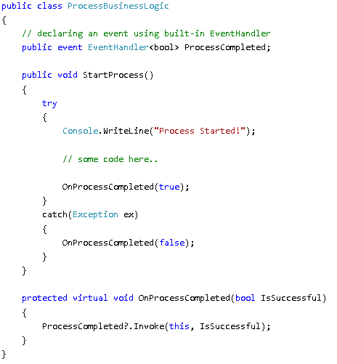
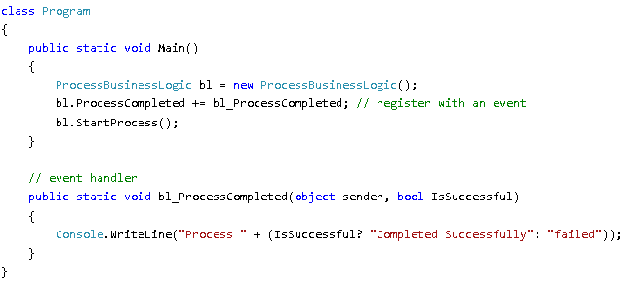
Event
event is a notification sent by an object to signal the occurrence of an action
an event is a wrapper around a delegate
it’s not allowed use the == operator with events

Slide 13
Extension methods
What are extension methods?
How to write and use extension methods?

Slide 14
What are extension methods?
allow to add additional methods without updating existing class
can be added for any class, struct, interface, predefined or custom type
special kind of static method defined in a static class
first parameter of the extension method must be of the type for which the extension method is applicable, preceded by this keyword
simplify method chaining
can be used anywhere in the application by including the namespace of the extension method.
LINQ is built upon extension methods

Slide 15
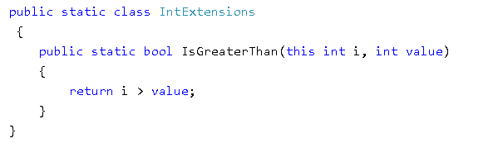
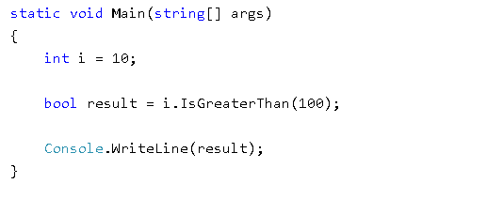
How to write and use extension methods?

