Slide 1
Team ReOpt
Smart Task Manager

Slide 2
Business and Data Analytics Problem
Business Problem:
ReAct provides a solution for retail shop employees by notifying them in real time, once their help is needed at any for them relevant occurring issue at the supermarket. Issues could be for example: needed maintenance of a machine, customer assistance, price inquiries, support by truck unloading, etc. Employees have to drop what they are doing and come to support.
Analyzing past data of occurring issues, employees can get a better picture of what is expected to happen during the day, which will allow them to coordinate their day more productively and more hassle-free.
Data Analytics Problem:
The data analytics problem lies in being able to forecast occurring issues using the dataset provided by ReAct and identifying any other factors which can have a role in their occurrence. Using this predictive model, a smart task manager can be developed, which uses the forecast to organize and prioritize tasks.

Slide 3
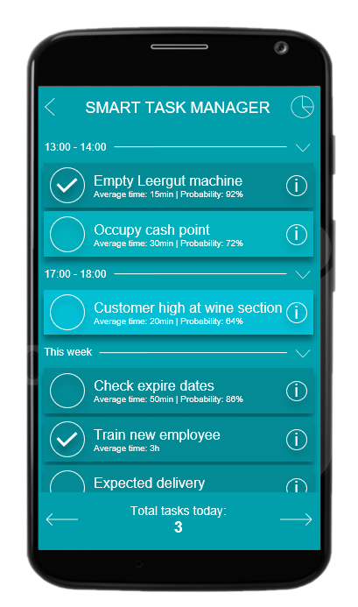
Product Vision
Prediction of tasks:
algorithm predicts the occurrence of tasks in the different time frames and their expected duration from past data and shows their probability accordingly
algorithm predicts expected duration of task from past completed similar tasks
Employee private statistic dashboard
Connected Workforce:
If a new task occurs the algorithm checks which employee is most probably free and asks him first for his support by a new task

Slide 4
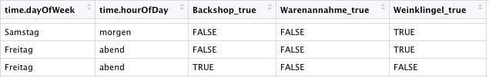
Updated Final Data and Analytics Approach
Product name: Smart Task Manager
Data Preparation
Combine all datasets of different calender weeks
Separate the recipient.roleName column in the different job roles at a retail shop
Pick one store location, three job roles which will be considered during the analysis and the hourof theday and dayoftheweek variable
Transform houroftheday variable to a categorical variable with values (morning, midmorning,noon, afternoon,evening, night)
Clean data (remove columns with NA values, remove duplicate columns, messages that have been sent multiple times)
Transform recipient.roleName columns into wide format (instead of one column with three possible categorical outcomes -> three columns with Boolean values
End Data Format

Slide 5
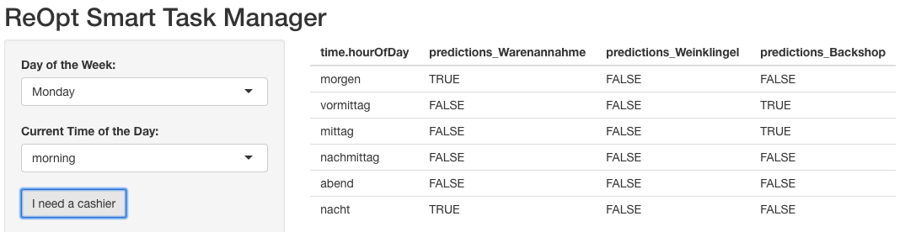
Updated Final Data and Analytics Approach
Product name: Smart Task Manager
Prediction Model
Predict the three Boolean job role variables using a Naïve Bayes classifier
Achieved Accuracies on test set for the three variables: 0.66, 0.726, 0.753
Rshiny User Interface
Contact Weinklingel and Backshop Employees, Warenannahme Employee is busy

