Slide 1


Slide 2

CS 3305A: Operating Systems
Assignment 3 Tutorial
Fall 2021
Computer Science

Slide 3
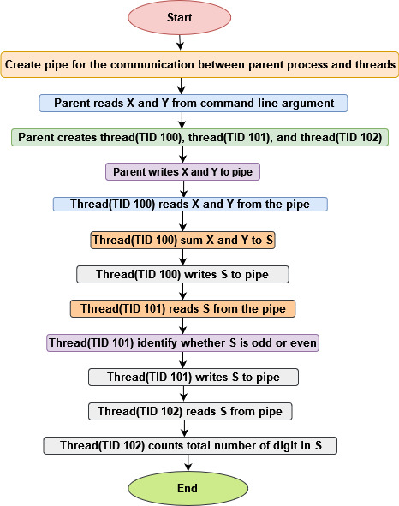
Execution Flow
ID’s have been used just to imitate that we are passing ID’s to their corresponding functions.
Each byte written to the pipe can be read exactly once.
Fig 1. Execution flow
Computer Science

Slide 4
Helper Function
pipe(): help to create a share memory
pthread_create(): function used to create a thread in the context of the calling process
pthread_join(): for threads to terminate.
read(): access data from pipe
write(): write data to the pipe
strcat(): concatenate string
Computer Science

Slide 5
Passing parameters
Any delimiter can be used to pass the parameters X and Y to the pipe.
For example, a space(“ ”) can be used as a delimiter to concatenate X and Y. The same delimiter must be used to parse them in the corresponding thread.
Computer Science

Slide 6
Program compile and run
Compile
gcc assignment3.c -o assignment3.out -pthread
Run
./assignment3.out 7 6
Computer Science

