Slide 1


Slide 2

CS 3305A: Operating Systems
Assignment 1 Tutorial
Fall 2021
Computer Science

Slide 3
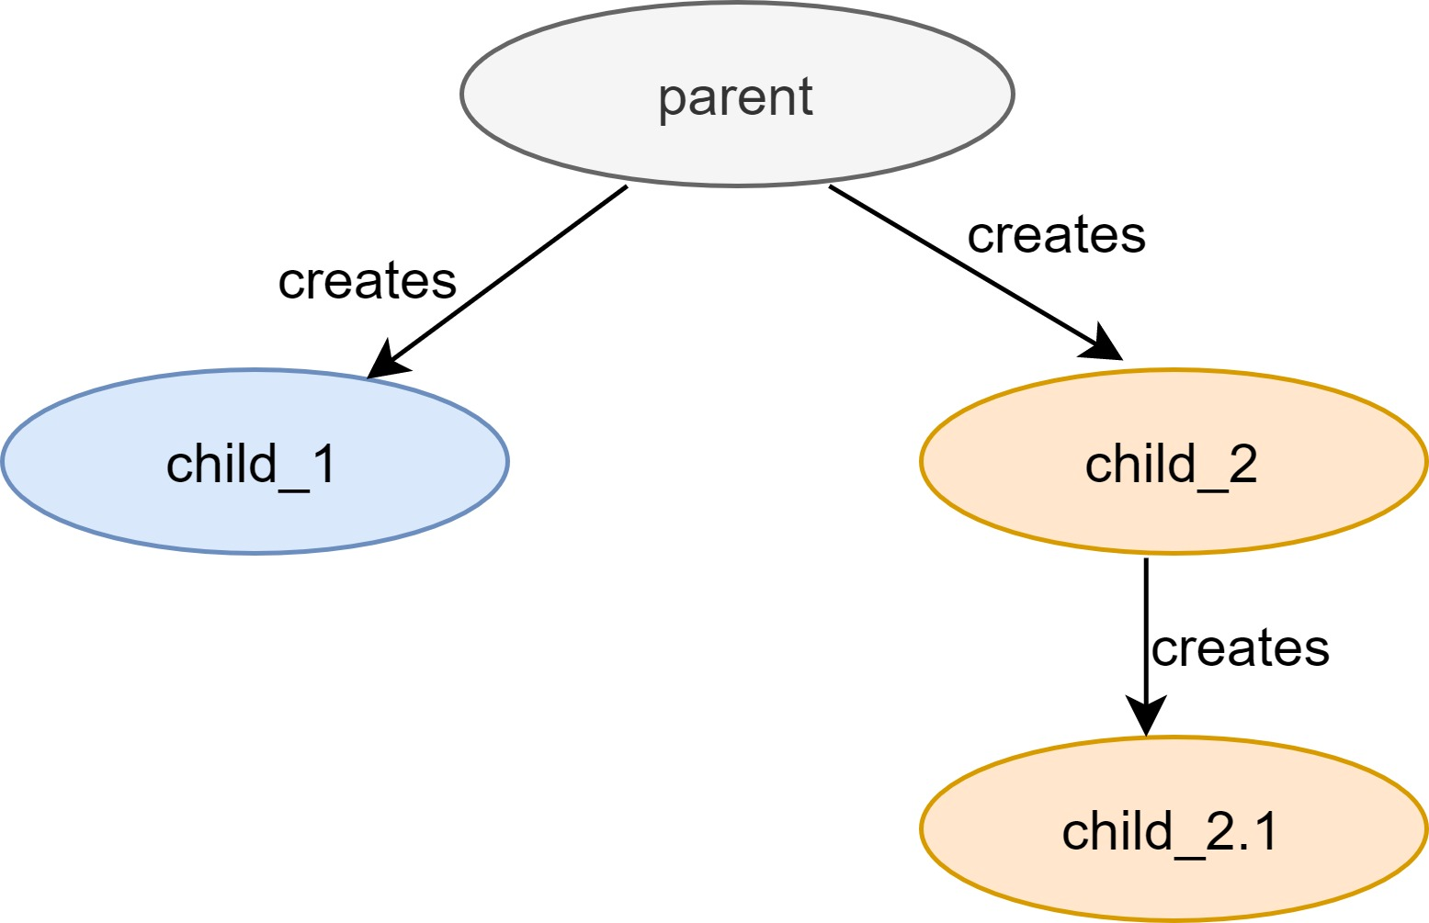
Process Hierarchy
Fig 1. Process Hierarchy
Computer Science

Slide 4
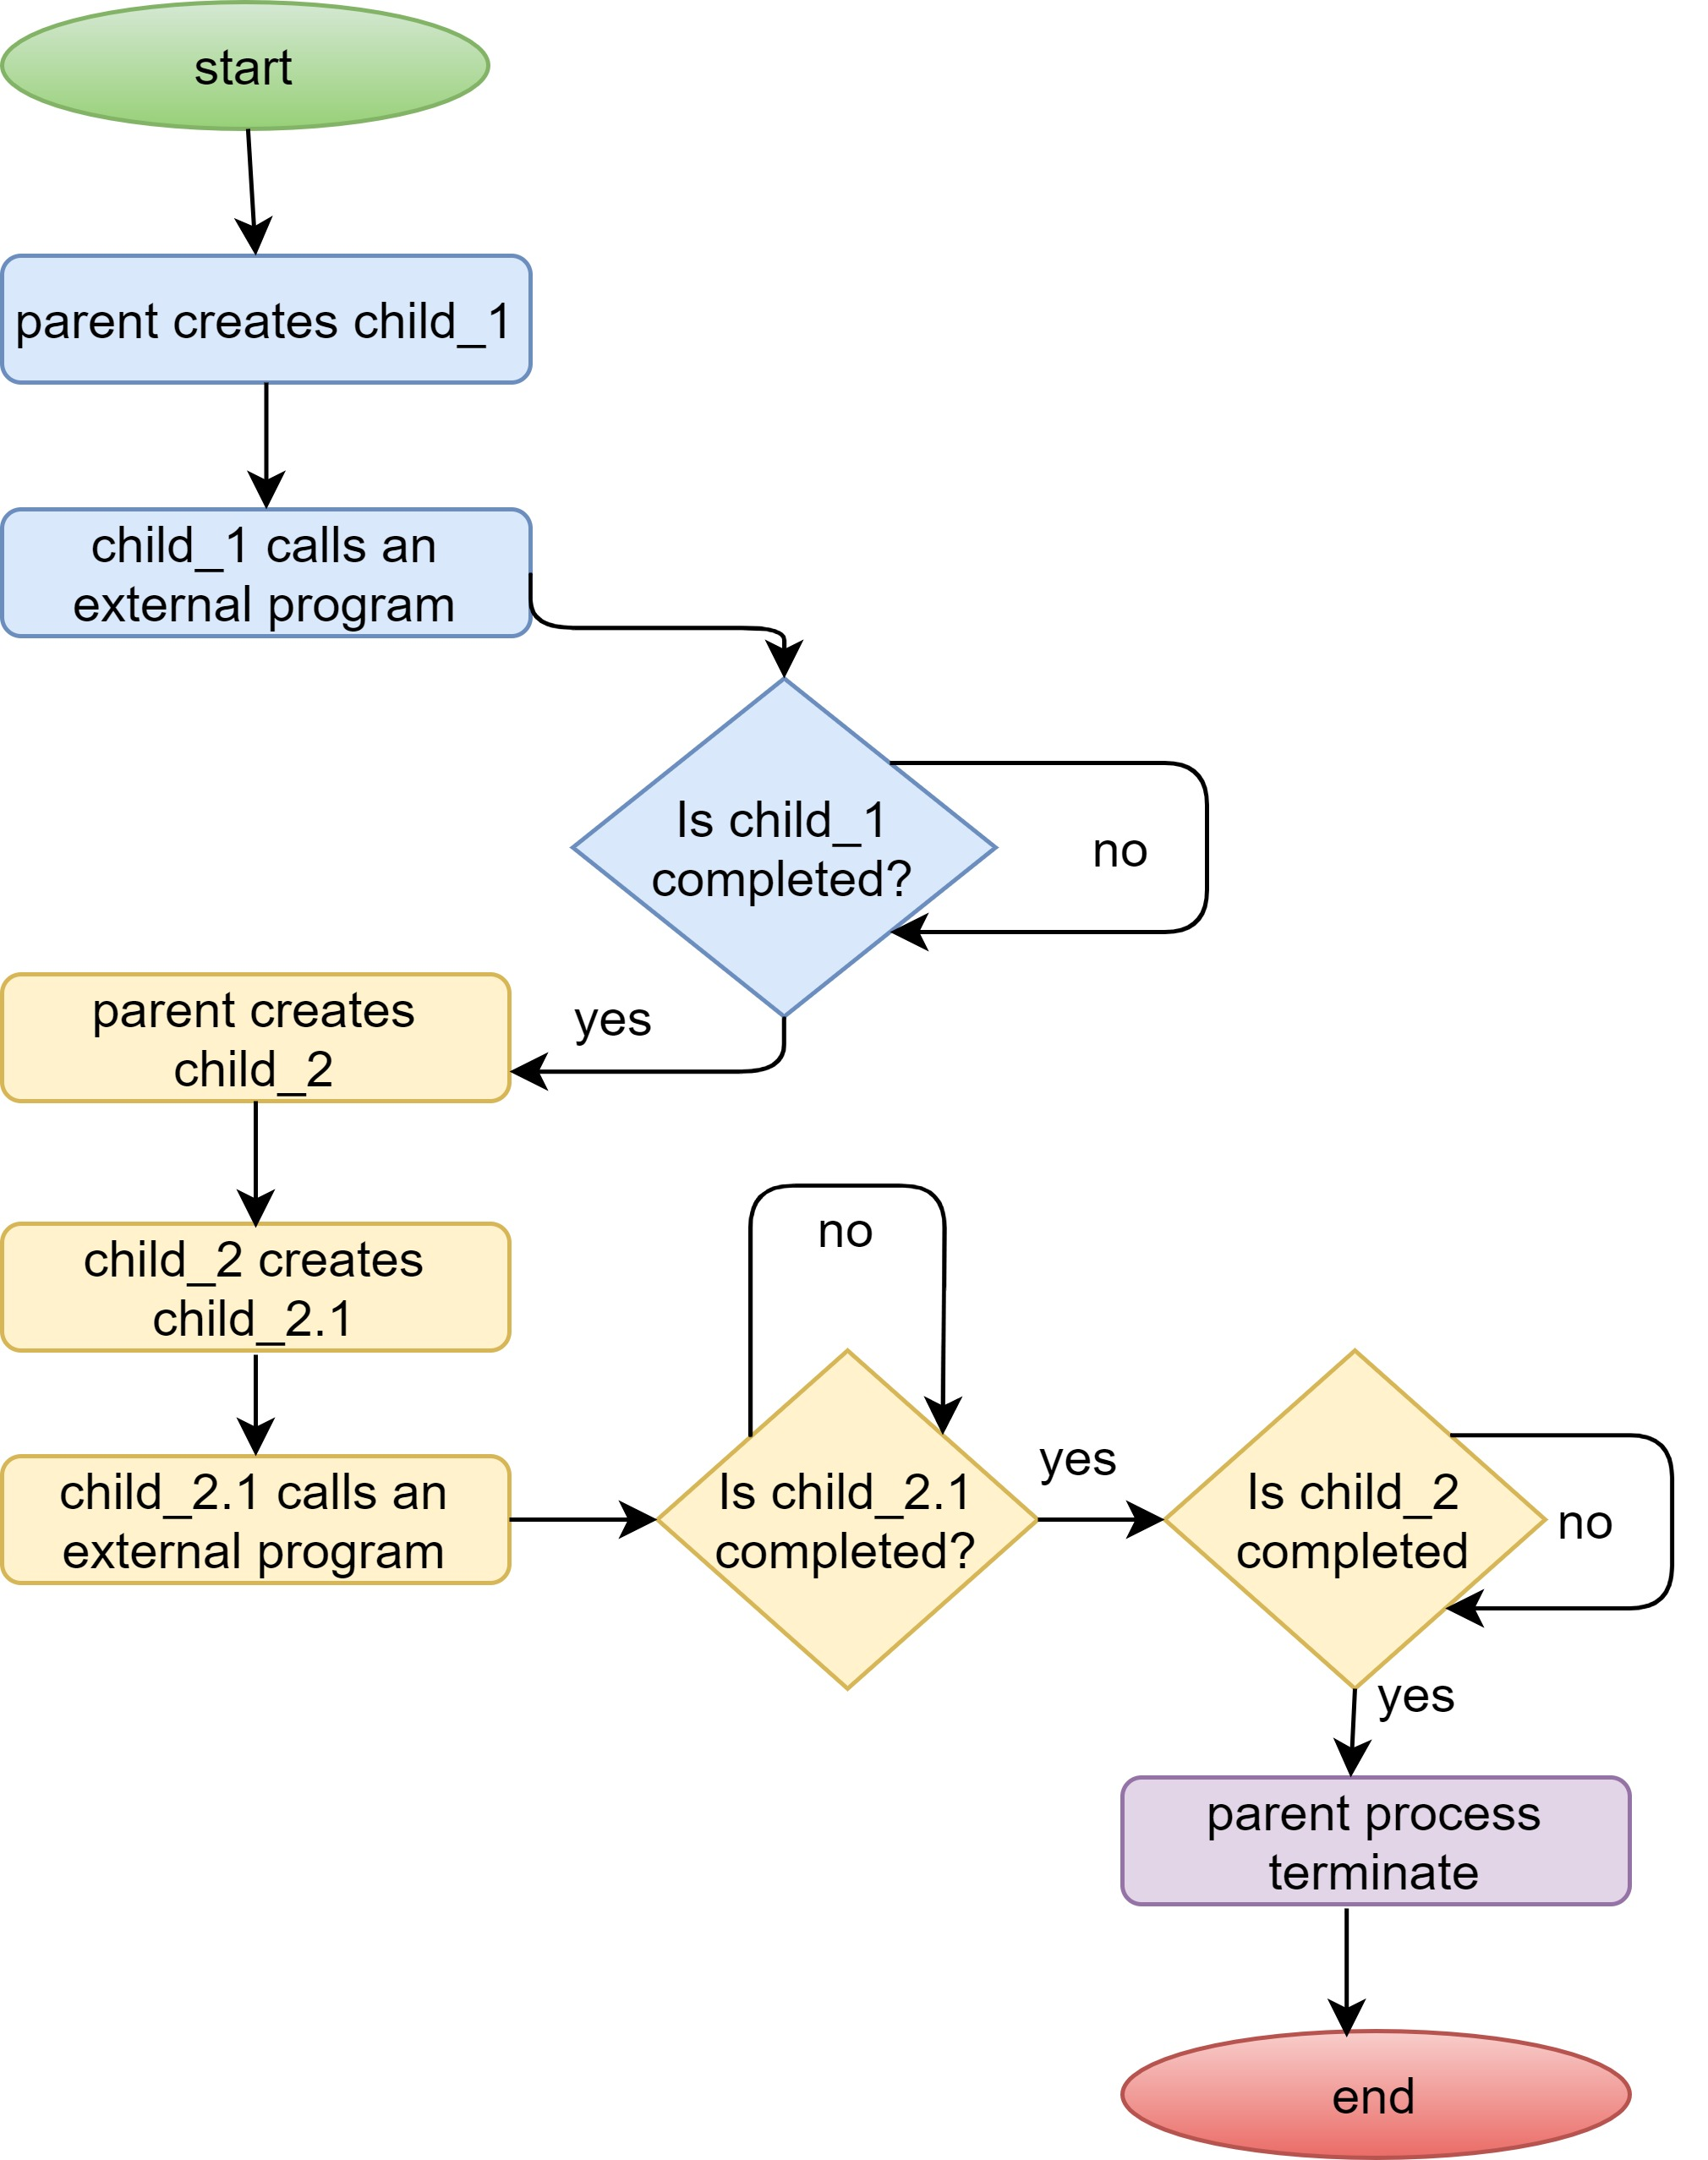
Process Workflow
Fig 2. Process workflow
Computer Science

Slide 5
Helper Function
fork(): creates child process
wait(): wait for process to complete
getpid(): return the process id
getppid(): return parent process id
execl(): call an external program. It requires the external program file location and parameter for the external program. The parameter list must be terminated using a null pointer
strcat(): concatenate two string
Computer Science

Slide 6
Program compile and run
Compile
gcc assignment1.c -o assignment1.out
gcc external_program.c -o external_program.out
Run
./assignment1.out directory/external_program.out
Computer Science

