Slide 1
VAVE

Slide 2
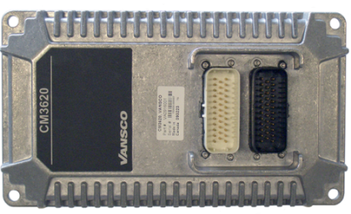
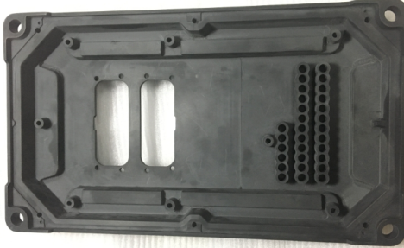
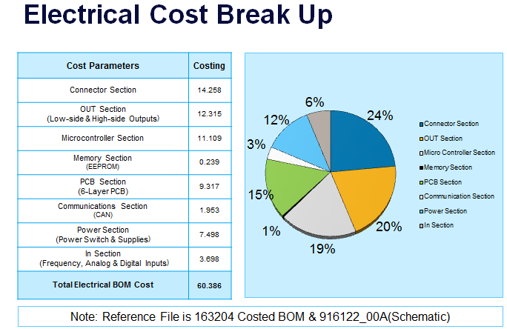
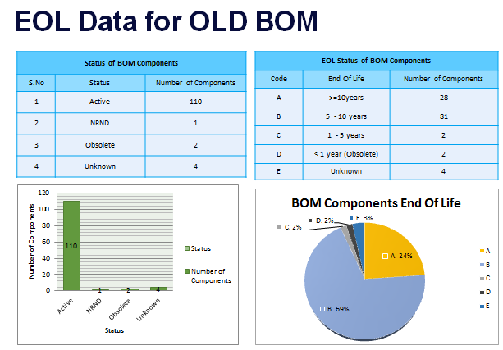
Division: ECD
CM3620 I/O Controller – VAVE Analysis
Scope
To perform VAVE Analysis on the CM3620 I/O Controller. Existing Microcontroller is Obsolete and alternate controller to be identified. The Project has to go through entire VAVE cycle and Schedule and costing to be submitted for Re-Design with new microcontroller.
The project scope included Electrical Cost Reduction, Mechanical Cost Reduction, Re-Design, Certification of the new design, Mechanical Enclosure Development and Firmware Development
Tools / Techniques used
Silicon Expert
Q-STAR
Pugh Matrix
Pareto Analysis
Autodesk Inventor
Allegro Tools
Manuscript
IAR
Collaborator
Parker Coding standards
Achievements
Listed 63 VAVE Ideas
Alternate Microcontroller identified
Cost Savings of $1 have been identified
Plastic Mechanical prototype has been built and shipped Parker for testing and evaluation
Schedule and Costing for the Re-Design Submitted
VAVE process has been defined and shared with Customer
EoL and Obsolescence check performed on the product Bill of Material

Slide 3
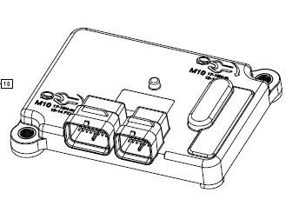
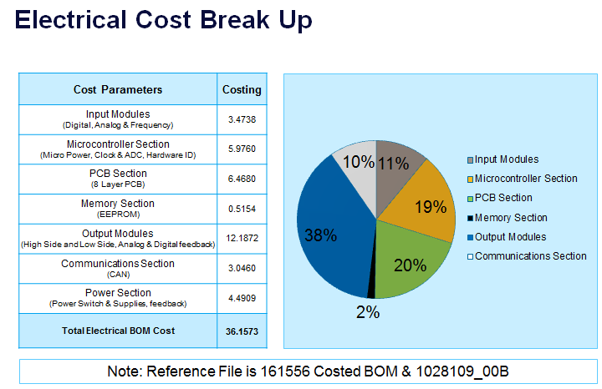
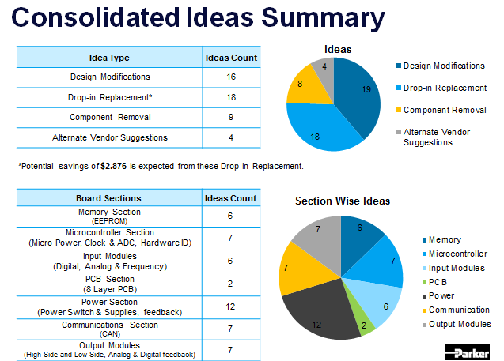
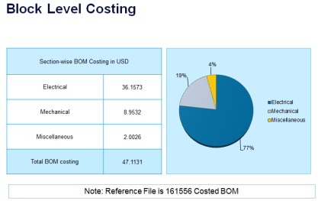
Division: ECD
CM2723 I/O Controller – VAVE Analysis
Scope
To perform VAVE Analysis on the CM2723 I/O Controller. The Project has to go through entire VAVE cycle. The scope of the project includes:
Electrical Cost Reduction Analysis
Competitor product Analysis
Reverse Engineering
BoM of Competitor Product
Comparison with the Parker Product
Tools / Techniques used
Silicon Expert
Q-STAR
Pugh Matrix
Pareto Analysis
Manuscript
Achievements
Listed 49 VAVE Ideas
Cost Savings of $7 have been identified
Competitor product Technical approach compared with the
Parker approach
Suggested different power topology approach to reduce costing
EoL and Obsolescence check performed on the product Bill of
Material
Schematics modified with the proposed Cost Reduction changes
and submitted to Parker

