Slide 1
:Case Study : BHEL - DSP based 3-level IGBT inverter Drive for 1.8 MW Induction Motor

Slide 2
System Level Block Diagram

Slide 3
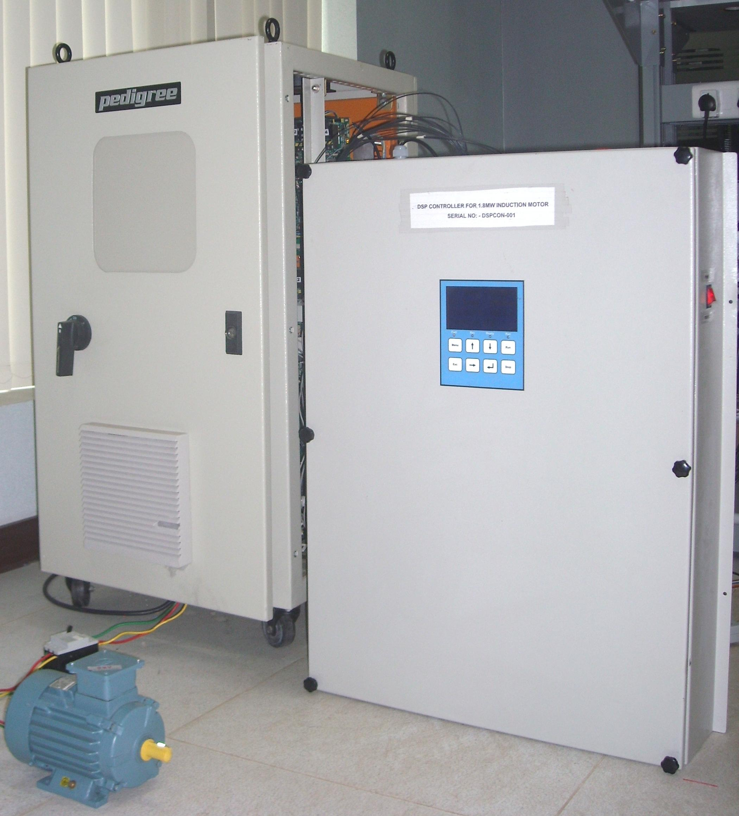
BHEL - DSP based 3-level IGBT inverter Drive for 1.8 MW Induction Motor
Scope
Design and Development of a controller for 3 level 12 Pulse 1.8 MW IGBT IM Drive
Modeling and Simulation of SV PWM technique for 3-level inverter
Highlights
Dual processor architecture – DSP and ARM9
Sensor less vector and V/F mode techniques for speed control
Dynamic Braking feature with Chopper control
Unique concept for 12 pulse 3 level SVPWM output generation
PC based SW tool for drive configuration
Event logging and fault diagnosis
CAN bus, Modbus, Profibus and USB communication interface
Has passed EMI/EMC and Environmental as per IEC STDs like 61000-4.3/2/6, IEC 68-2-2Bb, IEC 68-2030 Db and Dust Test as per IS9000 part XII – 1981
Tools/Environment
Code Composer studio, IAR Workbench and XDS-560 ICE
uC/OS RTOS, Lab view, MATLAB and Simulink
ORCAD schematic capture. Cadence Allegro, PSPICE and SI Analysis tools.

Slide 4
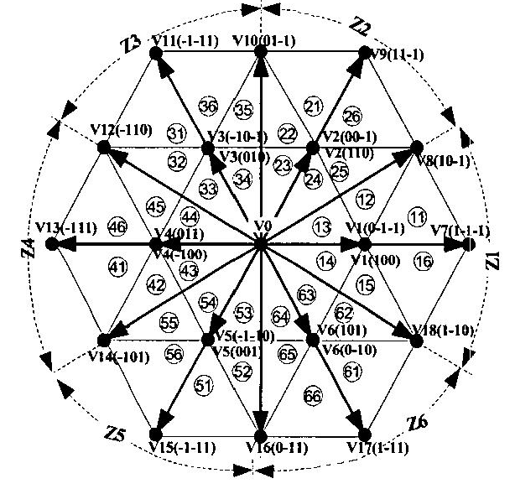
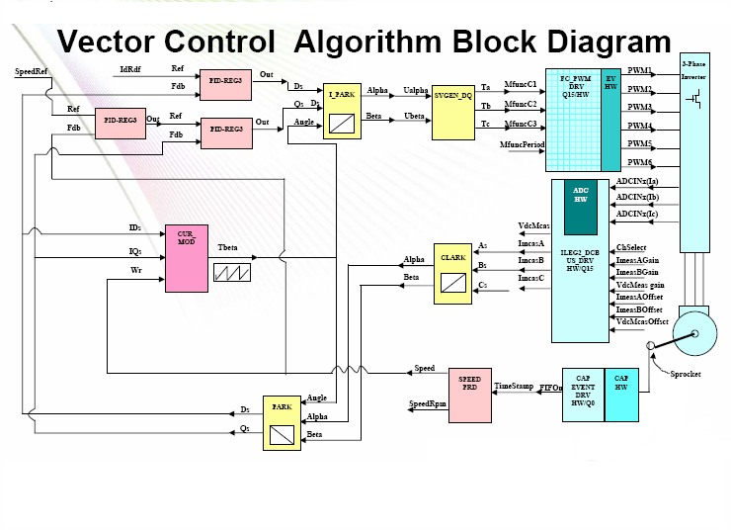
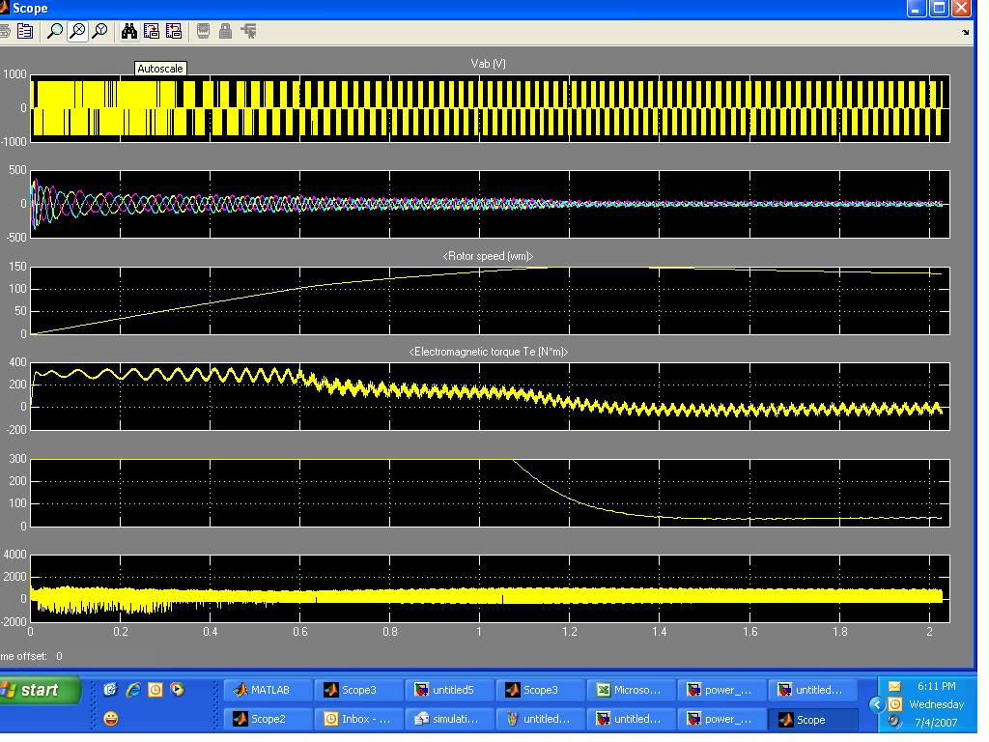
MatLab - Simulation of 3-Level SVPWM Algorithm
Highlights
Notes:
GE

Slide 5
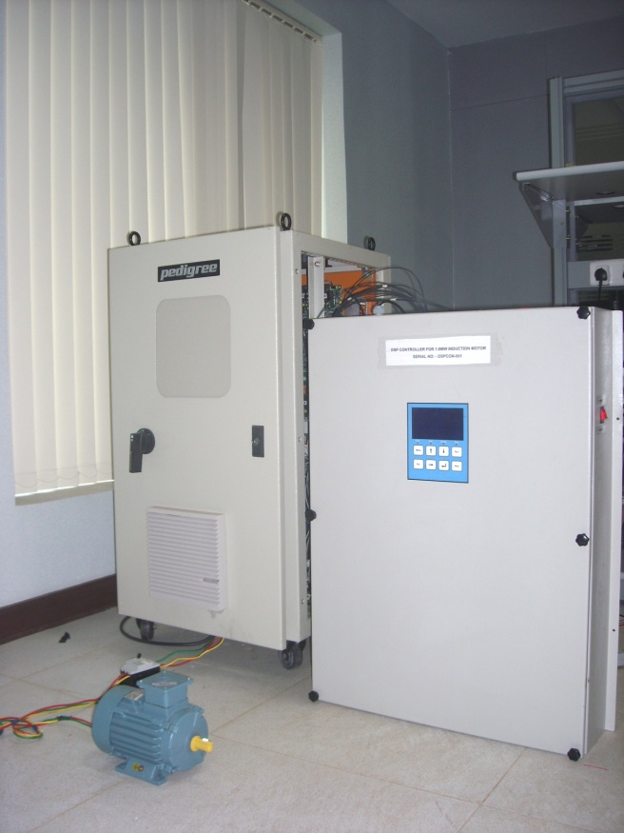
Project Details
Scope:
Design and Development of a DSP based controller of 3 level 12 Pulse 1.8 MW IGBT Induction Motor Drive for Induced Draft Fan applications in Thermal Power Plants
Modeling and Simulation of SV PWM technique for 3-level inverter
Critical Specs
Input supply : Single Phase 230V AC , 50Hz
Solution :
Unique concept for 12 pulse 3 level Space Vector PWM generation
Sensor less vector and V/F algorithms for Induction Motor speed control
Dynamic Braking feature with Chopper control
PC based SW tool for drive configuration and monitoring
CAN bus, Modbus, Profibus and USB communication interface
Benefits
Tools:
Code Composer studio, IAR Workbench and XDS-560 ICE
uC/OS RTOS, MATLAB and Simulink
ORCAD schematic capture. Cadence Allegro, PSPICE and SI Analysis tools
Standards :
EMI/EMC - IEC 61000-4.3/2/6
IEC 68-2-2Bb
IEC 68-2030 Db
Dust Test as per IS9000 part XII – 1981

Slide 6
Thank you

